Slide 1
Asp.net MVC
Internationalization
Andres Käver, IT Kolledž 2015

Slide 2
Internationalization
Globalization (G11N): The process of making an application support different languages and regions.
Localization (L10N): The process of customizing an application for a given language and region.
Internationalization (I18N): Describes both globalization and localization.
Culture: It is a language and, optionally, a region.
Locale: A locale is the same as a culture.
Neutral culture: A culture that has a specified language, but not a region. (e.g. "en", "es")
Specific culture: A culture that has a specified language and region. (e.g. "en-US", "en-GB", "es-CL")
https://msdn.microsoft.com/en-us/goglobal/bb896001.aspx

Slide 3
Example
int value = 5600;
Thread.CurrentThread.CurrentCulture = new System.Globalization.CultureInfo("es-CL");
Console.WriteLine(DateTime.Now.ToShortDateString());
Console.WriteLine(value.ToString("c"));
Thread.CurrentThread.CurrentCulture = new System.Globalization.CultureInfo("es-MX");
Console.WriteLine(DateTime.Now.ToShortDateString());
Console.WriteLine(value.ToString("c"));
// Output
26-07-2011 // Date in es-CL, Spanish (Chile)
$5.600,00 // Currency in es-CL, Spanish (Chile)
26/07/2011 // Date in es-MX, Spanish (Mexico)
$5,600.00 // Currency in es-MX, Spanish (Mexico)

Slide 4
Resources
Add new class library to solution, named Resources
Add new item to project: Resources files
Default culture en-US Resources.resx
Typically use only language part in extension Resources.et.resx (et-EE)

Slide 5
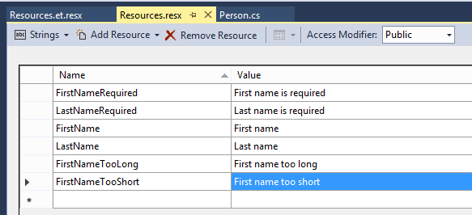
Resources

Slide 6
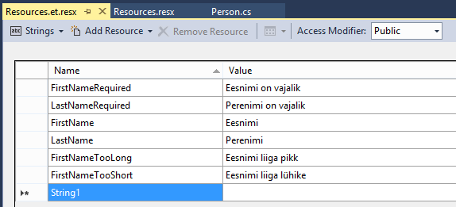
Resources

Slide 7
Validation/Laber/editor messages
[Required(ErrorMessageResourceName = "FirstNameRequired",
ErrorMessageResourceType = typeof(Resources.Resources))]
[MaxLength(5, ErrorMessageResourceName = "FirstNameTooLong",
ErrorMessageResourceType = typeof(Resources.Resources))]
[MinLength(2, ErrorMessageResourceName = "FirstNameTooShort",
ErrorMessageResourceType = typeof(Resources.Resources))]
[Display(Name = "FirstName", ResourceType = typeof(Resources.Resources))]
public String FirstName { get; set; }

Slide 8
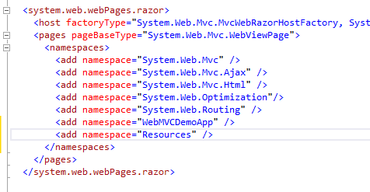
Views catalog, web.config

Slide 9
Razor
Html helpers – from attributes
Static text in views @Resources.<fieldname>
<div class="form-group">
<div class="col-md-offset-2 col-md-10">
<input type="submit" value="@Resources.Create" class="btn btn-default" />
</div>
</div>

Slide 10
Language determination
header field Accept-Language on every request Accept-Language: en-us,en;q=0.5 en-us – preffered en – next choice q=0.5 – estimate of users prefernce for that language

Slide 11
System language
ASP.NET (System.Web) keeps track in each thread:
Culture determines the results of culture-dependent functions, such as the date, number, and currency formatting, and so on
UICulture determines which resources are loaded for the page

Slide 12
Language override
Implement controller/action for user language choice selection – cookie creation
Keep track of users choice (cookie, session)
On every request, inspect users choice, update threads culture info
Implement base controller for cookie inspection

Slide 13
Base controller
public class BaseController : Controller
{
protected override IAsyncResult BeginExecuteCore(AsyncCallback callback, object state)
{
string cultureName = null;
// Attempt to read the culture cookie from Request
HttpCookie cultureCookie = Request.Cookies["_culture"];
if (cultureCookie != null)
cultureName = cultureCookie.Value;
else
cultureName = Request.UserLanguages != null && Request.UserLanguages.Length > 0 ?
Request.UserLanguages[0] : // obtain it from HTTP header AcceptLanguages
null;
// Validate culture name
cultureName = CultureHelper.GetImplementedCulture(cultureName);
// Modify current thread's cultures
Thread.CurrentThread.CurrentCulture = new System.Globalization.CultureInfo(cultureName);
Thread.CurrentThread.CurrentUICulture = Thread.CurrentThread.CurrentCulture;
return base.BeginExecuteCore(callback, state);
}
}

Slide 14
Controller action for language choice
public ActionResult SetCulture(string culture)
{
// Validate input
culture = CultureHelper.GetImplementedCulture(culture);
// Save culture in a cookie
HttpCookie cookie = Request.Cookies["_culture"];
if (cookie != null)
cookie.Value = culture; // update cookie value
else
{
cookie = new HttpCookie("_culture");
cookie.Value = culture;
cookie.Expires = DateTime.Now.AddYears(1);
}
Response.Cookies.Add(cookie);
return RedirectToAction("Index");
}

