Slide 1
TESTING TEST DRIVEN DEVELOPMENT
ASP.NET
Andres Käver, IT Kolledž 2016

Slide 2
TESTING - Intro
Developers
I don’t test. I’m a developer. I Create.
Managers
I don’t want to pay developers to test. That’s why I pay testers.
BUT!
It costs up to 500% more to fix a bug in production, than to fix it before commiting it to source control

Slide 3
Testing - Benefits
Higher quality
Living documentation
Well-crafted code
Automatic regression harness
Relative cost of testing
Unit Testing – 2
Integration Testing – 6
System Testing – 12
Functional Testing - 12

Slide 4
Testing – Unit test
UNIT TEST
A unit test confirms functionality of a small unit of functionality or component in a larger system
Much easier in new code (Greenfield)
Harder in legacy code (Brownfield) – code was often not written with testability in mind

Slide 5
Testing - frameworks
Nunit – www.nunit.com
xUnit – xunit.codeplex.com
MSpec - https://github.com/machine/machine.specifications
MSTest – included in visual studio

Slide 6
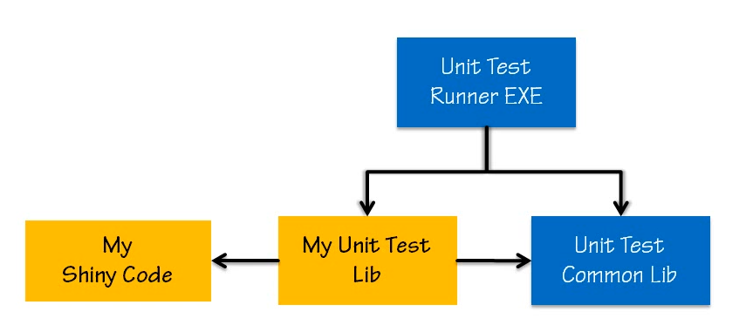
Testing - frameworks

Slide 7
Testing - TDD
Same as jig (template)
Jig – a shape/form upon which something else is built
Jig is the specification for the thing being built
Remove the jig after completion
In software development, the jig (testsuite) is often built just ahead of the actual code

Slide 8
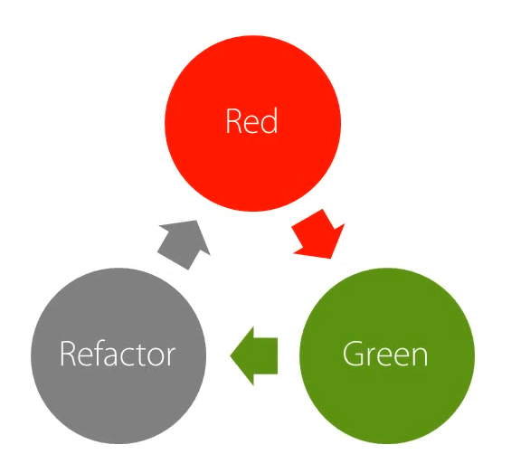
Testing - TDD
Test Driven Development
Create a failing test
RED
Make a test pass
GREEN
Refactor
Improve the internal implementation without changig the external contract or behavior (cleaning while we cook…)

Slide 9
Testing - TDD
THE TESTS ARE THE SPEC!!!!!
MS Word docs cant prove, that software works

Slide 10
Testing - xUnit
Install from NuGet – xUnit.net
Add support for Resharper test runner
Attributes
[Fact]
[Theory]
[InlineData()]
[Trait]
Asserting
Assert.*****()

Slide 11
Testing – xUnit assert – 3 phases
Triple A - AAA
Arrange
(sut – system under test)
Act
Assert

Slide 12
Testing – xUnit assert - numeric
Assert.****(expected, actual)
Numeric results
Assert.Equal
Floating point values
Asset.Equal(expected,actual,precision)

Slide 13
Testing – xUnit assert - strings
Strings
Assert.Equal
Ignore case
Assert.Equal(expected, actual, ignoreCase: true)
Contains
Assert.Contains
Starts with, Ends with
Assert.StartsWith Assert.EndsWith
Regex
Assert.Matches(regex, actual)

Slide 14
Testing – xUnit assert – boolean, null
Boolean, Null
Assert.False
Assert.True
Assert.Null

Slide 15
Testing – xUnit - collection
All items in collection
Assert.All(collection, lambda_or_method)
Assert.All(stringlist, s => Assert.False(s.IsNullOrWhiteSpace(s)));
Contains specific item
Assert.Contains(item, ListOfItems)
Does not contain specific item
Assert.DoesNotContain(item, ListOfItems)

Slide 16
Testing – xUnit - collection
Satisfying predicate (function that returns boolean)
Assert.Containt(ListOfItems, item => item.SomeOperation())
Has all expected items
Assert.Equal(expectedList, listToTest)

Slide 17
Testing – xUnit – numeric range
Assert.InRange(actual, low, high)

Slide 18
Testing – xUnit - exceptions
Assert.Throws<ExceptionTypeExpected>(methodToCall)
Assert.Throws<DividedByZeroExcpetion>(() => 5/0)
Inspecting exception
var ex = Assert.Throws<ExceptionTypeExpected>(methodToCall); Assert.Equal(“parameterName”,ex.ParamName);

Slide 19
Testing – xUnit – object types
Exact object type
Assert.IsType(typeof(Class), actualObject)
Derived object type
Assert.IsAssignableFrom(typeof(Class), actualObject)
Casting for futher examination
var obj = Assert.IsType<ClassToCast>(actualObject) Assert.XXXX(expected, obj.Actual)

Slide 20
Testing – xUnit – test grouping
Grouping tests
[Trait(“Category”,”SomeCategoryName”)]
name-value pairs
“Category” – conventional name
Can be applied to single test or to whole class
Can use several different traits at the same time

Slide 21
Testing – xUnit – diagnostic output
Some test frameworks (and xUnit < 2.0) allow to use
Console.WriteLine
In xUnit 2 you have to use ITestOutputHelper
Use Xunit.Abstractions
Declare private field in test class
private readonly ITestOutputHelper _testOutputHelper;
Initialize it in constructor public ClassName(ITestOutputHelper helper){ _testOutputHelper = helper;
Use it in place of Console.WriteLine
_testOutputHelper.WriteLine(…..)

Slide 22
Testing – xUnit – setup and clean-up
Run code before and after each test
Constructor for setup (initialize sut)
Dispose() for cleanup (implement IDisposable in testclass)
xUnit creates new instance of test class for every test in testclass!

Slide 23
Testing – xUnit – test runner option
If test runner names are too long
Namespace.ProjectName.MethodName
Configure app.config
<configuration><appsetings> <add key=”xunit.methodDisplay” value=“method”>
Will only display method name

Slide 24
Testing – xUnit - testFixture
Used, when sut is very expensive/slow to create (ef database for example)
Create sut only once and use it in all tests
Create separate class to hold your sut (and initialize sut in fixture constructor) (implement IDisposable)
Use IClassFixture<YourFixtureClass> in testclass
Get and save instance in testclass contructor
public ClassName(ITestOutputHelper helper, IClassFixture<YourFixtureClass> fixture){ _fixture = fixture; _fixture.Cleanup() <-!!!!!!
Cleanup _fixture.sut in testclasses constructor (implementation is up to you)

Slide 25
Testing – xUnit – sharing fixture
Add this attribute to several testclasses [Collection(“SomeCollectionName Collection”)]
Remove IClassFixture<YourFixtureClass> from testclasses
Create custom collection class
Use CollectionDefinition(“SomeCollectionName Collection”) attribute
Implemet ICollectionFixture<YourFixtureClass>

Slide 26
Testing – xUnit – data driven tests
Data Driven Test
A single test method that can be executed multiple times, each time using a discreet set of test data, with each execution representing an individual test case.
Reduced test code duplication
Reduced maintenance cost
Add new test cases quickly
External test cases (database, csv, …)

Slide 27
Testing – xUnit – data driven tests
Use [Theory] and [InlineData] attribute
[Theory] [InlineData(10,0)] [InlineData(20,2)] public void ShouldDivideByZero(int a, int b){ Assert.Throws<DividedByZeroExcpetion>(() => a/b) }
Unlimited count of parameters and InlineData attributes

Slide 28
Testing – xUnit – data driven test
[MemberData(“propertyName”)]
propertyName – public static field public static IENumberable<object[]> propertyName{ get{ yield return new object[] {10,0}; yield return new object[] {20,2}; } }
[Theory] [MemberData(“propertyName”)] public void ShouldDivideByZero(int a, int b){ Assert.Throws<DividedByZeroExcpetion>(() => a/b) }

Slide 29
Testing – xUnit – data driven test
Remove data to separate class
Use attribute on test method
[MemberData(“propertyName”, MemberType = typeof(SeparateClass))]

Slide 30
Testing – xUnit – data driven test
Creating custom data source attributes
Inherit from DataAttribute
Implement GetData method
Use custom attribute in test method
Anonymous AutoFixture test data supplied to data driven tests
[AutoData]
[InlineAutoData]
http://github.com/AutoFixture/AutoFixture

