Slide 1
I18n - DateTime
ASP.NET MVC

Slide 2
I18n DateTime – EF changes
[DataType(DataType.DateTime)] public DateTime DateTime { get; set; } [DataType(DataType.Date)] public DateTime Date { get; set; } [DataType(DataType.Time)] public DateTime Time { get; set; }
In model classes, use attributes
DataType(DataType.DateTime)
DataType(DataType.Date)
DataType(DataType.Time)
Configure EF
protected override void OnModelCreating(DbModelBuilder modelBuilder)
{
// convert all datetime and datetime? properties to datetime2 in ms sql
// ms sql datetime has min value of 1753-01-01 00:00:00.000
modelBuilder.Properties<DateTime>().Configure(c => c.HasColumnType("datetime2"));
// use Date type in ms sql, where [DataType(DataType.Date)] attribute is used
modelBuilder.Properties<DateTime>()
.Where(x => x.GetCustomAttributes(false).OfType<DataTypeAttribute>()
.Any(a => a.DataType == DataType.Date))
.Configure(c => c.HasColumnType("date"));
}

Slide 3
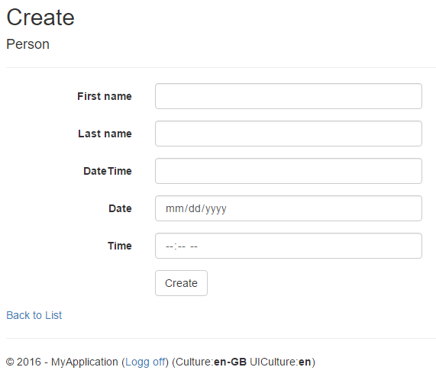
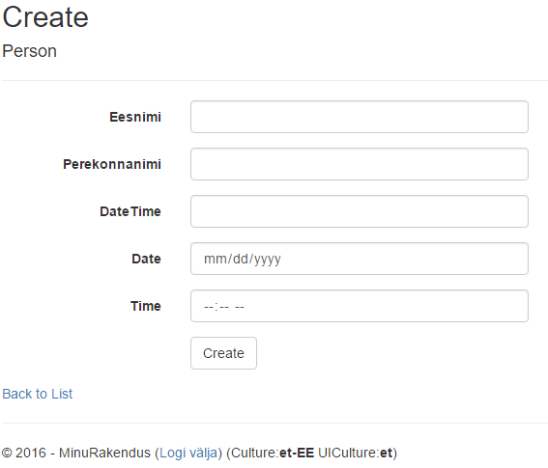
I18n - browsers
Chrome/Edge adds html5 support (but only in en-US format…)
Cant submit, will not validate on serverside (format mismatch between server and browser)

Slide 4
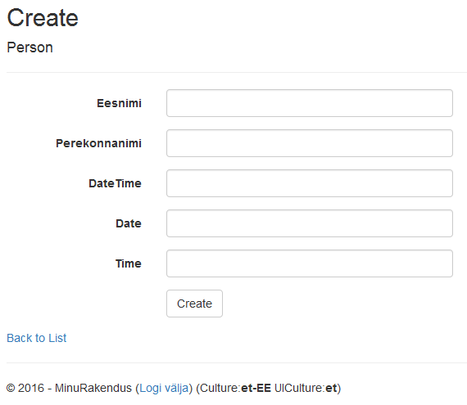
I18n - browsers
Firefox – no extra support
Unobtrusive (jquery) validation also fails

Slide 5
I18n
Solutions
Use simple text fields and dropdowns, skip direct clientside datetime validation
Can be problematic, different regions are used to their own way of seeing culture support (money, time, commas, etc)
Use js plugins to generate html and validate inputs – jquery
Hard to setup correctly
Jquery unobtrusive validate initially supports only en-US
Several jquery/bootstrap plugins to generate html inputs for datetime

Slide 6
I18n – jquery validation
Jquery needs several js packages
Nuget does not have all of them, or latest versions of them
ASP.NET Core will not use Nuget for clientside package management.
node.js - JavaScript runtime built on Chrome's V8 JavaScript engine.
npm – package manager for node.js modules
bower - a package manager for the web components
grunt/gulp – js task runner (minify, zip, etc)

Slide 7
I18n – frontend tooling
Download and install node.js – stable version
Includes npm
Install bower
npm install -g bower (from command line)
npm install -g cldr-data-downloader
Install git command line (https://git-for-windows.github.io/)

Slide 8
i18n – get project components
Cd into VS solution root directory
Web is name of the MVC project folder in solution
Setup bower in project root
Create file named .bowerrc
Create bower.json file
bower init
Use default answers initially
Install required scripts
bower install globalize -save
{
"directory" : "Web/bower_components",
"scripts" : {
}
}

Slide 9
i18n – get project components
Download CLDR data (json files, descripting locales) node %USERPROFILE%\AppData\Roaming\npm\node_modules\cldr-data-downloader\bin\download.js -i Web\bower_components\cldr-data\index.json -o Web\bower_components\cldr-data\
Install moment.js
bower install moment –save
Install bootstrap datetimepicker
bower install eonasdan-bootstrap-datetimepicker#latest --save

Slide 10
i18n – get project components
Install bootstrap
bower install bootstrap --save
Install respond
bower install respond --save
Install tinymce (if you want to edit texts in wysiwyg format)
Bower install tinymce –save

Slide 11
I18n – custom scripts
Jquery.validate.globalize does not support time and datetime validation. https://github.com/akaver/ASP.NET-BaseApps/blob/master/ContactApp/Web/Scripts/App/jquery.validate.globalize.datetime.js
...
$.validator.methods.datetimeGlobalizeOptions = { dateParseFormat: [{ skeleton: "yMdHm" }, { datetime: "short" }, { datetime: "medium" }, { datetime: "long" }, { datetime: "full" }] };
// additional method
$.validator.methods.datetime = function (value, element) {
// is it optional
if (this.optional(element) === true) return true;
// remove spaces just in case
value = value.trim();
var res = false;
var val;
for (var i = 0; i < $.validator.methods.datetimeGlobalizeOptions.dateParseFormat.length; i++) {
val = Globalize.parseDate(value, $.validator.methods.datetimeGlobalizeOptions.dateParseFormat[i]);
res = res || (val instanceof Date);
if (res === true) return res;
}
return res;
};
//create adapters for new type - so they will be attached automatically
//this depends on attribute data-val-time, data-val-datetime
$.validator.unobtrusive.adapters.addBool('datetime');
}(jQuery, Globalize));

Slide 12
I18n – custom scripts
https://github.com/akaver/ASP.NET-BaseApps/blob/master/ContactApp/Web/Scripts/App/jquery.validate.fixdata.js
$(function () {
// replace html5 datetime, date and time types on inputs - this disables builtin html5 editors in browsers
// add data-type attribute instead
$('input[type="datetime"]').attr('type', 'text').attr('data-type', 'datetime');
$('input[type="date"]').attr('type', 'text').attr('data-type', 'date');
$('input[type="time"]').attr('type', 'text').attr('data-type', 'time');
// fix up attributes for datetime
var attr = $('input[data-type="datetime"]:first');
var attrText;
if (attr.length === 1) {
attrText = attr.eq(0).attr('data-val-date');
if (attrText != undefined) {
attrText = attrText.replace('date.', 'datetime.');
$('input[data-type="datetime"]').removeAttr('data-val-date');
$('input[data-type="datetime"]').attr('data-val-datetime', attrText);
} else {
// TODO: translations
$('input[data-type="datetime"]').attr('data-val-datetime', 'Field has to be of type datetime.');
}
}
// fix up attributes for time
// TODO: translations
$('input[data-type="time"]').attr('data-val-time', 'Field has to be of type time.');
});

Slide 13
I18n – save culture code for js usage
@using System.Threading
@{
// set up global js variable, to hold culture code
var currentCultureCode = "root";
switch (Thread.CurrentThread.CurrentCulture.ToString())
{
case "et-EE":
currentCultureCode = "et";
break;
case "en-US":
currentCultureCode = "en";
break;
default:
currentCultureCode = Thread.CurrentThread.CurrentCulture.ToString();
break;
}
}
<!DOCTYPE html>
<html>
<head>
<meta charset="utf-8" />
<meta name="viewport" content="width=device-width, initial-scale=1.0">
<title>@ViewBag.Title - My ASP.NET Application</title>
@Styles.Render("~/Content/css")
@Scripts.Render("~/bundles/modernizr")
<script type="text/javascript">
var currentCultureCode = '@currentCultureCode';
</script>
</head>

Slide 14
I18n – modify html via js – app.js
Load cldr data, initialize Globalize and moment
var currentCultureCode; //global variable, created in _Layout.cshtml - et, en, etc
$.when(
$.get("/bower_components/cldr-data/supplemental/likelySubtags.json"),
$.get("/bower_components/cldr-data/main/" + currentCultureCode + "/numbers.json"),
$.get("/bower_components/cldr-data/supplemental/numberingSystems.json"),
$.get("/bower_components/cldr-data/main/" + currentCultureCode + "/ca-gregorian.json"),
$.get("/bower_components/cldr-data/main/" + currentCultureCode + "/ca-generic.json"),
$.get("/bower_components/cldr-data/main/" + currentCultureCode + "/timeZoneNames.json"),
$.get("/bower_components/cldr-data/supplemental/timeData.json"),
$.get("/bower_components/cldr-data/supplemental/weekData.json")
).then(function () {
// Normalize $.get results, we only need the JSON, not the request statuses.
return [].slice.apply(arguments, [0]).map(function (result) {
return result[0];
});
}).then(Globalize.load).then(function () {
// Initialise Globalize to the current UI culture
Globalize.locale(currentCultureCode);
moment.locale(currentCultureCode);
}); ...

Slide 15
I18n – modify html via js – app.js
Harmonize moment/globalize
Attach datetimepicker
Set up html placeholders
$(function () {
// fix specific locale problems in moment.js
// moment is not using cldr data yet
moment.localeData("et")._longDateFormat.LT = "HH:mm";
// attach bootstrap datetimepicker spinner
$('[data-type="datetime"]').datetimepicker({ locale: currentCultureCode, format: 'L LT' });
$('[data-type="date"]').datetimepicker({ locale: currentCultureCode, format: 'L' });
$('[data-type="time"]').datetimepicker({ locale: currentCultureCode, format: 'LT' });
//add placeholders, use moment.js formats - since datetimepicker uses it
$('[data-type="datetime"]').attr('placeholder',
moment.localeData(currentCultureCode)._longDateFormat.L + " " +
moment.localeData(currentCultureCode)._longDateFormat.LT);
$('[data-type="date"]').attr('placeholder', moment.localeData(currentCultureCode)._longDateFormat.L);
$('[data-type="time"]').attr('placeholder', moment.localeData(currentCultureCode)._longDateFormat.LT);
});

Slide 16
i18n – set up js bundles
public static void RegisterBundles(BundleCollection bundles)
{
bundles.Add(new ScriptBundle("~/bundles/jquery").Include(
"~/bower_components/jquery/dist/jquery.js"));
bundles.Add(new ScriptBundle("~/bundles/jqueryval").Include(
"~/Scripts/app/jquery.validate.fixdata.js",
"~/bower_components/jquery-validation/dist/jquery.validate.js",
"~/Scripts/jquery.validate.unobtrusive.js", // original ms package
"~/Scripts/app/jquery.validate.globalize.datetime.js"
));
bundles.Add(new ScriptBundle("~/bundles/cldr").Include(
"~/bower_components/cldrjs/dist/cldr.js",
"~/bower_components/cldrjs/dist/cldr/event.js",
"~/bower_components/cldrjs/dist/cldr/supplemental.js",
"~/bower_components/cldrjs/dist/cldr/unresolved.js"));
bundles.Add(new ScriptBundle("~/bundles/globalize").Include(
"~/bower_components/globalize/dist/globalize.js",
"~/bower_components/globalize/dist/globalize/number.js",
"~/bower_components/globalize/dist/globalize/*.js"
));
bundles.Add(new ScriptBundle("~/bundles/moment").Include(
"~/bower_components/moment/min/moment-with-locales.js"));

Slide 17
i18n – set up js bundles
// Use the development version of Modernizr to develop with and learn from. Then, when you're
// ready for production, use the build tool at http://modernizr.com to pick only the tests you need.
bundles.Add(new ScriptBundle("~/bundles/modernizr").Include(
"~/Scripts/modernizr-*"));
bundles.Add(new ScriptBundle("~/bundles/bootstrap").Include(
"~/bower_components/bootstrap/dist/js/bootstrap.js",
"~/bower_components/eonasdan-bootstrap-datetimepicker/build/js/bootstrap-datetimepicker.min.js",
"~/bower_components/respond/respond.min.js"));
bundles.Add(new StyleBundle("~/Content/css").Include(
"~/bower_components/bootstrap/dist/css/bootstrap.css",
"~/bower_components/eonasdan-bootstrap-datetimepicker/build/css/bootstrap-datetimepicker.css",
"~/Content/site.css"));
bundles.Add(new ScriptBundle("~/bundles/app").Include(
"~/Scripts/app/app.js"));
BundleTable.EnableOptimizations = false;
}

Slide 18
i18n – use bundles to reference scripts (_Layout.cshtml)
End of html body
@Scripts.Render("~/bundles/jquery")
@Scripts.Render("~/bundles/cldr")
@Scripts.Render("~/bundles/globalize")
@Scripts.Render("~/bundles/jqueryval")
@Scripts.Render("~/bundles/moment")
@Scripts.Render("~/bundles/bootstrap")
@Scripts.Render("~/Scripts/tinymce/tinymce.min.js")
@Scripts.Render("~/bundles/app")
@RenderSection("scripts", required: false)
</body>

Slide 19
I18n – DateTime.ToString()
Change default DateTime ToString functionality
protected void Application_BeginRequest()
{
// modify datetime.tostring formating in estonian locale (remove seconds)
// default format is: ShortDatePattern + ' ' + LongTimePattern
if (CultureInfo.CurrentCulture.Name.StartsWith("et"))
{
var culture = (CultureInfo)CultureInfo.CurrentCulture.Clone();
culture.DateTimeFormat.LongTimePattern = "HH:mm";
Thread.CurrentThread.CurrentCulture = culture;
}
}

Slide 20
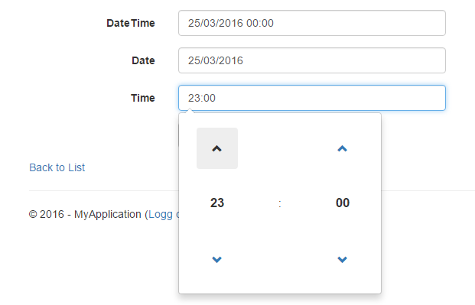
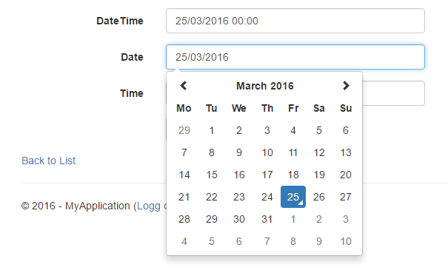
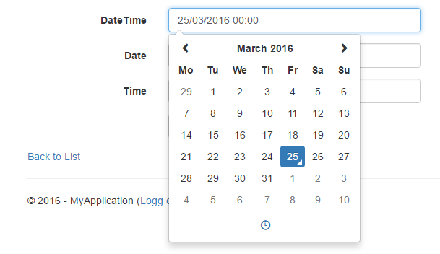
i18n – chrome/firefox

Slide 21
i18n – bower
{
"name": "Web",
"authors": ["Andres Käver <akaver@akaver.com>"],
"description": "",
"main": "",
"moduleType": [ ],
"license": "MIT",
"homepage": "",
"ignore": [
"**/.*",
"node_modules",
"bower_components",
"Web/bower_components",
"test",
"tests"
],
"dependencies": {
"globalize": "^1.1.1",
"cldr-data": "^29.0.0",
"moment": "^2.12.0",
"eonasdan-bootstrap-datetimepicker": "^4.17.37",
"bootstrap": "^3.3.6",
"respond": "^1.4.2",
"tinymce": "^4.3.8"
}
}
Final bower.json file
Restore bower packages described in bower.json
bower install
Update all installed packages
bower update

Slide 22
i18n – bower
C:\!dev\git\ASP.NET-BaseApps\ContactApp>bower list
bower check-new Checking for new versions of the project dependencies...
Web C:\!dev\git\ASP.NET-BaseApps\ContactApp
├─┬ bootstrap#3.3.6 (latest is 4.0.0-alpha.2)
│ └── jquery#2.2.2 (latest is 3.0.0-beta1)
├── cldr-data#29.0.0
├─┬ eonasdan-bootstrap-datetimepicker#4.17.37
│ ├── jquery#2.2.2 (3.0.0-beta1 available)
│ ├── moment#2.12.0
│ └─┬ moment-timezone#0.5.3
│ └── moment#2.12.0
├─┬ globalize#1.1.1
│ ├── cldr-data#29.0.0
│ └─┬ cldrjs#0.4.4
│ └── cldr-data#29.0.0
├── moment#2.12.0
├── respond#1.4.2
└── tinymce#4.3.8
Bower list

Slide 23
I18n – code management
Do not commit bower_components into code repository
Meaningless mirror of github projects…
Other team members will get bower.json and do bower install/update
Using git
in .gitignore add line /bower_components
In VS, include files into project
Probably do not include full cldr-data/main folder. Just pick required locales (et, en-GB, etc)

Slide 24
THE END

Slide 25
Materials
https://blog.engineyard.com/2014/frontend-dependencies-management-part-1
http://www.mikesdotnetting.com/article/283/asp-net-5-managing-client-side-dependencies-with-npm-bower-and-gulp
https://github.com/jquery/globalize
http://johnnyreilly.github.io/globalize-so-what-cha-want/#/?currency=true&date=true&message=true&number=true&plural=true&relativeTime=true&unit=true

