Slide 1
Deploy
ASP.nET

Slide 2
ASP.NET - publishing
VS supports app publishing directly from IDE
Several possibilities exists for Web apps – FTP, file system, Front Page Server Extensions, Web Deploy, etc.
Web Deploy is the recommended method
Propagates IIS setings (web.config transformations), sets up database, restarts app in server

Slide 3
ASP.NET - Azure
Azure – MS cloud services
Web hosting
SQL
IOT, nosql, virtual servers, etc…
Free for students – based on school email verification
Install Azure SDK for .NET (2.9 or later)
https://azure.microsoft.com/en-us/documentation/articles/dotnet-sdk/
http://go.microsoft.com/fwlink/?linkid=518003

Slide 4
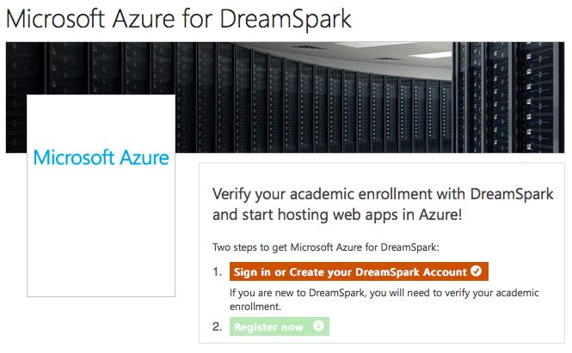
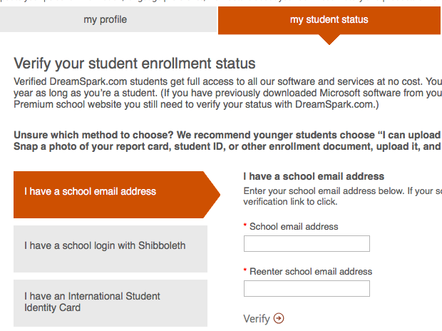
ASP.NET - Azure
Verify email
https://www.dreamspark.com/Product/Product.aspx?productid=99
Account will be valid for 1 year

Slide 5
ASP.NET - Azure

Slide 6
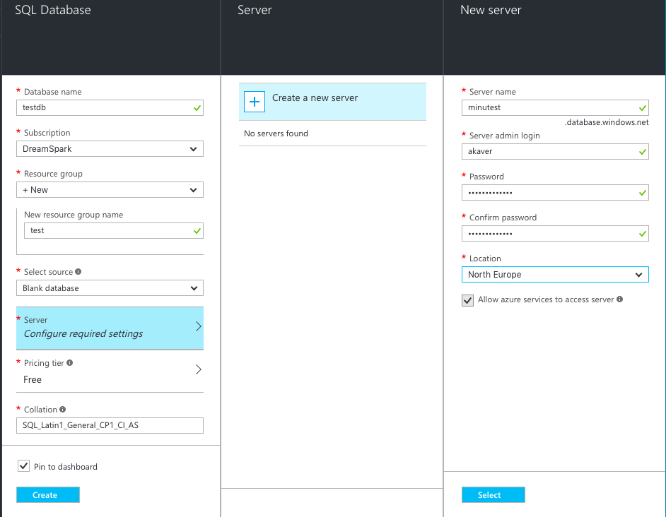
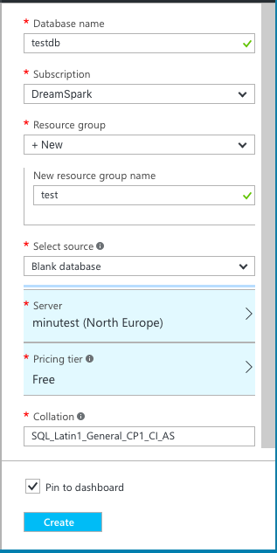
ASP.NET – Azure - SQL
SQL Databases, Add
Set and remember admin username and password

Slide 7
ASP.NET – Azure - SQL

Slide 8
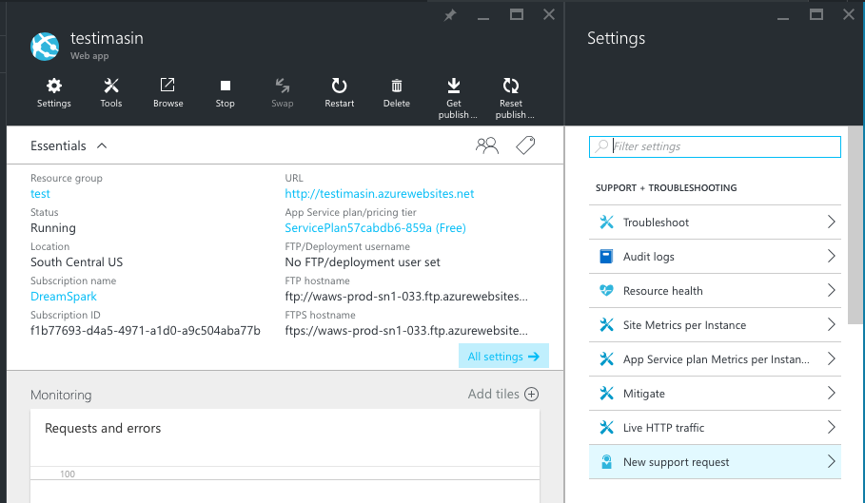
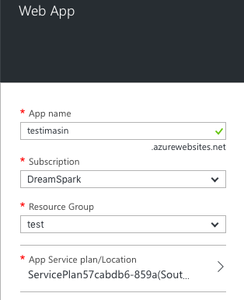
ASP.NET – Azure – App services
App Services, Add

Slide 9
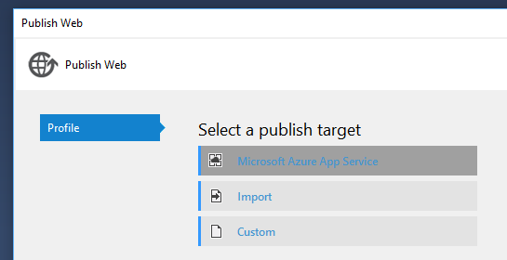
ASP.NET – Azure - publish
Only files INCLUDED in project will be published!
Project explorer, Show All icon
R-Click on greyed out folders/files -> Include into project (bower, etc)
Right click on Web project
Select Publish…

Slide 10
ASP.NET – Azure - publish

Slide 11
ASP.NET – Azure - publish

Slide 12
ASP.NET – Azure - publish
Copy SQL connection string (ADO.NET) from Azure – set username and password!! Server=tcp:minutest.database.windows.net,1433; Data Source=minutest.database.windows.net; Initial Catalog=testdb; Persist Security Info=False; User ID={your_username};Password={your_password}; Pooling=False; MultipleActiveResultSets=False; Encrypt=True; TrustServerCertificate=False; Connection Timeout=30;
Set MultipleActiveResultSets=True when needed.

Slide 13
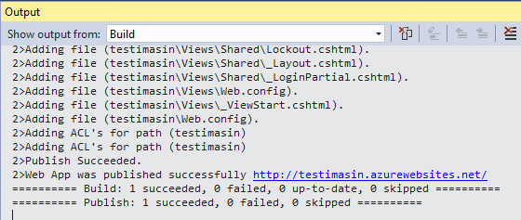
ASP.NET – Azure - publish

Slide 14
ASP.NET – Azure - publish

