Slide 1
Mobile Software Development for Android - I397
IT College, Andres Käver, 2015-2016
Email: akaver@itcollege.ee
Web: http://enos.itcollege.ee/~akaver/2015-2016/Distance/Android
Skype: akaver

Slide 2
Timetable – distance learners
2015
Oct 16 (1)
Nov 6 (2) & 7 (1)
Nov 29 (2)
Dec 18 (1) & 19 (1)
2016
Jan 9 – home project presentation
Total 8 meetings (lecture/practice) + final

Slide 3
Requirements
Development environment – latest Android Studio (java, IntelliJ)
http://developer.android.com/sdk/index.html
Base OS – free choice (MS Windows, OS X, Linux)
Android based development device for testing – not required. School has some test equipment available (old devices – ca 2010).
Personal Android device – (phone/tablet) strongly recommended
If possible, use personal laptop for development
Projects in GitHub

Slide 4
Topics
Android overview
Basic Android Studio usage
UI creation
Web services (REST API)
Local storage and data access (SQLite)
App lifecycle and state
Sensors (proximity, geomagnetic, motion, GPS, …)
Google Play - publishing

Slide 5
Android
Operating system, devised for mobile equipment (mostly)
Usage: phones, tablets, TV-s, watches, glasses, cars, laptops, cameras, game consoles, …
Market share among smartphones – ca 82%
Open source project
Google apps are closed source (mail, map, etc.)

Slide 6
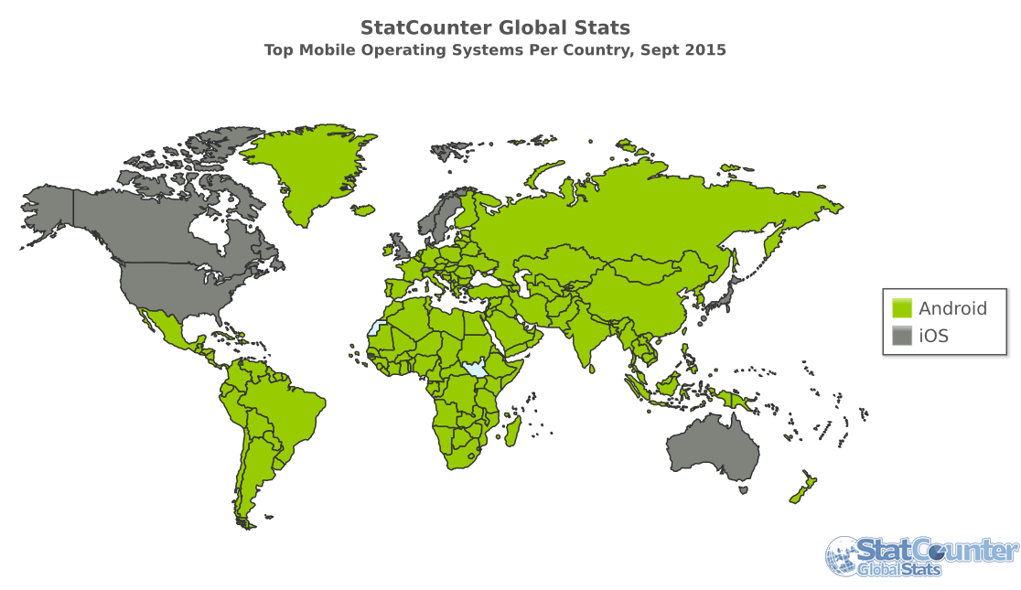
Android - mobile

Slide 7
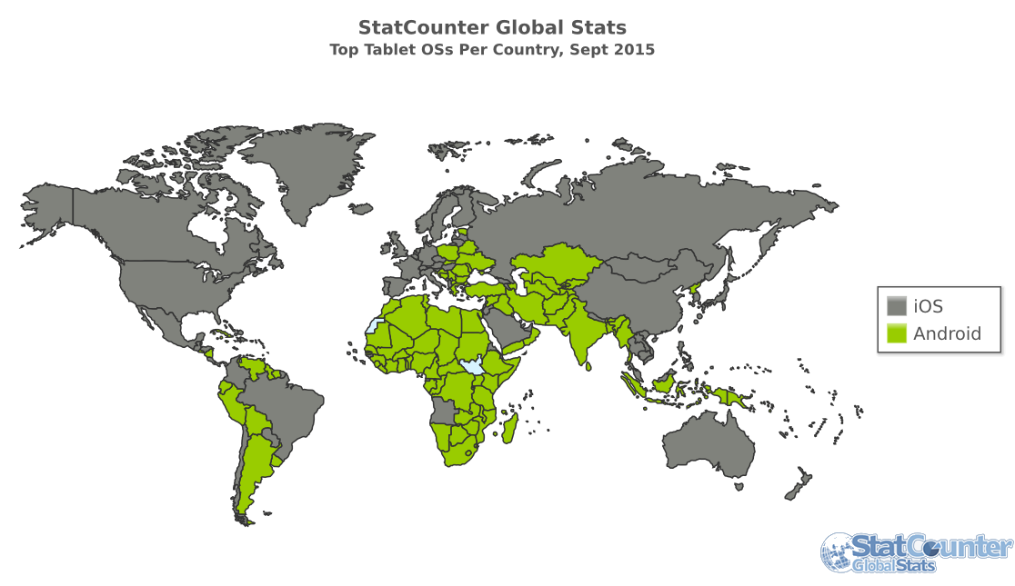
Android - tablet

Slide 8
Short history
2003 – founded (lead: Andy Rubin)
Initial idea – OS for cameras
New plan – Mobile OS, (others: Symbian/Nokia and Win Mobile)
2005 – Google acquires the whole project
2007 – Open Handset Alliance
Google, HTC, Sony, Samsung, Dell, Motorola, LG, Qualcomm, Intel, etc…
2008 – Android 1.0 (HTC Dream, no touchscreen)
2009 – Android 1.5 Cupcake (iPhone 2007, iPhone 3G 2008)
2010 – Android 2.2 Froyo, 2.3 Gingerbread

Slide 9
Short history
2011 – Android 3.0 Honeycomb (tablets only)
2011 - Android 4.0 Ice Cream Sandwich
HOLO UI
2014 - Android 5 Lollipop
Material design
Dalvik vs ART (Android Runtime) (JIT or precompile, garbage collection)
2015 - Android 6 Marshmallow

Slide 10
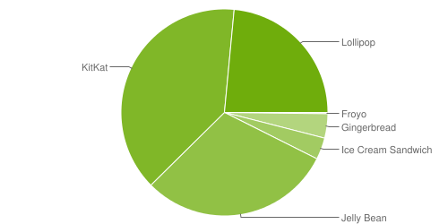
Version distribution
Lollipop - 5.X – 23%
KitKat, Jelly Bean, Ice Cream Sandwich - 4.X - 73%
Source: http://developer.android.com/about/dashboards/index.html

Slide 11
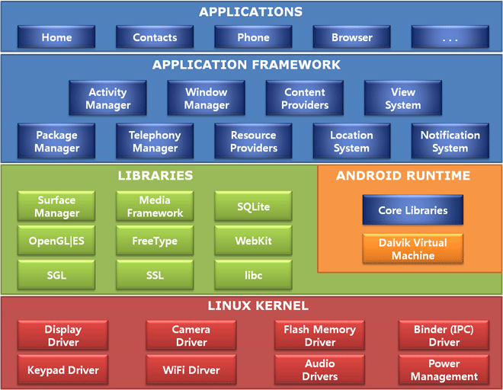
Android architecture

Slide 12
Android - App types
NDK - C/C++
Close to hardware and opsys
SDK - Native <- this course!!!!
Java (ART/Dalvik), using system libraries
Crossplatform – Xamarin (C#), etc
Html
One codebase/layout for different platforms
Problems with UI, weak access to hardware

Slide 13
Android – App architecture AndroidManifest.xml
The manifest file presents essential information about your app to the Android system, information the system must have before it can run any of the app's code.
Describes the components of the application — the activities, services, broadcast receivers, and content providers that the application is composed of.
Declares which permissions the application must have in order to access protected parts of the API and interact with other applications.
Declares the minimum level of the Android API that the application requires.

Slide 14
Android – AndroidManifest.xml Example -
<?xml version="1.0" encoding="utf-8"?> <manifest xmlns:android="http://schemas.android.com/apk/res/android" package="com.akaver.myapplication" > <application android:allowBackup="true" android:icon="@mipmap/ic_launcher" android:label="@string/app_name" android:supportsRtl="true" android:theme="@style/AppTheme" > <activity android:name=".MainActivity" android:label="@string/app_name" android:theme="@style/AppTheme.NoActionBar" > <intent-filter> <action android:name="android.intent.action.MAIN" /> <category android:name="android.intent.category.LAUNCHER" /> </intent-filter> </activity> </application> </manifest>

Slide 15
Android – Java code MainActivity.java
import android.widget.TextView; public class MainActivity extends AppCompatActivity { private SectionsPagerAdapter mSectionsPagerAdapter; private ViewPager mViewPager; @Override protected void onCreate(Bundle savedInstanceState) { super.onCreate(savedInstanceState); setContentView(R.layout.activity_main); Toolbar toolbar = (Toolbar) findViewById(R.id.toolbar); setSupportActionBar(toolbar); mSectionsPagerAdapter = new SectionsPagerAdapter(getSupportFragmentManager()); mViewPager = (ViewPager) findViewById(R.id.container); mViewPager.setAdapter(mSectionsPagerAdapter); TabLayout tabLayout = (TabLayout) findViewById(R.id.tabs); tabLayout.setupWithViewPager(mViewPager); FloatingActionButton fab = (FloatingActionButton) findViewById(R.id.fab); fab.setOnClickListener(new View.OnClickListener() { @Override public void onClick(View view) { Snackbar.make(view, "Replace with your own action", Snackbar.LENGTH_LONG) .setAction("Action", null).show(); } }); } ……..

Slide 16
Android – Layout - Resource files activity_main.xml fragment_main.xml
<?xml version="1.0" encoding="utf-8"?> <android.support.design.widget.CoordinatorLayout xmlns:android="http://schemas.android.com/apk/res/android" xmlns:tools="http://schemas.android.com/tools" xmlns:app="http://schemas.android.com/apk/res-auto" android:id="@+id/main_content" android:layout_width="match_parent" android:layout_height="match_parent" android:fitsSystemWindows="true" tools:context=".MainActivity"> <android.support.design.widget.AppBarLayout android:id="@+id/appbar" android:layout_width="match_parent" android:layout_height="wrap_content" android:paddingTop="@dimen/appbar_padding_top" android:theme="@style/AppTheme.AppBarOverlay"> <android.support.v7.widget.Toolbar android:id="@+id/toolbar" android:layout_width="match_parent" android:layout_height="?attr/actionBarSize" android:background="?attr/colorPrimary" app:popupTheme="@style/AppTheme.PopupOverlay" app:layout_scrollFlags="scroll|enterAlways"> </android.support.v7.widget.Toolbar> <android.support.design.widget.TabLayout android:id="@+id/tabs" android:layout_width="match_parent" android:layout_height="wrap_content" /> </android.support.design.widget.AppBarLayout> <android.support.v4.view.ViewPager android:id="@+id/container" android:layout_width="match_parent" android:layout_height="match_parent" app:layout_behavior="@string/appbar_scrolling_view_behavior" /> <android.support.design.widget.FloatingActionButton android:id="@+id/fab" android:layout_width="wrap_content" android:layout_height="wrap_content" android:layout_gravity="end|bottom" android:layout_margin="@dimen/fab_margin" android:src="@android:drawable/ic_dialog_email" /> </android.support.design.widget.CoordinatorLayout>
<RelativeLayout xmlns:android="http://schemas.android.com/apk/res/android" xmlns:tools="http://schemas.android.com/tools" android:layout_width="match_parent" android:layout_height="match_parent" android:paddingLeft="@dimen/activity_horizontal_margin" android:paddingRight="@dimen/activity_horizontal_margin" android:paddingTop="@dimen/activity_vertical_margin" android:paddingBottom="@dimen/activity_vertical_margin" tools:context=".MainActivity$PlaceholderFragment"> <TextView android:id="@+id/section_label" android:layout_width="wrap_content" android:layout_height="wrap_content" /> </RelativeLayout>

Slide 17
Android – Other resources
Images
Animations
Menu
Strings
Misc files

Slide 18
Android - apk
Android Application Package
ZIP file, combines all the resources and java bytecode
Signed with developer key
Developer key must be the same from version to next version
Don’t lose your keys (passwords)
Android Studio takes care of APK creation
APK-s can be downloaded from store, using 3-rd party utilities
Resources can be used as is
Most elements/code can be decompiled/recompiled

Slide 19
Android – Google Play - appstore
No review process
Problems are dealt with afterwards
App hijacking, etc. are real problems

Slide 20
Android – App security
Every app works in its own private virtual machine (Zygote)
Need permission for system resources (confirmed on app install)
Data is private, no other app can access directly other app data
Everything is possible on rooted device
End user is the weakest link

Slide 21
Android – dev problems
Gazillion different hardware devices and capabilities
Lots of different Android implementations
Samsung TouchWiz
HTC Sense
CyanogenMod
…..
Migration to newer versions very slow (or not done at all)
Rooted phones
Ca 2X time spent on development compared to iOS
Ca 60% better income on iOS

Slide 22
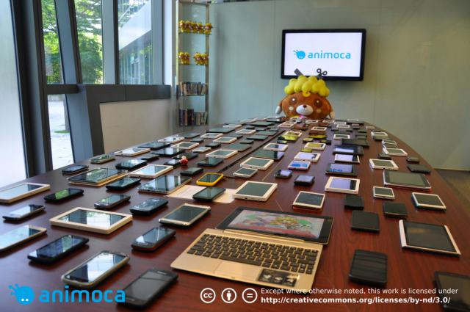
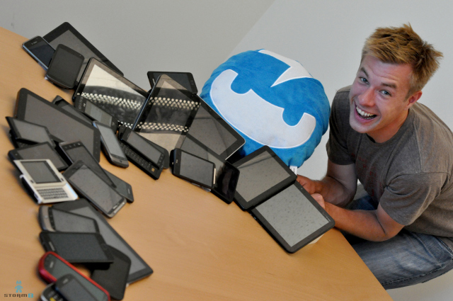
Android – testing on devices

Slide 23
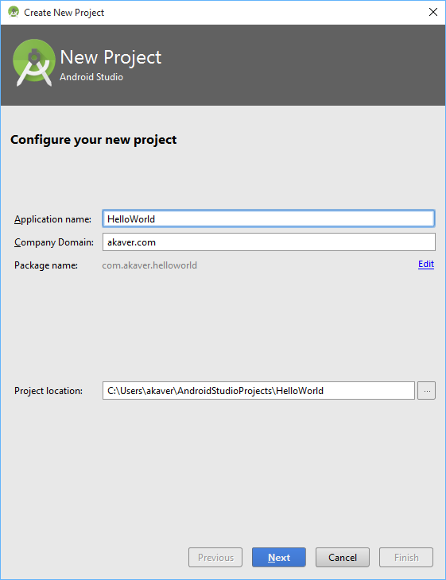
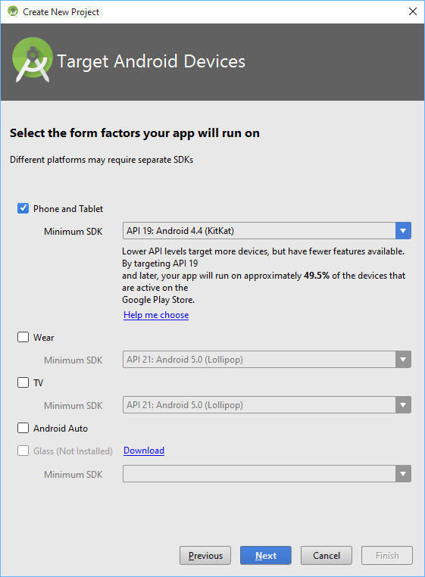
Android – HelloWorld

Slide 24
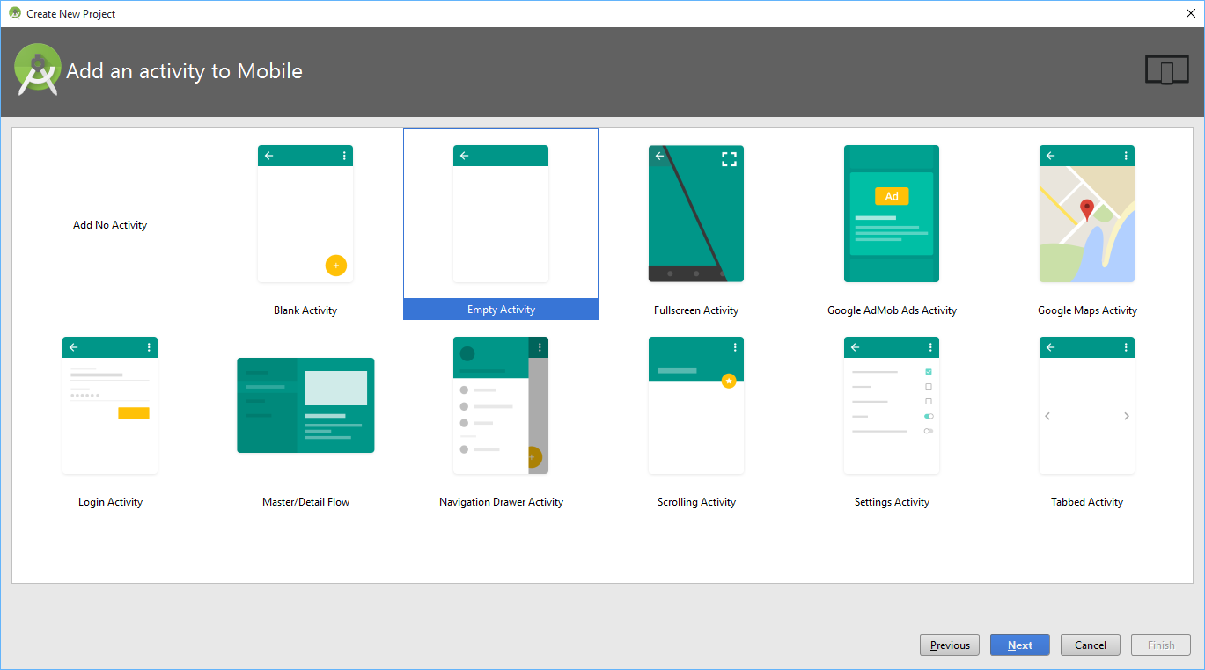
Android - HelloWorld

Slide 25
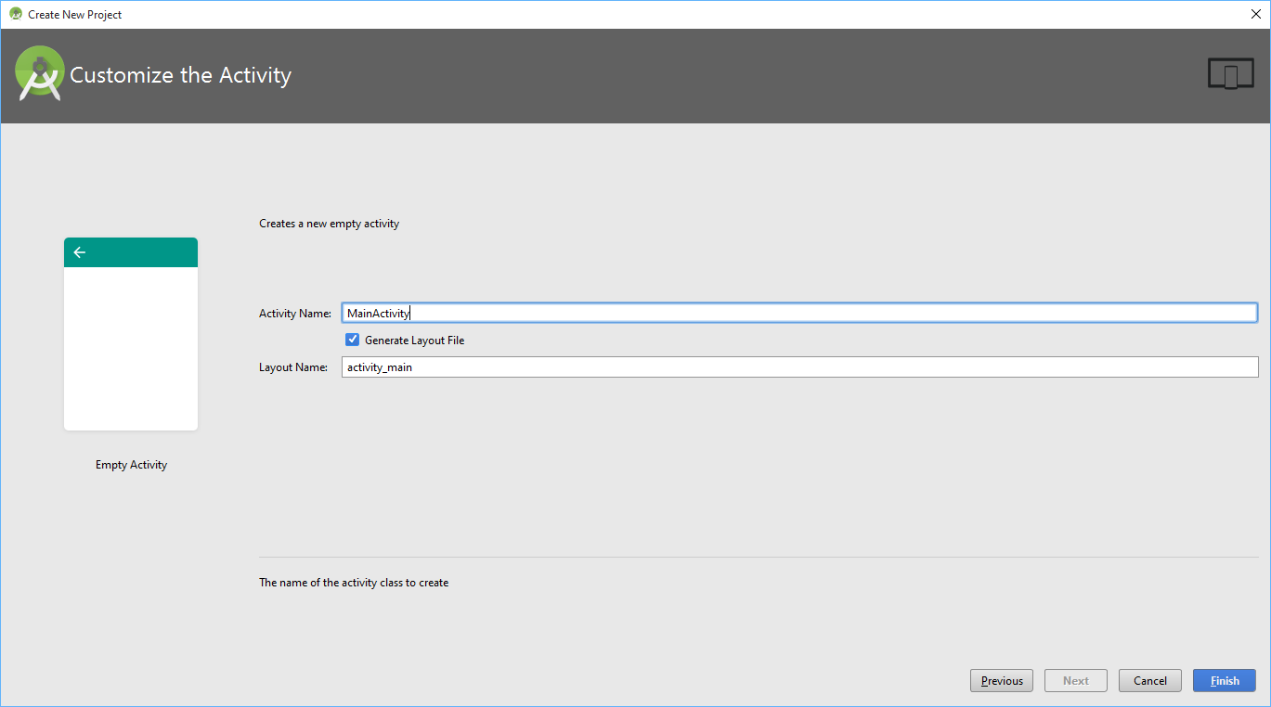
Android - HelloWorld

Slide 26
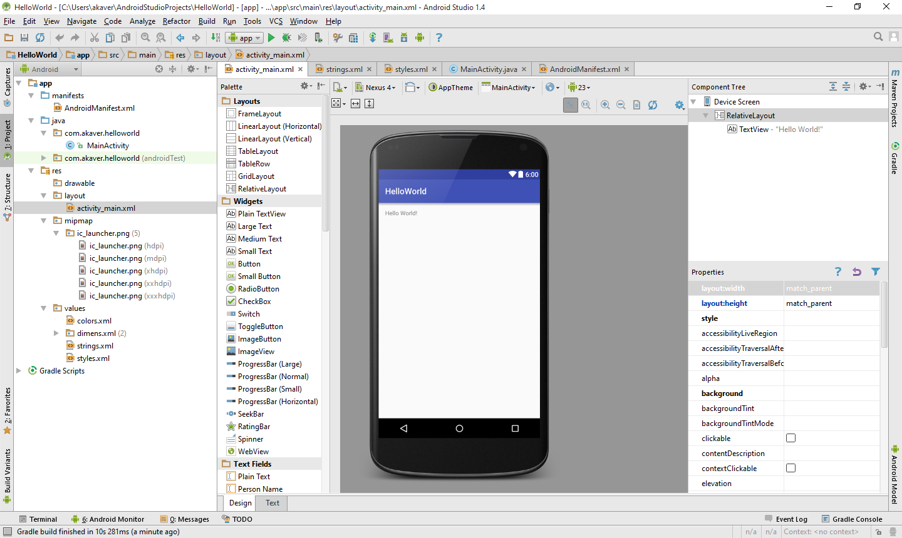
Android - HelloWorld

Slide 27
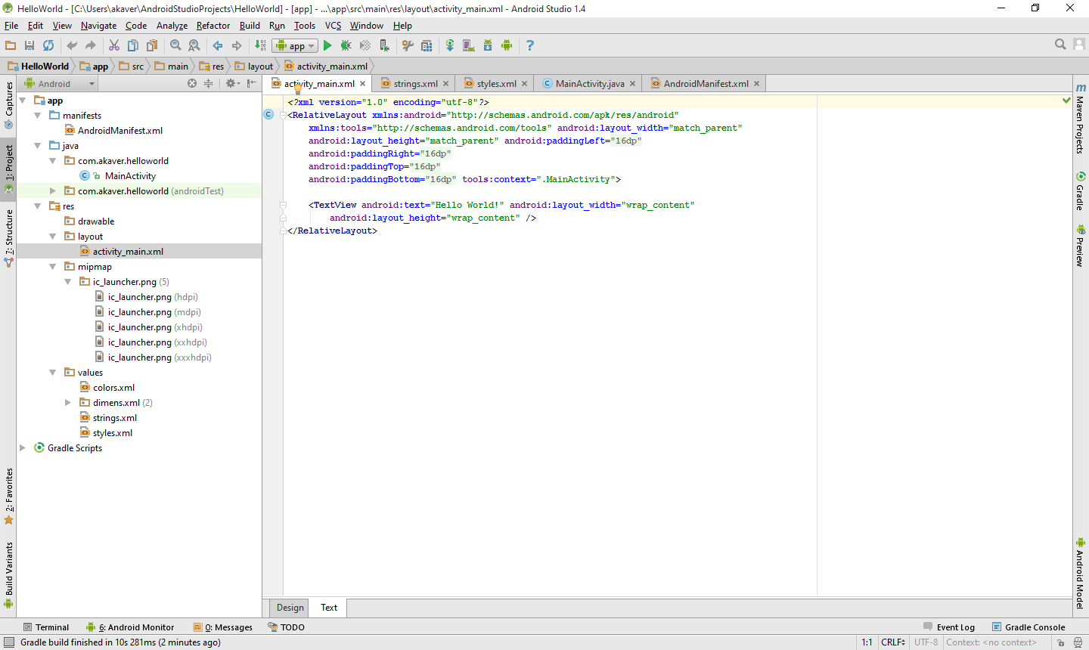
Android - HelloWorld

Slide 28
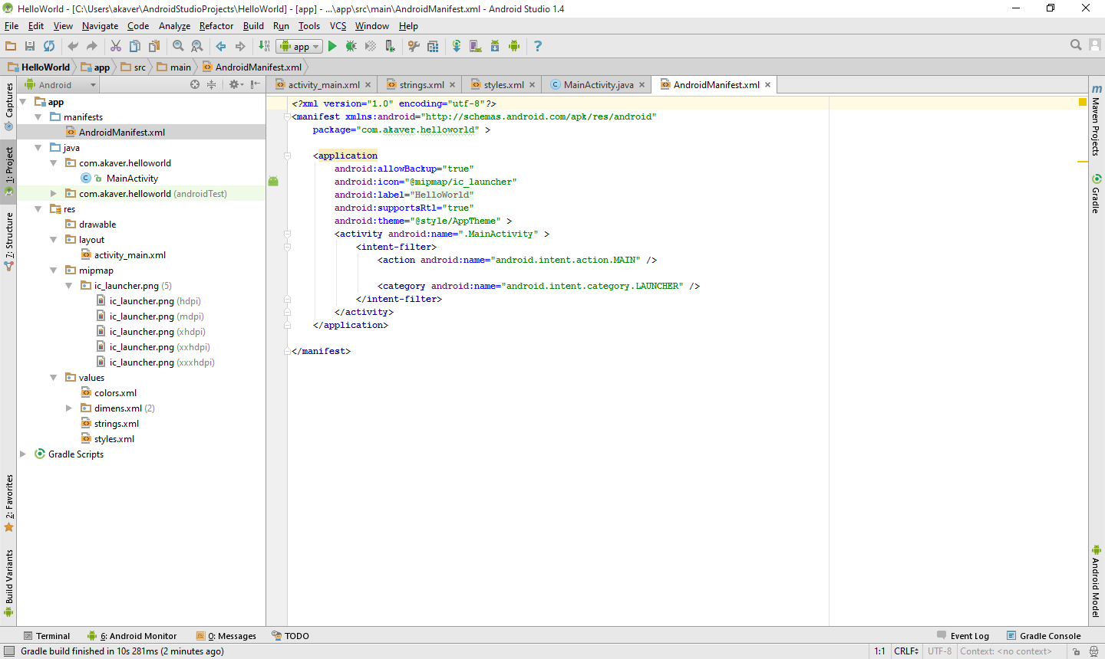
Android - HelloWorld

Slide 29
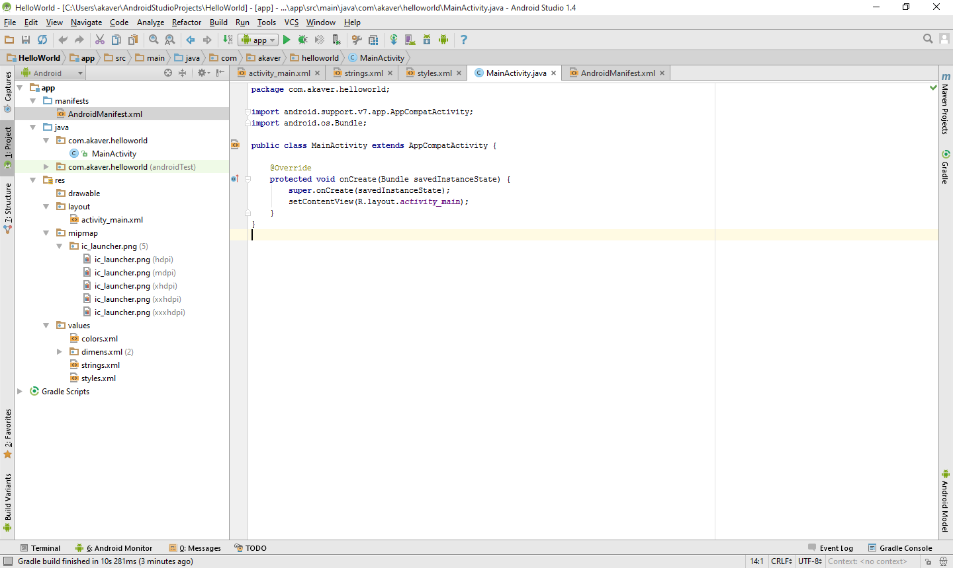
Android - HelloWorld

Slide 30
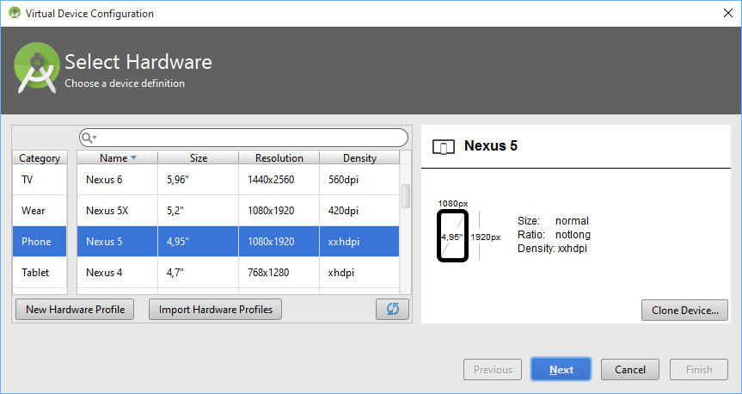
Android - HelloWorld

Slide 31
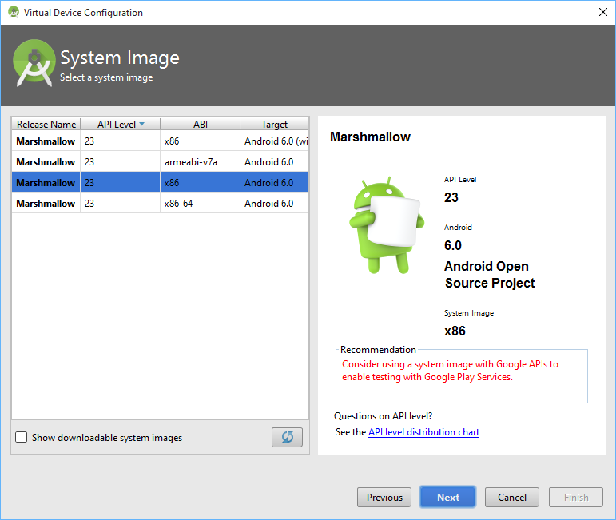
Android - HelloWorld

Slide 32
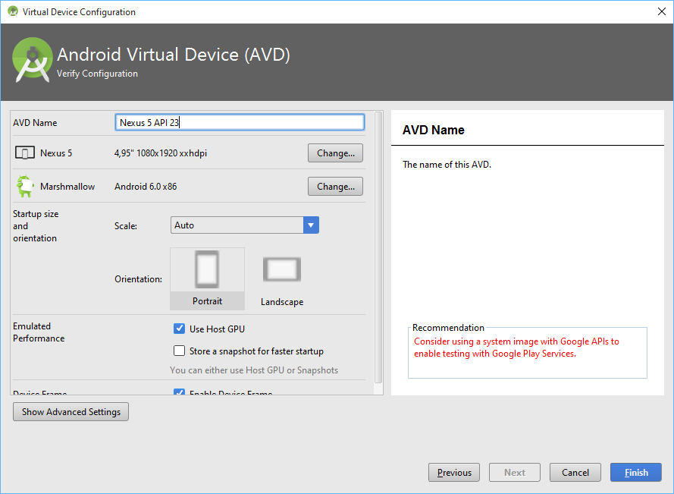
Android - HelloWorld

Slide 33
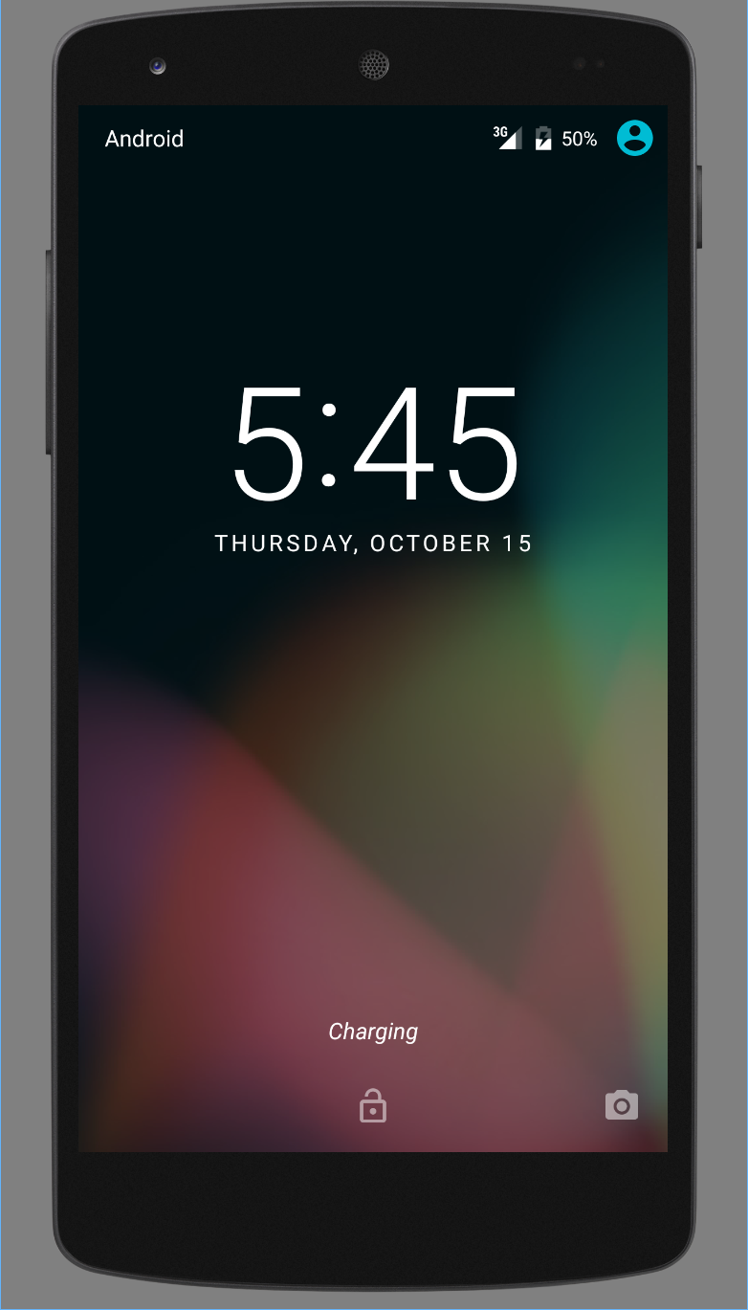
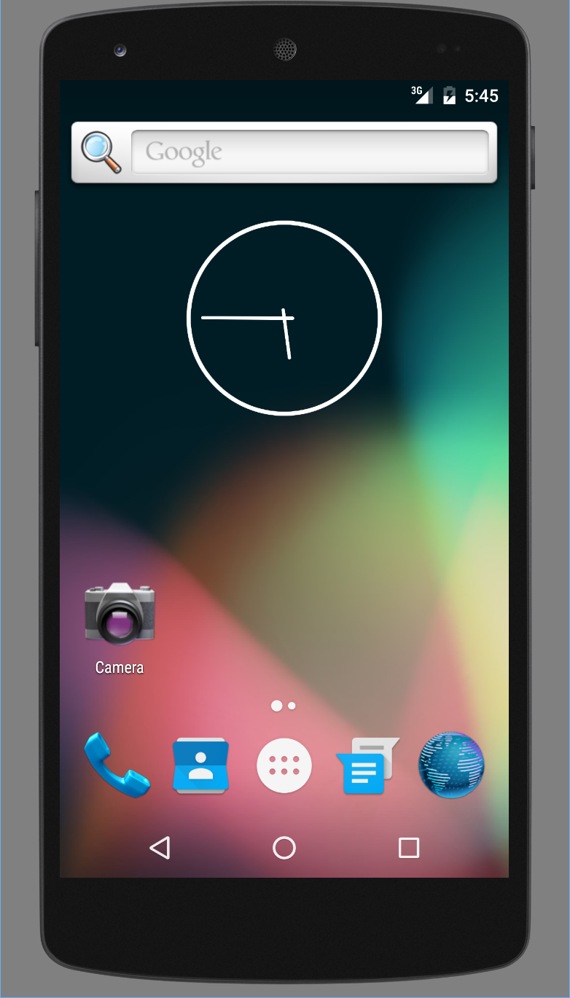
Android - HelloWorld

Slide 34
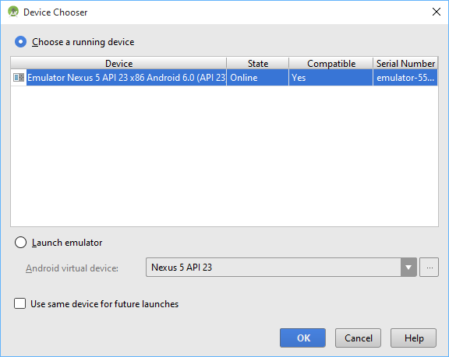
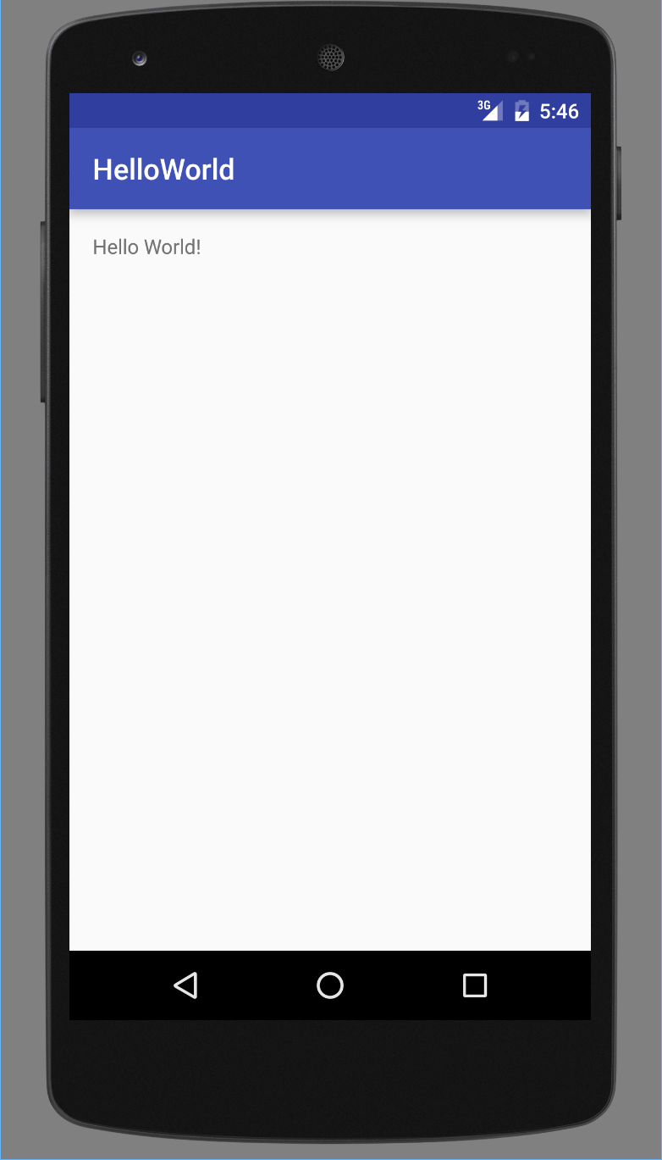
Android - HelloWorld

Slide 35
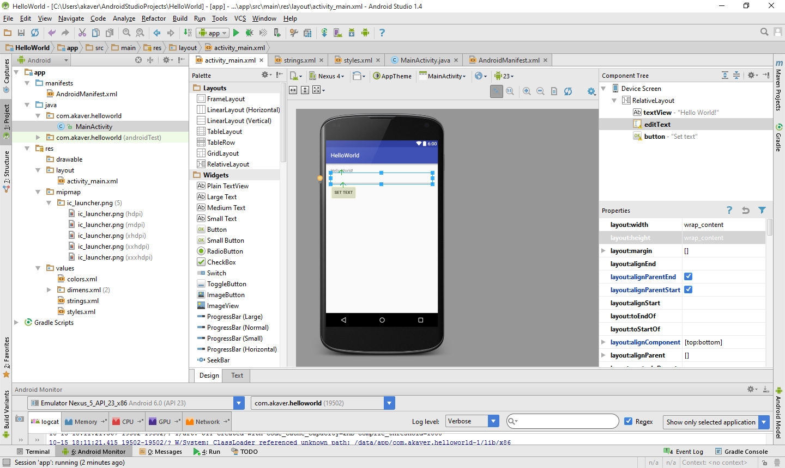
Android – HelloWorld – add TextBox

Slide 36
Android – HelloWorld – activity_main.xml
<?xml version="1.0" encoding="utf-8"?> <RelativeLayout xmlns:android="http://schemas.android.com/apk/res/android" xmlns:tools="http://schemas.android.com/tools" android:layout_width="match_parent" android:layout_height="match_parent" android:paddingLeft="@dimen/activity_horizontal_margin" android:paddingRight="@dimen/activity_horizontal_margin" android:paddingTop="@dimen/activity_vertical_margin" android:paddingBottom="@dimen/activity_vertical_margin" tools:context=".MainActivity"> <TextView android:text="Hello World!" android:layout_width="wrap_content" android:layout_height="wrap_content" android:id="@+id/textView" /> <EditText android:layout_width="wrap_content" android:layout_height="wrap_content" android:id="@+id/editText" android:layout_below="@+id/textView" android:layout_alignParentStart="true" android:layout_alignParentEnd="true" /> <Button android:layout_width="wrap_content" android:layout_height="wrap_content" android:text="Set text" android:id="@+id/button" android:layout_below="@+id/editText" android:layout_alignParentStart="true" android:onClick="buttonClicked" /> </RelativeLayout>

Slide 37
Android – HelloWorld – MainActivity.java
package com.akaver.helloworld; import android.support.v7.app.AppCompatActivity; import android.os.Bundle; import android.view.View; import android.view.inputmethod.InputMethodManager; import android.widget.EditText; import android.widget.TextView; public class MainActivity extends AppCompatActivity { @Override protected void onCreate(Bundle savedInstanceState) { super.onCreate(savedInstanceState); setContentView(R.layout.activity_main); } public void buttonClicked(View view) { TextView textView = (TextView) findViewById(R.id.textView); EditText editText = (EditText) findViewById(R.id.editText); textView.setText("Hello "+editText.getText()+"!"); editText.setText(""); InputMethodManager imm = (InputMethodManager) getSystemService(INPUT_METHOD_SERVICE); imm.hideSoftInputFromWindow(getCurrentFocus().getWindowToken(), 0); } }

