Slide 1
Building Distributed Systems – ICD0009 Network Applications II: Distributed Systems – I371
TalTech IT College, Andres Käver, 2018-2019, Spring semester
Web: http://enos.Itcollege.ee/~akaver/DistributedSystems
Skype: akaver Email: akaver@itcollege.ee

Slide 2
Deploy
Deploy your ASP.NET Core MVC App into cloud – MS Azure
Several ways, how to do it
Most standardized way – containers – Docker

Slide 3
Docker

Slide 4
Docker
Download and install docker desktop for your platform
Its free!
https://hub.docker.com
When you create a docker image of your app, you need to upload it to somewhere – so hosting can download it from there.
Typically docker hosters do not allow direct uploads!

Slide 5
Docker
Create Dockerfile in solution folder
It uses two ready-made base images from MS
sdk:2.2 – for building
Full .net core sdk
aspnet:2.2 – for running
This image only contains .net core runtime – its smaller
FROM mcr.microsoft.com/dotnet/core/sdk:2.2 AS build
WORKDIR /app
# copy csproj and restore as distinct layers
COPY *.sln .
COPY WebApp/*.csproj ./WebApp/
RUN dotnet restore
# copy everything else and build app
COPY WebApp/. ./WebApp/
WORKDIR /app/WebApp
RUN dotnet publish -c Release -o out
FROM mcr.microsoft.com/dotnet/core/aspnet:2.2 AS runtime
WORKDIR /app
COPY --from=build /app/WebApp/out ./
ENTRYPOINT ["dotnet", "WebApp.dll"]

Slide 6
Docker
Build your app into docker image
> docker build -t webapp .
Run it locally via docker
> docker run --name webapp_docker --rm -it -p 8000:80 webapp
-p 8000:80 – map port 8000 (local maschine) to docker port 80
--name webapp_docker – name of instance
-it – interactive (can close down with ctrl-c)
--rm - clean resources after closing down

Slide 7
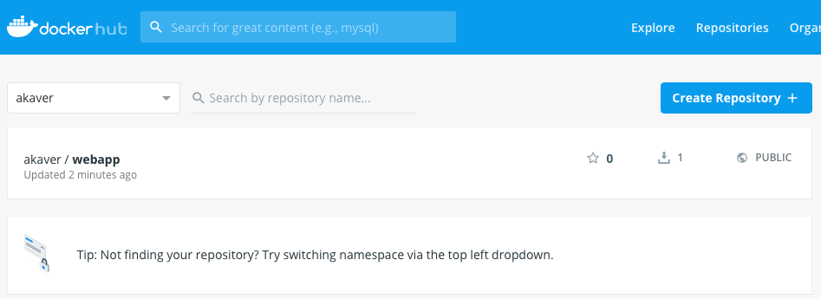
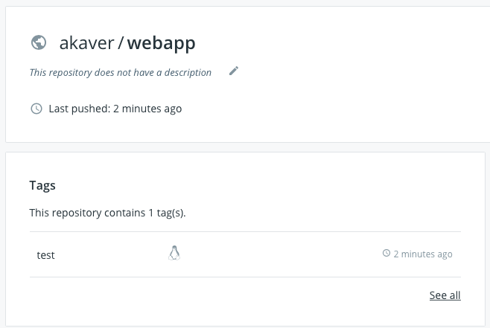
Docker
Tag your docker image (needed for publishing)
> docker tag webapp akaver/webapp:test
Publish your docker image to registry
> docker login -u [username] -p [password]
> docker push akaver/webapp:test
Check your image in Docker Hub

Slide 8
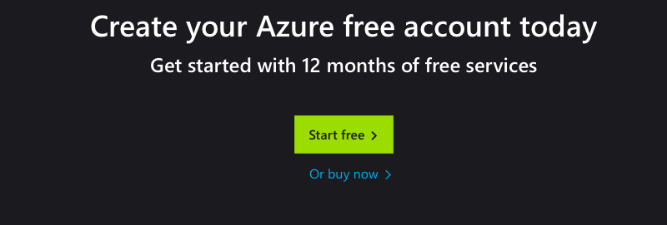
Deploy - Azure
Create Azure account, (using your TalTech Uni-Id)
Sadly, no student support currently (spring 2019) – or maybe it works for you!
Activate free plan (or pay-as-you-go)

Slide 9
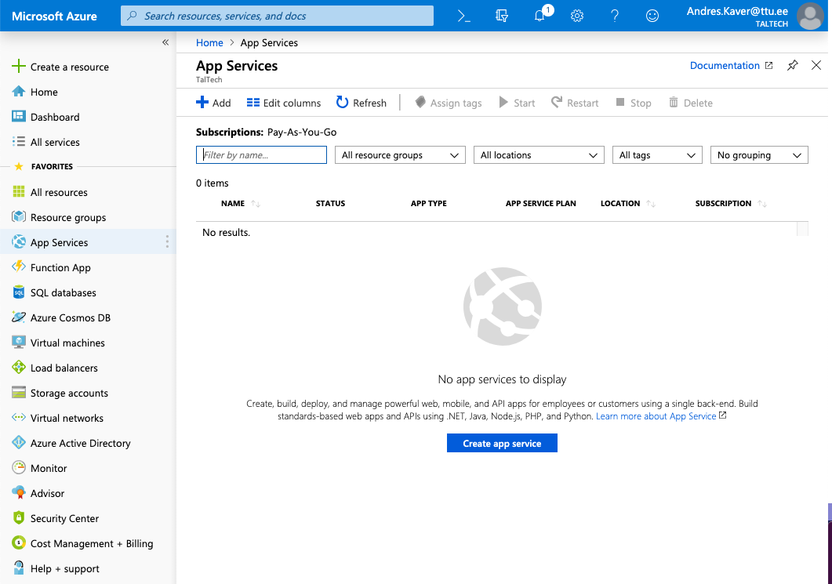
Deploy – Azure

Slide 10
Deploy - Azure
Basics
Create new resource group - easy to kill everything later in one go
Instance name – some_website_name.azurewebsites.net
Publish: Docker image
Operating system: Linux
Location: North Europe
Sku and size: Free F1

Slide 11
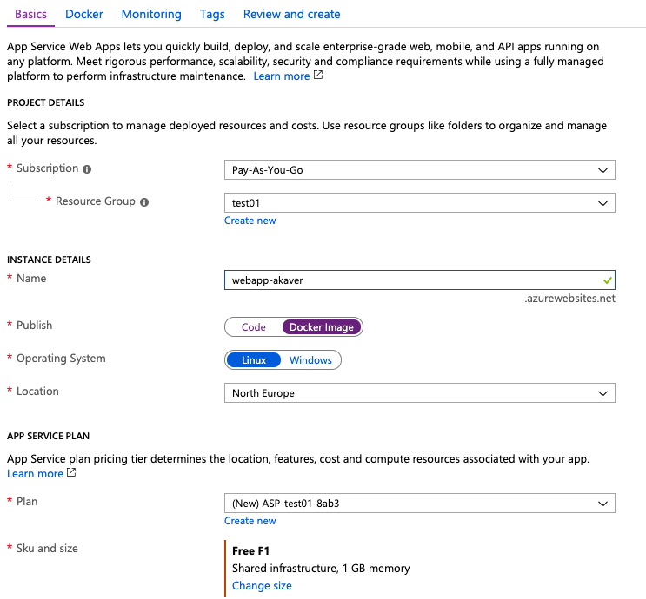
Deploy - Azure

Slide 12
Deploy - Azure
Docker
Options: Single Container
Image Source: Docker Hub
Access Type: Public
Image and tag: [your_repo/your_image:your_tag]

Slide 13
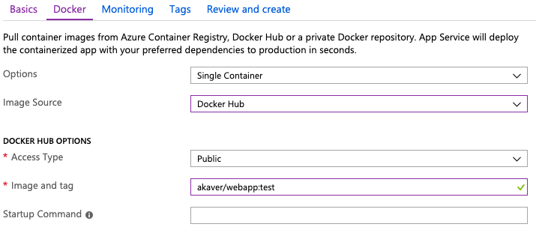
Deploy - Azure

Slide 14
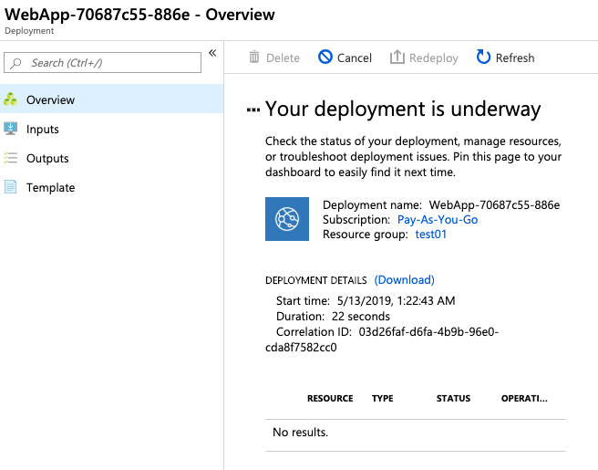
Deploy - Azure
Create!

Slide 15
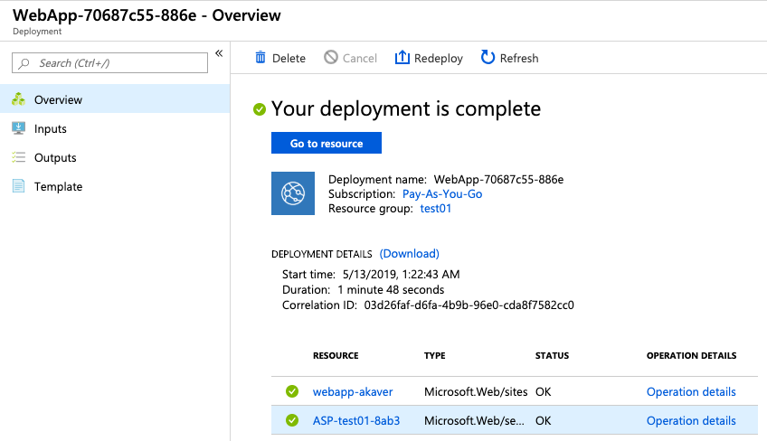
Deploy - Azure
Ca 2 min later

Slide 16
Deploy - Azure

Slide 17
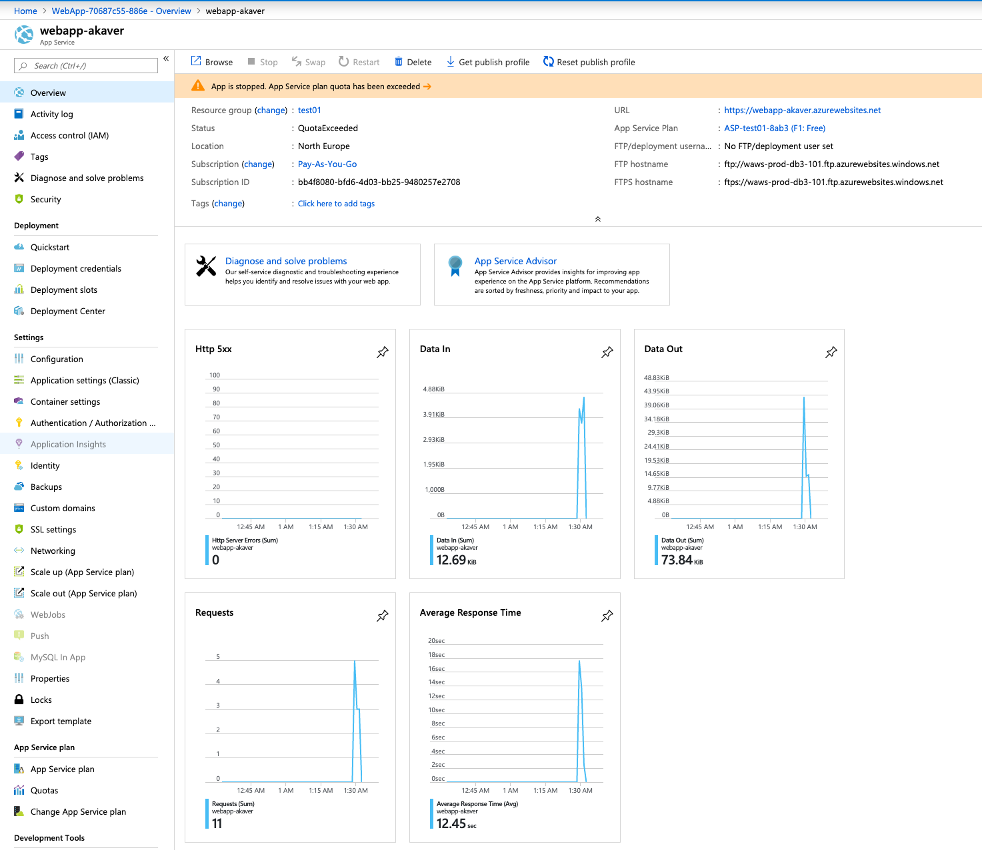
Monitor - azure

Slide 18
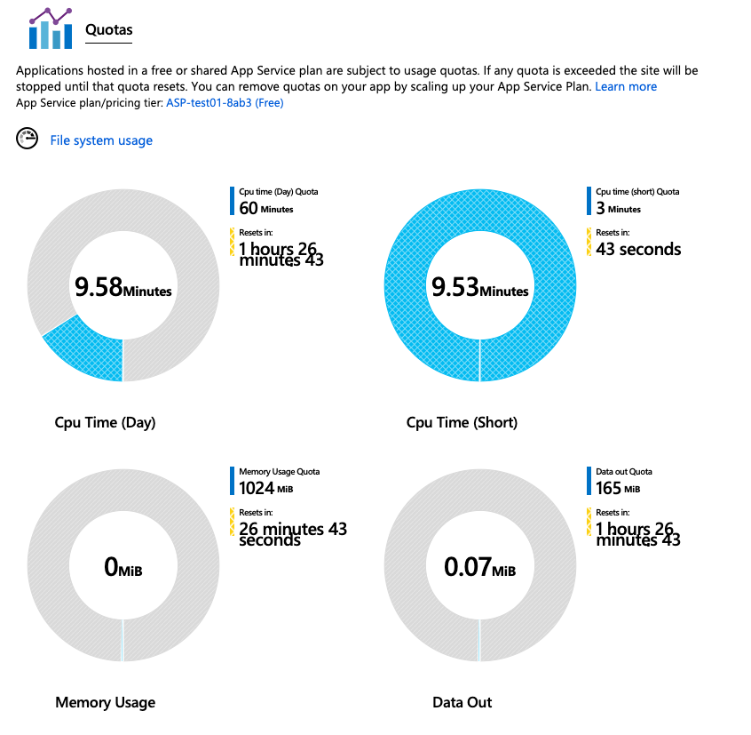
Azure - quotas

Slide 19
Azure – price calculation
https://azure.microsoft.com/en-us/pricing/calculator/
Full on (31*24h) simple app service - 32.01 €
Just some testing 4*24h – 96h - 4.21 €

