Slide 1
Hybrid Mobile Applications - ICD0018
TalTech IT College, Andres Käver, 2019-2020, Fall semester
Web: http://enos.Itcollege.ee/~akaver/HybridMobile
Skype: akaver Email: akaver@itcollege.ee

Slide 2
Requirements
Development environment
Xcode, Android Studio, VS Code, VS enterprise, OSX VS
OSX required for iOS. Can be virtual or rented.
Personal Android/iOS device – (phone/tablet) strongly recommended
Use personal laptop for development (or RDP to somewhere)
Cant really use school computers – lots of latest different software tools needed.

Slide 3
Skills needed (and/or learned)
HTML and CSS (html5, css3, web worker, IndexedDB)
Javascript (async, promises, modules)
Typescript
Modern frontend development tools and frameworks webpack, node, npm, uglify, react, vue, angular, etc
Java
C#
Swift

Slide 4
Grading – Pass/Fail
Projects in git - https://gitlab.cs.ttu.ee – log in with Uni-ID
Git repo has to be named exactly: icd0018-2019f
Grade is based on projects (all mandatory)
2-3-X projects on every technology
Demo projects
http://git.akaver.com/hybrid-mobile-apps-2019-fall

Slide 5
Communication
http://enos.Itcollege.ee/~akaver/HybridMobileApps
Slides, echo360, homework descriptions, etc…
Discord chat: https://discord.gg/P8fRrq Using your real name and Uni-ID is mandatory! Andres Käver (Andres.Kaver)
Skype: akaver
Email: akaver@itcollege.ee

Slide 6
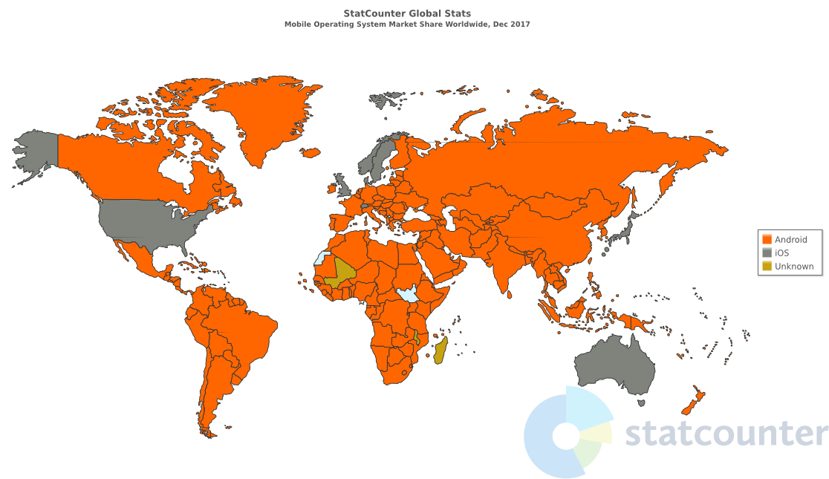
Mobile OS market share

Slide 7
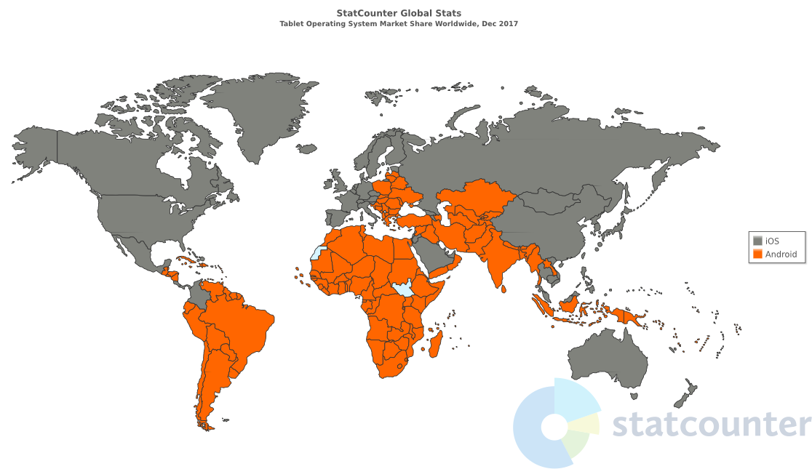
Tablet OS market share

Slide 8
Hybrid Dev Platforms
React Native, NativeScript, Titanium
Flutter
Ionic, Cordova, PhoneGap
Xamarin
Progressive Web Apps
And many more – Framework7, Mobile Angular UI, Onsen UI, Sencha, Kendo UI, Quasar

Slide 9
React Native
React Native
React Native is a JavaScript framework for writing real, natively rendering mobile applications for iOS and Android.
Based on React, Facebook’s JS library for building user interfaces
React Native applications are written using a mixture of JavaScript and XML-esque markup – JSX
React Native “bridge” invokes the native rendering APIs in Objective-C (for iOS) or Java (for Android).
React Native also exposes JavaScript interfaces for platform APIs, apps can access platform features – GPS, Camera, Motion

Slide 10
NativeScript
When you write NativeScript apps, your code has 3 parts: JavaScript, XML, and CSS. The JavaScript component runs business logic, accesses data, or controls the flow of the app. The XML portion defines the user interface (UI), and CSS is used to style the UI, much like an HTML application.
When run, the UI code renders native UI elements in the app.
Based on typescript!
Similar to React Native in many ways.
Apps can be based of Angular or Vue

Slide 11
Flutter
Flutter is Google’s UI toolkit for building beautiful, natively compiled applications for mobile, web, and desktop from a single codebase.
Supports almost anything – iOS, Android, Win, Linux, Mac, Fuchsia
Doesn’t use the underlying Android or iOS platforms, except for hardware access – GPS, Camera, etc.
UI, drawing to the screen, business logic – direct rendering. Like full screen 2d game (Skia engine). Does not use native UI components.
Programming is done in Dart (improved java, mostly like C#)

Slide 12
Xamarin
Open source app platform from Microsoft for building modern & performant iOS and Android apps with C# and .NET.
Xamarin.Forms cross-platform UI framework for building iOS, Android, & Windows apps with .NET from a single, shared codebase (XAML).
App is compiled to MSIL and bundled with .NET implementation for specific platform. AOT compiling for performance and security.

Slide 13
Ionic, PhoneGap, Cordova
Cordova is a framework which runs a JavaScript app in a WebView that has additional native extensions – to access hardware
PhoneGap is a distribution of Cordova with a few custom packages and tweaks (Adobe).
Ionic is based on Cordova and comes with Angular. It has set of standard controls that mimic native controls.
They are all essentially websites embedded in a mobile app.

Slide 14
Progressive Web Apps
Regular websites, enhanced to work in mobile phones.
Responsive, Connectivity independent, App-like-interactions, Fresh, Safe, Discoverable, Re-engageable, Installable, Linkable
Uses modern web technologies – https, service workers, manifest, etc.
Service Worker is a script that works on browser background without user interaction independently. Also, It resembles a proxy that works on the user side. With this script, you can track network traffic of the page, manage push notifications and develop “offline first” web applications with Cache API.

Slide 15
Native development

Slide 16
Javascript

Slide 17
Xamarin

Slide 18
Flutter

