Slide 1
Hybrid Mobile Applications - ICD0018
TalTech IT College, Andres Käver, 2019-2020, Fall semester
Web: http://enos.Itcollege.ee/~akaver/HybridMobile
Skype: akaver Email: akaver@itcollege.ee

Slide 2
React Native

Slide 3
React N
Initial release: 2015
Facebook and community
Open source project - https://github.com/facebook/react-native
Under active development, release branch every two weeks
Currently ver 0.6X

Slide 4
React N
React Native is like React, but it uses native components instead of web components as building blocks.
UI is rendered using platform native components - buttons, lists, navigation view, etc.
Uses the same concepts, as React – JSX, components, state, props.
Main language is JS – ES2015/ES6

Slide 5
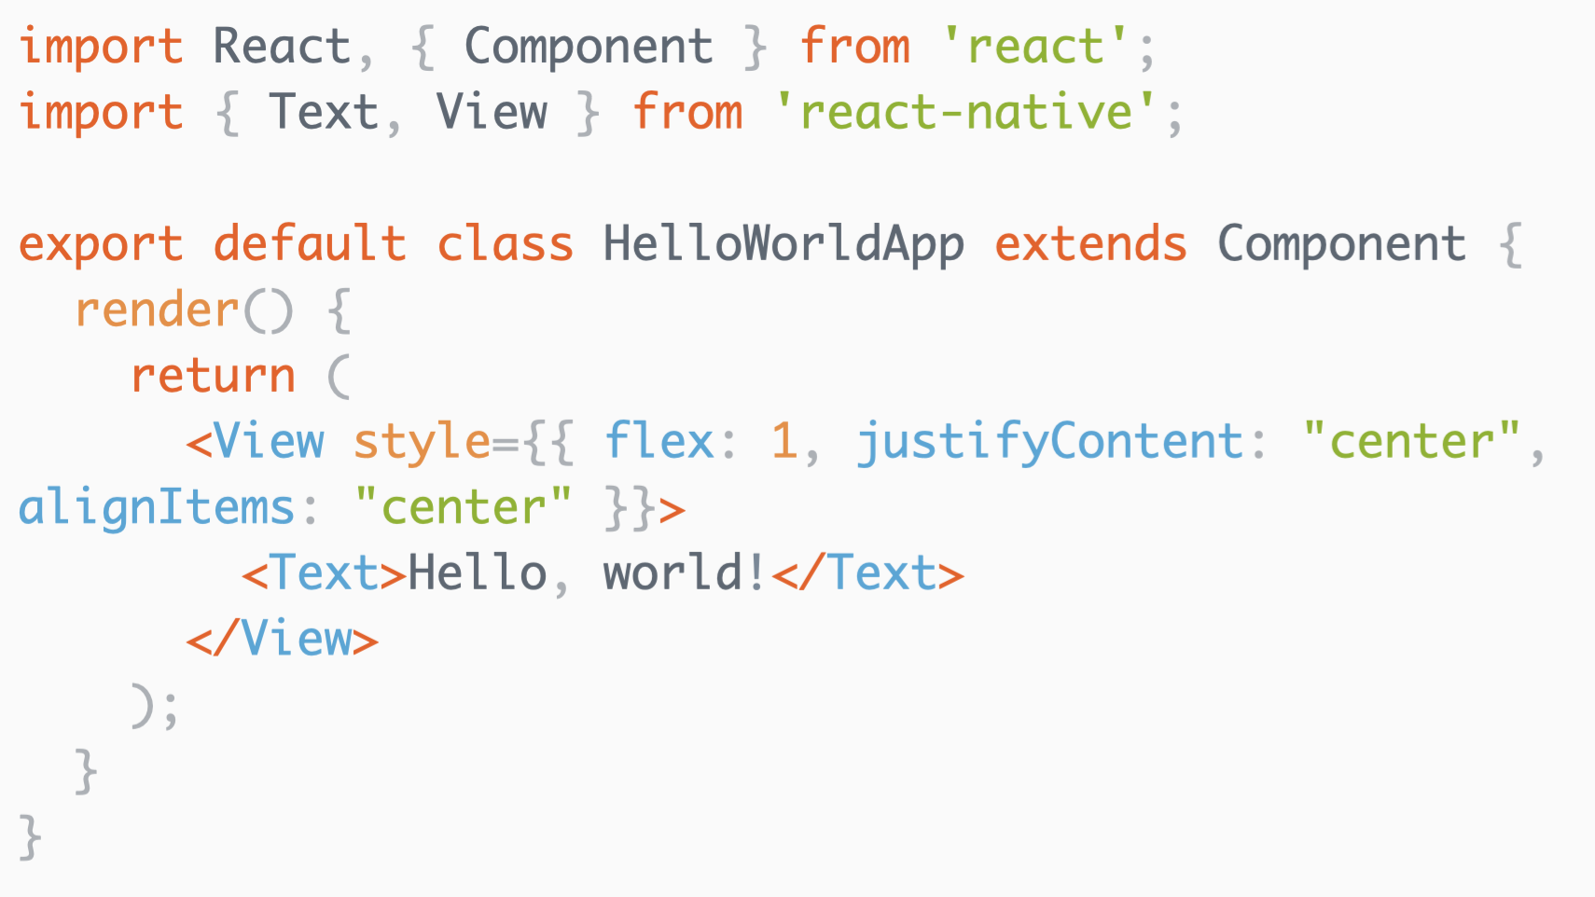
React N – Hello, world!

Slide 6
React N – installation
Two ways to start development – Expo or CLI
Expo – more handholding, less components, less possibilities, for newcomers. Requires only Node.
CLI – full experience, somewhat complicated. Requires lots of external tooling.

Slide 7
React N - CLI
macOS
Node, Watchman, CLI, JDK, Android Studio, Xcode for iOS
Windows
Node, CLI, Python2, JDK, Android Studio
Linux
Node, CLI, JDK, Android Studio
Find exact instructions at
https://facebook.github.io/react-native/docs/getting-started

Slide 8
React N – First Project
Init project >react-native init RNTest01
Run it >cd RNTest01 >react-native run-android

Slide 9
React N - IDE
VS Studio Code
React Native Tools https://marketplace.visualstudio.com/items?itemName=vsmobile.vscode-react-native https://github.com/microsoft/vscode-react-native
React-Native/React/Redux snippets for es6/es7 https://marketplace.visualstudio.com/items?itemName=EQuimper.react-native-react-redux

Slide 10
React N - TypeScript
Lets create a project: react-native init RNTest02 --template typescript
https://devblogs.microsoft.com/typescript/typescript-and-babel-7/
https://facebook.github.io/react-native/blog/2018/05/07/using-typescript-with-react-native

Slide 11
React N – Basic TS app
import React from 'react';
import { Hello } from './components/Hello';
const App = () => {
return (
<Hello name="Andres"></Hello>
);
};
export default App;

Slide 12
React N - component
import React from 'react';
import { StyleSheet, Text, View } from 'react-native';
export interface Props {
name: string;
}
export class Hello extends React.Component<Props> {
constructor(props: Props) {
super(props);
}
render() {
return (
<View style={styles.root}>
<Text style={styles.greeting}>
Hello, {this.props.name}
</Text>
</View>
);
}
}
const styles = StyleSheet.create({
root: {
flex: 1,
justifyContent: "center",
alignItems: "center"
},
greeting: {
color: '#999',
fontWeight: 'bold',
},
});

