Slide 1
Hybrid Mobile Applications - ICD0018
TalTech IT College, Andres Käver, 2019-2020, Fall semester
Web: http://enos.Itcollege.ee/~akaver/HybridMobile
Skype: akaver Email: akaver@itcollege.ee

Slide 2
React N – simple state
interface State {
level: number;
}
export class Hello extends React.Component<Props, State>{
constructor(props: Props) {
super(props);
this.state = { level: props.level }
}
onIcrement = () => this.setState({ level: this.state.level + 1 });
onDecrement = () => this.setState({ level: this.state.level - 1 });
render() {……

Slide 3
React N – simple state
render() {
return (
<View style={styles.root}>
<Text style={styles.greeting}>
Hello, {this.props.name}! Level: {this.state.level}!
</Text>
<View>
<View>
<Button title="-" onPress={this.onDecrement} />
</View>
<View>
<Button title="+" onPress={this.onIcrement} />
</View>
</View>
</View>
);
}

Slide 4
React N – State
So far we have one kind of data communication between components – props . But props is read-only, we also need state.
Simple state – local to component was straightforward.
But we often need pass data back also from child to parent. Or from sibling to sibling. What to do?
Pass callback function as prop to child
Use state management library (Redux)
Use Context API (possibly with Redux)
What about Dependency Injection?

Slide 5
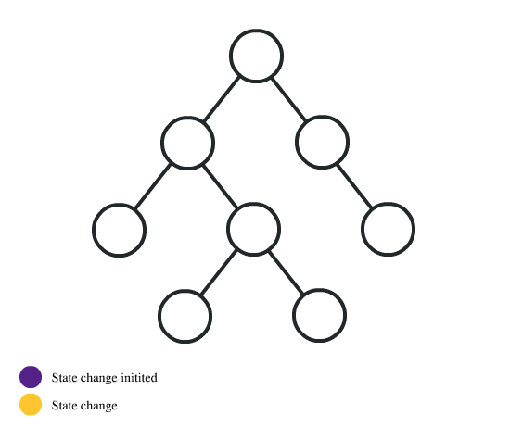
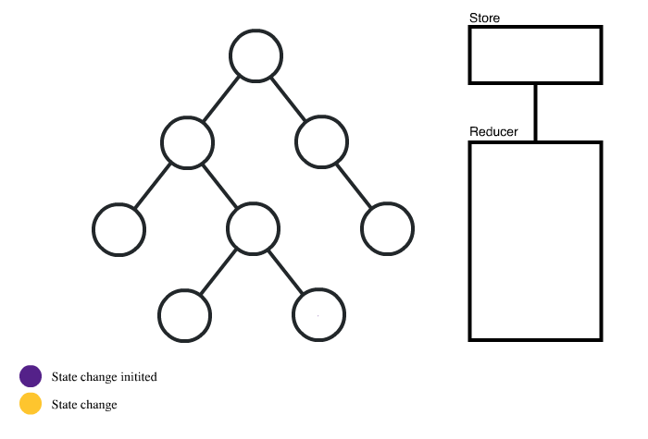
React N – State
Callbacks
Redux

Slide 6
React N – State
Context API vs Prop Drilling

Slide 7
React N – Redux
The state of the entire app is stored in a single object tree within a single store.
To change the state, you need to trigger an action that describes what needs to happen (reducer).
You should never mutate the state directly, always return a new object to do so.
Install redux and react-redux

Slide 8
React N –

Slide 9
React N –

Slide 10
React N –

Slide 11
React N –

Slide 12
React N –

Slide 13
React N –

Slide 14
React N –

Slide 15
React N –

Slide 16
React N –

Slide 17
React N –

Slide 18
React N –

Slide 19
React N
The End!

