Slide 1
Hybrid Mobile Applications - ICD0018
TalTech IT College, Andres Käver, 2019-2020, Fall semester
Web: http://enos.Itcollege.ee/~akaver/HybridMobile
Skype: akaver Email: akaver@itcollege.ee

Slide 2
React N - State
Local state within component
interface State {
level: number;
}
export class Hello extends React.Component<Props, State>{
constructor(props: Props) {
super(props);
this.state = { level: props.level }
}
onIcrement = () => this.setState({ level: this.state.level + 1 });
onDecrement = () => this.setState({ level: this.state.level - 1 });
render() {……

Slide 3
React N - State
Local state within component
render() {
return (
<View style={styles.root}>
<Text style={styles.greeting}>
Hello, {this.props.name}! Level: {this.state.level}!
</Text>
<View>
<View>
<Button title="-" onPress={this.onDecrement} />
</View>
<View>
<Button title="+" onPress={this.onIcrement} />
</View>
</View>
</View>
);
}

Slide 4
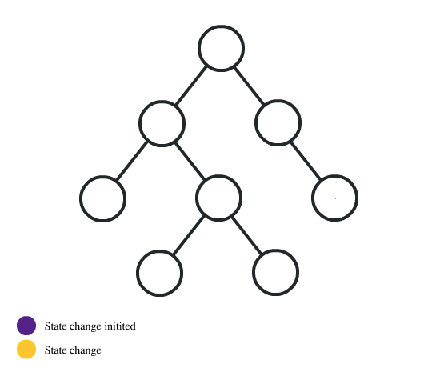
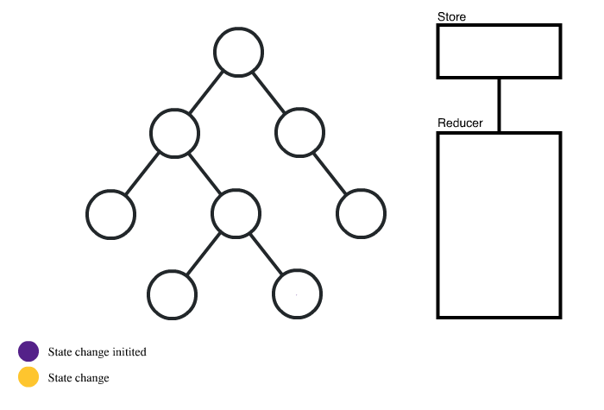
React N – State
Callbacks
Context API/Redux

Slide 5
React N – State
Global/Context API vs Prop Drilling

Slide 6
React N – Context API
When to Use Context
Context is designed to share data that can be considered “global” for a tree (or subtree) of React components
Context is primarily used when some data needs to be accessible by many components at different nesting levels.

Slide 7
React N – Context API
export const AppContext = React.createContext<IAppContext>(defaultValue);
Creates context (state) object
Also creates Provider and Consumer export const AppContextProvider = AppContext.Provider; export const AppContextConsumer = AppContext.Consumer;

Slide 8
React N – Context API
Context Provider
Every Context object comes with a Provider React component that allows consuming components to subscribe to context changes.
defaultValue from createContext is only used, when provider is not found!
All consumers that are descendants of a Provider will re-render whenever the Provider’s value prop changes. (same algorithm as Object.is)
render() {
return (
<AppContextProvider value={this.state} >
<View style={styles.main}>

Slide 9
React N – Context API
render() {
return (
<AppContextConsumer>
{appContext =>
<View style={styles.mainView}>
<Text>Board {appContext.moves}</Text>
</View>
}
</AppContextConsumer>
Context Consumer
A React component that subscribes to context changes.
The function receives the current context value and returns a React node. The value argument passed to the function will be equal to the value prop of the closest Provider for this context above in the tree.
If there is no Provider for this context above, the value argument will be equal to the defaultValue that was passed to createContext().

Slide 10
React N – Context API
contextType
The contextType property on a class can be assigned a Context object created by React.createContext().
Lets you consume the nearest current value of that Context type using this.context.
You can reference this in any of the lifecycle methods including the render function.

Slide 11
React N – Context API
contextType with TypeScript in class component
export class Stats extends React.Component {
static contextType = AppContext;
context!: React.ContextType<typeof AppContext>;
render() {
return (
<View style={styles.main}>
<Text>Stats: {this.context.moves}</Text>
</View>
);
}
}

Slide 12
React N – Context API
Functional component can use Hook board = () => { const user = useContext(UserContext);

Slide 13
React N – Context API
Mutating context from child components
Include methods for updating the state in the Context object
export interface IAppContext {
moves: number,
changeMoves: (amount: number) => void,
setMoves: (amount: number) => void,
}
export const AppContext = React.createContext<IAppContext>(
null
);

Slide 14
React N – Context API
export interface State extends IAppContext {}
class App extends React.Component<Props, State>{
constructor(props) {
super(props);
this.state = {
moves: 0,
changeMoves: this.changeMoves,
setMoves: this.setMoves,
}
}
changeMoves = (amount: number) => {
this.setState({ moves: this.state.moves + amount });
}
setMoves = (amount: number) => { this.setState({ moves: amount }); }
render() {
return (
<AppContextProvider value={this.state}>

Slide 15
React N – Context API
Recap
Use ctx = React.createContext() to create context
Pull ctx.Provider and ctx.Consumer out of ctx
Wrap Provider around parent component
Consuming – 3 alternatives
Wrap <Consumer>{ctx => <></>… around context usage.
Use this option, when multiple contexts are needed simultaneously
A class can consume with static contextType = ctx
A functional component with const x = useContext(ctx)
Updating context from child component – include methods in context. Take care of triggering rendering updates (no deep object monitoring)

Slide 16
React N - Redux

Slide 17
React N – Redux
Redux allows you to manage your entire application state in one object, called the Store.
Updates to the Store will trigger re-renders of components that are connected to the part of the store that was updated.
To update something, emit an Action (type and data). Actions are created by Action Creators.
Functions to handle Actions and return the updated Store are called Reducers.
All the reducers are combined into one container - combinedReducers

Slide 18
React N – Redux
Presentational and Container Components

Slide 19
React N – Redux
Install required components > yarn add redux react-redux @types/react-redux or > npm install redux react-redux @types/react-redux --save

Slide 20
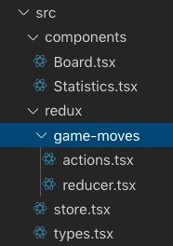
React N – Redux
Declare types for global state object and sub-state objects in types.tsx
// this is our sub-state object type
export type GameMoves = {
moves: number;
totalMoves: number;
}
// big overall state
export type AppState = {
gameMoves: GameMoves,
// add more sub-states here
}

Slide 21
React N – Redux
Define types for actions and combined action type (types.tsx)
Action – identifier(command) and data to be used for state manipulation. Similar to Intent object in Android
// our action types
export type AddGameMovesAction = {
type: string;
amount: number;
}
export type ResetGameMovesAction = {
type: string;
}
// combined type of Actions
export type GameMovesActions = AddGameMovesAction | ResetGameMovesAction;

Slide 22
React N – Redux
Create a catalog for sub-state code pieces.
Define action creators in <sub-state name>/actions.tsx
import { AddGameMovesAction, ResetGameMovesAction } from "../types";
export enum GAME_MOVES_ACTION_TYPES {
ADD_MOVES = 'GAME_MOVES:ADD',
RESET_MOVES = 'GAME_MOVES:RESET',
}
// action creators
export const addGameMoves = (amount: number): AddGameMovesAction => ({
type: GAME_MOVES_ACTION_TYPES.ADD_MOVES,
amount: amount
});
export const resetGameMoves = (): ResetGameMovesAction => ({
type: GAME_MOVES_ACTION_TYPES.RESET_MOVES
});

Slide 23
React N – Redux
Create initial state and reducer (state manipulator – receivers state and action, return new state) in <sub-state>/reducer.tsx
import { GameMovesActions, AddGameMovesAction, GameMoves } from "../types";
import { GAME_MOVES_ACTION_TYPES } from "./actions";
export const initialState: GameMoves = { moves: 7, totalMoves: 21 }
// this reducer has to have the same name, as AppState sub-state it manages!!!!
export const gameMoves = (
state: GameMoves = initialState,
action: GameMovesActions
) => {
// create deep copy of state
const newState: GameMoves = {
moves: state.moves,
totalMoves: state.totalMoves,
}
...

Slide 24
React N – Redux
continued… Switch over action.type, cast with (action as SomeAction)
switch (action.type) {
case GAME_MOVES_ACTION_TYPES.ADD_MOVES:
newState.moves += (action as AddGameMovesAction).amount;
newState.totalMoves += 1;
return newState;
case GAME_MOVES_ACTION_TYPES.RESET_MOVES:
// zip objects together
return { ...newState, ...{
moves: 0,
totalMoves: newState.totalMoves + 1}
};
default:
return state;
}
};

Slide 25
React N – Redux
Create Redux store – holds global state and reducers in store.tsx
import { createStore, combineReducers } from "redux";
import { AppState } from "./types";
import { gameMoves } from "./game-moves/reducer";
export default createStore(
combineReducers<AppState>({
gameMoves,
})
)

Slide 26
React N – Redux
Wrap main React component inside Redux provider. All the sub components can now access store.
import store from './src/redux/store';
import { Provider } from 'react-redux’;
import Statistics from './src/components/Statistics';
import Board from './src/components/Board';
...
render() {
return (
<Provider store={store}>
<View style={styles.mainView}>
<Statistics></Statistics>
<Board></Board>
</View>
</Provider>
);
}

Slide 27
React N – Redux
Consume store in sub-component (presentational component)
Make state accessible via properties (this happens in runtime)
const mapStateToProps = (state: AppState, ownProps: {}) => ({
gameMoves: state.gameMoves
});
const mapDispatchToProps = (dispatch: Dispatch<AnyAction>) => ({
onAddGameMoves: (amount: number) => {dispatch(addGameMoves(amount))},
onResetGameMoves: () => {dispatch(resetGameMoves())},
});
export default connect(mapStateToProps, mapDispatchToProps)(Board);

Slide 28
React N – Redux
Let typescript know, that component properties will be enhanced
export interface Props {
gameMoves: GameMoves,
onAddGameMoves: (amount: number) => Promise<void>,
onResetGameMoves: () => Promise<void>,
}
export interface State {}
class Board extends React.Component<Props, State>{
render() {
return (
<View style={styles.mainView}>
<Text>Moves: {this.props.gameMoves.moves}</Text>
<Text>Total moves: {this.props.gameMoves.totalMoves}</Text>
<View style={styles.buttonView}>
<Button title="-"
onPress={() => { this.props.onAddGameMoves(-1) }} />
<Button title="Reset" color="grey"
onPress={() => { this.props.onResetGameMoves()}} />
<Button title="+"
onPress={() => { this.props.onAddGameMoves(1) }} />
</View>
</View>
);
}
}

Slide 29
React N – Redux

Slide 30
React N – Redux

Slide 31
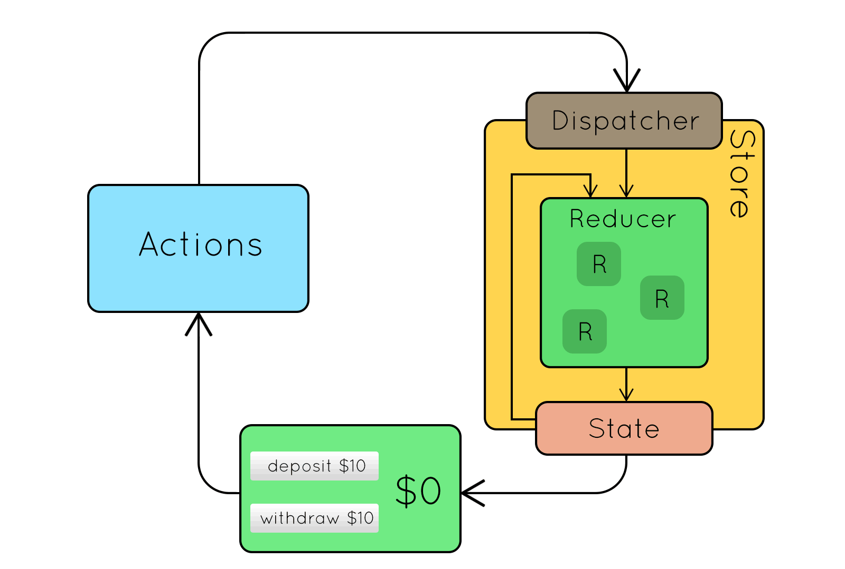
React N – Redux

Slide 32
React N – Redux
Recap
State is immutable! Make a deep copy of existing state, modify it and store back in stack of states. [tate-3, state-2, state-1, state-current]
Simple flow in Redux (no side effects)
You need to update state (user does something in UI for example)
Call an Action Creator, giving it necessary data to modify state
Receive an Action, Dispatch it to Store
Store calls Reducer – giving it your Action and Current State
Reducer produces New State, returns it to Store
Store puts new state somewhere and informs all the subscribed Views of New state (or Sub-state)
Update Views with new state/sub-state data

Slide 33
React N – Redux
THE END!

