Slide 1


Hybrid Mobile Applications - ICD0018
TalTech IT College, Andres Käver, 2019-2020, Fall semester
Web: http://enos.Itcollege.ee/~akaver/HybridMobile
Skype: akaver Email: akaver@itcollege.ee

Slide 2
Flutter
Still to come… maybe….
Persistence
  Networking
    Tokens/Auth, Json parsing in background, WebSockets/SignalR
  Working with SQLite
  Files, Key-Value data
Cupertino vs Material
Background services (Isolate), Media, notifications, push, sensors
Plugins – interfacing with native API’s
i18n, accessibility
Animations, Assets

Slide 3
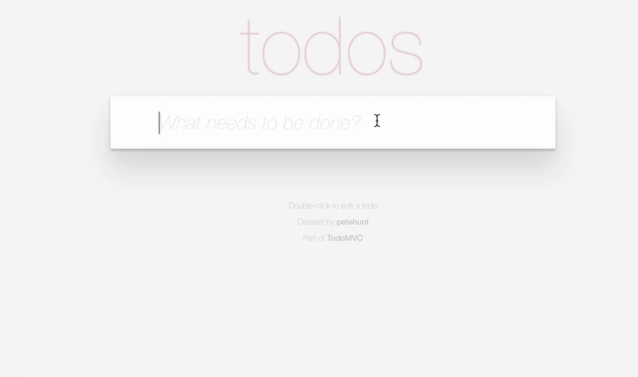
Flutter – final project
ToDo App
  State and SQLite
  Sync to ASP.NET Core 3 backend
  (provided by course)
    Auth
  Lists, dragging, swiping
  https://medium.muz.li/designing-pocket-lists-18b6cafd1161
  Backend source: https://git.akaver.com/taltech-public/com.akaver.taltech
  https://taltech.akaver.com

Slide 4
Flutter – final project
Features to implement
  Create/edit todos (category, priority)
  Delete todo by swipping
  Mark done/not done in list
  Filter todo list by status (all/done/not done)
  Change tasks order via drag-drop
  Change theme (light to dark and vice versa) at runtime
  Login/logout/sync data
  Register new account
  Work offline (local db)

Slide 5
Flutter - Auth
Flow – Register, Login, Work, Logout
  Content-Type: application/json
  Host: https://taltech.akaver.com/

Slide 6
Flutter – Auth Register
Register
  /api/account/register
  Method: post
  Body
  {
  "email": "test01@akaver.com",
  “password": "Kala.maja1”
  }
  Response
  {
  "token": ”eyJhbGciOiJIUzI…",
  "status": "Account created for test01@akaver.com”
  }

Slide 7
Flutter – Auth Login
Login
  /api/account/login
  Method: post
  Body
  {
  "email": "test01@akaver.com",
  “password": "Kala.maja1”
  }
  Response
  {
  "token": ” eyJhbGciOiJIUzI…",
  "status": "Logged in”
  }

Slide 8
Flutter – Auth Logout
Logout
  Just delete the token

Slide 9
Flutter – api endpoints
ToDo Api endpoints (get all)
  /api/todocategories
  /api/todopriorities
  /api/todotasks
/api/todocategories/1
Get, Post, Put, Delete – classical Rest backend http verbs

Slide 10
Flutter - Requests with auth
On every Rest API request
Header:
Authorization: bearer eyJhbGciOiJIUzI…

Slide 11
Flutter – Rest Auth
Login/Register
Future<JWT> fetchToken(String email, String password) async {
Map<String, String> headers = {"Content-type": "application/json"};
final response = await http.post(
'https://taltech.akaver.com/api/account/login',
headers: headers,
body: '{"email": "$email","password": "$password"}');
if (response.statusCode == 200) {
return JWT.fromJson(json.decode(response.body));
} else {
return JWT(token: "", status: response.reasonPhrase);
}
}

Slide 12
Flutter - JWT
JWT class
import 'package:flutter/widgets.dart';
class JWT {
final String token;
final String status;
JWT({@required this.token, @required this.status});
factory JWT.fromJson(Map<String, dynamic> json){
return JWT(token: json['token'], status: json['status']);
}
}

Slide 13
Flutter – App State
Wrap the whole app inside state provider (including routes)
void main() {
runApp(
ChangeNotifierProvider<AuthModel>(
builder: (_) => AuthModel(),
child: MaterialApp(
title: 'Navigation',
initialRoute: '/',
routes: {
'/': (context) => LoginScreen(),
'/main': (context) => MainScreen(),
},
),
),
);
}

Slide 14
Flutter – DataBase SQLite
Packages
sqflite: ^1.1.7+2
path_provider: ^1.4.0
Implement database helper class

Slide 15
Flutter - SQLite
class DatabaseHelper {
static final _databaseName = "MyDatabase.db";
static final _databaseVersion = 1;
DatabaseHelper._internal();
static final DatabaseHelper instance = DatabaseHelper._internal();
factory DatabaseHelper(){
return instance;
}
static Database _database;
Future<Database> get database async {
if (_database != null) return _database;
_database = await _initDatabase();
return _database;
}
_initDatabase() async {
Directory documentsDirectory = await getApplicationDocumentsDirectory();
String path = join(documentsDirectory.path, _databaseName);
return await openDatabase(path,
version: _databaseVersion, onCreate: _onCreate);
}
Singleton
Lazy

Slide 16
Flutter - SQLite
static final table = 'my_table';
static final columnId = '_id';
static final columnName = 'name';
static final columnAge = 'age';
// SQL code to create the database table
Future _onCreate(Database db, int version) async {
await db.execute('''
CREATE TABLE $table (
$columnId INTEGER PRIMARY KEY,
$columnName TEXT NOT NULL,
$columnAge INTEGER NOT NULL
)
''');
}
_onCreate

Slide 17
Flutter – SQLite, data access
// Inserts a row in the database where each key in the Map is a column name
// and the value is the column value. The return value is the id of the
// inserted row.
Future<int> insert(Map<String, dynamic> row) async {
Database db = await instance.database;
return await db.insert(table, row);
}
// All of the rows are returned as a list of maps, where each map is
// a key-value list of columns.
Future<List<Map<String, dynamic>>> queryAllRows() async {
Database db = await instance.database;
return await db.query(table);
}
// All of the methods (insert, query, update, delete) can also be done using
// raw SQL commands. This method uses a raw query to give the row count.
Future<int> queryRowCount() async {
Database db = await instance.database;
return Sqflite.firstIntValue(
await db.rawQuery('SELECT COUNT(*) FROM $table'));
}

Slide 18
Flutter – SQLite, data access
Implement repo probably!
// Assume that the id column in the map is set. The other
// column values will be used to update the row.
Future<int> update(Map<String, dynamic> row) async {
Database db = await instance.database;
int id = row[columnId];
return await db.update(table, row, where: '$columnId = ?', whereArgs: [id]);
}
// Deletes the row specified by the id. The number of affected rows is
// returned. This should be 1 as long as the row exists.
Future<int> delete(int id) async {
Database db = await instance.database;
return await db.delete(table, where: '$columnId = ?', whereArgs: [id]);
}

Slide 19
Flutter – More?
Still to come… maybe….
Persistence
  Networking
    Json parsing in background, WebSockets/SignalR
  Files, Key-Value data
Cupertino vs Material
Background services (Isolate), Media, notifications, push, sensors
Plugins – interfacing with native API’s
i18n, accessibility
Animations, Assets

