Slide 1
Hybrid Mobile Applications - ICD0018
TalTech IT College, Andres Käver, 2019-2020, Fall semester
Web: http://enos.Itcollege.ee/~akaver/HybridMobile
Skype: akaver Email: akaver@itcollege.ee

Slide 2
Xamarin
Abstraction layer that manages communication of shared code with underlying platform code.
Runs in a managed environment that provides conveniences such as memory allocation and garbage collection.
Open-source platform for building modern and performant applications for iOS, Android, Windows and Mac.
Share code and business logic across platforms.

Slide 3
Xamarin
Enables developers to share an average of 90% of their application code across platforms
Achieve native performance, look, and feel on each platform.
Can be written on PC or Mac and compile into native application packages, such as an .apk file on Android, or an .ipa file on iOS.
Officially requires Win and or Mac for development (Mac is mandatory for iOS development) and Visual Studio or Visual Studio Mac. Rider is also an option, theoretically Android should be doable under Linux.

Slide 4
Xamarin – How it works

Slide 5
Xamarin - Android
Xamarin.Android applications compile from C# into Intermediate Language (IL) which is then Just-in-Time (JIT) compiled to a native assembly when the application launches.
Xamarin.Android applications run within the Mono execution environment, side by side with the Android Runtime (ART) virtual machine.
Mono execution environment calls into Android/Java via Managed Callable Wrappers (MCW) and provides Android Callable Wrappers (ACW) to the ART

Slide 6
Xamarin - iOS
Xamarin.iOS applications are fully Ahead-of-Time (AOT) compiled from C# into native ARM assembly code.
Xamarin uses Selectors to expose Objective-C to managed C# and Registrars to expose managed C# code to Objective-C.
Selectors and Registrars collectively are called "bindings" and allow Objective-C and C# to communicate.

Slide 7
Xamarin.Forms
Complete cross-platform UI toolkit for .NET
Create user interfaces in XAML with code-behind in C#. Rendered as performant native controls.

Slide 8
Xamarin.Forms vs Xamarin.Native
Xamarin-Forms
Application that requires little platform-specific functionality, where code sharing is more important than custom UI
Xamarin.Native (iOS and Android)
Cross-platform apps with intricate designs, specialized user interactions, and platform-specific APIs
iOS – stroryboards, Android – AXML, UWP – XAML

Slide 9
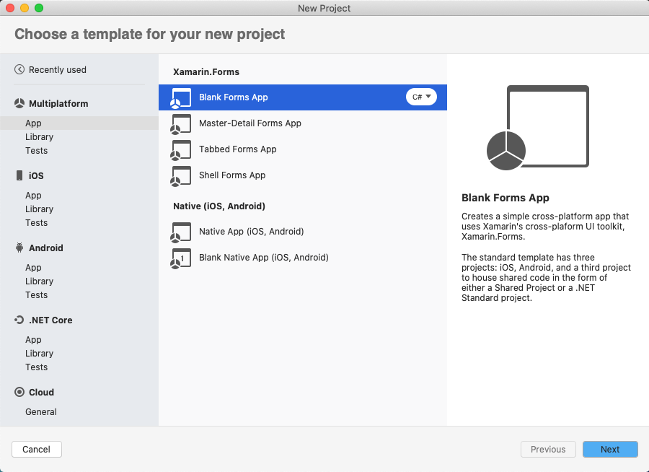
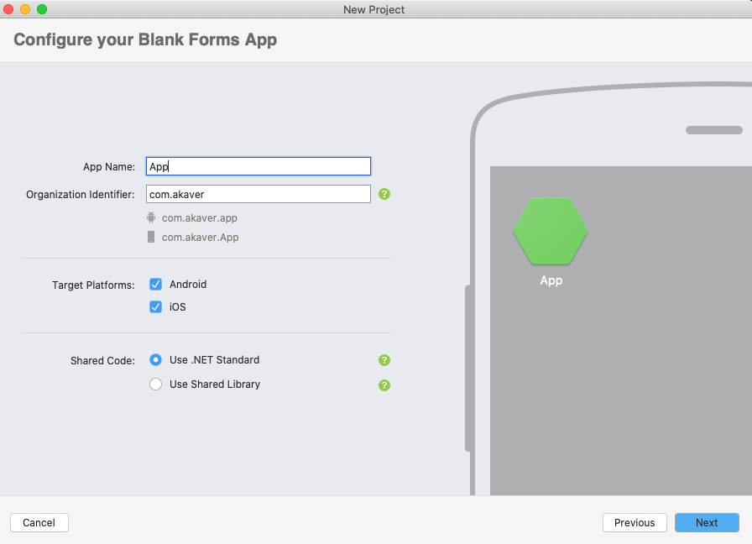
Xamarin – First App
Visual Studio Mac

Slide 10
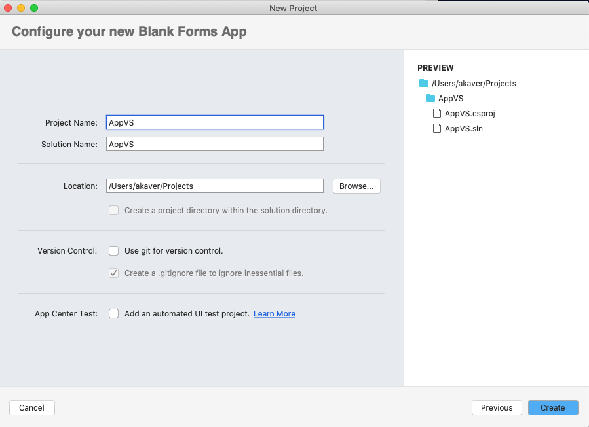
Xamarin – First App
Visual Studio Mac
Does visualize XAML!

Slide 11
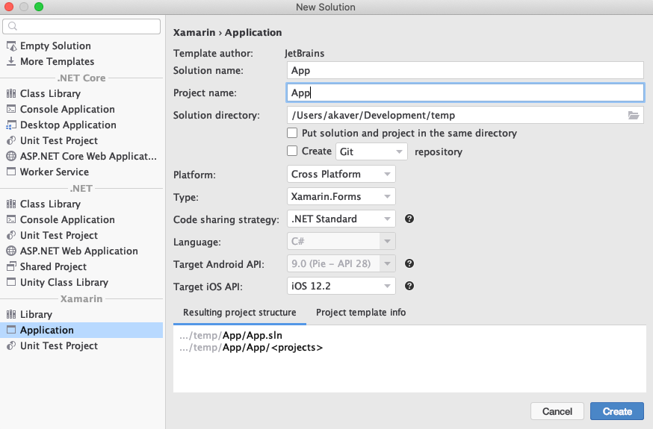
Xamarin – First App
Rider
XAML Preview – only in windows

Slide 12
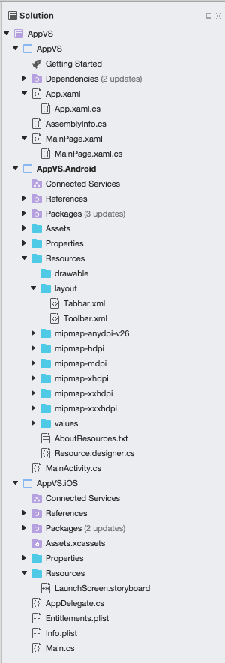
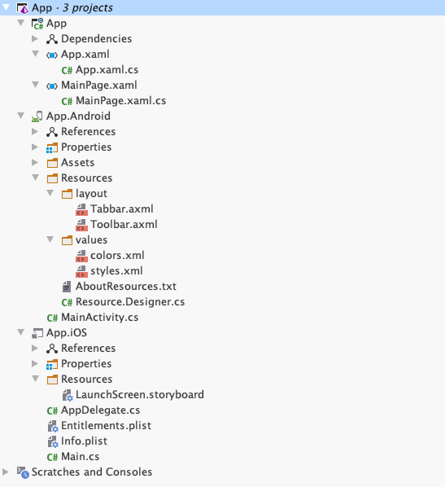
Xamarin – First App
Rider vs VS Mac

Slide 13
Xamarin – First App - Forms
Shared project
All shared UI and BLL logic
Platform specific projects
App.Android – almost native like structure
Layout folder does not contain your UI
MainActivity.cs calls into App.xaml.cs to start up
App.iOS – almost native like structure
AppDelegate.cs initializes Xamarin.Forms and call into shared App project to start up
Info.plist and Entitlements.plist – app information and needed device features

Slide 14
Xamarin – UI
MainPage.xaml
<?xml version="1.0" encoding="utf-8"?> <ContentPage xmlns="http://xamarin.com/schemas/2014/forms" xmlns:x="http://schemas.microsoft.com/winfx/2009/xaml" xmlns:local="clr-namespace:App" x:Class="App.MainPage"> <StackLayout> <!-- Place new controls here --> <Label Text="Welcome to Xamarin.Forms!" HorizontalOptions="Center" VerticalOptions="CenterAndExpand" /> </StackLayout> </ContentPage>

Slide 15
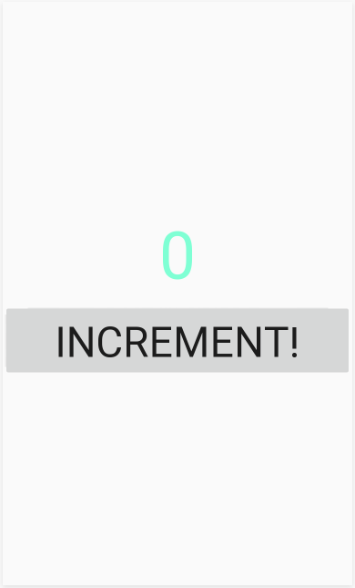
Xamarin - UI
MainPage.xaml
<ContentPage …> <StackLayout VerticalOptions="Center"> <Label Text="0" x:Name="CounterLabel" TextColor="Aquamarine" FontSize="72" FontFamily="ComicSans" HorizontalOptions="Center" /> <Button Text="Increment!" Clicked="IncrementCounterClicked" FontSize="46" /> </StackLayout> </ContentPage>

Slide 16
Xamarin - Code
MainPage.xaml.cs
using Xamarin.Forms; namespace App { public partial class MainPage : ContentPage { public MainPage() { InitializeComponent(); } } }

Slide 17
Xamarin - Code
public partial class MainPage : ContentPage { private int _count = 0; public MainPage() { InitializeComponent(); } private void IncrementCounterClicked(object sender, EventArgs e) { _count++; CounterLabel.Text = _count.ToString(); } }

Slide 18
Xamarin.Forms - css
<?xml version="1.0" encoding="utf-8"?> <ContentPage … x:Class="App.MainPage">
<ContentPage.Resources> <StyleSheet Source="/styles.css" /> </ContentPage.Resources>
<StackLayout VerticalOptions="Center"> <Label Text="0" x:Name="CounterLabel" HorizontalOptions="Center" /> <Button Text="Increment!" Clicked="IncrementCounterClicked" />
</StackLayout>
</ContentPage>
Create styles.css
Use it in XAML
label { font-size: 72; color: aquamarine; } button { font-size: 46; }

Slide 19
Xamarin – Run it!

Slide 20
Xamarin – More realistic app
Single page
Navigation
SQLite
Styling
REST Api usage (Https!)

Slide 21
Xamarin - App
Create empty forms app
Add model for data
Design simple one screen UI
Add Navigation
Entry page
Listing page
Change app entry

Slide 22
Xamarin - BindingContext
Gets or sets object that contains the properties that will be targeted by the bound properties that belong to this BindableObject.
Typically, the runtime performance is better if BindingContext is set after all calls to SetBinding(BindableProperty, BindingBase) have been made.
var label = new Label ();
label.SetBinding (Label.TextProperty, "Name");
label.BindingContext = new {Name = "John Doe", Company = "Xamarin"};
Debug.WriteLine (label.Text); //prints "John Doe"

Slide 23
Xamarin – Data Binding
Data binding is used to simplify how a Xamarin.Forms application displays and interacts with its data.
It establishes a connection between the user interface and the underlying application.
While the BindingContext property of each target object can be individually set, this isn’t necessary. BindingContext is a special property that’s inherited by all its children.

Slide 24
Xamarin - Navigation
Xamarin.Forms provides a number of different page navigation experiences, depending upon the Page type being used.

Slide 25
Xamarin - Navigation
NavigationPage
Starting up
MainPage = new NavigationPage (new Page1Xaml ());
Pushing
await Navigation.PushAsync (new Page2Xaml ());
Poping
await Navigation.PopAsync ();
Pop to start
await Navigation.PopToRootAsync ();

Slide 26
Xamarin - Navigation
Passing data to next page
Via constructor
Via BindingContext
Receive data back - callbacks In page B: public event EventHandler LoginSucceeded; LoginSucceeded(this, EventArgs.Empty); In page A: BPage.LoginSucceeded += HandleLoginSucceeded; private async void HandleLoginSucceeded(object sender, EventArgs e)
Manipulate stack
Navigation.InsertPageBefore (new MainPage (), this);

Slide 27
Xamarin - SQLite
Nuget sqlite-net-pcl 1.6.292
Add attributes to the ID field in model. [PrimaryKey, AutoIncrement]
public class SongInfo { [PrimaryKey, AutoIncrement] public int ID { get; set; } public string Artist { get; set; } public string Title { get; set; } }

Slide 28
Xamarin - SQLite
public class Database { readonly SQLiteAsyncConnection _database; public Database(string dbPath) { _database = new SQLiteAsyncConnection(dbPath); _database.CreateTableAsync<SongInfo>().Wait(); } public Task<List<SongInfo>> GetAllAsync() { return _database.Table<SongInfo>().ToListAsync(); } public Task<SongInfo> GetAsync(int id) { return _database.Table<SongInfo>() .Where(i => i.ID == id) .FirstOrDefaultAsync(); } public Task<int> SaveAsync(SongInfo songInfo) { return songInfo.ID != 0 ? _database.UpdateAsync(songInfo) :_database.InsertAsync(songInfo); } public Task<int> DeleteAsync(SongInfo songInfo) { return _database.DeleteAsync(songInfo); } }
Define Database container (and repo)

Slide 29
Xamarin - SQLite
public partial class App : Application { static Database database; public static Database Database { get { if (database == null) { database = new Database(Path.Combine(
Environment.GetFolderPath(
Environment.SpecialFolder.LocalApplicationData),
”SongInfo.db")); } return database; } }
In App.xaml.cs define lazy singleton

Slide 30
Xamarin – Style XAML views
<Application.Resources> <Thickness x:Key="PageMargin">20</Thickness> <!-- Colors --> <Color x:Key="AppBackgroundColor">WhiteSmoke</Color> <Color x:Key="iOSNavigationBarColor">WhiteSmoke</Color> <Color x:Key="AndroidNavigationBarColor">#2196F3</Color> <Color x:Key="iOSNavigationBarTextColor">Black</Color> <Color x:Key="AndroidNavigationBarTextColor">White</Color> <!-- Implicit styles --> <Style TargetType="{x:Type NavigationPage}"> <Setter Property="BarBackgroundColor" Value="{OnPlatform iOS={StaticResource iOSNavigationBarColor}, Android={StaticResource AndroidNavigationBarColor}}" /> <Setter Property="BarTextColor" Value="{OnPlatform iOS={StaticResource iOSNavigationBarTextColor}, Android={StaticResource AndroidNavigationBarTextColor}}" /> </Style> <Style TargetType="{x:Type ContentPage}" ApplyToDerivedTypes="True"> <Setter Property="BackgroundColor" Value="{StaticResource AppBackgroundColor}" /> </Style> </Application.Resources>
Add styles in App.Xaml

Slide 31
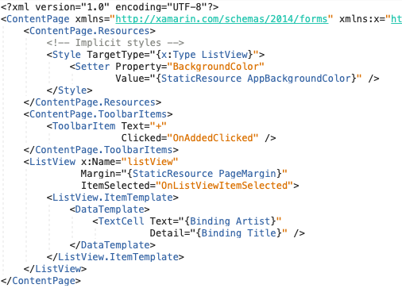
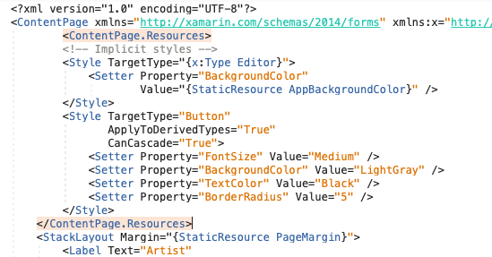
Xamarin - SQLite
Use styles

