Slide 1
Hybrid Mobile Applications - ICD0018
TalTech IT College, Andres Käver, 2019-2020, Fall semester
Web: http://enos.Itcollege.ee/~akaver/HybridMobile
Skype: akaver Email: akaver@itcollege.ee

Slide 2
Xamarin.Forms vs Xamarin.Native
Xamarin-Forms
Application that requires little platform-specific functionality, where code sharing is more important than custom UI
Xamarin.Native (iOS and Android)
Cross-platform apps with intricate designs, specialized user interactions, and platform-specific APIs
iOS – stroryboards, Android – AXML, UWP – XAML

Slide 3
Xamarin – How it works

Slide 4
Xamarin - Android
Xamarin.Android applications compile from C# into Intermediate Language (IL) which is then Just-in-Time (JIT) compiled to a native assembly when the application launches.
Xamarin.Android applications run within the Mono execution environment, side by side with the Android Runtime (ART) virtual machine.
Mono execution environment calls into Android/Java via Managed Callable Wrappers (MCW) and provides Android Callable Wrappers (ACW) to the ART

Slide 5
Xamarin - iOS
Xamarin.iOS applications are fully Ahead-of-Time (AOT) compiled from C# into native ARM assembly code.
Xamarin uses Selectors to expose Objective-C to managed C# and Registrars to expose managed C# code to Objective-C.
Selectors and Registrars collectively are called "bindings" and allow Objective-C and C# to communicate.

Slide 6
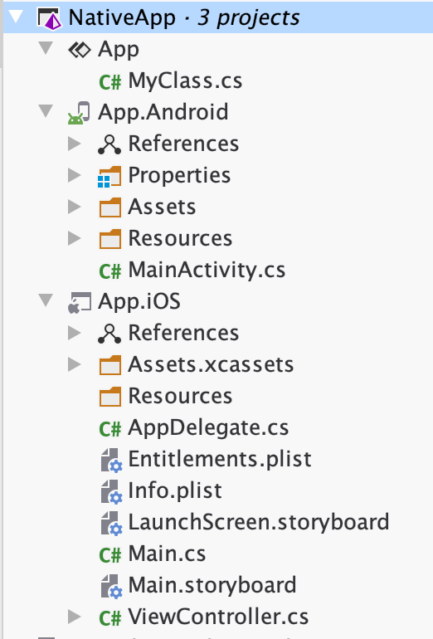
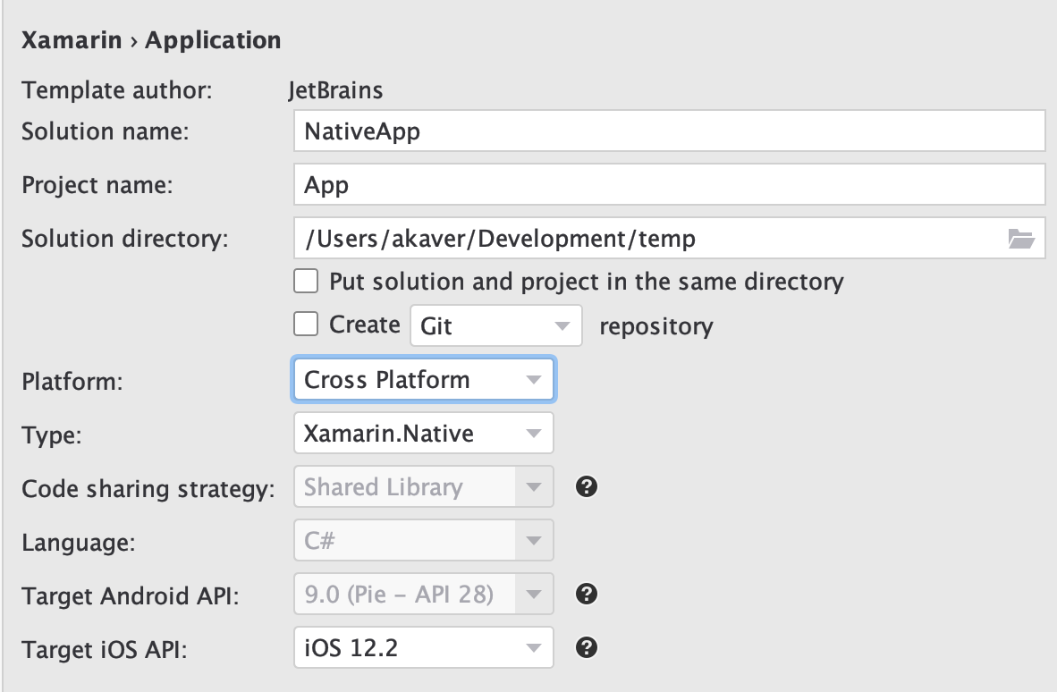
Xamarin.Native
New solution – Native
Target both Android and iOS

Slide 7
Xamarin.Native
Main idea is to share business logic between iOS and Android!
Both UI’s will be designed and wired up separately.
Xamarin.Android
https://docs.microsoft.com/en-us/xamarin/android/
Xamarin.iOS
https://docs.microsoft.com/en-us/xamarin/ios/

Slide 8
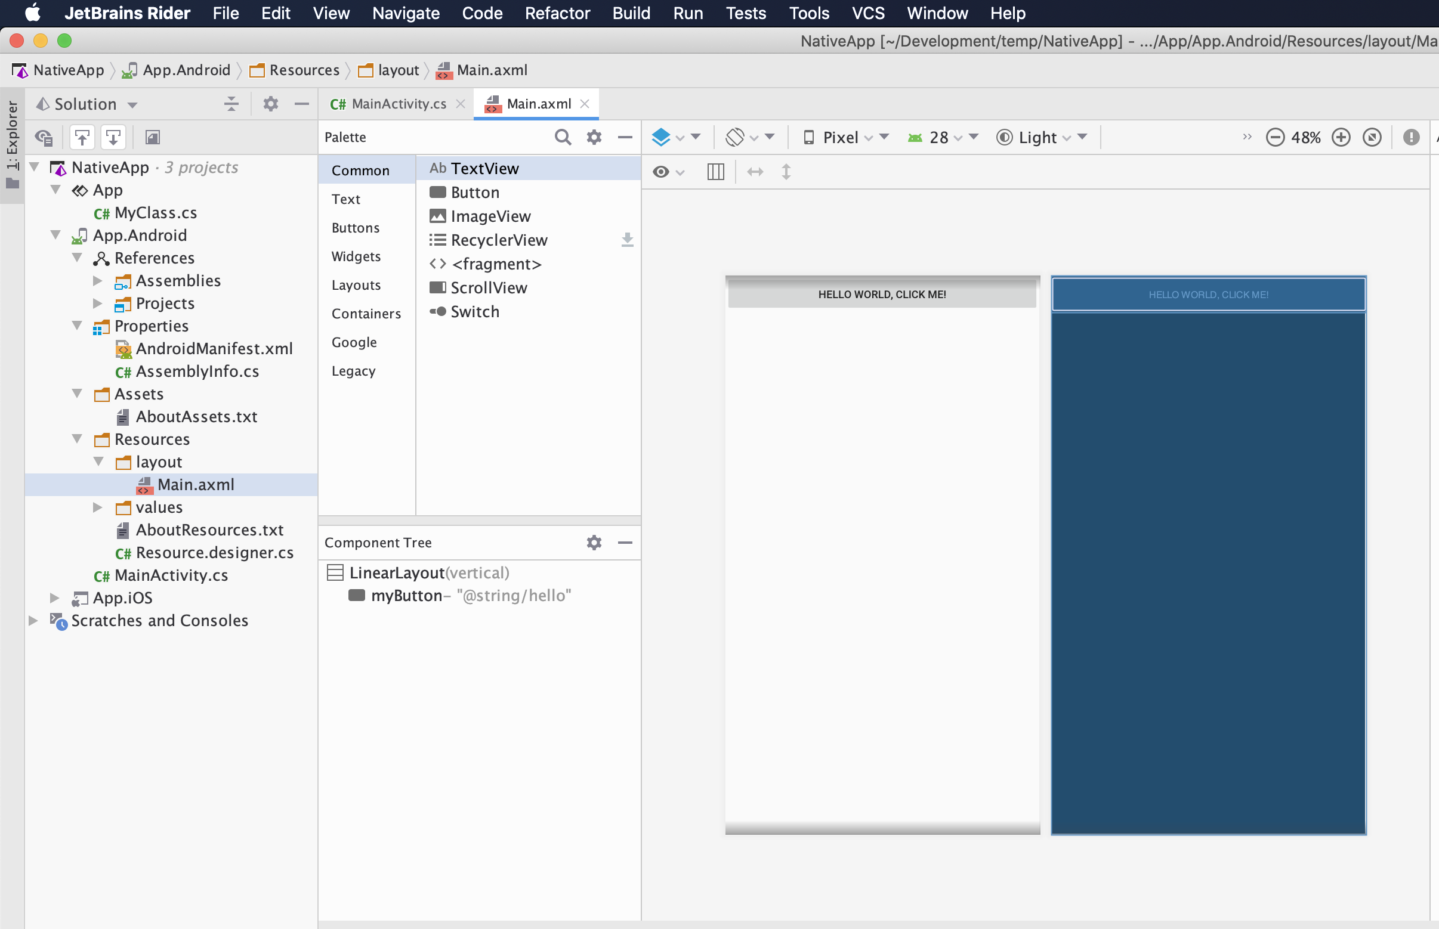
Xamarin.Android
Jetbrains Rider seems to use Adroid Studio preview engine

Slide 9
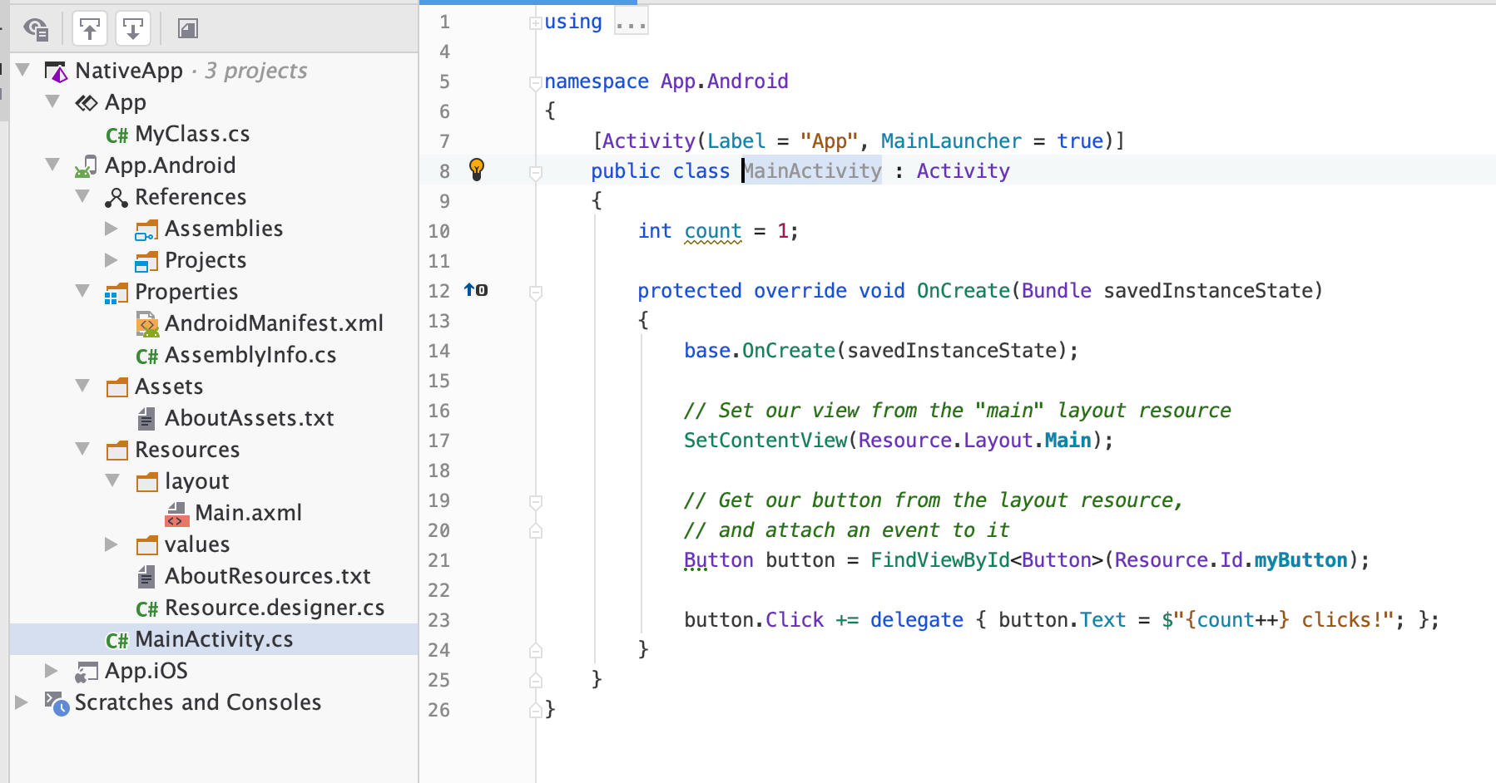
Xamarin.Android

Slide 10
Xamarin.Android
Define views in AXML
<?xml version="1.0" encoding="utf-8"?> <LinearLayout
xmlns:android="http://schemas.android.com/apk/res/android" android:orientation="vertical" android:layout_width="match_parent"
android:layout_height="match_parent">
<Button android:id="@+id/myButton"
android:layout_width="match_parent"
android:layout_height="wrap_content" android:text="@string/hello"/>
</LinearLayout>

Slide 11
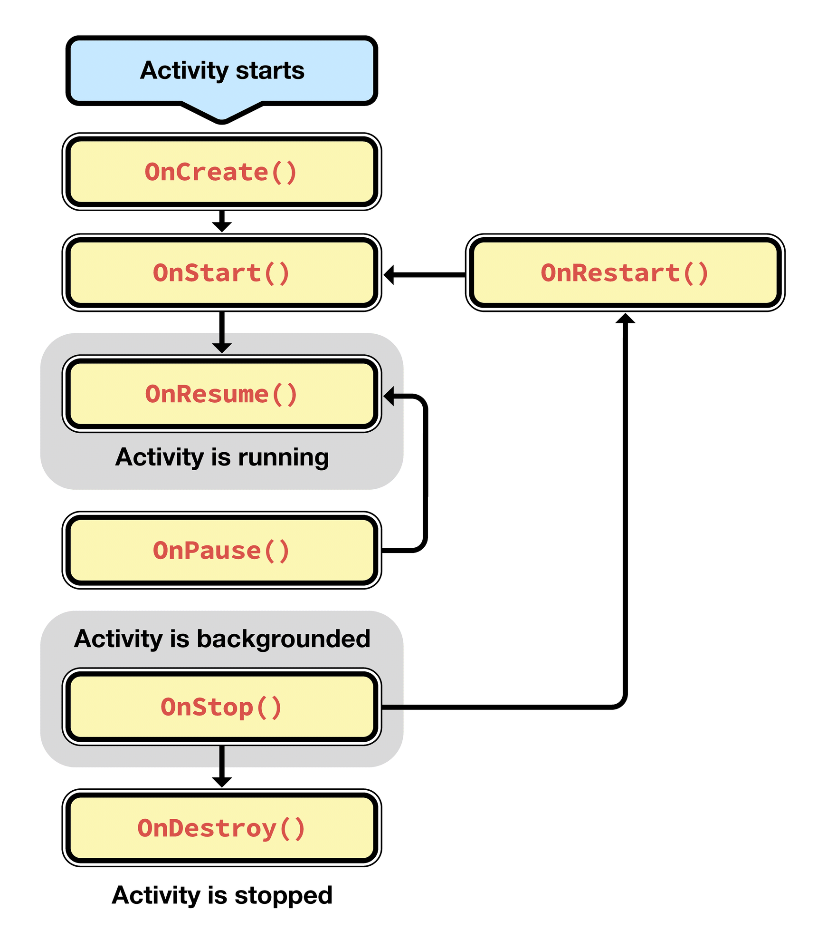
Xamarin.Android
Straightforward Android JDK programming, with mappings and convenience methods in C#
Services, Broadcasts, Notifications, Rotation, Location, etc

Slide 12
Xamarin.iOS
Idea is the same as in the Android
Program almost like in Xcode/Swift, just in C#

Slide 13
Xamarin.iOS
Main.cs is the entry point, then control is given over to AppDelegate.
AppDelegate will unpack main storyboard, initialize main ViewController and start-up first view
Info.plist contains app options (including the first View to start)
<key>UILaunchStoryboardName</key>
<string>LaunchScreen</string>
<key>UIMainStoryboardFile</key>
<string>Main</string>
<key>UIMainStoryboardFile~ipad</key>
<string>Main</string>
Storyboard is edited in Xcode and synced back to Xamarin C# code.

Slide 14
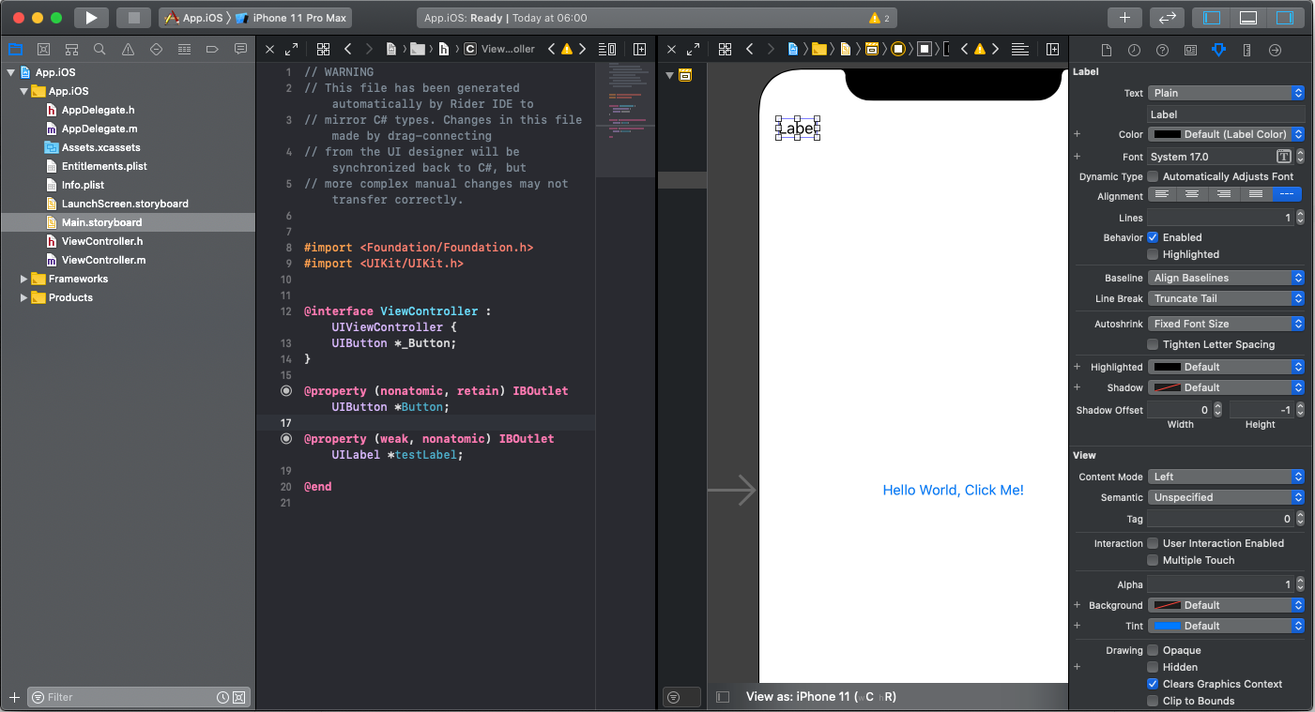
Xamarin.iOS
Edit UI in Xcode
Create/connect outlets
Code is synced back to C# ViewController.Designer.cs

Slide 15
Xamarin.iOS
ViewController and ViewController.Designer partial
using System; using UIKit; namespace App.iOS { public partial class ViewController : UIViewController { int count = 1; public ViewController(IntPtr handle) : base(handle) { } public override void ViewDidLoad() { base.ViewDidLoad(); Button.AccessibilityIdentifier = "myButton"; Button.TouchUpInside += delegate { var title = string.Format("{0} clicks!", count++); Button.SetTitle(title, UIControlState.Normal); }; } public override void DidReceiveMemoryWarning() { base.DidReceiveMemoryWarning(); } } }
using Foundation; using System.CodeDom.Compiler; namespace App.iOS { [Register ("ViewController")] partial class ViewController { [Outlet] UIKit.UIButton Button { get; set; } [Outlet] UIKit.UILabel testLabel { get; set; } void ReleaseDesignerOutlets () { if (Button != null) { Button.Dispose (); Button = null; } if (testLabel != null) { testLabel.Dispose (); testLabel = null; } } } }

Slide 16
Xamarin.Native - Essentials
Cross platform APIs for mobile apps
Android, iOS, and UWP offer unique operating system and platform APIs that developers have access to all in C# leveraging Xamarin.
Xamarin.Essentials provides a single cross-platform API that works with any Xamarin application
Can be accessed from shared code no matter how the user interface is created.
https://docs.microsoft.com/en-us/xamarin/essentials/

Slide 17
Xamarin.Essentials
Accelerometer – Acceleration data in three dimensional space.
App Information – Find out information about the application.
Barometer – Monitor the barometer for pressure changes.
Battery – Easily detect battery level, source, and state.
Clipboard – Quickly and easily set or read text on the clipboard.
Color Converters – Helper methods for System.Drawing.Color.
Compass – Monitor compass for changes.
Connectivity – Check connectivity state and detect changes.
Detect Shake – Detect a shake movement of the device.
Device Display Information –Screen metrics and orientation.
Device Information – Find out about the device with ease.
Email – Easily send email messages.
File System Helpers – Easily save files to app data.
Flashlight – A simple way to turn the flashlight on/off.
Geocoding – Geocode and reverse geocode.
Geolocation – Retrieve the device's GPS location.
Gyroscope – Track rotation around the device's three primary axes.
Launcher – Enables an application to open a URI by the system.
Magnetometer – Detect device's orientation relative to Earth's magnetic field.
MainThread – Run code on the application's main thread.
Maps – Open the maps application to a specific location.
Open Browser – Quickly and easily open a browser to a specific website.
Orientation Sensor –Orientation of the device in three dimensional space.
Phone Dialer – Open the phone dialer.
Platform Extensions – Helper methods for converting Rect, Size, and Point.
Preferences – Quickly and easily add persistent preferences.
Secure Storage – Securely store data.
Share – Send text and website uris to other apps.
SMS – Create an SMS message for sending.
Text-to-Speech – Vocalize text on the device.
Unit Converters – Helper methods to convert units.
Version Tracking – Track the applications version and build numbers.
Vibrate – Make the device vibrate.

Slide 18
Xamarin.Essentials
Delivered as Nuget package
Xamarin.Essentials
using Xamarin.Essentials;
On Android some setup in code is needed in every Activity
protected override void OnCreate(Bundle savedInstanceState) {
//...
base.OnCreate(savedInstanceState);
Xamarin.Essentials.Platform.Init(this, savedInstanceState);
//...
public override void OnRequestPermissionsResult(int requestCode, string[] permissions, [GeneratedEnum] Android.Content.PM.Permission[] grantResults) {
Xamarin.Essentials.Platform.OnRequestPermissionsResult(requestCode, permissions, grantResults);
base.OnRequestPermissionsResult(requestCode, permissions, grantResults);
}

Slide 19
Xamarin.Essentials
File System Helpers
var cacheDir = FileSystem.CacheDirectory;
var mainDir = FileSystem.AppDataDirectory;
Preferences
Preferences.Set("my_key", "my_value");
var myValue = Preferences.Get("my_key", "default_value");
Preferences.Remove("my_key");
Preferences.Clear();

Slide 20
Xamarin.Essentials - GPS
Android manifest <uses-permission android:name="android.permission.ACCESS_COARSE_LOCATION" /> <uses-permission android:name="android.permission.ACCESS_FINE_LOCATION" /> <uses-feature android:name="android.hardware.location" android:required="false" /> <uses-feature android:name="android.hardware.location.gps" android:required="false" /> <uses-feature android:name="android.hardware.location.network" android:required="false" />
iOS Info.plist <key>NSLocationWhenInUseUsageDescription</key> <string>Fill in a reason why your app needs access to location.</string>

Slide 21
Xamarin.Essentials - GPS
GetLastKnownLocationAsync
try {
var location = await Geolocation.GetLastKnownLocationAsync();
if (location != null) {
Console.WriteLine(
$"Latitude: {location.Latitude}, Longitude: {location.Longitude}, Altitude: {location.Altitude}");
}
} catch (FeatureNotSupportedException fnsEx) {
// Handle not supported on device exception }
catch (FeatureNotEnabledException fneEx) {
// Handle not enabled on device exception }
catch (PermissionException pEx) {
// Handle permission exception }
catch (Exception ex) {
// Unable to get location
}

Slide 22
Xamarin.Essentials - GPS
GetLocationAsync
GeolocationAccuracy Lowest, Low, Medium, High, Best
try {
var request = new GeolocationRequest(GeolocationAccuracy.Medium);
var location = await Geolocation.GetLocationAsync(request);
if (location != null) {
Console.WriteLine($"Latitude: {location.Latitude}, Longitude: {location.Longitude}, Altitude: {location.Altitude}");
}
} catch…

