Slide 1
Hybrid Mobile Applications - ICD0018
TalTech IT College, Andres Käver, 2019-2020, Fall semester
Web: http://enos.Itcollege.ee/~akaver/HybridMobile
Skype: akaver Email: akaver@itcollege.ee

Slide 2
Progressive Web Apps
Regular websites, enhanced to work in mobile phones.
Responsive, Connectivity independent, App-like-interactions, Fresh, Safe, Discoverable, Re-engageable, Installable, Linkable
Uses modern web technologies – https, manifest, service workers, manifest, html5
Manifest – describes to the system how to make Native-like app out of website
Service Worker is a script that works on browser background without user interaction independently. Also, It resembles a proxy that works on the user side. With this script, you can track network traffic of the page, manage push notifications and develop “offline first” web applications with Cache API.
Everything is bleeding edge, iOS has support since March 2018. (iOS 11.3)

Slide 3
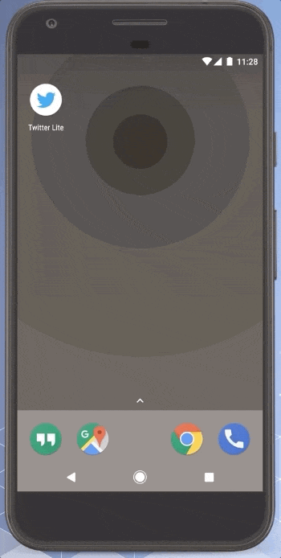
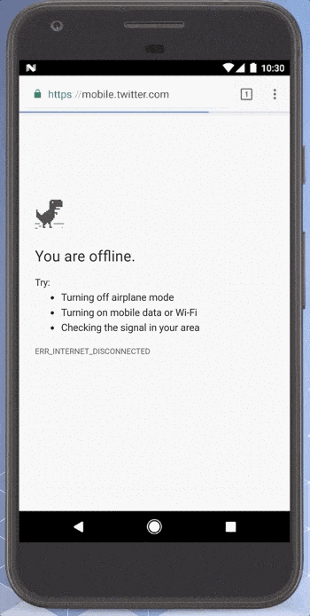
PWA

Slide 4
PWA - Manifest
File should be named “manifest.webmanifest”
{
"name": "Hacker Web",
"short_name": "HackerWeb",
"start_url": ”/",
"display": "standalone",
"background_color": "#fff",
"description": "A simple app.",
"icons": [{
"src": "images/touch/homescreen48.png",
"sizes": "48x48",
"type": "image/png"
},……more icons….]
}

Slide 5
PWA - Manifest
Display: browser, minimal-ui, standalone, fullscreen
Fullscreen All of the available display area is used and no user agent chrome is shown.
Standalone The application will look and feel like a standalone application. This can include the application having a different window, its own icon in the application launcher, etc. In this mode, the user agent will exclude UI elements for controlling navigation, but can include other UI elements such as a status bar.
Minimal-ui The application will look and feel like a standalone application, but will have a minimal set of UI elements for controlling navigation. The elements will vary by browser.
Browser The application opens in a conventional browser tab or new window, depending on the browser and platform. This is the default.

Slide 6
PWA - Manifest
Icons
Specifies an array of objects representing image files that can serve as application icons for different contexts. For example, they can be used to represent the web application amongst a list of other applications, or to integrate the web application with an OS's task switcher and/or system preferences. Splash screen on launch.

Slide 7
PWA - Manifest
Orientation
any
natural
landscape
landscape-primary
landscape-secondary
portrait
portrait-primary
portrait-secondary

Slide 8
PWA - Manifest
background_color, theme_color
The background_color member defines a placeholder background color for the application page to display before its stylesheet is loaded. This value is used by the user agent to draw the background color of a shortcut when the manifest is available before the stylesheet has loaded.
The theme_color member is a string that defines the default theme color for the application. This sometimes affects how the OS displays the site (e.g., on Android's task switcher, the theme color surrounds the site).

Slide 9
PWA - Manifest
Some parts are still experimental, iOS need some stuff in html headers also.
<link rel="icon" sizes="192x192" href="/img/icon-192x192.png">
<link rel="apple-touch-icon" href="/img/icon-192x192.png">
<link href="/manifest.webmanifest" rel="manifest" />

Slide 10
PWA – Service Workers
A service worker is a script that your browser runs in the background, separate from a web page (no DOM access, no user interaction)
Background sync,
Caching,
Push notifications,
Offline experience (network proxy)
Terminated automatically – if you need state, then store it in DB
Extensive use of native promises!

Slide 11
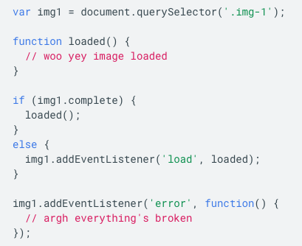
PWA – JS Promise
Classical, events based way

Slide 12
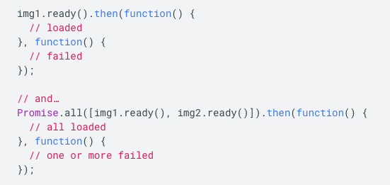
PWA – JS Promise
Promise way

Slide 13
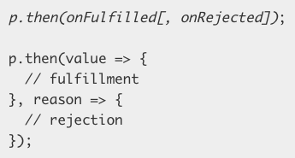
PWA – JS Promise
A promise can be:
fulfilled - The action relating to the promise succeeded
rejected - The action relating to the promise failed
pending - Hasn't fulfilled or rejected yet
settled - Has fulfilled or rejected

Slide 14
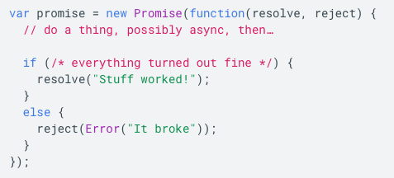
PWA – JS Promises
Create your own
In practice, it is often desirable to catch rejected promises rather than use then's two case syntax

Slide 15
PWA – JS Promise
A promise can only succeed or fail once. It cannot succeed or fail twice, neither can it switch from success to failure or vice versa.
If a promise has succeeded or failed and you later add a success/failure callback, the correct callback will be called, even though the event took place earlier.

Slide 16
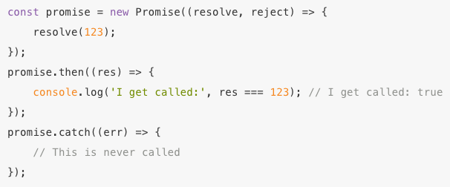
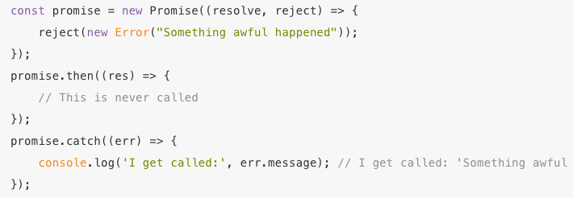
PWA – JS Promise
The promise fate can be subscribed to using .then (if resolved) or .catch (if rejected).
Quickly creating an already resolved promise: Promise.resolve(result)
Quickly creating an already rejected promise: Promise.reject(error)

Slide 17
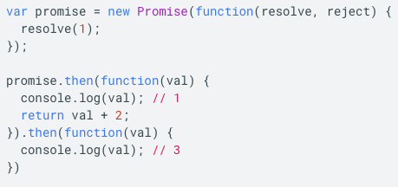
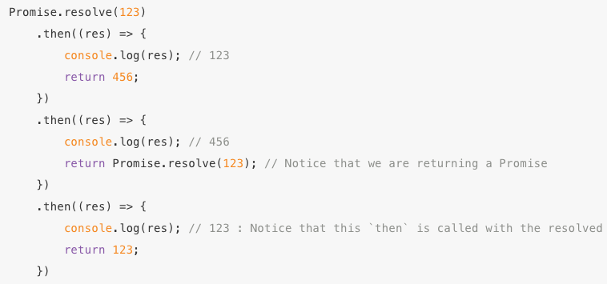
PWA – JS Promise
Chaining - Queuing asynchronous actions
When you return something from a then() callback, it's a bit magic.
If you return a value, the next then() is called with that value.
If you return something promise-like, the next then() waits on it, and is only called when that promise settles (succeeds/fails)

Slide 18
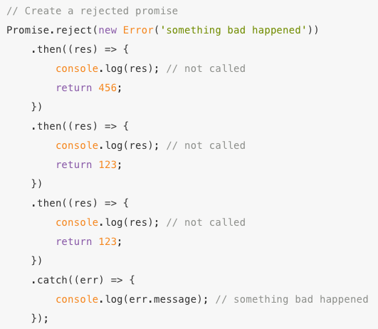
PWA – JS Promise
Aggregate the error handling of any preceding portion of the chain with a single catch
The catch actually returns a new promise (effectively creating a new promise chain)
Any synchronous errors thrown in a then (or catch) result in the returned promise to fail
Only the relevant (nearest tailing) catch is called for a given error (as the catch starts a new promise chain)

Slide 19
PWA – JS Promise
Parallel control flow
Promise provides a static Promise.all function that you can use to wait for N number of promises to complete.
Promise provides a static Promise.race function that can be used to wait for the first of N promises to complete

Slide 20
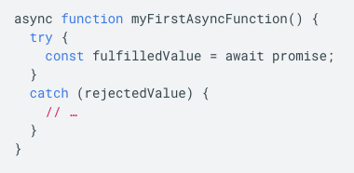
PWA – JS Async
Async functions - making promises more friendly
They allow you to write promise-based code as if it were synchronous, but without blocking the main thread. They make your asynchronous code less "clever" and more readable.
Use the async keyword before a function definition, then use await within the function. When you await a promise, the function is paused in a non-blocking way until the promise settles. If the promise fulfills, you get the value back. If the promise rejects, the rejected value is thrown.

Slide 21
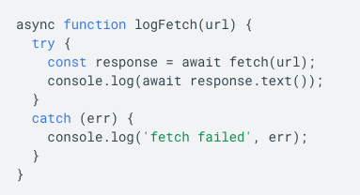
PWA – JS Async

Slide 22
Progressive Web Apps
Service Worker is a script that works on browser background without user interaction independently.
Resembles a proxy that works on the user side.
With this script, you can track network traffic of the page.
And manage push notifications
Develop “offline first” web applications with Cache API.
Background sync!

Slide 23
PWA - architecture
50-mile overview

Slide 24
PWA - Lifecycle
Typical lifecycle on first installation

Slide 25
PWA - Lifecycle

Slide 26
PWA – Lifecycle - register
A service worker has a lifecycle that is completely separate from web page.
Registering a service worker will cause the browser to start the service worker install step in the background – typically done in /index.html (head or end of body).
<script>
if ('serviceWorker' in navigator) {
navigator.serviceWorker.register('/sw.js’)
.then(function () { console.log("Service worker registered"); });
}
</script>

Slide 27
PWA - Lifecycle - install
First event to run, when app gets installed. Prefetch resources needed for app launch.
var CACHE = 'cache_0.0.1';
self.addEventListener('install', function (event) {
var urlsToPrefetch = [
'./static/pre_fetched.txt', './static/pre_fetched.html’,
];
console.log('Install. Pre-fetch:', urlsToPrefetch);
event.waitUntil(
caches.open(CACHE).then(function (cache) {
cache.addAll(urlsToPrefetch.map(function (urlToPrefetch) {
return new Request(urlToPrefetch, { mode: 'no-cors' });
})).then(function () {
console.log('All done.’);
});
}).catch(function (error) {
console.error('Pre-fetching failed:', error);
})
);
});

Slide 28
PWA – Lifecycle - Activate
This is a generally used to do stuff that would have broken the previous version while it was still running, for example getting rid of old caches.
This is also useful for removing data that is no longer needed to avoid filling up too much disk space — each browser has a hard limit on the amount of cache storage that a given service worker can use.

Slide 29
PWA - Lifecycle - Activate
Delete everything from cache that is not current
self.addEventListener('activate', (event) => {
event.waitUntil(
caches.keys().then((keyList) => {
return Promise.all([CACHE].map((key) => {
if (cacheKeeplist.indexOf(key) === -1) {
return caches.delete(key);
}
}));
})
);
});

Slide 30
PWA – Lifecycle - Fetch
Proxy all the app network requests. Decide what to do on case of hit, miss, offline, etc.
self.addEventListener('fetch', (event) => {
event.respondWith(
caches.match(event.request).then((resp) => {
return resp || fetch(event.request).then((response) => {
return caches.open(CACHE).then((cache) => {
cache.put(event.request, response.clone());
return response;
});
});
})
);
});

Slide 31
PWA - Lifecycle
Sync
Push

Slide 32
PWA - Design

Slide 33
PWA -

Slide 34
PWA -

Slide 35
PWA - Lifecycle
Sync
Push

Slide 36
PWA - Design

Slide 37
PWA -

Slide 38
PWA
The end!

Slide 39
PWA -

