Slide 1
Hybrid Mobile Applications - ICD0018
TalTech IT College, Andres Käver, 2019-2020, Fall semester
Web: http://enos.Itcollege.ee/~akaver/HybridMobile
Skype: akaver Email: akaver@itcollege.ee

Slide 2
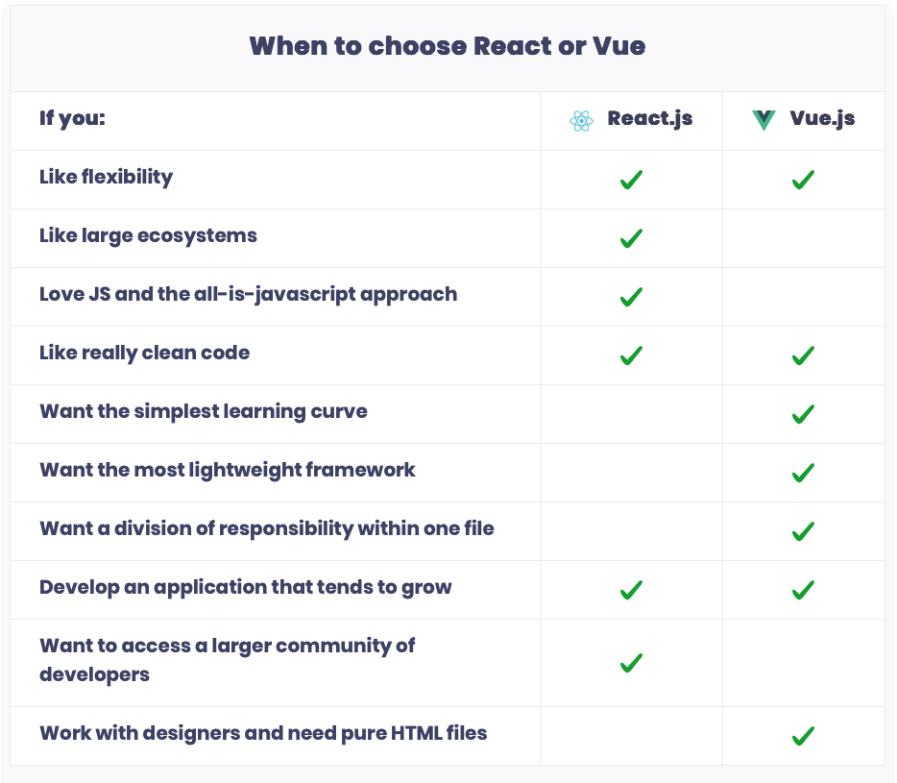
PWA - Vue
Why Vue?
I figured, what if I could just extract the part that I really liked about React and build something really lightweight without all the extra concepts involved? I was also curious as to how its internal implementation worked. I started this experiment just trying to replicate this minimal feature set, like declarative data binding. That was basically how Vue started. - Evan You
Like React.js – but simplified

Slide 3
PWA – Vue
Install VUE cli (cli.vuejs.org) >npm install -g @vue/cli
Create new project with >vue create <projectname>
Select typescript, babel, vuex, router, pwa,….
Change to project directory and lauch VS Code
Install Vue plugins for VS Code (Vetur)
Launch dev website > npm serve

Slide 4
PWA - Vue
<template>
<div class="hello">
Hello, world!
</div>
</template>
<script lang="ts">
import { Component, Vue } from 'vue-property-decorator'
@Component
export default class HelloWorld extends Vue {
}
</script>
<style scoped>
.hello {
color: #F00;
}
</style>
Everything is component once again (almost)
3 main parts Template, Script, Style
Template can contain only single root level element!
We will use TypeScript for everything. And property decorators.
https://github.com/kaorun343/vue-property-decorator

Slide 5
PWA – Vue app entry
Main.ts
import Vue from 'vue'
import App from './App.vue'
import './registerServiceWorker'
import router from './router'
import store from './store'
// diables warning ("You are running Vue in development mode.")
Vue.config.productionTip = false
new Vue({
router,
store,
render: h => h(App)
}).$mount('#app')

Slide 6
PWA - Vue
App.vue component
<template>
<div id="app">
<div id="nav">
<router-link to="/">Home</router-link> |
<router-link to="/about">About</router-link>
</div>
<router-view/>
</div>
</template>
<style>
</style>

Slide 7
PWA - Vue router
Main navigation between different sections in app are provided Router component - src/router/index.ts
Selected component is renderd to <router-view/>

Slide 8
PWA – Vue router
import Vue from 'vue'
import VueRouter from 'vue-router'
import Home from '../views/Home.vue'
Vue.use(VueRouter)
const routes = [
{
path: '/',
name: 'home',
component: Home
},
{
path: '/about',
name: 'about',
// route level code-splitting
component: () => import(/* webpackChunkName: "about" */ '../views/About.vue')
},
]
const router = new VueRouter({
mode: 'history',
base: process.env.BASE_URL,
routes
})
export default router
Src/router/index.ts

Slide 9
PWA – Vue child components
Using child components
Don’t forget to register imported components!
<template>
<div class="home">
<HelloWorld msg="Welcome to Your Vue.js App" />
</div>
</template>
<script lang="ts">
import { Component, Prop, Vue } from "vue-property-decorator";
// @ is an alias to /src
import HelloWorld from "../components/HelloWorld.vue";
@Component({
components: {
HelloWorld
}
})
export default class Home extends Vue {}
</script>

Slide 10
PWA - Vue props
Sending data down to sub-component
Receiving data in subcomponent
<template>
<div class="home">
<HelloWorld msg="Welcome to Your Vue.js App" />
export default class HelloWorld extends Vue {
@Prop()
private msg!: string;

Slide 11
PWA – Vue class properties and methods
Declare your properties as regular class properties.
Declare methods as class methods. Don’t use => syntax when you need to reference ”this”. Arrow functions are bound to the parent context, and therefore this will not be the Vue instance (it will be Window instance)
@Component
export default class HelloWorld extends Vue {
@Prop()
private msg!: string;
private alertMsg: string = "Alert ";
onClick(): void {
window.alert(this.alertMsg + this.msg);
}
}

Slide 12
PWA – Vue directives in templates
Directives are using v- prefix. v-for, v-bind, v-on, v-if, etc.
Some directives take an argument, using colon v-on:click=“methodName”
Shorthands v-bind - <a :href="url"> ... </a> v-on - <a @click="doSomething"> ... </a>

Slide 13
PWA - Vue bindings in template
Text interpolation with {{variableName}} <span>Message: {{ msg }}</span>
One-time interpolation with v-once <span v-once>This will never change: {{ msg }}</span>
Raw-html binding with v-html=“variableName” <p>Using v-html directive: <span v-html="rawHtml"></span></p>
Binding in html attributes with v-bind=“variableName” <div v-bind:id="dynamicId"></div>
Vue supports JavaScript expressions inside all data bindings <div v-bind:id=”`list-` + id"></div>

Slide 14
PWA - Vue bindings
Conditional rendering – v-if, v-else, v-else-if
Hidding element – v-show only toggles the display CSS property of the element.
<div v-if="type === 'A’”>
A
</div>
<div v-else-if="type === 'B’”>
B
</div>
<div v-else-if="type === 'C’”>
C
</div>
<div v-else>
Not A/B/C
</div>

Slide 15
PWA – Vue list rendering
v-for directive to render a list of items based on an array. The v-for directive requires a special syntax in the form of item in items, where items is the source data array and item is an alias for the array element being iterated on. Use (item, index) to get counter also.
Also use v-for to iterate through the properties of an object.
v-for can also take an integer. In this case it will repeat the template that many times.
<ul id="example-2">
<li v-for="(item, index) in items">
{{ parentMessage }} - {{ index }} - {{ item.message }}
</li>
</ul>

Slide 16
PWA – Vue event handling
Use the v-on directive to listen to DOM events and run some JavaScript when they’re triggered. <button v-on:click="counter += 1">Add 1</button> <button v-on:click="greet">Greet</button> <button v-on:click="say('what')">Say what</button>
Sometimes we also need to access the original DOM event in an inline statement handler. You can pass it into a method using the special $event variable <button v-on:click="warn(Denied!', $event)">Submit</button>

Slide 17
PWA – Vue form bindings
Use the v-model directive to create two-way data bindings on form input, textarea, and select elements. It automatically picks the correct way to update the element based on the input type. <input v-model="message" placeholder="edit me">

Slide 18
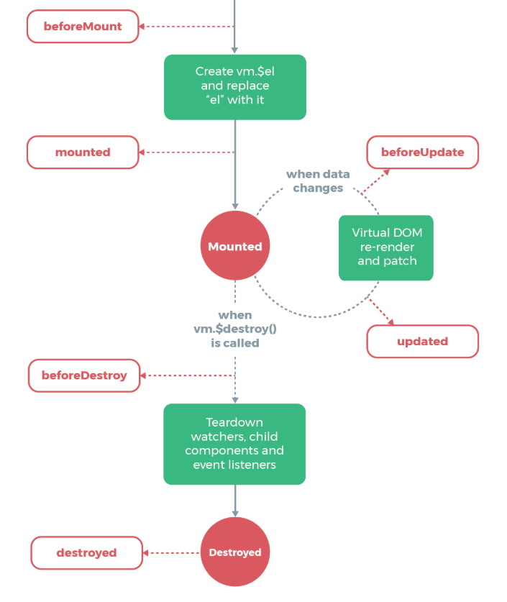
PWA – Vue lifecycle

Slide 19
PWA – Vue lifecycle
// ============ Lifecycle methods ==========
beforeCreate():void {
console.log('beforeCreate');
}
created():void {
console.log('created');
}
beforeMount():void {
console.log('beforeMount');
}
mounted():void {
console.log('mounted');
}
beforeUpdate():void {
console.log('beforeUpdate');
}
updated():void {
console.log('updated');
}
beforeDestroy():void {
console.log('beforeDestroy');
}
destroyed():void {
console.log('destroyed');
}
Lifecycle methods, add as regular class component methods

Slide 20
Vue – simple state management
Simple approach
Props to send data down
Events to send data up
In child component this.$emit('update:title', newTitle)
In parent component <text-document v-bind:title="doc.title" v-on:update:title="doc.title = $event"></text-document>

Slide 21
PWA - Vue state management - VUEX
State management pattern + library
It serves as a centralized store for all the components in an application, with rules ensuring that the state can only be mutated in a predictable fashion.
Flux, Redux, etc

Slide 22
PWA – Vue state management VUEX
State: initial state object
Getters: computed properties, cached. Will receive state and other getters as params
Mutations: sync state modifiers. State as first param. Payload as second param.
Actions: commit mutations, can contain arbitrary async operations. Context as first parameter (store like object).
Modules – when store grows too big.
Strict: monitor direct state access.
export default new Vuex.Store({
strict: process.env.NODE_ENV !== 'production',
state: {
count: 0
},
getters: {
message: (state, getters)
=> 'Count is ' + state.count.toString()
},
mutations: {
increment: state => state.count++,
decrement: state => state.count--
},
actions: {
increment: (context)
=> context.commit('increment')
},
modules: {
}
})

Slide 23
PWA – VUEX using in components
Computed properties via get
Store.commit – call actions
Store.dispatch – call mutations
import store from "../store";
@Component
export default class HelloWorld extends Vue {
get count(): number {
return store.state.count;
}
onClick(): void {
store.commit('increment');
store.dispatch('increment');
}

Slide 24
VUE – reactive problems
Vue has no possibility to monitor some data changes
When adding new properties to an Object, you should either: Use Vue.set(obj, 'newProp', 123), or Replace that Object with a fresh one. For example, using the object spread syntax we can write it like this: state.obj = { ...state.obj, newProp: 123 }
Array change detection: push(), pop(), shift(), unshift(), splice(), sort(), reverse() Bad: vm.items[indexOfItem] = newValue Use instead: Vue.set(vm.items, indexOfItem, newValue) vm.items.splice(indexOfItem, 1, newValue)

