Slide 1
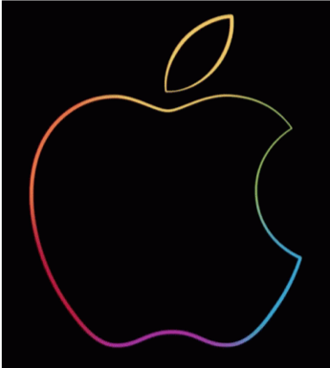
Native Mobile Applications - ICD0017
TalTech IT College, Andres Käver, 2018-2019, Spring semester
Web: http://enos.Itcollege.ee/~akaver/MobileApps
Skype: akaver Email: akaver@itcollege.ee

Slide 2
iOS - MVC
CONTROLLER
MODEL
VIEW
Program is divided into 3 logical units

Slide 3
iOS - MVC
CONTROLLER
What your application is
MODEL
VIEW
Program is divided into 3 logical units

Slide 4
iOS - MVC
How your Model is presented to the user (UI logic)
CONTROLLER
What your application is
MODEL
VIEW
Program is divided into 3 logical units

Slide 5
iOS - MVC
How your Model is presented to the user (UI logic)
CONTROLLER
What your application is
UI Components and layout
MODEL
VIEW
Program is divided into 3 logical units

Slide 6
iOS - MVC
CONTROLLER
MODEL
VIEW
Communication management is the key

Slide 7
iOS - MVC
CONTROLLER
MODEL
VIEW
Controlles can communicate with their Model

Slide 8
iOS - MVC
CONTROLLER
outlet
MODEL
VIEW
Controlles can communicate with their Model
and View

Slide 9
iOS - MVC
CONTROLLER
outlet
MODEL
VIEW
Model and View should never speak to each other!!!!

Slide 10
iOS - MVC
CONTROLLER
outlet
MODEL
VIEW
Can View communicate vith Controller?

Slide 11
iOS - MVC
target
CONTROLLER
outlet
action
MODEL
VIEW
Communication is blind and structured. Controller can specify a target on itself and hand out an action to the View. View sends the action when events happen in UI

Slide 12
iOS - MVC
target
CONTROLLER
outlet
action
will
should did
MODEL
VIEW
Sometimes View needs to synchronize with the Controller.
Will, should, did, …. (willScroll, shouldScroll, didScroll)

Slide 13
iOS - MVC
will
should did
target
CONTROLLER
outlet
delegate
action
MODEL
VIEW
Controller sets itself as the View’s delegate.
Delegate is set via protocol.

Slide 14
iOS - MVC
will
should did
target
CONTROLLER
outlet
delegate
action
MODEL
VIEW
data at count
Views do not own the data they display.
If needed, they have a protocol to acquire it.

Slide 15
iOS - MVC
will
should did
target
CONTROLLER
data at count
outlet
data source
action
delegate
MODEL
VIEW
Controllers are almost always that data source (not Model).

Slide 16
iOS - MVC
will
should did
target
CONTROLLER
data at count
outlet
data source
action
delegate
MODEL
VIEW
Controllers interpret/format Model information for View.

Slide 17
iOS - MVC
will
should did
target
CONTROLLER
data at count
outlet
data source
action
delegate
MODEL
VIEW
Can the Model talk directly to the Controller?
No, they are UI independent. But sometimes Model (network) needs to inform, that data has changed.

Slide 18
iOS - MVC
will
should did
target
CONTROLLER
data at count
Notification & KVO
outlet
data source
action
delegate
MODEL
VIEW
Broadcast (messaging) mechanism is used for this. Interested parties can subscribe to these messages (Controllers and Models).

