Slide 1
Native Mobile Applications - ICD0017
TalTech IT College, Andres Käver, 2018-2019, Spring semester
Web: http://enos.Itcollege.ee/~akaver/MobileApps
Skype: akaver Email: akaver@itcollege.ee

Slide 2
iOS - MVC
will
should did
target
CONTROLLER
data at count
Notification & KVO
outlet
data source
action
delegate
MODEL
VIEW
will
should did
will
should did
target
CONTROLLER
target
CONTROLLER
data at count
data at count
Notification & KVO
outlet
outlet
Notification & KVO
data source
action
data source
action
delegate
delegate
MODEL
VIEW
MODEL
VIEW

Slide 3
iOS – Multi MVC
Apps usually consists of multiple views
Multiple MVC-s must be combined
One MVC acts as an VIEW for some other MVC
iOS provides some controllers for it
UITabBarController
UISplitViewController
UINavigationController
You can write your own (in theory…)

Slide 4
iOS - UITabBarController
Every view is separate MVC
UITabBarController gets its display attributes from child viewControllers var tabBarItem: UITabBarItem!
5 tabs in max!

Slide 5
iOS - UISplitViewController
Two MVC-s side by side (in landscape)
Master
Detail
Master is hidden in portrait
Master will slide out from left side

Slide 6
iOS - UINavigationController
Like a stack of cards
New MVC is pushed on top
Going back destroys the topmost MVC
Title and backbutton info are grabbed from navigationItem from stacked MVC-s (previous and current)
rootViewController holds the initial View
toolbarItems on the bottom

Slide 7
iOS – accessing sub-MVCs
viewController property var viewControllers: [UIViewController]? {get set}
tabBar – in order, from left to right
splitView – 0 is master, 1 is detail
navigationController – 0 is master, rest in order of stack
every UIViewController knows its master (one of them is set) var tabBarController: UITabBarController? { get } var splitViewController: UISplitViewController? { get } var navigationController: UINavigationController? { get }
To get the detail view from the master (in splitView) if let detail: UIViewController? = splitViewController?.viewControllers[1] { ... }

Slide 8
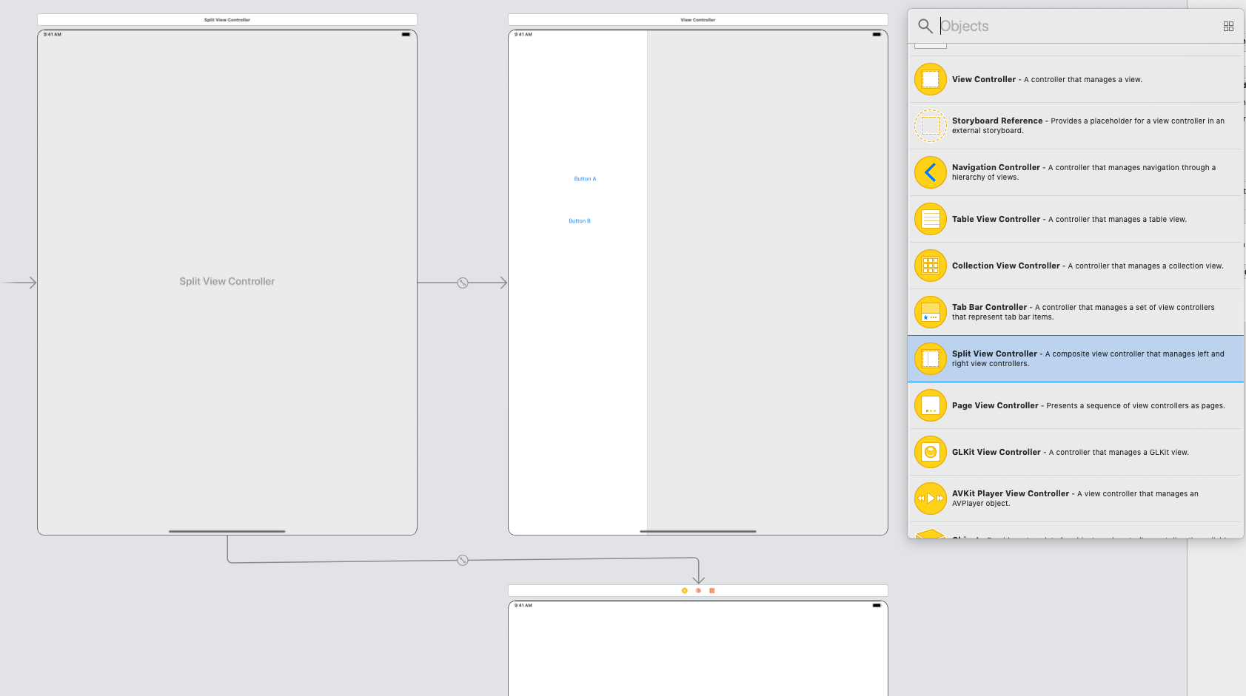
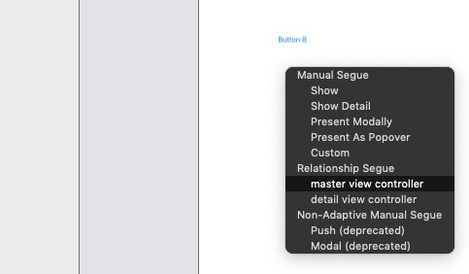
iOS – Wiring up MVCs
Ctrl – Drag in storyboard!
Delete all extra stuff
Move startup pointer to correct view

Slide 9
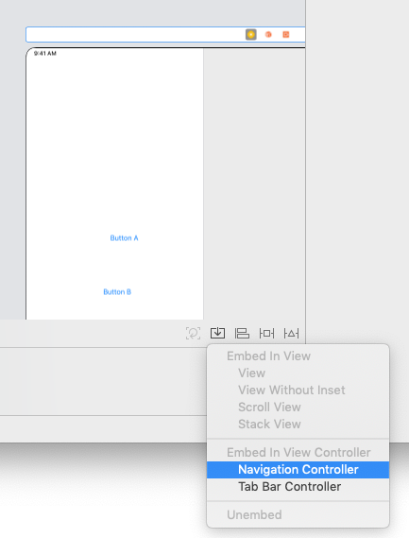
iOS – Wiring up MVCs
SplitView controller only really works on iPad/iPhone+
Embed master view into Navigation Controller

Slide 10
iOS - Segues
When one MVC causes other MVC to appear – it’s called “SEGUE”
Possible segues are
Show Segue (push in Navigation, else Modal)
Show Detail Segue (shows Detail in Split or push in Navigation)
Modal Segue (full screen takeover, no way back)
Popover Segue (modal little popover window)
Segues always create a new instance of an MVC
Adding or removing MVCs from UINavigationController
Func pushViewController(_ vc: UIViewController, animated: Bool)
Func popViewController(animated: Bool)

Slide 11
iOS – wiring up the Segues
In interface builder ctrl-drag from button to some other MVC
Inspect the new segue and give it an Identifier (string) – used later in the code
Preparing for a segue
New MVC needs to be configured (Model and display properties)
Invoke segue from code (rarely used) func performSegue(withIdentifier: String, sender: Any?)

Slide 12
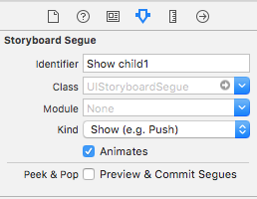
iOS – Segues - naming
Click on segue in storyboard
set identifier (name for the segue)

Slide 13
iOS – preparing for Segue
Most important func in whole Multi MVC
vc.someOutlet – its not set yet! Do not access any outlets!
func prepare(for segue: UIStoryboardSegue, sender: Any?) {
if let identifier = segue.identifier {
switch identifier {
case "SegueIdentifierFromStoryboard":
if let vc = segue.destinationViewController as? SomeViewController {
vc.someproperty = ...
vc.setUp(...)
}
default: break
}
}
}

Slide 14
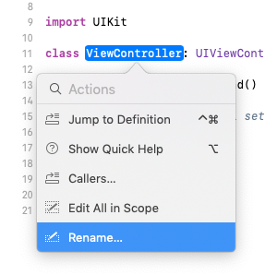
iOS – renaming viewcontrollers
CMD-Click on ViewController class name
Choose Rename
Rename it to better name
Xcode updates all the references (in storyboard also)
And filename gets also updated
New viewcontrollers – you need to set up the controllers manualy in storyboard inspector

Slide 15
iOS - Segues
Ctrl-drag in a storyboard from an instigator (like a button) to the MVC to segue to
Can be done also in code
@IBAction func Action2Clicked(_ sender: UIButton) {
let storyboard = UIStoryboard(name: "Main", bundle: nil)
let vc = storyboard.instantiateViewController(withIdentifier: "Child2ViewController") as! Child2ViewController
present(vc, animated: false, completion: nil)
}

Slide 16
iOS - Segues
Close viewcontroller (navigate back to caller)
@IBAction func CloseClicked(_ sender: UIButton) {
if ((self.presentingViewController) != nil){
self.dismiss(animated: false, completion: nil)
print("close")
}
}

Slide 17
iOS – Segue - declining
Maybe you don’t want to do a segue? Return true for segue to happen
override func shouldPerformSegue
(withIdentifier identifier: String, sender: Any?) -> Bool {
<#code#>
}

Slide 18
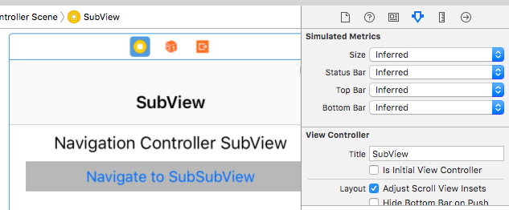
iOS – UINavigationController
Set root view title in Navigation Item
Make segues to other MVCs
Set their title in ViewController Title

Slide 19
iOS -
import UIKitclass
SplitViewController: UISplitViewController, UISplitViewControllerDelegate {
override func viewDidLoad() {
super.viewDidLoad()
// Do any additional setup after loading the view.
self.delegate = self
self.preferredDisplayMode = .allVisible
}
func splitViewController(_ splitViewController: UISplitViewController, collapseSecondary secondaryViewController: UIViewController, onto primaryViewController: UIViewController) -> Bool {
return true
}
}

Slide 20
iOS -

Slide 21
iOS -

Slide 22
iOS -

Slide 23
iOS -

Slide 24
iOS -

Slide 25
iOS -

Slide 26
iOS -

Slide 27
iOS -

