Slide 1
Native Mobile Applications - ICD0017
TalTech IT College, Andres Käver, 2018-2019, Spring semester
Web: http://enos.Itcollege.ee/~akaver/MobileApps
Skype: akaver Email: akaver@itcollege.ee

Slide 2
iOS – Swift syntax
guard container != nil else {
fatalError("This view needs a persistent container.")
}
// container is accessible here!
guard
The unwrapping is a little unintuitive with guard - if let unwraps values for use inside a block. Here the guard statement has an associated block but it’s actually an else block - i.e. the thing you do if the unwrapping fails - the values are unwrapped straight into the same context as the statement itself.

Slide 3
iOS – Swift syntax
extension ViewController: UITableViewDelegate {
func tableView(_ tableView: UITableView,
canEditRowAt indexPath: IndexPath) -> Bool {
return true
}
}
extension
Add computed instance properties and computed type properties
Define instance methods and type methods
Provide new initializers
Define subscripts
Define and use new nested types
Make an existing type conform to a protocol
Extensions can add new functionality to a type, but they cannot override existing functionality.

Slide 4
iOS – Swift syntax
extension Double {
var km: Double { return self * 1_000.0 }
var m: Double { return self }
var cm: Double { return self / 100.0 }
var mm: Double { return self / 1_000.0 }
var ft: Double { return self / 3.28084 }
}
extension
Although properties are implemented as computed properties, the names of these properties can be appended to a floating-point literal value with dot syntax, as a way to use that literal value to perform distance conversions.
let oneInch = 25.4.mm
print("One inch is \(oneInch) meters")
// Prints "One inch is 0.0254 meters"
let threeFeet = 3.ft
print("Three feet is \(threeFeet) meters")
// Prints "Three feet is 0.914399970739201 meters"
let aMarathon = 42.km + 195.m
print("A marathon is \(aMarathon) meters long")
// Prints "A marathon is 42195.0 meters long"

Slide 5
iOS – Core Data
Core data is used to manage the model layer object in our application.
Core Data is a framework to save, track, modify and filter the data within iOS apps
Core Data is not a Database!.
Core Data is using SQLite as it’s persistent store but the framework itself is not the database.
Core Data does much more than databases - managing the object graphs, tracking the changes in the data and more

Slide 6
iOS – Core Data
Persistence
Core Data abstracts the details of mapping your objects to a store, making it easy to save data from Swift and Objective-C without administering a database directly.

Slide 7
iOS – Core Data
Undo and Redo of Individual or Batched Changes
Core Data’s undo manager tracks changes and can roll them back individually, in groups, or all at once, making it easy to add undo and redo support to your app.

Slide 8
iOS – Core Data
Background Data Tasks
Perform potentially UI-blocking data tasks, like parsing JSON into objects, in the background. You can then cache or store the results to reduce server roundtrips.

Slide 9
iOS – Core Data
View Synchronization
Core Data also helps keep your views and data synchronized by providing data sources for table and collection views.
Versioning and Migration
Core Data includes mechanisms for versioning your data model and migrating user data as your app evolves.

Slide 10
iOS – Core Data Model
Create a core data model

Slide 11
iOS – Core Data Stack
Classes that manage and persist your app’s objects.
NSManagedObjectModel represents your app’s model file describing your app’s types, properties, and relationships.
NSManagedObjectContext tracks changes to instances of your app’s types.
NSPersistentStoreCoordinator saves and fetches instances of your app’s types from stores.
NSPersistentContainer sets up the model, context, and store coordinator all at once.

Slide 12
iOS – Core Data Stack
Initialize Core Data during your app’s startup. Create the persistent container as a lazy variable to defer instantiation until its first use in your app’s delegate.
import UIKit
import CoreData
@UIApplicationMain
class AppDelegate: UIResponder, UIApplicationDelegate {
...
lazy var persistentContainer: NSPersistentContainer = {
let container = NSPersistentContainer(name: "testcore")
container.loadPersistentStores(completionHandler: { (storeDescription, error) in
if let error = error as NSError? {
fatalError("Unresolved error \(error), \(error.userInfo)")
}
})
return container
}()

Slide 13
iOS – Core Data Stack
Add also core data saving in AppDelegate
func saveContext () {
let context = persistentContainer.viewContext
if context.hasChanges {
do {
try context.save()
} catch {
let nserror = error as NSError
fatalError("Unresolved error \(nserror), \(nserror.userInfo)")
}
}
}
func applicationWillTerminate(_ application: UIApplication) {
self.saveContext()
}

Slide 14
iOS – Core Data Stack
Pass a container reference to main view controller
In app’s root view controller, import Core Data and create a variable to hold a reference to a persistent container.
import UIKit
import CoreData
class ViewController: UIViewController {
var container: NSPersistentContainer!
override func viewDidLoad() {
super.viewDidLoad()
guard container != nil else {
fatalError("This view needs a persistent container.")
}
}
}

Slide 15
iOS – Core Data Stack
From appDelegate set the root view controller’s container property to the persistent container. (Downcast the view controller to base type)
class AppDelegate: UIResponder, UIApplicationDelegate {
var window: UIWindow?
func application(_ application: UIApplication,
didFinishLaunchingWithOptions launchOptions: [UIApplication.LaunchOptionsKey: Any]?) -> Bool {
if let rootVC = window?.rootViewController as? ViewController {
rootVC.container = persistentContainer
}
return true
}

Slide 16
iOS – Core Data Stack
To pass container into more view controllers
Repeat the creation of a container variable in each view controller, and set its value in the previous view controller’s prepare for segue.
override func prepare(for segue: UIStoryboardSegue, sender: Any?) {
if let nextVC = segue.destination as? NextViewController {
nextVC.container = container
}
}

Slide 17
iOS – Core Data Modelling

Slide 18
iOS – Core Data Modelling
Entities
Model your app’s objects.
Attributes
Describe the properties that compose an entity.
Relationships
Specify how entities relate and how change propagates between them.
Generating Code
Automatically or manually generate managed object subclasses from entities.

Slide 19
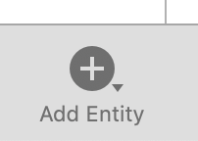
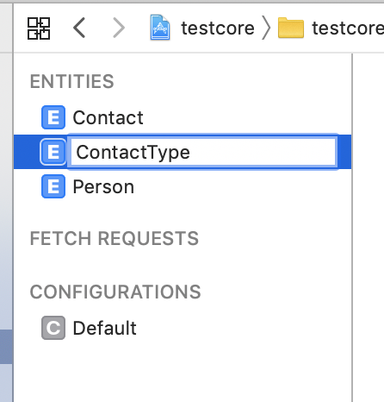
iOS – Core Data Modelling
An entity describes an object, including its name, attributes, and relationships. Create an entity for each of your app’s objects.
Person, Contact, ContactType
Click Add Entity at the bottom of the editor area. A new entity with placeholder name Entity appears in the Entities list.
In the Entities list, double-click the newly added entity, and name it in place. This updates both the entity name and class name visible in the Data Model inspector.

Slide 20
iOS – Core Data Modelling
Entity Properties – advanced usage, defaults are mostly ok
Entity Name The name of the entity in the managed object model. This field reflects the name shown in the Entities list.
Class Name The name of the class you'll use when creating managed object instances from this entity. By default, the class name mirrors the entity name; however, if you change the class name, the changes are not reflected in the entity name.
Parent Entity If you have a number of similar entities, you can define the common properties in a parent entity, and have child entities inherit those properties. By default, this field is blank.
Constraints After adding attributes, optionally enter the name of an attribute (or comma-separated list of attributes) to serve as unique constraints on the entity. Unique constraints prevent duplicate records in the store.

Slide 21
iOS – Core Data Modelling
Abstract Entity Select the Abstract Entity checkbox if you won’t create any instances of the entity—for example, if it exists only as a parent entity that should never be instantiated directly. By default, this option is unselected, resulting in a concrete entity.
Module The module where the class for this entity resides. By default, Core Data locates class files in the global namespace.
Codegen Select a code generation option for generating managed object subclass and properties files to support your entity. By default, this is set to Class Definition, and Core Data generates both files for you automatically.
Spotlight Display Name An NSExpression used by Core Spotlight to display an instance created from this entity.
User Info A dictionary in which you can optionally store any application-specific information related to the entity.
Versioning Hash Modifier Provide a hash modifier when maintaining multiple model versions if the structure of an entity is the same, but the format or content of its data has changed.
Versioning Renaming ID Provide a renaming ID if you rename an entity between model versions. Set the renaming identifier in the new model to the name of the corresponding entity in the previous model.

Slide 22
iOS – Core Data Modelling
Configuring Attributes - Describe the properties that compose an entity.
An attribute describes a property of an entity. At minimum, you need to specify the property’s name and data type, whether it should be saved in the store, and whether it is required to have a value when it’s saved.
For some attribute types you can also choose whether to use a scalar type to represent the attribute in generated classes, as well as configure the attribute to have a default value, or to apply data validation rules.

Slide 23
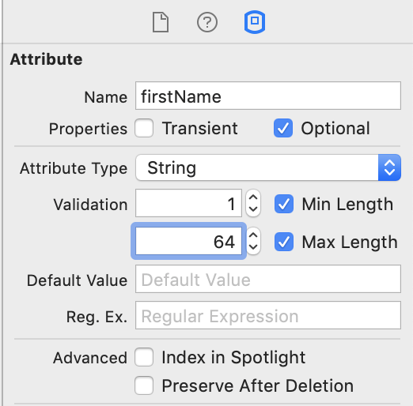
iOS – Core Data Modelling
With an entity selected, click Add Attribute at the bottom of the editor area. A new attribute with placeholder name attribute, of type Undefined, appears in the Attributes list.
In the Attributes list, double-click the newly added attribute, and name it in place.
In the Attributes list, click on Undefined and select the attribute’s data type from the Type dropdown list.

Slide 24
iOS – Core Data Modelling
Configure Attributes
Transient Transient attributes aren’t saved to the persistent store. By default, attributes are saved to the store. Transient attributes are a useful place to temporarily store calculated or derived values. Core Data does track changes to transient property values for undo purposes.
Optional Optional attributes aren’t required to have a value when saved to the persistent store. Attributes are optional by default. Core Data optionals aren’t the same as Swift optionals. You can use a Swift optional to represent a required attribute, for example, if you need flexibility to set its value during the time between the object’s initialization and its first save.
Attribute Type The attribute’s data type. This field reflects the selection made in the Attributes list’s Type dropdown.
Default Value Most types allow you to supply a default value. New object instances set the attribute to this default value on initialization, unless you specify another value at that time. Supplying a default value, in combination with making the type non-optional, can provide performance benefits.
Validation Optionally, set validation rules such as the minimum and maximum values for a numeric type, or regular expressions requirements for strings. The data model inspector shows validation options specific to the selected attribute’s type.
Use Scalar Type Optionally, for some types, choose between scalar and non-scalar representations during code generation. For a Double, selecting the Use Scalar checkbox produces a Double, while leaving it unselected produces an NSNumber.

Slide 25
iOS – Core Data Modelling
A relationship describes how an entity affects another entity.
At minimum, a relationship specifies
a name,
a destination entity,
a delete rule,
a cardinality type (To One or To Many),
settings for whether the relationship should be saved in the store (transient),
and whether it is required to have a value when saved (optional).
You should also configure every relationship with an inverse relationship.

Slide 26
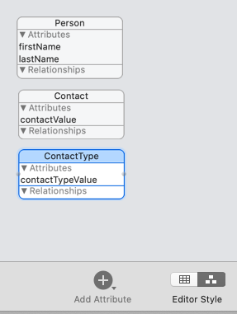
iOS – Core Data Modelling
Select the graph editor style to view all of your app’s entities at once.
Control-drag from one entity relationships are to another entity to create a pair of relationships. An arrow appears between the entities to indicate a relationship, and a relationship with placeholder name newRelationship is added to each entity.

Slide 27
iOS – Core Data Modelling
Configure created relationships (double click on relationship name)
1:Many
1:1

Slide 28
iOS – Core Data Modelling
Relationship properties
Transient Transient relationships aren’t saved to the persistent store. This makes transient relationships a useful place to temporarily store calculated or derived values. Core Data does track changes to transient property values for undo purposes.
Optional Optional relationships aren’t required to have any instances of their destination type. A required relationship must point to one or more instances of the destination type.
Destination Each relationship points from a source entity (the entity whose relationships you’re editing) to a destination entity. The destination entity is a related type that affects and is affected by the source type. Setting the same source and destination types creates a reflexive relationship. For example, an Employee may manage another Employee.
Inverse Inverse relationships enable Core Data to propagate change in both directions when an instance of either the source or destination type changes. Every relationship should have an inverse. When creating relationships in the Graph editor, you add inverse relationships between entities in a single step. When creating relationships in the Table editor, you add inverse relationships to each entity in turn.

Slide 29
iOS – Core Data Modelling
Relationship properties cont.
Delete Rule A relationship’s delete rule specifies how change propagates across relationships when a source instance is deleted. No Action to delete the source object instance, but leave references to it in any destination object instances, which you update manually. Nullify to delete the source object instance, and nullify references to it in any destination object instances. Cascade to delete the source object instance, and with it, all of the destination object instances. Deny to delete the source object only if it doesn’t point to any destination object instances.
Cardinality Type Specify a relationship as being To One or To Many, which is known as its cardinality. Use To One relationships to connect the source with a single instance of the destination type. Use To Many relationships to connect the source with a mutable set of the destination type, and to optionally specify an arrangement and count: Arrangement: Select the Ordered checkbox to specify that the relationship has an inherent ordering, and to generate an ordered mutable set. Count: You can also place upper and lower limits on the number of destination instances. For optional relationships, the number of instances can be zero or within these bounds.

Slide 30
iOS – Core Data Code
Code generation
Select an entity from the Entities list.
In the Data Model inspector, under Class, the Codegen list offers three options:
Class Definition – you won’t need to edit generated logic or properties
Category/Extension – to add logic to the managed object subclass
Manual/None – to edit properties and logic in the managed object subclass

Slide 31
iOS – Core Data Code
Code generation
Class definition
The generated source code doesn’t appear in your project’s source list. Xcode produces the class and properties files as part of the build process and places them in your project’s build directory. These files regenerate whenever the related entity changes in the data model.
Category/Extension
Take full control of the class file, while continuing to automatically generate the properties file to keep it up-to-date with the model editor. Create and maintain your class manually. (custom getters/setters etc)

Slide 32
iOS – Core Data Code
Category/Extension
To generate the class file initially
Choose Editor > Create NSManagedObject Subclass from the menu at the top of the screen.
Select your data model, then the appropriate entity, and choose where to save the files. Xcode places both class and properties files into your project.
Because the properties file continues to be produced as part of the build process, move this duplicate file from your project source list to the trash.
You can now see and edit the class file in your project source list.

Slide 33
iOS – Core Data – insert
let context = container.viewContext
let entity = NSEntityDescription.entity(forEntityName: "Person", in: context)
let newPerson = NSManagedObject(entity: entity!, insertInto: context)
newPerson.setValue("Andres", forKey: "firstName")
newPerson.setValue("Käver", forKey: "lastName")
do {
try context.save()
} catch {
print("Failed saving")
}

Slide 34
iOS – Core Data – read
let context = container.viewContext
let request = NSFetchRequest<NSFetchRequestResult>(entityName: "Person")
request.predicate = NSPredicate(format: "firstName = %@", "Andres")
request.returnsObjectsAsFaults = false
do {
let result = try context.fetch(request)
for data in result as! [NSManagedObject] {
print(data.value(forKey: "firstName") as! String)
print(data.value(forKey: "lastName") as! String)
}
} catch {
print("Failed fetching")
}

Slide 35
iOS – Core Data
This is bad! Anonymous, string based access to data…
Switch over to Manual/None code generation and generate classes
Lets create Repo for data access

Slide 36
iOS – Core Data
import Foundation
import CoreData
class PersonDataController {
var container: NSPersistentContainer!
var context: NSManagedObjectContext {
return container.viewContext
}
init(container: NSPersistentContainer) {
self.container = container
}

Slide 37
iOS – Core Data
func all() throws -> [Person] {
let persons = try context.fetch(Person.fetchRequest() as NSFetchRequest<Person>)
return persons
}
func all(withFirstName firstName: String) throws -> [Person] {
let request = NSFetchRequest<Person>(entityName: "Person")
request.predicate = NSPredicate(format: "firstName == %@", firstName)
let persons = try context.fetch(request)
return persons
}
func insert(person: Person) throws {
context.insert(person)
try context.save()
}
func update(person: Person) throws {
try context.save()
}

Slide 38
iOS – Core Data
func delete(person: Person) throws {
context.delete(person)
try context.save()
}
func delete(withFirstName firstName: String) throws {
let fetchRequest = Person.fetchRequest() as NSFetchRequest<NSFetchRequestResult>
fetchRequest.predicate = NSPredicate(format: "firstName == %@", firstName)
let deleteRequest = NSBatchDeleteRequest(fetchRequest: fetchRequest)
try context.execute(deleteRequest)
try context.save()
}
}

Slide 39
iOS – Core Data
class ViewController: UIViewController {
var container: NSPersistentContainer!
var personData: PersonDataController!
override func viewDidLoad() {
super.viewDidLoad()
guard container != nil else {
fatalError("This view needs a persistent container.")
}
personData = PersonDataController(container: container)
do{
let result = try personData.all()
for person in result {
print(person.firstName!)
print(person.lastName!)
}
} catch {
print("Failed fetching")
}
}
Lets test repo in viewcontroller

Slide 40
iOS – Core Data and UITableView
UITableView is most suitable UI component to show data from CoreData
This is so common use case, that iOS provides specific controller to connect CoreData fetchrequest to UITableView NSFetchedResultsController
Not a view controller!

Slide 41
iOS – Core Data and UITableView
Usually an var in UITableViewController
Connect up to NSFetchRequest to retrieve data
Answers to UITableViewDataSource protocol’s methods
Provides dynamic updates to TableView (automatic updates)
TableView is a delegate in NSFetchedResultsController
Provides all methods for UITableViewDataSource

Slide 42
iOS – Core Data
Add TableViewDelegate and TableViewDataSource via extensions
extension ViewController: UITableViewDataSource {
func tableView(_ tableView: UITableView, numberOfRowsInSection section: Int) -> Int {
return self.fetchController?.fetchedObjects?.count ?? 0
}
func tableView(_ tableView: UITableView, cellForRowAt indexPath: IndexPath) -> UITableViewCell {
let cell = self.tableView.dequeueReusableCell(withIdentifier: "cell", for: indexPath)
guard let person = self.fetchController?.object(at: indexPath) else { return cell }
cell.selectionStyle = .none
cell.textLabel?.text = "\(person.firstName!) \(person.lastName!)"
return cell
}
}

Slide 43
iOS – Core Data
Add TableViewDelegate and TableViewDataSource via extensions
extension ViewController: UITableViewDelegate {
func tableView(_ tableView: UITableView, canEditRowAt indexPath: IndexPath) -> Bool {
return true
}
func tableView(_ tableView: UITableView, commit editingStyle: UITableViewCell.EditingStyle, forRowAt indexPath: IndexPath) {
if (editingStyle == .delete) {
guard let person = self.fetchController?.object(at: indexPath) else { return }
try? personData.delete(person: person)
}
}
}

Slide 44
iOS – Core Data
Add NSFetchedResultsControllerDelegate via extension
extension ViewController: NSFetchedResultsControllerDelegate {
func controller(_ controller: NSFetchedResultsController<NSFetchRequestResult>,
didChange anObject: Any, at indexPath: IndexPath?,
for type: NSFetchedResultsChangeType, newIndexPath: IndexPath?) {
switch type {
case .delete: self.tableView.deleteRows(at: [indexPath!], with: .automatic)
case .insert: self.tableView.insertRows(at: [newIndexPath!], with: .automatic)
case .update: self.tableView.reloadRows(at: [indexPath!], with: .automatic)
case .move: self.tableView.reloadData()
@unknown default:
fatalError("unknown NSFetchedResultsChangeType")
}
}
}

Slide 45
iOS – Core Data
Add ui to create new records in db - UIAlertController
@IBAction func addButtonClicked(_ sender: UIButton) {
let alertController = UIAlertController(title: "New User", message: "", preferredStyle: .alert)
alertController.addAction(UIAlertAction(title: "Cancel", style: .cancel, handler: nil))
alertController.addAction(UIAlertAction(title: "Save", style: .default) { _ in
let person = Person(context: self.personData.context)
person.firstName = alertController.textFields?[0].text?
.trimmingCharacters(in: CharacterSet.whitespaces) ?? ""
person.lastName = alertController.textFields?[1].text?
.trimmingCharacters(in: CharacterSet.whitespaces) ?? ""
try? self.personData.insert(person: person)
})
alertController.addTextField { textField in
textField.placeholder = "First name"
}
alertController.addTextField { textField in
textField.placeholder = "Last name"
}
self.present(alertController, animated: true, completion: nil)
}

Slide 46
iOS – Core Data
class ViewController: UIViewController {
var container: NSPersistentContainer!
var personData: PersonDataController!
var fetchController: NSFetchedResultsController<Person>?
@IBOutlet weak var tableView: UITableView!
override func viewDidLoad() {
super.viewDidLoad()
guard container != nil else {
fatalError("This view needs a persistent container.")
}
personData = PersonDataController(container: container)
tableView.register(UITableViewCell.self, forCellReuseIdentifier: "cell")
tableView.tableFooterView = UIView()
tableView.dataSource = self
tableView.delegate = self
let request = Person.fetchRequest() as NSFetchRequest<Person>
request.sortDescriptors = [NSSortDescriptor(key: "firstName", ascending: true)]
fetchController = NSFetchedResultsController(
fetchRequest: request,
managedObjectContext: personData.context,
sectionNameKeyPath: nil, cacheName: nil)
fetchController!.delegate = self
try? fetchController!.performFetch()
}
viewDidLoad

Slide 47
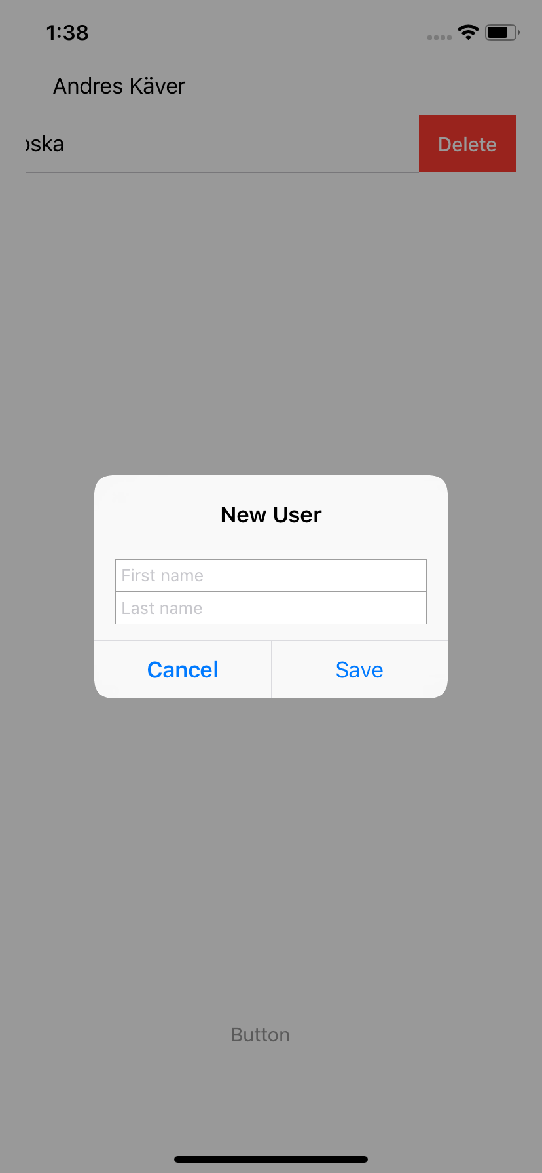
iOS – Core Data
Result

Slide 48
iOS – Core Data
The END!

