Slide 1
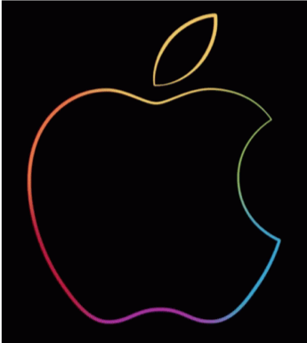
Native Mobile Applications - ICD0017
TalTech IT College, Andres Käver, 2018-2019, Spring semester
Web: http://enos.Itcollege.ee/~akaver/MobileApps
Skype: akaver Email: akaver@itcollege.ee

Slide 2
iOS - MediaPlayer
import UIKit
import AVFoundation
import MediaPlayer
class ViewController: UIViewController {
enum AudioStatus{
case stopped
case buffering
case playing
}
let audioSession = AVAudioSession.sharedInstance()
var audioPlayer: AVPlayer!
var audioStatus = AudioStatus.stopped
@IBOutlet weak var button: UIButton!
override func viewDidLoad() {
super.viewDidLoad()
do {
try audioSession.setCategory(
AVAudioSession.Category(rawValue: "AVAudioSessionCategoryPlayback"))
try audioSession.setActive(true)
} catch {
print("Error in audiosession \(error)")
}
}
MediaPlayer minimal setup

Slide 3
iOS - MediaPlayer
func audioPrepare(){
button.setTitle("buffer", for: UIControl.State.normal)
audioStatus = .buffering
audioPlayer = AVPlayer(
url: URL(string: "http://skymedia.babahhcdn.com/rrap" )!)
audioPlayer.addObserver(
self, forKeyPath: "status",
options: NSKeyValueObservingOptions(), context: nil)
}
func audioPlay(){
audioStatus = .playing
button.setTitle("pause", for: UIControl.State.normal)
audioPlayer.play()
}
func audioStop(){
audioStatus = .stopped
button.setTitle("play", for: UIControl.State.normal)
if (audioPlayer != nil){
audioPlayer.pause()
audioPlayer.removeObserver(self, forKeyPath: "status")
audioPlayer = nil
}
}
Play, Stop, Prepare

Slide 4
iOS - MediaPlayer
Observer for media player events
override func observeValue(
forKeyPath keyPath: String?, of object: Any?, change: [NSKeyValueChangeKey : Any]?,
context: UnsafeMutableRawPointer?) {
if object is AVPlayer {
switch audioPlayer.status {
case .failed: print("audioPlayer failed")
case .readyToPlay:
print("audioPlayer ready")
audioPlay()
case .unknown: print("audioPlayer status unknown")
default: print("audioPlayer status: something new")
}
}
}

Slide 5
iOS - MediaPlayer
The END!

