Slide 1
Native Mobile Applications - ICD0017
TalTech IT College, Andres Käver, 2018-2019, Spring semester
Web: http://enos.Itcollege.ee/~akaver/MobileApps
Skype: akaver Email: akaver@itcollege.ee

Slide 2
Requirements - Android
Development environment – latest Android Studio (start installing now!)
http://developer.android.com/sdk/index.html
Base OS – free choice (Windows, macOS, Linux)
Personal PC – can’t really use school computers
Personal Android device – (phone/tablet) strongly recommended
Use personal laptop for development (or RDP to somewhere)

Slide 3
Requirements - iOS
Development environment – latest XCode
https://developer.apple.com/xcode/
Only on macOS
Personal mac PC (320 class has 12 computers)
Personal iOS device – (phone/tablet) strongly recommended
Use personal mac laptop for development (or RDP to somewhere)
Virtual machine is also a possibility(although macOS does not work well in VM’s)
Rent computer time from some service - popular choice
MacInCloud, HostMyApple, MacStadium, vmOSX, Xcloud, Xcodeclub

Slide 4
Grading
Projects in git -https://gitlab.cs.ttu.ee – log in with Uni-ID
Git repo has to be named exactly: icd0017-2018s
Grant Andres.Kaver developer rights
Grade is based on projects (all mandatory)
2-3 projects on both platforms

Slide 5
Communication
http://enos.Itcollege.ee/~akaver/MobileApps
Slides, echo360, hw descriptions
Discord chat: https://discord.gg/B6zvtG (link is alive till 01.02.2019)
Skype: akaver
Email: akaver@itcollege.ee

Slide 6
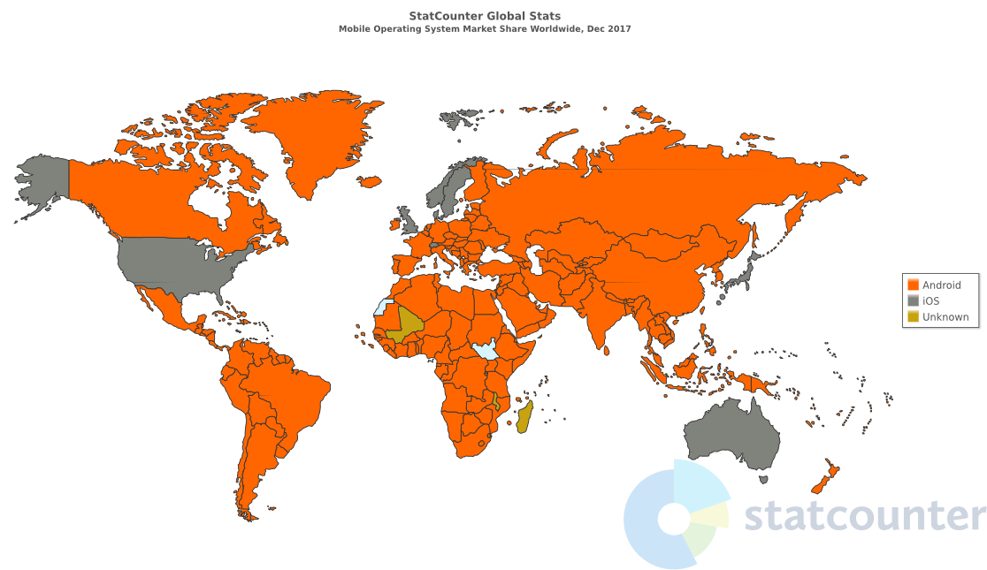
Mobile OS market share

Slide 7
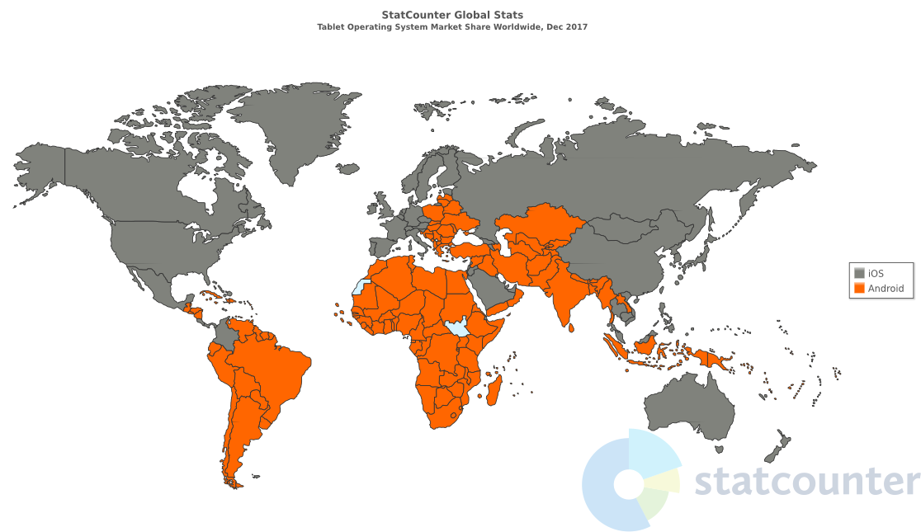
Tablet OS market share

