Slide 1
Native Mobile Applications - ICD0017
TalTech IT College, Andres Käver, 2019-2020, Spring semester
Web: http://enos.Itcollege.ee/~akaver/mobileapps
Skype: akaver Email: akaver@itcollege.ee

Slide 2
Android app components
Logging
Activity
Intent
Fragment
Service
ContentProvider
BroadcastReceiver

Slide 3
Android - logging
Full support in ide
Use android.util.Log
Verbose Log.v(), debug Log.d(), info Log.i(), warn Log.w(), error Log.e(), or “what a terrible Failure” Log.wtf()
Deployed application should not contain logging code
Use BuildConfig.DEBUG flag for checking state (deployed or not)
if (BuildConfig.DEBUG) { Log.e(Constants.TAG, "onCreate called"); }
TAG – string, usually statically fixed
public static int w (String tag, Throwable tr)
public static int w (String tag, String msg, Throwable tr)
public class FragmentMain extends Fragment { private static final String TAG = FragmentMain.class.getSimpleName();

Slide 4
Android - activity
Activity – one screen (UI and code)
User interface – 1..n activities
Every activity is separate component
Activity can start other activities
Back stack (lifo)
Has to be declared in manifest also!

Slide 5
Android - activity
Activity
FragmentActivity
ListActivity
PreferenceActivity
TabActivity

Slide 6
Android - activity
One activity is designated as “Main”
Launched on first app activation
Every time new activity is started, previous one is stopped
Previous activity is stored in the back stack
When activity is stopped/paused, callback methods are called
Callbacks – create, resume, stop, destroy, etc…

Slide 7
Android – new activity
Create subclass of Activity (or subclass of subclass of Activity)
Implement callbacks
OnCreate()
OnPause()
Implement user interface
XML layout file
Or programmatically

Slide 8
Android – new activity, manifest
<manifest ... > <application ... > <activity android:name=".ExampleActivity" /> ... </application ... > ... </manifest >
Declaration in AndroidManifest is mandatory
Specify intent filters
Intent filter declares, how other system components may use this activity
Auto-created stub for main activity
Action action.MAIN – activity responds to the “main” action
Category category.LAUNCHER – actitvity is placed into launcher category
<activity android:name=".ExampleActivity" android:icon="@drawable/app_icon"> <intent-filter> <action android:name="android.intent.action.MAIN" /> <category android:name="android.intent.category.LAUNCHER" /> </intent-filter> </activity>

Slide 9
Android – new activity, starting
startActivity(intent)
Starting your own activity – specify class name
Calling other activities
Intent.EXTRA_EMAIL – stores list of email recipients
Intent intent = new Intent(this, SignInActivity.class); startActivity(intent);
Intent intent = new Intent(Intent.ACTION_SEND); intent.putExtra(Intent.EXTRA_EMAIL, recipientArray); startActivity(intent);

Slide 10
Android – new activity, starting for result
StartActivityForResult()
Implement onActivityResult() callback method
private void pickContact() { // Create an intent to "pick" a contact, as defined by the content provider URI Intent intent = new Intent(Intent.ACTION_PICK, Contacts.CONTENT_URI); startActivityForResult(intent, PICK_CONTACT_REQUEST); } @Override protected void onActivityResult(int requestCode, int resultCode, Intent data) { // If the request went well (OK) and the request was PICK_CONTACT_REQUEST if (resultCode == Activity.RESULT_OK && requestCode == PICK_CONTACT_REQUEST) { // Perform a query to the contact's content provider for the contact's name Cursor cursor = getContentResolver().query(data.getData(), new String[] {Contacts.DISPLAY_NAME}, null, null, null); if (cursor.moveToFirst()) { // True if the cursor is not empty int columnIndex = cursor.getColumnIndex(Contacts.DISPLAY_NAME); String name = cursor.getString(columnIndex); // Do something with the selected contact's name... } } }

Slide 11
Android – shut down activity
Finish()
shut down previously started activity – finishActivity()

Slide 12
Android – activity lifecycle
Three essential states
Resumed
In foreground, has user focus. “running”
Paused
Activity is partially visible, and is “alive”. Can be killed by system in low memory situation
Stopped
Activity is 100% obscured by another activity. It is alive, but is not attached to the window manager. Can be killed by system, when memory is needed.
Paused or Stopped – system calls finish() method on activity. When activity is reopened, it must be created again

Slide 13
Android – Lifecycle callbacks
public class ExampleActivity extends Activity { @Override public void onCreate(Bundle savedInstanceState) { super.onCreate(savedInstanceState); // The activity is being created. } @Override protected void onStart() { super.onStart(); // The activity is about to become visible. } @Override protected void onResume() { super.onResume(); // The activity has become visible (it is now "resumed"). } @Override protected void onPause() { super.onPause(); // Another activity is taking focus (this activity is about to be "paused"). } @Override protected void onStop() { super.onStop(); // The activity is no longer visible (it is now "stopped") } @Override protected void onDestroy() { super.onDestroy(); // The activity is about to be destroyed. } }
Fundamental callbacks
Must always call the superclass implementation before doing any work

Slide 14
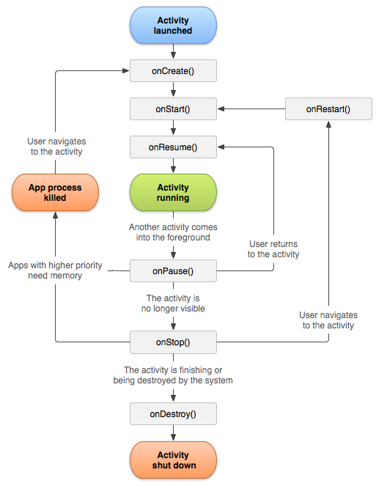
Android – Lifecycle

Slide 15
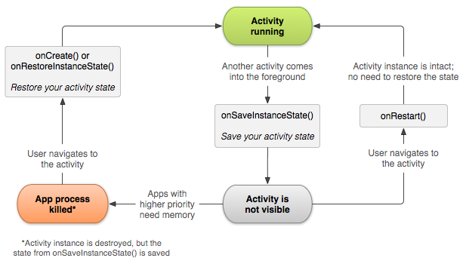
Android - SaveInstanceState
system calls onSaveInstanceState() before making the activity vulnerable to destruction
Passes Bundle, as name-value pairs
Save state, using
putString() and putInt()
Bundle is passed back in
onCreate() and onRestoreInstanceState()

Slide 16
Android - handling conf changes
Orientation change, physical keyboard, language
System recreates the running activity
calls onDestroy(),
then immediately calls onCreate()

Slide 17
Android – Intent and Intent filters
Messaging object, used for requesting action from another app component
Fundamental uses
Start an activity
startActivity or startActivityForResult
Start a service
startService or bindService
Deliver broadcast
sendBroadcast, sendOrderedBroadcast, or sendStickyBroadcast

Slide 18
Android – Intent and Intent filters
Explicit intents
Specify component by name (usually in your own app)
Implicit intents
Declare general action to perform
System searches in manifests (intent-filter) for suitable activity
If several are found, user is presented with dialog for picking

Slide 19
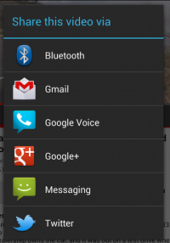
Android - intents
// Executed in an Activity, so 'this' is the Context // The fileUrl is a string URL, such as "http://www.example.com/image.png" Intent downloadIntent = new Intent(this, DownloadService.class); downloadIntent.setData(Uri.parse(fileUrl)); startService(downloadIntent);
Explicit intent
Implicit intent
Forcing an app chooser
To show the chooser, create an Intent using createChooser() and pass it to startActivity()
// Create the text message with a string Intent sendIntent = new Intent(); sendIntent.setAction(Intent.ACTION_SEND); sendIntent.putExtra(Intent.EXTRA_TEXT, textMessage); sendIntent.setType("text/plain"); // Verify that the intent will resolve to an activity if (sendIntent.resolveActivity(getPackageManager()) != null) { startActivity(sendIntent); }
Intent sendIntent = new Intent(Intent.ACTION_SEND); ... // Always use string resources for UI text. // This says something like "Share this photo with" String title = getResources().getString(R.string.chooser_title); // Create intent to show the chooser dialog Intent chooser = Intent.createChooser(sendIntent, title); // Verify the original intent will resolve to at least one activity if (sendIntent.resolveActivity(getPackageManager()) != null) { startActivity(chooser); }

Slide 20
Android – intent filter
To advertise which implicit intents your app can receive
declare one or more intent filters for each of your app components with an <intent-filter> element in your manifest file
Action
intent action accepted, in the name attribute
Data
type of data accepted, using one or more attributes that specify various aspects of the data URI (scheme, host, port, path, etc.) and MIME type
Category
category accepted, in the name attribute.
In order to receive implicit intents, you must include the CATEGORY_DEFAULT

Slide 21
Android – intent filter
Activity declaration with an intent filter to receive an ACTION_SEND intent when the data type is text
An implicit intent is tested against a filter by comparing the intent to each of the three elements.
To be delivered to the component, the intent must pass all three tests.
<activity android:name="ShareActivity"> <intent-filter> <action android:name="android.intent.action.SEND"/> <category android:name="android.intent.category.DEFAULT"/> <data android:mimeType="text/plain"/> </intent-filter> </activity>

Slide 22
Android – intent filter
Social app
<activity android:name="MainActivity"> <!-- This activity is the main entry, should appear in app launcher --> <intent-filter> <action android:name="android.intent.action.MAIN" /> <category android:name="android.intent.category.LAUNCHER" /> </intent-filter> </activity> <activity android:name="ShareActivity"> <!-- This activity handles "SEND" actions with text data --> <intent-filter> <action android:name="android.intent.action.SEND"/> <category android:name="android.intent.category.DEFAULT"/> <data android:mimeType="text/plain"/> </intent-filter> <!-- This activity also handles "SEND" and "SEND_MULTIPLE" with media data --> <intent-filter> <action android:name="android.intent.action.SEND"/> <action android:name="android.intent.action.SEND_MULTIPLE"/> <category android:name="android.intent.category.DEFAULT"/> <data android:mimeType="application/vnd.google.panorama360+jpg"/> <data android:mimeType="image/*"/> <data android:mimeType="video/*"/> </intent-filter> </activity>

Slide 23
Android – receive intent - code
void onCreate (Bundle savedInstanceState) { ... // Get intent, action and MIME type Intent intent = getIntent(); String action = intent.getAction(); String type = intent.getType(); if (Intent.ACTION_SEND.equals(action) && type != null) { if ("text/plain".equals(type)) { handleSendText(intent); // Handle text being sent } else if (type.startsWith("image/")) { handleSendImage(intent); // Handle single image being sent } } else if (Intent.ACTION_SEND_MULTIPLE.equals(action) && type != null) { if (type.startsWith("image/")) { handleSendMultipleImages(intent); // Handle multiple images being sent } } else { // Handle other intents, such as being started from the home screen } ... }
void handleSendText(Intent intent) { String sharedText = intent.getStringExtra(Intent.EXTRA_TEXT); if (sharedText != null) { // Update UI to reflect text being shared } } void handleSendImage(Intent intent) { Uri imageUri = (Uri) intent.getParcelableExtra(Intent.EXTRA_STREAM); if (imageUri != null) { // Update UI to reflect image being shared } } void handleSendMultipleImages(Intent intent) { ArrayList<Uri> imageUris = intent.getParcelableArrayListExtra(Intent.EXTRA_STREAM); if (imageUris != null) { // Update UI to reflect multiple images being shared } }

Slide 24
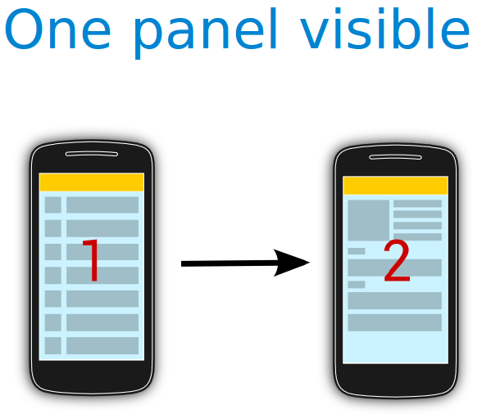
Android - Fragments
A panel or pane represents a part of the user interface.
A fragment is an independent Android component which can be used by an activity.
A fragment runs in the context of an activity, but has its own life cycle and typically its own user interface.
No Context class, use the getActivity()

Slide 25
Android - Fragments
Extend the android.app.Fragment class or one of its subclasses, for example, ListFragment, DialogFragment, PreferenceFragment or WebViewFragment
public class DetailFragment extends Fragment { @Override public View onCreateView(LayoutInflater inflater, ViewGroup container, Bundle savedInstanceState) { View view = inflater.inflate(R.layout.fragment_rssitem_detail, container, false); return view; } public void setText(String url) { TextView view = (TextView) getView().findViewById(R.id.detailsText); view.setText(url); } }

Slide 26
Android – Fragments communication
Should not directly communicate with each other
Should be done via the host activity
Define an interface as an inner type
Require that the activity, which uses it, must implement this interface

Slide 27
Android - Fragments
public class MyListFragment extends Fragment { private OnItemSelectedListener listener; @Override public View onCreateView(LayoutInflater inflater, ViewGroup container, Bundle savedInstanceState) { View view = inflater.inflate(R.layout.fragment_rsslist_overview, container, false); Button button = (Button) view.findViewById(R.id.button1); button.setOnClickListener(new View.OnClickListener() { @Override public void onClick(View v) { updateDetail("fake"); } }); return view; } public interface OnItemSelectedListener { public void onRssItemSelected(String link); }
@Override public void onAttach(Context context) { super.onAttach(context); if (context instanceof OnItemSelectedListener) { listener = (OnItemSelectedListener) context; } else { throw new ClassCastException(context.toString() + " must implemenet " + "MyListFragment.OnItemSelectedListener"); } } @Override public void onDetach() { super.onDetach(); listener = null; } // may also be triggered from the Activity public void updateDetail(String uri) { // create a string just for testing String newTime = String.valueOf(System.currentTimeMillis()); // inform the Activity about the change based // interface defintion listener.onRssItemSelected(newTime); } }

Slide 28
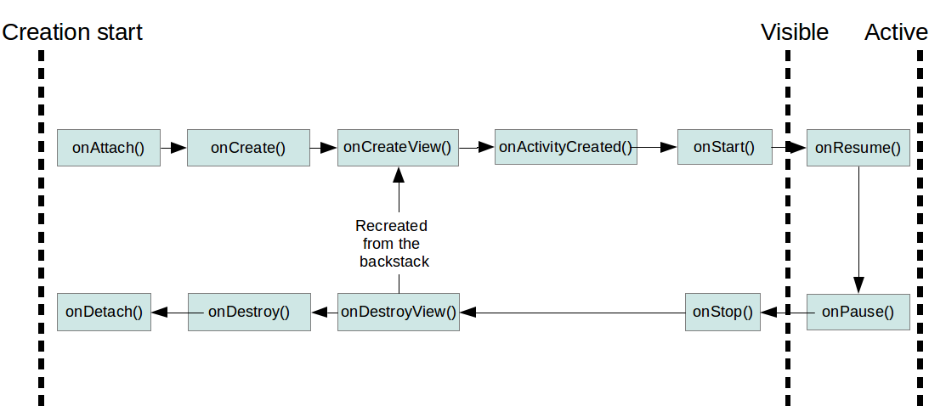
Android – fragments lifecycle
fragment has its own life cycle
always connected to the life cycle of the activity
activity stops, its fragments are stopped
activity is destroyed, its fragments are also destroyed.

Slide 29
Android – defining fragments
Adding fragments statically to the layout file
Different static layout files for different device configurations
Can be done dynamically
<?xml version="1.0" encoding="utf-8"?> <LinearLayout xmlns:android="http://schemas.android.com/apk/res/android" android:layout_width="fill_parent" android:layout_height="fill_parent" android:baselineAligned="false" android:orientation="horizontal"> <fragment android:id="@+id/listFragment" class="com.example.android.rssreader.MyListFragment" android:layout_width="0dp" android:layout_height="match_parent" android:layout_weight="1"></fragment> <fragment android:id="@+id/detailFragment" class="com.example.android.rssreader.DetailFragment" android:layout_width="0dp" android:layout_height="match_parent" android:layout_weight="2"></fragment> </LinearLayout>

Slide 30
Android – fragments demo
Its demo time (FragmentDemo01)!
After hours demo - use different number of fragments depending on the portrait/landscape configuration

Slide 31
Android - Service
Runs in the background without direct interaction with the user
Not bound to the lifecycle of an activity
Used for repetitive and potentially long running operations
Internet downloads
checking for new data
Streaming
Service runs in the same process as the main thread of the app
Use asynchronous processing in the service

Slide 32
Android – Service (platform)
Predefined system services
Application can use them, given the right permissions
getSystemService()

Slide 33
Android – Service (custom)
<service android:name="MyService" android:icon="@drawable/icon" android:label="@string/service_name"></service>
Declare in manifest
Inside <application> tags!
Extend the Service class or one of its subclasses.
Start service
Can also start via bindService(). Allows direct communication with the service
Use android:exported="false“ for keeping service private
import android.app.Service; import android.content.Intent; import android.os.IBinder; /** * Created by akaver on 07.11.2015. */ public class MyService extends Service { @Override public int onStartCommand(Intent intent, int flags, int startId) { //TODO do something useful return Service.START_NOT_STICKY; } @Override public IBinder onBind(Intent intent) { //TODO for communication return IBinder implementation return null; } }
// use this to start and trigger a service Intent i= new Intent(this, MyService.class); // potentially add data to the intent i.putExtra("KEY1", "Value to be used by the service"); this.startService(i);

Slide 34
Android – service restart
Service.START_STICKY
Service is restarted if it gets terminated. Intent data passed to the onStartCommand method is null. Used for services which manages their own state and do not depend on the Intent data.
Service.START_NOT_STICKY
Service is not restarted. Used for services which are periodically triggered anyway.
Service.START_REDELIVER_INTENT
Similar to Service.START_STICKY but the original Intent is re-delivered to the onStartCommand method.

Slide 35
Android – service stop
stopService()
One call to the stopService() method stops the service.
stopSelf() – service terminates itself. Used when service finishes its work.

Slide 36
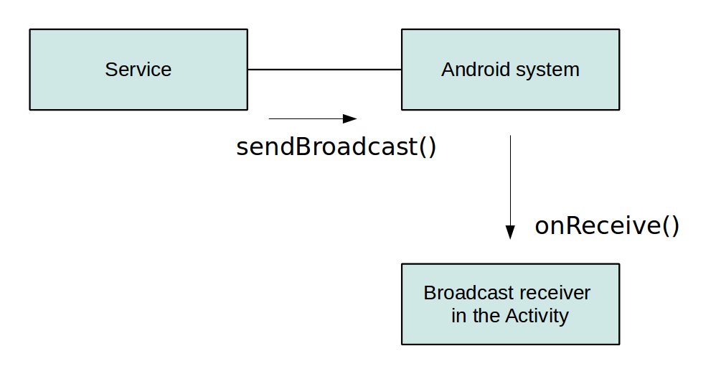
Android – communication with service
Simple scenario – no direct communication. Service receives intent when starting.
Using receiver
Service broadcasts events
Activity registers broadcast receiver and receives events from service
Activity binds to local service
IBinder, onBind()

Slide 37
Android – service
Service starting, stopping and starting a new thread in service
ServiceDemo02
Binder demo
ServiceDemo01

Slide 38
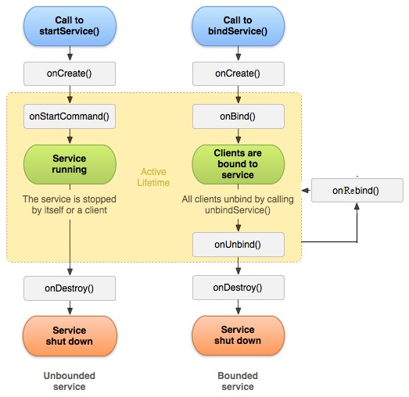
Android – service lifecycle

