Slide 1
Asp.net mvc
MVC5 Identity & Security
Mait Poska & Andres Käver, IT Kolledž 2014

Slide 2
Identity & Security
No Authentication
All anonymous users
Individual User Accounts
Forms authentication (SQL)
Google, Facebook, Twitter, MS
Organizational Accounts
Active directory Federation Services (Azure, Office 365)
Windows Authentication
Intranet – no anonymous users

Slide 3
Request & User – set by framework
Request.IsAuthenticated
User.Identity.GetUserName()
User.IsInRole(“xxxxx”)
@if (Request.IsAuthenticated)
{
using (Html.BeginForm("LogOff", "Account", FormMethod.Post, new { id = "logoutForm", @class = "navbar-right" }))
{
@Html.AntiForgeryToken()
<ul class="nav navbar-nav navbar-right">
<li>
@Html.ActionLink("Hello " + User.Identity.GetUserName() + "!", "Manage", "Account", routeValues: null, htmlAttributes: new { title = "Manage" })
</li>
<li><a href="javascript:document.getElementById('logoutForm').submit()">Log off</a></li>
</ul>
}
}

Slide 4
Authorize attribute
[Authorize] – controller or action method
Only logged in users (redirect to login page)
[AllowAnonymous]
Can override controllers [Authorize]
[Authorize(Users=“akaver, mposka”)]
[Authorize(Roles=“admin, sales”)]

Slide 5
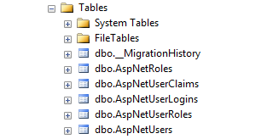
Database

Slide 6
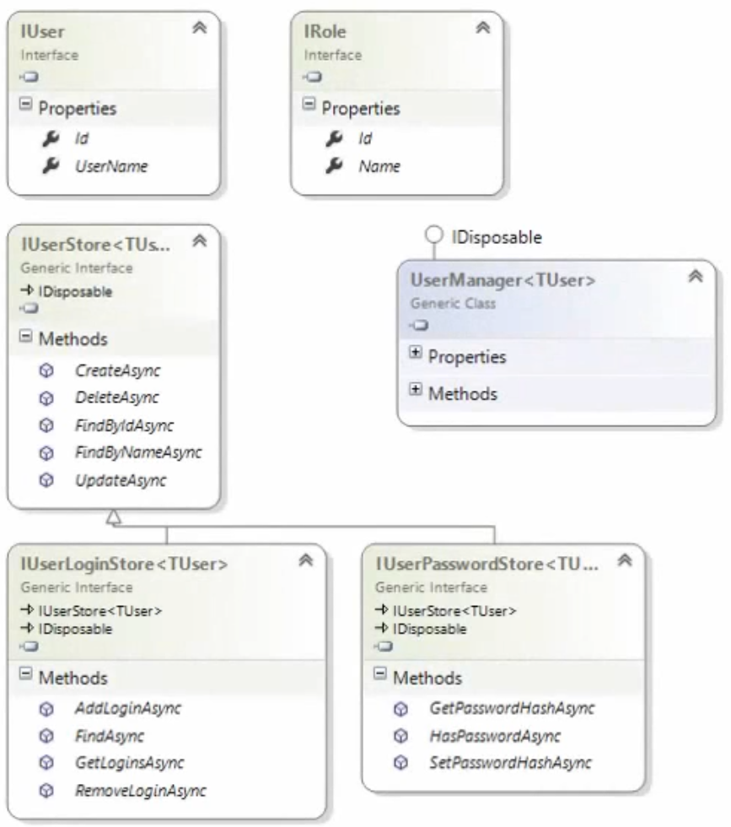
Core Identity
Microsoft.AspNet. Identity.Core

Slide 7
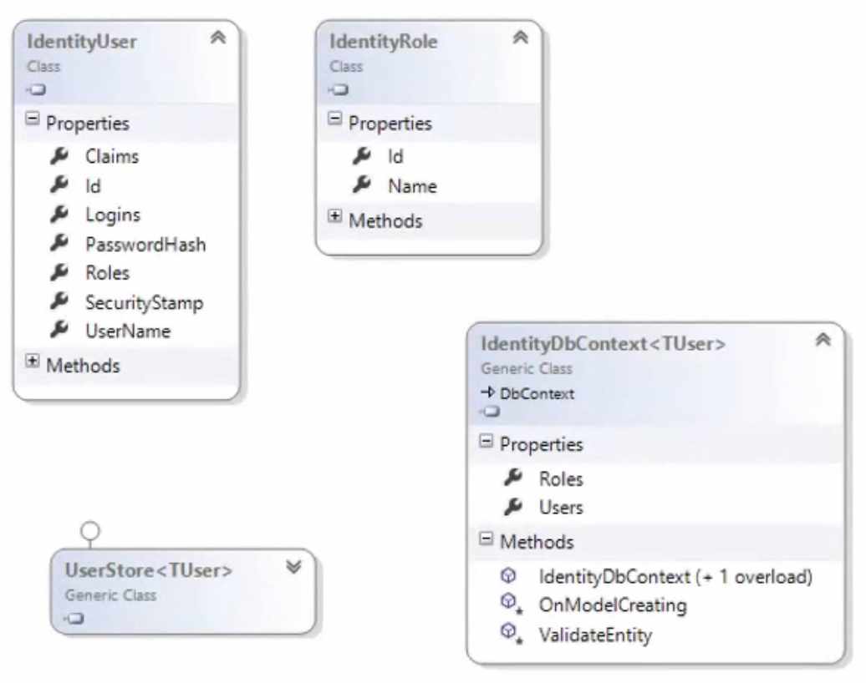
Identity Stored In SQL Server
Microsoft.AspNet.Identity.EntityFramework

Slide 8
UserManager
var manager = new ApplicationUserManager(
new UserStore<ApplicationUser>(
context.Get<ApplicationDbContext>()
)
);
public class ApplicationUser : IdentityUser
{
public async Task<ClaimsIdentity> GenerateUserIdentityAsync(
UserManager<ApplicationUser> manager)
{
var userIdentity = await manager.CreateIdentityAsync(this, DefaultAuthenticationTypes.ApplicationCookie);
return userIdentity;
}
// Add custom fields here
}
public class ApplicationDbContext : IdentityDbContext<ApplicationUser>
{
public ApplicationDbContext()
: base("StudentDBConnection", throwIfV1Schema: false)
{
}
public static ApplicationDbContext Create()
{
return new ApplicationDbContext();
}
}

Slide 9
External Logins

Slide 10
THE END
Mait Poska & Andres Käver

