Slide 1
Asp.net Web-API
WEB-API & MVC5 - Identity & Security
Mait Poska & Andres Käver, IT Kolledž 2014

Slide 2
Transport security
HTTPS == HTTP over TLS
  RFC 1818
Tunnels unprotected HTTP and adds
  Server authentication
    Is it really amazon.com?
  Integrity protection
    Nobody can change your book order in the middle of communication
  Replay protection
    Nobody can take your packet and resend it 500x times
  Confidentiality
    Encryption – nobody knows what book you are buying

Slide 3
Security Architecture
Overview
Hosting
Message handlers
Authentication filter
Authorization filter
Accessing client identity

Slide 4
WEB-API Overview
No dependencies on specific host
  IIS
  Self-host
  OWIN & Katana
No ASP.NET system.web

Slide 5
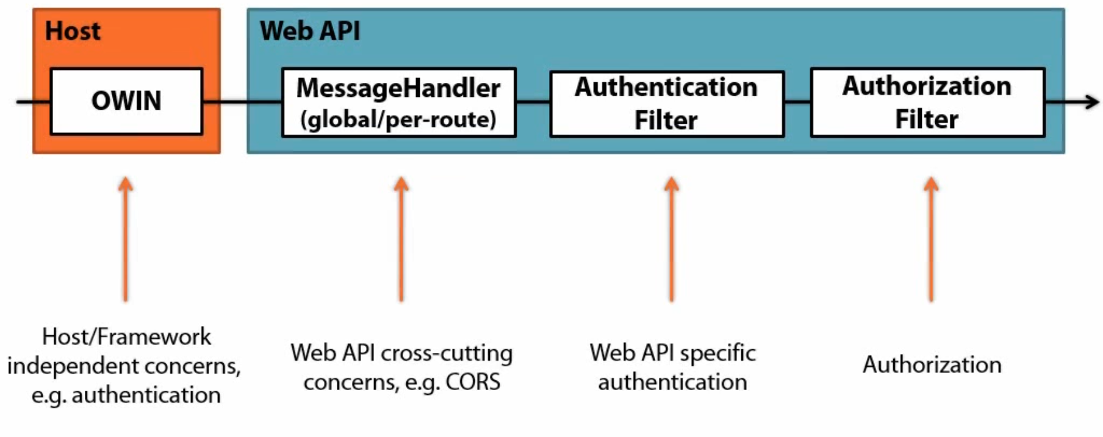
Security pipeline

Slide 6
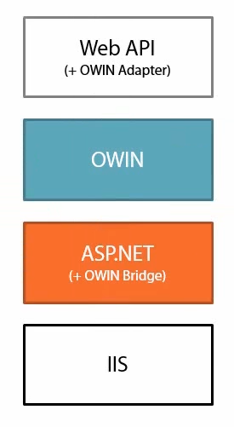
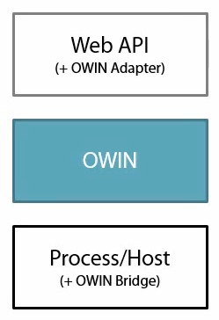
OWIN system.web hosting

Slide 7
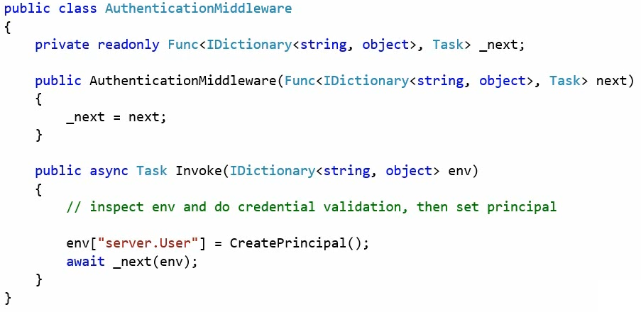
OWIN Middleware

Slide 8
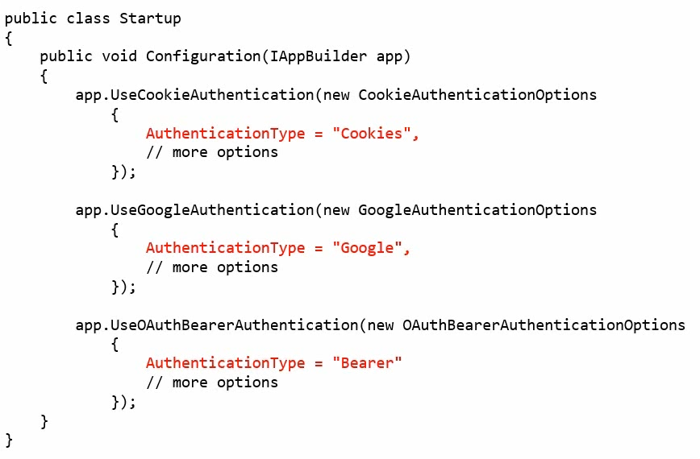
Katana Authentication Middleware

Slide 9
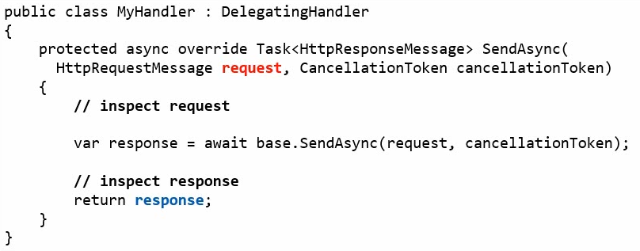
MessageHandler
Web API, global or per-route

Slide 10
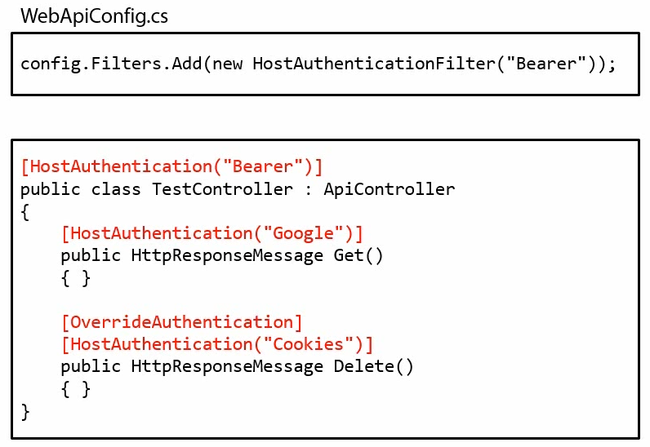
Authentication Filter

Slide 11
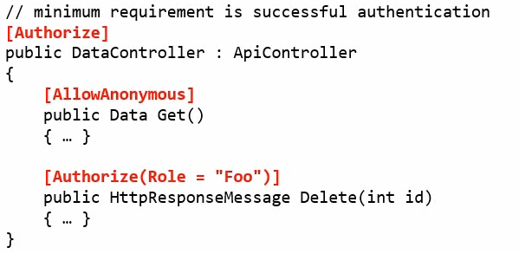
Authorization Filter
Determines if a resource needs authentication
[AllowAnonymous] to skip authorization for an action
Emits the 401 code, if unsuccessful

Slide 12
Accessing the Client Identity
RequestContext
  HttpRequestMessage – hosting enviroment
  ApiController.User is now shortcut to the request context (used to be Thread.CurrentPrincipal in WEB Api 1)
  Could be null

Slide 13
Summary
Web API security extensibility is a pipeline
  Katana
  Authentication filters
  Authorization filters
Avoid host (IIS) specific dependencies
HttpRequestMessage.GetRequestContext().Principal
  One stop shop for client identity

Slide 14
JS/Browser-based clients
Same origin policy
Implicit Browser Authentication
Cross Site Request Forgery (CSRF)
Cross Origin Resource Sharing (CORS)

Slide 15
Same Origin Policy
Sandbox
  Scripts, communication, implicit browser authentication

Slide 16
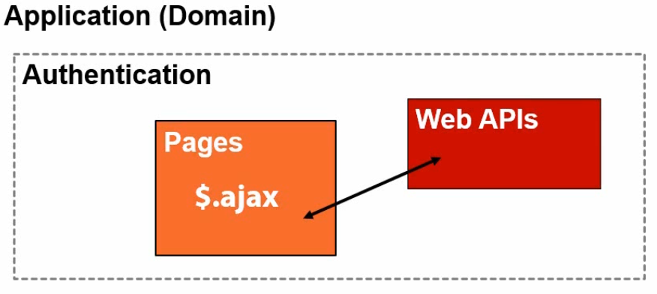
Using same-domain for Auth
Web APIs inherit security settings of web host
  Cookies, Win/Basic auth, client certs …

Slide 17
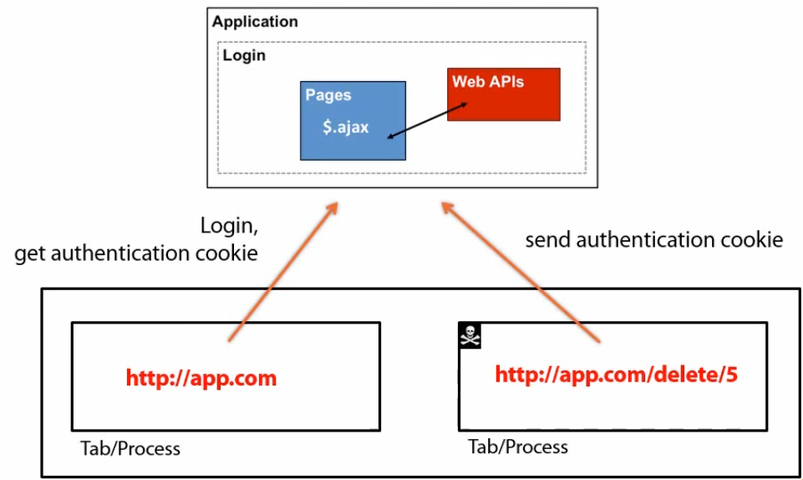
CSRF

Slide 18
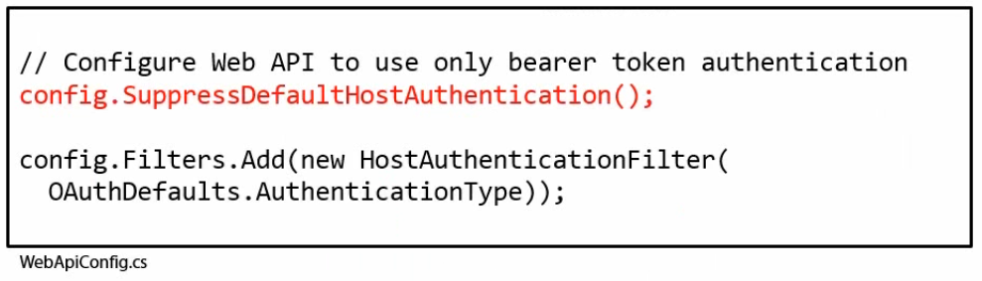
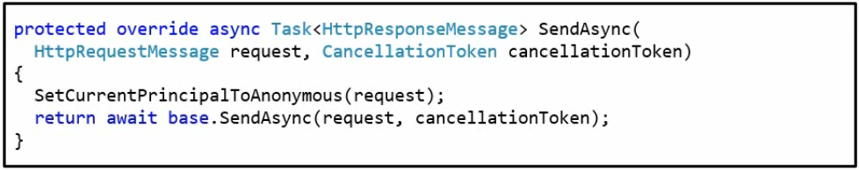
CSRF – Web API 2

Slide 19
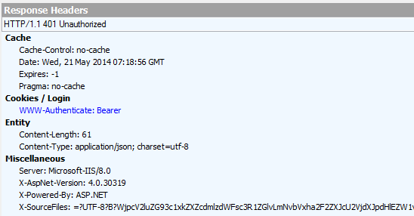
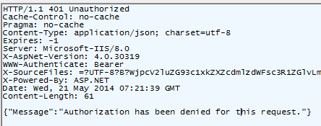
Web API 2 – demo - FIDDLER
Get http://localhost:3456/api/Values

Slide 20
Web API 2 – Register user
Post
  http://localhost:3456/api/Account/Register
Request headers
  Content-Type: application/json
Request body
  {
  "Password": “parool”,
  "ConfirmPassword": “parool”,
  “Email”: “user@akaver.com”
  }

Slide 21
Web API 2 – Authenticate
Post
  http://localhost:3456/Token/
Request headers
  Content-Type: application/x-www-form-urlencoded
Request body
  grant_type=password&username=user@akaver.com&password=parool

Slide 22
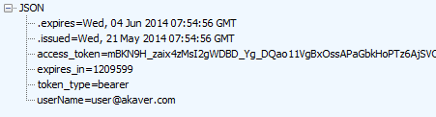
Web API 2 – Authenticate
Bearer token is a particular type of access token. An access token is a credential string that authorizes a client to access a protected resource. (RFC 6749.)
A bearer token is an access token that can be used by any client. (RFC 6750.)
Bearer tokens must be used with SSL.

Slide 23
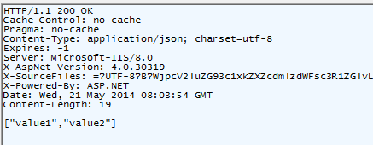
Web API 2 – Authorized request
Get
  http://localhost:3456/api/Values
Request headers
  Authorization: Bearer mBKN9H_zaix….

Slide 24
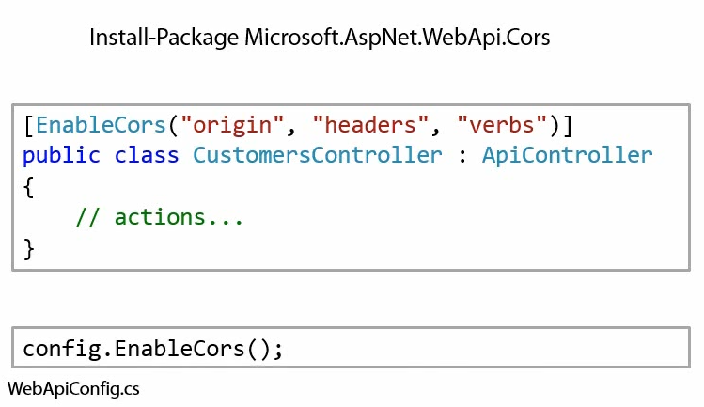
CORS

Slide 26
THE END
Mait Poska & Andres Käver

Slide 27
Classic/Basic authentication
Anti pattern
  Client must store the secret or obtain it from the user (on every request)
  Storage in clear text (or reversible encryption)
  Server has to validate the secret on every request
  High computational cost – brute force protection
High probability of accidental exposure of the secret is increased

Slide 28
Basic authentication
Base64 encoded credentials on auth header
GET /service/resource
Authorization: Basic username:password

