Slide 1
React Native
State of the Art in Mobile Development - AndRES Käver, 2016

Slide 2
RN – basic principle

Slide 3
RN - architecture

Slide 4
RN – key points
React Native is a JavaScript framework/library for writing real, natively rendering iOS, Android and UWP applications.
Mostly just V part of the application architecture (MVC) paradigm.
Learn once, write anywhere (not write once, run anywhere)
FlexBox layout
Reuse almost all non-UI code, most UI code among different platforms
ES6
Over the wire updates (AppHub)
React isn’t framework, it’s a (view)library – state management, routing, … - up to developer!

Slide 5
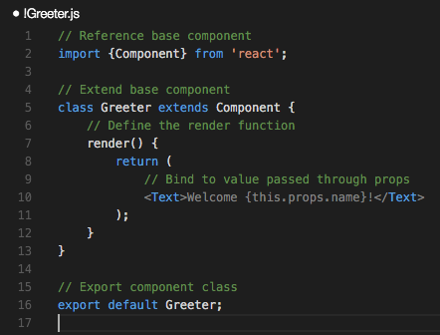
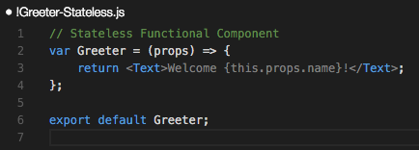
RN – components - lets get started!

Slide 6
RN – js dev environment
Visual Studio Code (or Atom,….)
Node and NPM
npm install -g react-native-cli
XCode
Android Studio
Dev npm packages
npm install eslint eslint-plugin-import eslint-plugin-jsx-a11y babel-eslint eslint-config-airbnb eslint-plugin-react eslint-plugin-react-native --save
VS Code plugins – F1 - ext install
react-native
eslint

Slide 7
RN – create new project
Create RN project
react-native init ContactRN
cd ContactRN
Prelaunch android emulator from Android Studio
Close Android Studio, just emulator is needed
react-native run-ios
react-native run-android
Launch Visual Studio Code
code .

Slide 8
RN – packages
package.json
{
"name": "ContactRN",
"version": "0.0.1",
"private": true,
"scripts": {
"start": "node node_modules/react-native/local-cli/cli.js start"
},
"dependencies": {
"react": "^15.1.0",
"react-native": "^0.28.0"
},
"devDependencies": {
"babel-eslint": "^6.1.0",
"eslint": "^2.13.1",
"eslint-config-airbnb": "^9.0.1",
"eslint-plugin-import": "^1.9.2",
"eslint-plugin-jsx-a11y": "^1.5.3",
"eslint-plugin-react": "^5.2.2",
"eslint-plugin-react-native": "^1.1.0"
}
}

Slide 9
RN - eslint
{
"env": {
"es6": true,
"node": true,
"jasmine": true
},
"extends": "airbnb/base",
"installedESLint": true,
"parserOptions": {
"ecmaFeatures": {
"experimentalObjectRestSpread": true,
"jsx": true
},
"sourceType": "module"
},
"plugins": [
"react",
"react-native"
],
"rules": {
"indent": [
1,
4
],
"no-console": 0,
"no-unused-vars": [
1,
{
"vars": "local",
"args": "none"
}
],
"react/forbid-prop-types": 1,
"react/jsx-boolean-value": 1,
"react/jsx-closing-bracket-location": [
1,
{
"selfClosing": "after-props",
"nonEmpty": "after-props"
}
],
"react/jsx-curly-spacing": [
1,
"never",
{
"spacing": {
"objectLiterals": "always"
}
}
],
"react/jsx-indent-props": 1,
"react/jsx-key": 1,
"react/jsx-max-props-per-line": 1,
"react/jsx-no-duplicate-props": 1,
"react/jsx-no-undef": 1,
"react/jsx-quotes": 0,
"react/jsx-sort-prop-types": 1,
"react/jsx-sort-props": 1,
"react/jsx-uses-react": 1,
"react/jsx-uses-vars": 1,
"react/no-danger": 1,
"react/no-did-mount-set-state": 1,
"react/no-did-update-set-state": 1,
"react/no-direct-mutation-state": 1,
"react/no-multi-comp": 1,
"react/no-set-state": 1,
"react/no-unknown-property": 1,
"react/prefer-es6-class": 1,
"react/prop-types": 1,
"react/react-in-jsx-scope": 1,
"react/require-extension": 1,
"react/self-closing-comp": 1,
"react/sort-comp": 1,
"react/wrap-multilines": 1,
"id-length": 0,
"jsx-quotes": 1
}
}
.eslintrc.json

Slide 10
RN – VSCode custom settings
VSCode > Code > Preferences > User Settings
// Place your settings in this file to overwrite the default settings
{
// When opening a file, `editor.tabSize` and `editor.insertSpaces` will be detected based on the file contents.
"editor.detectIndentation": false
}

Slide 11
RN – initial view – login screen
flexbox is used for element positions and scaling
https://css-tricks.com/snippets/css/a-guide-to-flexbox/
Typical elements
View
Text
Image
TextInput
TouchableHighlight

Slide 12
RN – initial view – login screen
Create new react component
Keep app code in new directory - app
Add new file – Login.js

Slide 13
RN – initial view – login
import React, { Component } from 'react';
import {
StyleSheet,
Text,
View,
} from 'react-native';
const styles = StyleSheet.create({
container: {
flex: 1,
justifyContent: 'center',
alignItems: 'center',
},
});
class Login extends Component {
constructor(props) {
super(props);
this.state = {
};
}
render() {
return (
<View style={styles.container}>
<Text>
Login view
</Text>
</View>
);
}
}
module.exports = Login;
ES6 classes
Import
Styles - flexbox
define class
constructor(props)
this.state for initial state management
render() – mandatory
return (..JSX.. markup); - only one root element
Export class

Slide 14
RN – initial view – index.*.js
import React, { Component } from 'react';
import {
AppRegistry,
StyleSheet,
View,
} from 'react-native';
import Login from './app/Login';
const styles = StyleSheet.create({
container: {
flex: 1,
justifyContent: 'center',
alignItems: 'center',
backgroundColor: '#F5FCFF',
},
});
class ContactRN extends Component {
render() {
return (
<View style={styles.container}>
<Login/>
</View>
);
}
}
AppRegistry.registerComponent('ContactRN', () => ContactRN);
Import created module
Use it in view
import Login from './app/Login';
<Login/>

Slide 15
RN - emulators
iOS
cmd+r for reload
cmd+d for dev menu
Enable reload
Android
cmd+m for dev menu
Enable reload

Slide 16
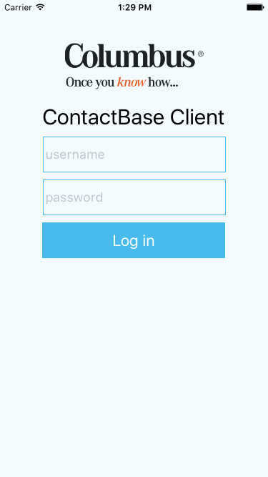
RN – design view
images folder, logo.png
const logo = require('../images/logo.png');

Slide 17
RN – design view
Elements
this.setState for updating state info
{} – for js code
{{}} - for js objects
<View style={styles.container}>
<Image
source={logo}
style={styles.logo} />
<Text style={styles.heading}>
ContactBase Client
</Text>
<TextInput
onChangeText={(text) => this.setState({ username: text }) }
placeholder="username"
style={styles.input} />
<TextInput
onChangeText={(text) => this.setState({ password: text }) }
placeholder="password"
secureTextEntry
style={styles.input} />
<TouchableHighlight
style={styles.button}>
<Text
style={styles.buttonText}>
Log in
</Text>
</TouchableHighlight>
</View>

Slide 18
RN – design view
const styles = StyleSheet.create({
container: {
backgroundColor: '#F5FCFF',
flex: 1,
paddingTop: 60,
alignItems: 'center',
padding: 10,
},
logo: {
width: 194,
height: 65,
},
heading: {
fontSize: 30,
marginTop: 20,
},
input: {
alignSelf: 'stretch',
height: 50,
marginTop: 10,
padding: 4,
fontSize: 18,
borderWidth: 1,
borderColor: '#48bbec',
},
button: {
height: 50,
backgroundColor: '#48BBEC',
alignSelf: 'stretch',
marginTop: 10,
justifyContent: 'center',
},
buttonText: {
fontSize: 22,
color: '#FFF',
alignSelf: 'center',
},
});
Styles

Slide 19
RN – es6 and “this”
”this” is scoped differently in various JS code parts
In arrow functions – surrounding class
Class functions – function itsself
Bind class scope “this” to function scope in class constructor
this.someFunction = this.someFunction.bind(this);

Slide 20
RN - onPress
class Login extends Component {
constructor(props) {
super(props);
this.onLoginPressed = this.onLoginPressed.bind(this);
this.state = {
};
}
onLoginPressed() {
console.log(`Log in - user:${this.state.username} pass:${this.state.password}`);
console.log(this);
}
render() {
return (
<View style={styles.container}>
<TouchableHighlight
onPress={this.onLoginPressed.bind(this) }
style={styles.button}>
<Text
style={styles.buttonText}>
Log in
</Text>
</TouchableHighlight>
</View>
);
}
}

Slide 21
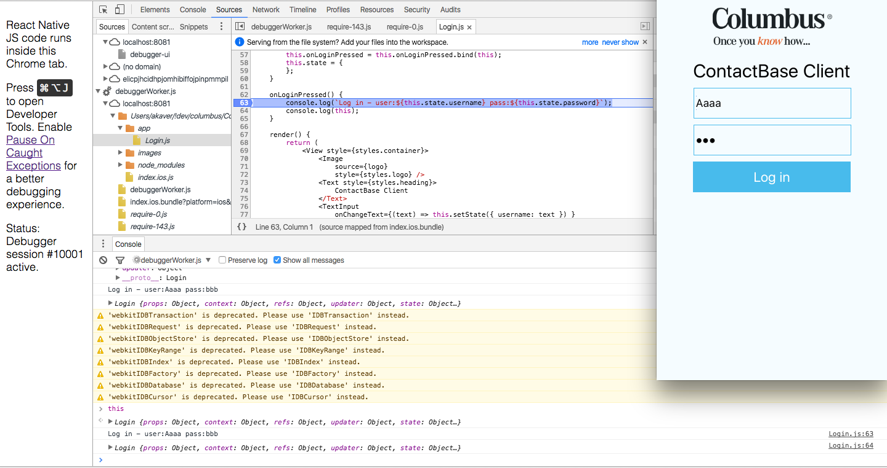
RN – debugging in Chrome
Dev menu
Debug JS Remotely
Open dev console in Chrome
Monitor console
Source code in debuggerWorker.js tree
Breakpoints!!!!!

Slide 22
RN – state, ActivityIndicator
Add variable to state – to display ActivityIndicator after button touch
Update state in press handler
RN monitors state (it is special object) and redraws screen on updates
Add ActivityIndicator to view

Slide 23
RN – state, ActivityIndicator
import React, { Component } from 'react';
import {
ActivityIndicator,
Image,
StyleSheet,
Text,
TextInput,
TouchableHighlight,
View,
} from 'react-native';
class Login extends Component {
constructor(props) {
super(props);
this.onLoginPressed = this.onLoginPressed.bind(this);
this.state = {
showProgress: false,
};
}
onLoginPressed() {
console.log(`Log in - user:${this.state.username} pass:${this.state.password}`);
this.setState({ showProgress: true });
}
render() {
return (
<View style={styles.container}>
...
<ActivityIndicator
animating={this.state.showProgress}
hidesWhenStopped
size="large"
style={styles.loader}/>
</View>
);
}
}

Slide 24
RN – Rest request (Web API)
Demo server is at: https://contacts.akaver.com
RN is running on very limited JS engine
Use Fetch for http requests – promise based
Note: Errors thrown by rejected Promises need to be caught, or they will be swallowed silently
fetch('https://mywebsite.com/endpoint.php')
.then((response) => response.text())
.then((responseText) => {
console.log(responseText);
})
.catch((error) => {
console.warn(error);
});

Slide 25
RN - AuthService
OAuth2 Web API token
Post
https://servername/Token
Request headers
Content-Type: application/x-www-form-urlencoded
Request body (urlencoded)
grant_type=password&username=user@akaver.com&password=parool

Slide 26
RN - AuthService
Set up info for request
Encode formbody
Callback – callback function to send info back to on various results
class AuthService {
loginOAuth(credentials, callback) {
const loginDetails = {
grant_type: 'password',
username: credentials.username,
password: credentials.password,
};
let formBody = [];
Object.keys(loginDetails).forEach((property, index) => {
if ({}.hasOwnProperty.call(loginDetails, property)) {
const encodedKey = encodeURIComponent(property);
const encodedValue = encodeURIComponent(loginDetails[property]);
formBody.push(`${encodedKey}=${encodedValue}`);
}
});
formBody = formBody.join('&');
const uri = 'https://contacts.akaver.com/Token';
...

Slide 27
RN - AuthService
...
fetch(uri, {
method: 'POST',
headers: {
Accept: 'application/json',
'Content-Type': 'application/x-www-form-urlencoded',
},
body: formBody,
})
.then((response) => {
if (response.status >= 200 && response.status <= 299) {
return response;
}
console.log(response);
throw { // should be Error object or its derivative
badCredentials: response.status === 400,
unknownError: response.status !== 400,
statusCode: response.status,
};
})
.then((response) => response.json())
.then((results) => callback({ success: true }))
.catch((error) => callback(error));
}
}
// new it up immediately
module.exports = new AuthService();
Fetch
Keep track of promises
return response; - it gives data over to next method in chain

Slide 28
RN – using AuthService
render() {
let errorCtrl = <View />;
if (!this.state.success && this.state.badCredentials) {
errorCtrl = (<Text style={styles.error}>
Bad username/password!
</Text>);
}
if (!this.state.success && this.state.unknownError) {
errorCtrl = (<Text style={styles.error}>
Unknown error ({this.state.statusCode}) !
</Text>);
}
return (
<View style={styles.container}>
...
<TouchableHighlight
...
</TouchableHighlight>
{errorCtrl}
<ActivityIndicator
animating={this.state.showProgress}
hidesWhenStopped
size="large"
style={styles.loader}/>
</View>
);
}
Import class
import authService from './AuthService';
onLoginPressed() {
console.log(`Log in - user:${this.state.username} pass:${this.state.password}`);
this.setState({ showProgress: true });
authService.loginOAuth({
username: this.state.username,
password: this.state.password,
}, (results) => {
this.setState(
// merge objects
Object.assign({ showProgress: false }, results)
);
});
}

Slide 29
RN – navigation in app
After successful login:
save auth info (token has to be used on every following request)
navigate to real app content
Tabbed layout
Multiple screens within one Tab
Provide callbacks for login and logout

Slide 30
RN – AuthService – save token
AsyncStorage
AsyncStorage is a simple, asynchronous, persistent, key-value storage system that is global to the app.
multiSet takes arrays of key-value array, returns a Promise object
multiSet([['k1', 'val1'], ['k2', 'val2']], (err) => {});
multiRemove - Delete all the keys in the keys array. Returns a Promise object.
AsyncStorage.multiRemove(['k1’, 'k2'], (err) => {});

Slide 31
RN – AuthService – save/del token
import { AsyncStorage } from 'react-native';
const tokenKey = 'token';
const userKey = 'user';
class AuthService {
getAuthInfo(callback) {
AsyncStorage.multiGet([tokenKey, userKey], (err, val) => {
if (err) {
return callback(err);
}
if (!val) {
return callback();
}
const authInfo = {
header: {
Authorization: `Bearer ${val[0][1]}`,
},
username: val[1][1],
};
return callback(null, authInfo);
});
}
logout() {
AsyncStorage.multiRemove([tokenKey, userKey]);
}
loginOAuth(credentials, callback) {
...
.then((response) => response.json())
.then((results) => {
AsyncStorage.multiSet([
[tokenKey, results.access_token],
[userKey, results.userName],
], (err) => {
if (err) {
throw err;
}
return callback({ success: true });
});
})
.catch((error) => callback(error));
}
}
// new it up immediately
module.exports = new AuthService();

Slide 32
RN - navigation
Main view
IOS
TabBarIOS and NavigatorIOS
Android
DrawerLayoutAndroid
Platform detection
File extension
BigButton.ios.js
BigButton.android.js
import BigButton from './components/BigButton';
Platform module
var { Platform } = ReactNative;
Platform.OS === 'ios' ( or 'android')
var Component = Platform.select({ ios: () => require('ComponentIOS'), android: () => require('ComponentAndroid'), })();

Slide 33
RN - Navigation
Move all logic out of index.*.js
App.js – analog to Login.js
App.js
Add state – isLoggedIn
Add callback to Login for successful login
<Login onLogin={this.onLogin.bind(this) } />
Add onLogin method to App
onLogin() { this.setState({ isLoggedIn: true }); }
In render, check for state and select correct component
Add callback to AppContainer for logout

Slide 34
RN – data flow
Unidirectional data flow – data flows in one direction – from parent to child
It's not obvious how two non parent-child components would communicate
From React docs:
For communication between two components that don't have a parent-child relationship, you can set up your own global event system. ... Flux pattern is one of the possible ways to arrange this.

Slide 35
RN – data flow - Redux
Single source of truth
State is read only
"The only way to mutate the state is to emit an action, an object describing what happened.”
Changes are made with Pure Functions – called reducers

Slide 36
RN – Flux/Redux
https://github.com/facebook/flux/tree/master/examples/flux-todomvc/
https://facebook.github.io/flux/docs/overview.html

