Slide 1
Xamarin
State of the Art in Mobile Development - AndRES Käver, 2016

Slide 2
X – sharing code cross platform
Shared Projects
Use the Shared Asset Project type to organize your source code, and use #if compiler directives as required to manage platform-specific requirements.
Portable Class Libraries
Create a Portable Class Library (PCL) targetting the platforms you wish to support, and use Interfaces to provide platform-specific functionality.

Slide 3
X – sharing code - high level overview

Slide 4
X – Shared Projects

Slide 5
X – Shared Projects
Allows you to share code across multiple projects.
Shared code can be branched based on the platform using compiler directives
using #if __ANDROID__
Code refactoring is problematic, bigger projects are hard to read
Partial class can be used instead, whole linux kernel is done with them
Application projects can include platform-specific references that the shared code can utilize
No output assembly – code is part of the referencing project during compilation
Good solution, if code is only shared within app – no distribution to other developers

Slide 6
X – Portable Class Libraries

Slide 7
X – Portable Class Libraries
Allows you to share code across multiple projects.
Refactoring operations always update all affected references.
Cannot use compiler directives.
Only a subset of the .NET framework is available to use
determined by the profile selected
Abstract classes are needed in PCL, fulfilled later in platform specific code
A good solution if you plan to share the resulting assembly with other developers.
Code readability is generally much better

Slide 8
X - Forms
Xamarin.Forms - similar to React-s components
Uses XAML and MVVM pattern
XAML not mandatory, views can be constructed in code
Converted into native views

Slide 9
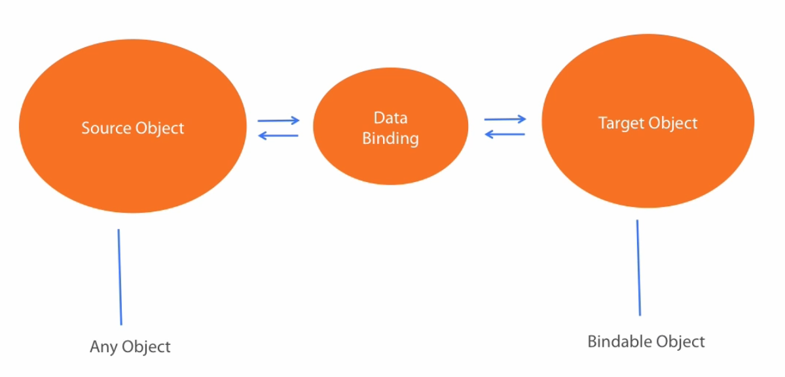
X - XAML
Data binding
Source – provides data
Target – UI control
Data Binding – automatically push changes in source to target and optionally push changes back
<Entry Text="{Binding FirstName}" ... />

Slide 10
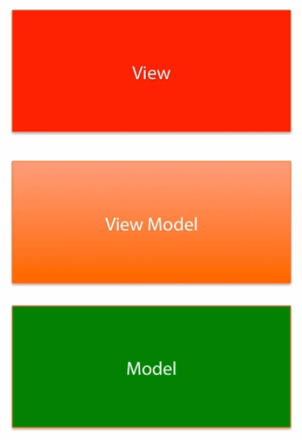
X - MVVM
Model
Data
View
UI
ViewModel
Logic
View -> View Model -> Model
Never look up!!!

Slide 11
X - Layouts

Slide 12
X - Navigation

Slide 13
X – Login view
Create MVVM folders
Model, View, ViewModel
Add Images to platform projects
iOS - Place images in the Resources folder with
Build Action: BundleResource
Place images in the Resources/drawable directory with
Build Action: AndroidResource.
Filename - only lowercase letters, numerals, the underscore, and the period are allowed. Hi-Res images with @2x, @3x suffixes on iOS, Android uses xxxhdpi folders.

Slide 14
X – Login View
Add new ContentPage to View folder
In Xaml, add StackLayout
Define controls inside StackLayout
Image
Label
Entry
Button

Slide 15
X – Login View – XAML
<?xml version="1.0" encoding="UTF-8"?> <ContentPage xmlns="http://xamarin.com/schemas/2014/forms" xmlns:x="http://schemas.microsoft.com/winfx/2009/xaml" x:Class="xapp1.LoginPage"> <ContentPage.Content> <StackLayout Padding="40" Spacing="15" x:Name="loginLayout" BackgroundColor="#F5FCFF"> <Image Source="logo.png" Aspect="AspectFit" /> <Label Text="ContactBase Client" FontSize="20" HorizontalTextAlignment="Center" /> <Entry x:Name="UserName" Placeholder="username" WidthRequest="150" /> <Entry x:Name="Password" Placeholder="password" WidthRequest="150" IsPassword="true" /> <Button x:Name="LoginButton" Text="Login" BackgroundColor="#48BBEC" TextColor="White" WidthRequest="10" Clicked="OnLogin" /> <Label Text="" FontSize="10" HorizontalTextAlignment="Center" TextColor="Red" x:Name="ErrorLabel"/> </StackLayout> </ContentPage.Content> </ContentPage>

Slide 16
X – Login View - code
public partial class LoginPage : ContentPage { public LoginPage() { InitializeComponent(); } public void OnLogin(object o, EventArgs e) { Debug.WriteLine("user: "+UserName.Text+
" pass:"+Password.Text); ErrorLabel.Text = "not implemented yet!"; Navigation.PushModalAsync(new AppContainerPage()); } }
Updates to xaml elements are automatic
Navigation
Push and Pop
Modal or not

Slide 17
X – AppContainer - TabbedView
<?xml version="1.0" encoding="UTF-8"?> <TabbedPage xmlns="http://xamarin.com/schemas/2014/forms" xmlns:x="http://schemas.microsoft.com/winfx/2009/xaml" xmlns:local="clr-namespace:xapp1;assembly=xapp1" x:Class="xapp1.AppContainerPage"> <local:PersonsPage Title="Persons" Icon="persons.png" /> <local:ContactTypesPage Title="Contact Types" Icon="contacttypes.png" /> <local:LogoutPage Title="Logout" Icon="logout.png" /> </TabbedPage>
public partial class AppContainerPage : TabbedPage { public AppContainerPage() { InitializeComponent(); } }

Slide 18
X – Data binding
<?xml version="1.0" encoding="UTF-8"?> <ContentPage xmlns="http://xamarin.com/schemas/2014/forms" xmlns:x="http://schemas.microsoft.com/winfx/2009/xaml" x:Class="xapp1.ContactTypesPage"> <ContentPage.Content> <StackLayout Padding="40" Spacing="15" BackgroundColor="#F5FCFF"> <Label Text="{Binding TestString}" /> </StackLayout> </ContentPage.Content> </ContentPage>
{Binding SomeSource}
BindingContext
public partial class ContactTypesPage : ContentPage { public string TestString { get; set; } public ContactTypesPage() { TestString = "Brexit!"; BindingContext = this; InitializeComponent(); } }

Slide 19
X – Data binding - List
<?xml version="1.0" encoding="UTF-8"?> <ContentPage xmlns="http://xamarin.com/schemas/2014/forms" xmlns:x="http://schemas.microsoft.com/winfx/2009/xaml" x:Class="xapp1.ContactTypesPage"> <ContentPage.Content> <StackLayout Padding="40" Spacing="15" BackgroundColor="#F5FCFF"> <ListView x:Name="ListView" ItemTapped="OnSelected" ItemsSource="{Binding TestStrings}"> <ListView.ItemTemplate> <DataTemplate> <ViewCell> <ViewCell.View> <Label x:Name="ListItem" Text="{Binding}" /> </ViewCell.View> </ViewCell> </DataTemplate> </ListView.ItemTemplate> </ListView> </StackLayout> </ContentPage.Content> </ContentPage>

Slide 20
X – Data binding - List
ItemTappedEventArgs e – cast to original object
DisplayAlert
public partial class ContactTypesPage : ContentPage { public List<string> TestStrings { get; set; } public ContactTypesPage() { TestStrings = new List<string>() { "Ahven", "Haug", "Kiisk" }; BindingContext = this; InitializeComponent(); } public void OnSelected(object o, ItemTappedEventArgs e) { var selectedString = e.Item as string; DisplayAlert("Chosen!", selectedString+" was selected!","OK"); } }

Slide 21
X – MVVM - ViewModel
public class ContactTypesViewModel : INotifyPropertyChanged { private ObservableCollection<ContactType> _contactTypes = new ObservableCollection<ContactType>(); public ObservableCollection<ContactType> ContactTypes { get { return _contactTypes; } set { _contactTypes = value; OnPropertyChanged("ContactTypes"); } } public event PropertyChangedEventHandler PropertyChanged; protected virtual void OnPropertyChanged(string propertyName) { if (PropertyChanged == null) return; PropertyChanged(this, new PropertyChangedEventArgs(propertyName)); } }
ViewModel

Slide 22
X – MVVM - View
<?xml version="1.0" encoding="UTF-8"?> <ContentPage xmlns="http://xamarin.com/schemas/2014/forms" xmlns:x="http://schemas.microsoft.com/winfx/2009/xaml" x:Class="xapp1.ContactTypesPage"> <ContentPage.Content> <StackLayout Padding="40" Spacing="15" BackgroundColor="#F5FCFF"> <ListView x:Name="ListView" ItemTapped="OnSelected" ItemsSource="{Binding ContactTypes}" BackgroundColor="#F5FCFF"> <ListView.ItemTemplate> <DataTemplate> <ViewCell> <ViewCell.View> <StackLayout Padding="0,0,0,0" Spacing="10" HorizontalOptions="StartAndExpand" Orientation="Horizontal"> <Image Source="{Binding ImageUri}" /> <Label Text="{Binding ContactTypeName}" HorizontalTextAlignment="Center" VerticalTextAlignment="Center" /> </StackLayout> </ViewCell.View> </ViewCell> </DataTemplate> </ListView.ItemTemplate> </ListView> </StackLayout> </ContentPage.Content> </ContentPage>

Slide 23
X – MVVM - Codebehind
public partial class ContactTypesPage : ContentPage { public ContactTypesViewModel VM { get; set; } = new ContactTypesViewModel(); public ContactTypesPage() { this.BindingContext = VM; // this sets the viewmodel/datasource to the XAML. InitializeComponent(); } protected async override void OnAppearing() { base.OnAppearing(); VM.ContactTypes = new ObservableCollection<ContactType>(
await App.ContactTypeManager.GetContactTypesAsync()); } public void OnSelected(object o, ItemTappedEventArgs e) { var selectedContactType = e.Item as ContactType; DisplayAlert("Chosen!", selectedContactType.ContactTypeName + " was selected!", "OK"); } }

