Slide 1
Building Web Applications with Microsoft ASP.NET - I376 Web Application Programming II – I713
IT College, Andres Käver, 2016-2017, Spring semester
Web: http://enos.Itcollege.ee/~akaver/ASP.NETCore
Skype: akaver Email: akaver@itcollege.ee

Slide 2
I18n DateTime – EF changes
In model classes, use attributes
DataType(DataType.DateTime)
DataType(DataType.Date)
DataType(DataType.Time)
[DataType(DataType.DateTime)] public DateTime DateTime { get; set; } [DataType(DataType.Date)] public DateTime Date { get; set; } [DataType(DataType.Time)] public DateTime Time { get; set; }
<input class="form-control" type="datetime"
data-val="true" data-val-required="The DateAndTime field is required." id="FooBar_DateAndTime" name="FooBar.DateAndTime" value="" />

Slide 3
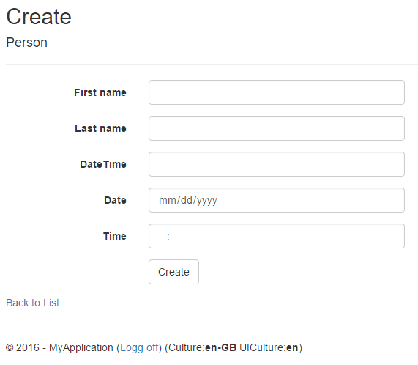
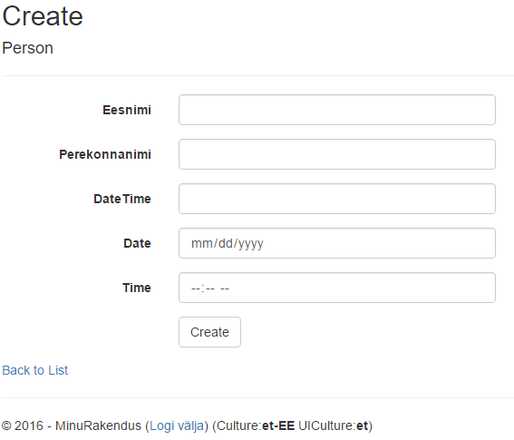
I18n - browsers
Chrome/Edge adds html5 support (but only in en-US format…)
Cant submit, will not validate on serverside (format mismatch between server and browser)

Slide 4
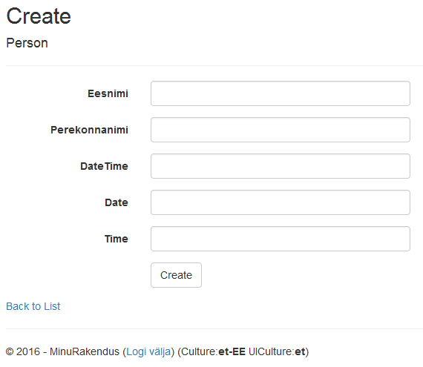
I18n - browsers
Firefox – no extra support
Unobtrusive (jquery) validation also fails

Slide 5
I18n
Solutions
Use simple text fields and dropdowns, skip clientside datetime validation
Can be problematic, different regions are used to their own way of seeing culture support (money, time, commas, etc)
Use js plugins to generate html and validate inputs – jquery
Hard to setup correctly
Jquery unobtrusive validate initially supports only en-US
Several jquery/bootstrap plugins to generate html inputs for datetime types

Slide 6
I18n – js packages
Using bower install
"globalize”
"moment”
"eonasdan-bootstrap-datetimepicker”
"cldr-core”
"cldr-numbers-modern”
"cldr-dates-modern"

Slide 7
I18n – set up js in _Layout
<script src="~/lib/cldrjs/dist/cldr.js"></script>
<script src="~/lib/cldrjs/dist/cldr/event.js"></script>
<script src="~/lib/cldrjs/dist/cldr/supplemental.js"></script>
<script src="~/lib/cldrjs/dist/cldr/unresolved.js"></script>
<script src="~/lib/globalize/dist/globalize.js"></script>
<script src="~/lib/globalize/dist/globalize/number.js"></script>
<script src="~/lib/globalize/dist/globalize/currency.js"></script>
<script src="~/lib/globalize/dist/globalize/date.js"></script>
<script src="~/lib/globalize/dist/globalize/message.js"></script>
<script src="~/lib/globalize/dist/globalize/plural.js"></script>
<script src="~/lib/globalize/dist/globalize/relative-time.js"></script>
<script src="~/lib/globalize/dist/globalize/unit.js"></script>
<script src="~/lib/moment/min/moment-with-locales.min.js"></script>
<script src="~/lib/eonasdan-bootstrap-datetimepicker/build/js/bootstrap-datetimepicker.min.js"></script>

Slide 8
I18n – configure i18n support in js
@{
var currentCultureCode = CultureInfo.CurrentCulture.Name;
if (currentCultureCode == "et-EE")
{
currentCultureCode = "et";
}
}

Slide 9
I18n – configure i18n support in js
<script type="text/javascript">
$.when(
$.get("/lib/cldr-core/supplemental/likelySubtags.json"),
$.get("/lib/cldr-core/supplemental/numberingSystems.json"),
$.get("/lib/cldr-core/supplemental/timeData.json"),
$.get("/lib/cldr-core/supplemental/weekData.json"),
$.get("/lib/cldr-numbers-modern/main/@currentCultureCode/numbers.json"),
$.get("/lib/cldr-numbers-modern/main/@currentCultureCode/currencies.json"),
$.get("/lib/cldr-dates-modern/main/@currentCultureCode/ca-generic.json"),
$.get("/lib/cldr-dates-modern/main/@currentCultureCode/ca-gregorian.json"),
$.get("/lib/cldr-dates-modern/main/@currentCultureCode/dateFields.json"),
$.get("/lib/cldr-dates-modern/main/@currentCultureCode/timeZoneNames.json")
).then(function () {
// Normalize $.get results, we only need the JSON, not the request statuses.
return [].slice.apply(arguments, [0]).map(function (result) {
return result[0];
});
}).then(Globalize.load).then(function () {
// Initialise Globalize to the current UI culture
Globalize.locale('@CultureInfo.CurrentCulture.Name');
});

Slide 10
I18n – replace browser functionality
$(function () {
$('[type="datetime"]')
.datetimepicker({ locale: '@CultureInfo.CurrentCulture.Name' })
.attr('type', 'text');
$('[type="time"]')
.datetimepicker({ locale: '@CultureInfo.CurrentCulture.Name', format: 'LT' })
.attr('type', 'text');
// attach datepicker, change type to text, set value to original from html text
$('[type="date"]').each(function (index, value) {
$(value).datetimepicker({ locale: '@CultureInfo.CurrentCulture.Name', format: 'L' })
.attr('type', 'text');
$(value).val(value.defaultValue);
});
});

Slide 11
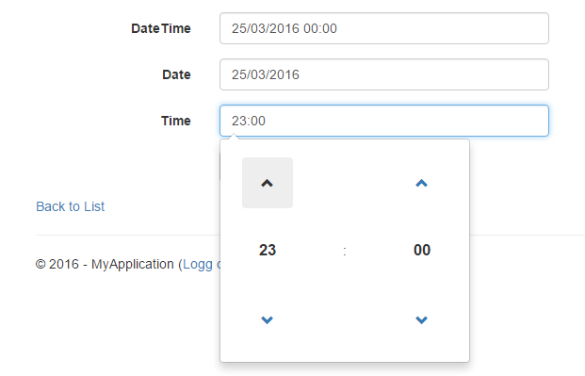
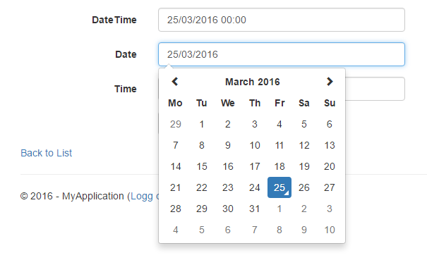
i18n – chrome/firefox

Slide 12
THE END

