Slide 1
Building Web Applications with Microsoft ASP.NET - I376
Web Application Programming II – I713
TTU IT College, Andres Käver, 2017-2018, Spring semester
Web: http://enos.Itcollege.ee/~akaver/ASP.NETCore
Skype: akaver Email: akaver@itcollege.ee

Slide 2
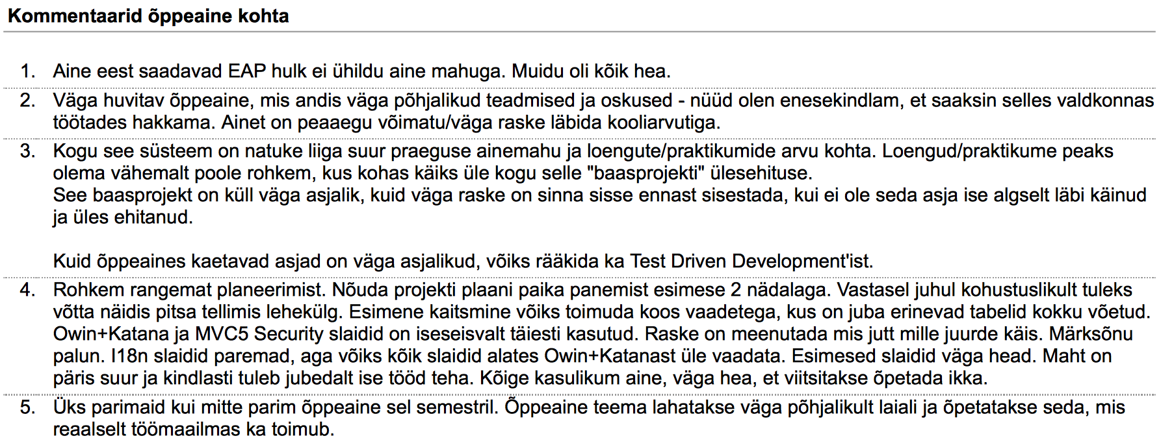
Brag – About course
http://enos.itcollege.ee/~akaver/AineKysitlused/

Slide 3
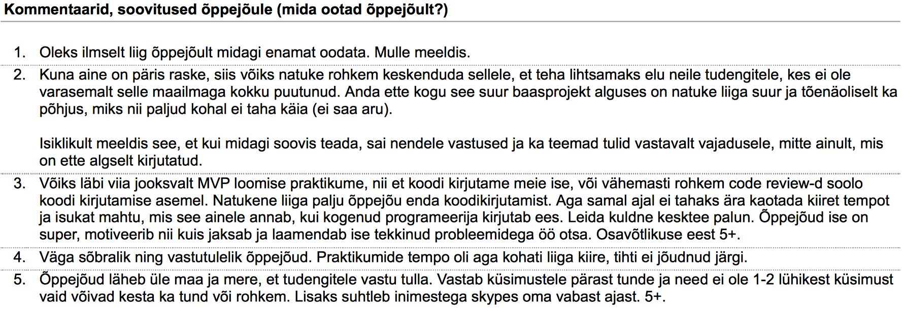
Brag – About teacher
http://enos.itcollege.ee/~akaver/AineKysitlused/

Slide 4
Technical requirements
Development environment
  Visual Studio 2017, ReSharper (Windows)
  Visual Studio Mac (OSX)
  Visual Studio Core (all platforms)
  JetBrains Rider (all platforms)
If possible, use personal laptop for development (or rdp to somewhere)
  School pc-s are not updated that frequently. You don’t have admin rights, cant install some of the required components.
Projects in git (git.akaver.com)
  Use your full name (same as in ÕIS)!

Slide 5
What, Why, How, ….
How to build web applications with modern tools and frameworks
Patterns and technologies
  Model View Controller - MVC
  Entity Framework
  Unit of Work
  Dependency Injection
  Repository
  …
Project – single person + teacher
Several milestones in project – less student syndrome

Slide 6
Grading
50% project, 15% theoretical exam, 35% practical exam
All grade components have >50% requirement
Project
  Complicated, hard, nerve breaking, all nighters
  Minimum 10 functional entities (not counting user management, logging, simple many:many in-between entities)
  Hard requirements on patterns, practices and technologies

Slide 7
Project
1 member teams + teacher
  No running away of learning it all
  Medium complexity projects (pizza ordering, time management)
  Practical project is highly recommended
Don’t leave it at the end – it is too much
End result:
  Deployed ASP.NET Core web app (Azure)
  Multilingual (UI and content! DateTimes, currency, db content etc)
  Visually and aesthetically decent (more than just default Bootstrap)
  Separate admin and client areas

Slide 8
Project
Project valuation
  Teacher is like an angel investor
  Your project does not have to be ready for worldwide full production usage
  But it has to be at level, where potential investor would understand, that you and your work is good enough for seed investment

Slide 9
VR2 and ASP.NET
App architectural structure
How to share work between different courses
Teamwork

