Slide 1
Mobile Software Development for Android - I397
IT College, Andres Käver, 2015-2016
Email: akaver@itcollege.ee
Web: http://enos.itcollege.ee/~akaver/2015-2016/Distance/Android
Skype: akaver

Slide 2
Android app components
Logging
Activity
Intent
Fragment
Service
ContentProvider
BroadcastReceiver

Slide 3
Android - ContentProvider
Access to a central repository of data
Often provides its own UI for working with the data
Primarily intended to be used by other applications
Inter-process communication and secure data access

Slide 4
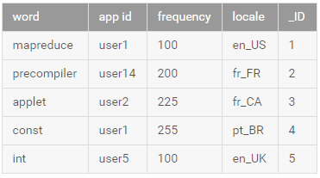
Android - ContentProvider
Provider presents data to external applications as one or more tables
Row represents an instance of some type of data the provider collects, and each column in the row represents an individual piece of data collected

Slide 5
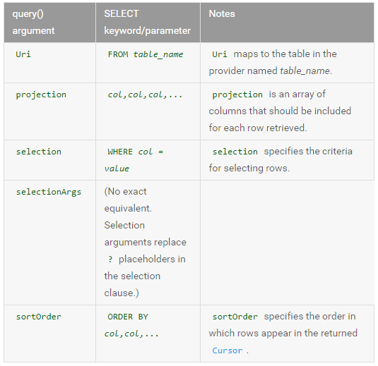
Android – ContentProvider - Accessing
ContentResolver – CRUD
NB! Permissions in manifest!
getContentResolver().query(…)
Similar to sql select statement
// Queries the user dictionary and returns results mCursor = getContentResolver().query( UserDictionary.Words.CONTENT_URI, // The content URI of the words table mProjection, // The columns to return for each row mSelectionClause // Selection criteria mSelectionArgs, // Selection criteria mSortOrder); // The sort order for the returned rows
<uses-permission android:name="android.permission.READ_USER_DICTIONARY">

Slide 6
Android – ContentProvider - Accessing
String[] projection = { UserDictionary.Words.WORD }; Cursor cursor = getContentResolver().query( UserDictionary.Words.CONTENT_URI, projection, null, null, null); while (cursor.moveToNext()) { int index = cursor.getColumnIndex(UserDictionary.Words.WORD) String word = cursor.getString(index); }

Slide 7
Android – ContentProvider - Inserting
// Defines a new Uri object that receives the result of the insertion Uri mNewUri; ... // Defines an object to contain the new values to insert ContentValues mNewValues = new ContentValues(); /* * Sets the values of each column and inserts the word. The arguments to the "put" * method are "column name" and "value" */ mNewValues.put(UserDictionary.Words.APP_ID, "example.user"); mNewValues.put(UserDictionary.Words.LOCALE, "en_US"); mNewValues.put(UserDictionary.Words.WORD, "insert"); mNewValues.put(UserDictionary.Words.FREQUENCY, "100"); mNewUri = getContentResolver().insert( UserDictionary.Word.CONTENT_URI, // the user dictionary content URI mNewValues // the values to insert );

Slide 8
Android – ContentProvider - Updating
// Defines an object to contain the updated values ContentValues mUpdateValues = new ContentValues(); // Defines selection criteria for the rows you want to update String mSelectionClause = UserDictionary.Words.LOCALE + "LIKE ?"; String[] mSelectionArgs = {"en_%"}; // Defines a variable to contain the number of updated rows int mRowsUpdated = 0; ... /* * Sets the updated value and updates the selected words. */ mUpdateValues.putNull(UserDictionary.Words.LOCALE); mRowsUpdated = getContentResolver().update( UserDictionary.Words.CONTENT_URI, // the user dictionary content URI mUpdateValues // the columns to update mSelectionClause // the column to select on mSelectionArgs // the value to compare to );

Slide 9
Android – ContentProvider - Deleting
// Defines selection criteria for the rows you want to delete String mSelectionClause = UserDictionary.Words.APP_ID + " LIKE ?"; String[] mSelectionArgs = {"user"}; // Defines a variable to contain the number of rows deleted int mRowsDeleted = 0; ... // Deletes the words that match the selection criteria mRowsDeleted = getContentResolver().delete( UserDictionary.Words.CONTENT_URI, // the user dictionary content URI mSelectionClause // the column to select on mSelectionArgs // the value to compare to );

Slide 10
Android – ContentProvider – Creating your own
Do you really need it?
You want to offer complex data or files to other applications.
You want to allow users to copy complex data from your app into other apps.
You want to provide custom search suggestions using the search framework.

Slide 11
Android – ContentProvider – Creating your own
File data or structured data
Define a concrete implementation of the ContentProvider class and its required methods.
Define the provider's authority string, its content URIs, and column names. If you want the provider's application to handle intents, also define intent actions, extras data, and flags. Also define the permissions that you will require for applications that want to access your data.

Slide 12
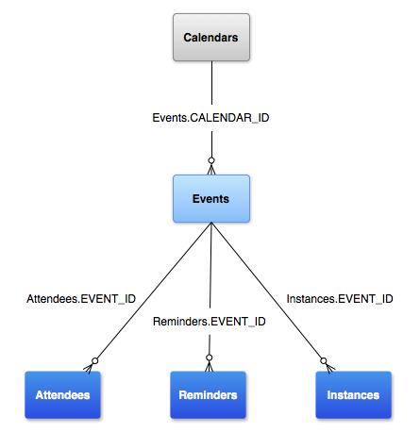
Android – ContentProvider – Calendar
Calendar Provider API allows you to perform query, insert, update, and delete operations on calendars, events, attendees, reminders, etc.
A user can have multiple calendars, and different calendars can be associated with different types of accounts (Google Calendar, Exchange)

Slide 13
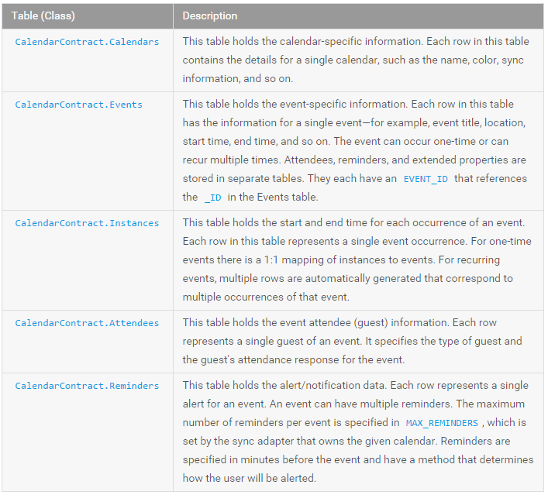
Android – ContentProvider – Calendar
<?xml version="1.0" encoding="utf-8"?> <manifest xmlns:android="http://schemas.android.com/apk/res/android"...> <uses-sdk android:minSdkVersion="14" /> <uses-permission android:name="android.permission.READ_CALENDAR" /> <uses-permission android:name="android.permission.WRITE_CALENDAR" /> ... </manifest>

Slide 14
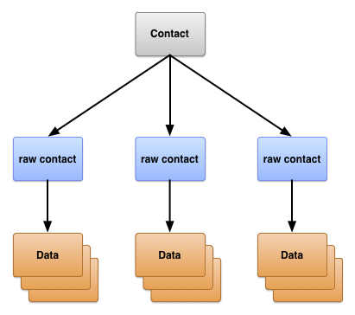
Android – ContentProvider – Contacts
Accommodates a wide range of data sources and tries to manage as much data as possible for each person, with the result that its organization is complex.
ContactsContract.Contacts table
Rows representing different people, based on aggregations of raw contact rows.
ContactsContract.RawContacts table
Rows containing a summary of a person's data, specific to a user account and type.
ContactsContract.Data table
Rows containing the details for raw contact, such as email addresses or phone numbers.

Slide 15
Android – Broadcast receiver
Component which allows you to register for system or application events.
All registered receivers for an event are notified by the Android runtime once this event happens.
Example: applications can register for the ACTION_BOOT_COMPLETED system event which is fired once the Android system has completed the boot process.

Slide 16
Android – Broadcast receiver
Can be registered via the AndroidManifest.xml
Or dynamically via the Context.registerReceiver()
Implementing class for a receiver extends the BroadcastReceiver class
If the event for which the broadcast receiver has registered happens, the onReceive() method of the receiver is called by the Android system
After the onReceive() of the receiver class has finished, the Android system is allowed to recycle the receiver
Android system excludes all receivers from receiving intents by default if the corresponding application has never been started by the user or if the user explicitly stopped the application via the Android menu (in Manage → Application).

Slide 17
Android – Broadcast receiver
import android.content.BroadcastReceiver; import android.content.Context; import android.content.Intent; import android.os.Bundle; import android.telephony.TelephonyManager; import android.util.Log; public class MyPhoneReceiver extends BroadcastReceiver { @Override public void onReceive(Context context, Intent intent) { Bundle extras = intent.getExtras(); if (extras != null) { String state = extras.getString(TelephonyManager.EXTRA_STATE); Log.w("MY_DEBUG_TAG", state); if (state.equals(TelephonyManager.EXTRA_STATE_RINGING)) { String phoneNumber = extras .getString(TelephonyManager.EXTRA_INCOMING_NUMBER); Log.w("MY_DEBUG_TAG", phoneNumber); } } } }

Slide 18
Android – Custom broadcast receiver
@Override
public void onReceive(Context context, Intent intent) {
if (isOrderedBroadcast()) {
Bundle extras = intent.getExtras();
if (extras != null) {
value1 = extras.getDouble(“something");
}
setResultCode(Activity.RESULT_OK);
setResultData(value1 + “something");
}
}

Slide 19
Android – Broadcast receiver
<application android:allowBackup="true" android:icon="@mipmap/ic_launcher" android:label="@string/app_name" android:supportsRtl="true" android:theme="@style/AppTheme"> <activity android:name=".MainActivity"> <intent-filter> <action android:name="android.intent.action.MAIN" /> <category android:name="android.intent.category.LAUNCHER" /> </intent-filter> </activity> <receiver android:name="MyPhoneReceiver" > <intent-filter> <action android:name="android.intent.action.PHONE_STATE" > </action> </intent-filter> </receiver> </application>

Slide 20
Android – Custom broadcast receiver
<manifest xmlns:android="http://schemas.android.com/apk/res/android"
package="com.akaver.custombroadcast">
<application android:allowBackup="true" android:label="@string/app_name"
android:icon="@mipmap/ic_launcher" android:supportsRtl="true"
android:theme="@style/AppTheme">
<receiver android:name=".CustomReceiver" >
<intent-filter>
<action android:name="com.akaver.sendCustomRequest" >
</action>
</intent-filter>
</receiver>
</application>
</manifest>

Slide 21
Android – Broadcast receiver
Sending broadcast
Sending to custom receiver, waiting for answer
Intent intent = new Intent(); intent.setAction("com.example.ACTION_SOMETHING_HAPPENED"); sendBroadcast(intent);
Intent intent = new Intent();
intent.setAction("com.akaver.sendCustomRequest");
intent.addFlags(Intent.FLAG_INCLUDE_STOPPED_PACKAGES);
intent.putExtra(“something", value);
sendOrderedBroadcast(intent, null, new BroadcastReceiver() {
@Override
public void onReceive(Context context, Intent intent) {
String result = getResultData();
screen.setText(result);
}
}, null, Activity.RESULT_OK, null, null);

Slide 22
Android – Broadcast receiver - Pending Intent
Token that you give to another application (e.g., notification manager, alarm manager or other 3rd party applications), which allows this other application to use the permissions of your application to execute a predefined piece of code
To perform a broadcast via a pending intent, get a PendingIntent via the getBroadcast() method of the PendingIntent class. To perform an activity via a pending intent, you receive the activity via PendingIntent.getActivity()

Slide 23
Android – Broadcast receiver - Pending Intent
public void startAlert(View view) { EditText text = (EditText) findViewById(R.id.time); int i = Integer.parseInt(text.getText().toString()); Intent intent = new Intent(this, MyBroadcastReceiver.class); PendingIntent pendingIntent = PendingIntent.getBroadcast(this.getApplicationContext(), 234324243, intent, 0); AlarmManager alarmManager = (AlarmManager) getSystemService(ALARM_SERVICE); alarmManager.set(AlarmManager.RTC_WAKEUP, System.currentTimeMillis() + (i * 1000), pendingIntent); Toast.makeText(this, "Alarm set in " + i + " seconds", Toast.LENGTH_LONG).show(); }

Slide 24
Android – Broadcast receiver - Pending Intent
So what's a pending intent?
It's a token that your app process will give to the location process, and the location process will use it to wake up your app when an event of interest happens. So this basically means that your app in the background doesn't have to be always running. When something of interest happens, we will wake you up. This saves a lot of battery.
PendingIntent mIntent = PendingIntent.getService(...); mLocationClient.requestLocationUpdates(locationRequest, mIntent); public void onHandleIntent(Intent intent) { String action = intent.getAction(); if (ACTION_LOCATION.equals(action)) { Location location = intent.getParcelableExtra(...) } }

