Slide 1
Introduction to Apple mobile technologies- I393
IT College, Andres Käver, 2016-2017 Spring
Web: http://enos.itcollege.ee/~akaver/apple
Skype: akaver Email: akaver@itcollege.ee

Slide 2
iOS
Recommended iTunes course (already old, uses Xcode 7 and Swift 2)
Developing iOS 9 Apps with Swift – by Stanford
https://itunes.apple.com/ee/course/developing-ios-9-apps-swift/id1104579961
https://www.youtube.com/channel/UCYVp6suz7ztKAKY8jpfACXA/videos?flow=grid&view=0&sort=da
Home reading
The Swift Programming Language
https://developer.apple.com /library/content/documentation/Swift/Conceptual/Swift_Programming_Language/

Slide 3
iOS
Requirements
Programming experience – java, databases, algorithms
OOP
Class, Instance, Superclass/Subclass
Message, Method
Protocol (interface)
Reference vs Value types, Instance variable
Closures...

Slide 4
iOS
Requirements
Latest Xcode (8.2.1)
IT College class 320 – limited access
Or macOS based computer (ca be rented from Apple resellers)
Or virtualized macOS (slow, but works)
Or rented virtual access
http://www.macincloud.com/ ($20+ month)
HostMyApple, MacStadium, vmOSX, Xcloud, Xcodeclub, …

Slide 5
iOS
What’s in iOS
Core OS
OSX Kernel, Mach 3, BSD, Sockets, Security, Power Management, Keychain Access, Certificates, File System, Bonjour
Core Services
Collections, Address Book, Networking, File Access, SQLite, Core Location, Net Services, Threading, Preferences, URL Utilities
Media
Core Audio, OpenAL, Audio Mixing, Audio Recording, Video Playback, Images, PDF, Quartz, Core Animation, OpenGL ES
Cocoa Touch
Multi-Touch, Core Motion, View Hierarchy, Localization, Controls, Alerts, WebView, Map Kit, Image Picker, Camera

Slide 6
iOS - Swift
Latest language in development scene (released in autumn 2014)
Current version is 3 (released in sept 13, 2016 - not source compatible with Swift 2.2!!!)
You can mix it with older Apple language of choice – Objective C
Language is open source
https://swift.org

Slide 7
iOS - Swift
Mandatory reading – a Swift tour
https://developer.apple.com/library/prerelease/content/documentation/Swift/Conceptual/Swift_Programming_Language/GuidedTour.html

Slide 8
iOS - MVC
All iOS development is MVC based!
Model – data and business logic
View – UI
Controller – the glue between View and Model
Controller can directly control Model and View (Outlet)
Model and View never communicate with each other
View communicates with controller via
Action
Outlet
Delegate (should, will, did) – property in view using protocol
Data source – protocol
Model communicates via broadcasts – notifications & KVO – Key Value Observing

Slide 9
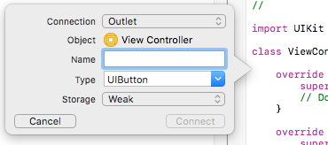
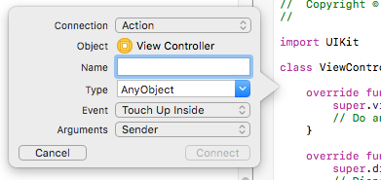
iOS – connecting UI and code
Open up Assistant editor (click double rings in upper right corner)
Hold ctrl key and drag with your mouse from UI element to code
Choose type for connection: Outlet or Action
Action – UI calls into code (buttons)
Outlet – code updates UI (labels)

Slide 10
iOS
Demo and some hands-on!

