Slide 1
C# - Entity Framework
IT College 2016, Andres käver
http://enos.itcollege.ee/~akaver/csharp

Slide 2
C# - ORM
ORM – Object Relational Mapping
For converting data between incompatible type systems in oop languages.
In effect creates “virtual object database”, for using within the oop language
.NET ORM systems
Entity Framework – Microsoft
NHibernate
Dapper
… and many others

Slide 3
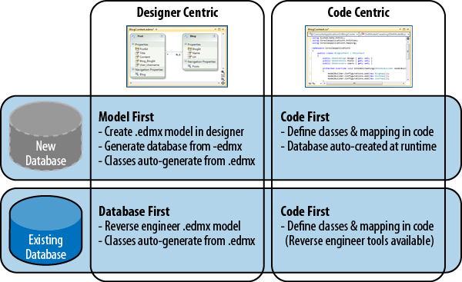
C# - EF
Model, databse or code first?

Slide 4
C# - EF, Code First
Code First approach
Write your business classes
Add relationships between classes
Add attributes
Add custom getters and setters where needed
EF will construct database based on your classes
EF will handle all the CRUD, converting code into sql clauses

Slide 5
C# - EF conventions
Every entity (class) has to contain attribute suitable for primary key (PK)
Attribute with name Id or <EntityName>Id is automatically taken as PK
Other conventions set string length, structure of tables in case of inheritance, cascade delete, etc
Every convention in EF can be configured or changed
You can add your own conventions

Slide 6
C# - EF and DbContext
Entities have no idea of EF
To use EF you need to add class, that inherits from DbContext
Inside DbContext, add neccesary DbSet<Entity> attributes
Relational tables are created automatically
DbContext – database, DbSet – table in database

Slide 7
C# - EF, DbContext
public class ContactContext : DbContext
{
public DbSet<Person> People { get; set; }
public DbSet<Contact> Contacts { get; set; }
public DbSet<ContactType> ContactTypes { get; set; }
}

Slide 8
C# - EF, DB initialization
EF will create your DB on first access
Afterwards, when you change your domain classes – exception:
EF will create in memory model of your Db structure and save its hash into db. During next db initialization hashes are compared – if they are not matching – db is changed from outside.
Solution – migrations (data is retained) or recreation (data is lost) of db.
The model backing the 'ContactContext' context has changed since the database was created. Consider using Code First Migrations to update the database (http://go.microsoft.com/fwlink/?LinkId=238269).

Slide 9
C# - EF, Db initialization
Different strategies exist
CreateDatabaseIfNotExists – default
DropCreateDatabaseIfModelChanges
DropCreateDatabaseAlways
MigrateDatabaseToLatestVersion
Or create your own
Set DB initializer in your DbContext class constructor
Database.SetInitializer<MyDBContext>(new DropCreateDatabaseIfModelChanges <MyDBContext>());

Slide 10
C# - EF, annotations, Fluent API
Annotations are the simplest way to configure your entities for EF
Several frameworks use the same annotations (MVC, Web Api, EF)
Annotations don’t cover all options
Fluent API is capable of full EF configuration. But only EF sees those configurations.
It is necessary to use both options.
using System.ComponentModel.DataAnnotations; ... public class ContactType { ... [Required] [MaxLength(128)] public String Name { get; set; } ... } ...
public class ContactConfiguration : EntityTypeConfiguration<Contact>
{
public ContactConfiguration()
{
Property(t =>t.Value).IsRequired().HasMaxLength(128);
}
}

Slide 11
C# - EF, Key
[Key]
Sets, that this attribute is used as primary key in Db
Fluent: Entity<T>.HasKey(t=>t.PropertyName)

Slide 12
C# - EF, Required
[Required]
Attribute value is required, NULL is not allowed in Db
Fluent: Entity<T>.Property(t=>t.PropertyName). IsRequired

Slide 13
C# - EF, MaxLength, MinLength
[MaxLength(xxx)]
Max length of string, db type is nvarchar(xxx)
[MinLength(yyy)]
String minimum length, used in client side validation (MVC), no Fluent API.
Fluent: Entity<T>.Property(t=>t.PropertyName). HasMaxLength(nn)

Slide 14
C# - EF, NotMapped
[NotMapped]
If attribute is synthetic (calculated) and not stored into Db
Fluent: Entity.Ignore(d => d.Property);

Slide 15
C# - EF, ForeignKey
[ForeignKey("XxxId")] – on object
[ForeignKey("XxxName")] – on Id
Used in case of multiple same type relationships, or if names and keynames of entities don’t match
Fluent: modelBuilder.Entity<>().HasRequired().WithMany(). HasForeignKey();

Slide 16
C# - EF, Fluent API
using System.Data.Entity;
using System.Data.Entity.ModelConfiguration;
namespace ContactsLibrary
{
public class PersonConfiguration : EntityTypeConfiguration<Person>{
public PersonConfiguration()
{
Property(l => l.FirstName).IsRequired().HasMaxLength(150);
}
}
public class ContactContext : DbContext{
public DbSet<Person> People { get; set; }
public DbSet<Contact> Contacts { get; set; }
public DbSet<ContactType> ContactTypes { get; set; }
protected override void OnModelCreating(DbModelBuilder modelBuilder)
{
modelBuilder.Configurations.Add(new PersonConfiguration());
}
}
}

Slide 17
C# - Fluent API only configurations
Decimal precision (default 18,2) Entity<T>.Property(t=>t.PropertyName). HasPrecision(n,n)
Defining relationships Entity.Has[Multiplicity](Property). With[Multiplicity](Property) Has – HasOptional, HasRequired, HasMany With – WithOptional, WithRequired, WithMany
Disabling cascade delete Entity.HasRequired().WithMany(). WillCascadeOnDelete(false)
Changing conventions: modelBuilder.Conventions.Remove<PluralizingTableNameConvention>(); modelBuilder.Conventions.Remove<OneToManyCascadeDeleteConvention>(); http://msdn.microsoft.com/en-us/library/gg696316

Slide 18
C# - EF Logging
To see, what EF is doing
context.Database.Log = Console.Write;
Context.Database.Log is an Action<string> so that you can attach any method which has one string parameter and void return type.
public class Logger
{
public static void Log(string message)
{
Console.WriteLine("EF Message: {0} ", message);
}
}

Slide 19
C# - EF, Db connection
EF system configuration is in startup project config file (app.config)
Add connection string
Use it in DbContext constructor
<configuration>
<configSections>
</configSections>
<connectionStrings>
<add name="DataBaseConnectionStr" connectionString="Data Source=(LocalDb)\MSSQLLocalDB;Initial Catalog=mydbname;Integrated Security=True;MultipleActiveResultSets=true" providerName="System.Data.SqlClient" />
</connectionStrings>
public class MyDBContext: DbContext
{
public MyDBContext(): base(“name=DataBaseConnectionStr")
{

Slide 20
The end is near….

Slide 21
The end

