Slide 1
C# - EF Core Intro
IT College, Andres Käver, 2018-2019, Fall semester
Web: http://enos.Itcollege.ee/~akaver/csharp
Skype: akaver Email: akaver@itcollege.ee

Slide 2
EF Core
Total rewrite of Entity Framework
Previous version of EF - EF6 is production ready, fully supported, stable
EF Core is production ready!
Some features are still missing
Some features will never be there
Some features will only be in EF Core

Slide 3
EF Core – Console app
PM> Install-Package
Microsoft.EntityFrameworkCore.SqlServer
Microsoft.EntityFrameworkCore.Design
Microsoft.EntityFrameworkCore.Tools (VS tools) or Microsoft.EntityFrameworkCore.Tools.DotNet (Command line tools)

Slide 4
EF Core – Model and Context
public class Person
{
public int PersonId { get; set; }
public string FirstName { get; set; }
public string LastName { get; set; }
public List<Contact> Contacts { get; set; } = new List<Contact>();
}
public class ContactType
{
public int ContactTypeId { get; set; }
public string ContactTypeValue { get; set; }
public List<Contact> Contacts { get; set; } = new List<Contact>();
}
public class Contact
{
public int ContactId { get; set; }
public string ContactValue { get; set; }
public int PersonId { get; set; }
public Person Person { get; set; }
public int ContactTypeId { get; set; }
public ContactType ContactType { get; set; }
}

Slide 5
EF Core – Model and Context
public class DataBaseContext : DbContext
{
public DbSet<Person> People { get; set; }
public DbSet<Contact> Contacts { get; set; }
public DbSet<ContactType> ContactTypes { get; set; }
protected override void OnConfiguring(DbContextOptionsBuilder optionsBuilder)
{
optionsBuilder.UseSqlServer(
@"Server=(localdb)\mssqllocaldb;Database=MyDatabase;Trusted_Connection=True;");
}
}

Slide 6
EF Core – Basic stuff
Write your models (POCO-s)
Every class used in EF needs primary key (PK)
By convention, PK-s are named <ClassName>Id or Id
Declare context class, derived from DbContext
Inside context class add DbSet<YourPoco>
If you don’t include all pocos in DbSets, EF will autodiscover them and create tables for them
Don’t rely on EF automatic creation of properties and other stuff! Check your DB structure, does it match your model 1:1!

Slide 7
EF Core – Initial DB migration
EF Core will not automatically create for you db creation code
Open Tools->NuGet Package Manager->Package Manager Console
PM> Add-Migration InitialDbCreation To undo this action, use Remove-Migration.
Console> dotnet ef migrations add InitialDbCreation
Migrations folder is created, with necessary classes for DB creation and Model structure

Slide 8
EF Core – Initial DB Creation
In PM console PM> Update-Database Console> dotnet ef database update
PM> Update-Database -verbose
Executed DbCommand (202ms) [Parameters=[], CommandType='Text', CommandTimeout='60']
CREATE DATABASE [MyDatabase];
Executed DbCommand (58ms) [Parameters=[], CommandType='Text', CommandTimeout='60']
IF SERVERPROPERTY('EngineEdition') <> 5 EXEC(N'ALTER DATABASE [MyDatabase] SET READ_COMMITTED_SNAPSHOT ON;');
Executed DbCommand (12ms) [Parameters=[], CommandType='Text', CommandTimeout='30']
CREATE TABLE [__EFMigrationsHistory] (
[MigrationId] nvarchar(150) NOT NULL,
[ProductVersion] nvarchar(32) NOT NULL,
CONSTRAINT [PK___EFMigrationsHistory] PRIMARY KEY ([MigrationId])
);

Slide 9
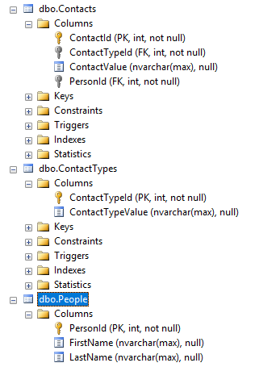
EF Core – Check structure
Check DB structure you got!
It has to match your model 1:1
Look out for automatically created fields or tables.
Use VS View->Server Explorer or MS SQL Server Management Studio Or any other tool suitable for your DB engine
EF Core supports several DB engines (most have multiple connector providers)

Slide 10
EF Core – Use your model/context
static void Main(string[] args)
{
using (var db = new DataBaseContext())
{
db.People.Add(new Person { FirstName="Andres", LastName = "Käver" });
var count = db.SaveChanges();
Console.WriteLine("{0} records saved to database", count);
Console.WriteLine();
Console.WriteLine("All people in database:");
foreach (var person in db.People)
{
Console.WriteLine($" - {person.FirstName} {person.LastName}");
}
}
}

