Slide 1
Building Distributed Systems – ICD0009
Network Applications II: Distributed Systems – I371
TalTech IT College, Andres Käver, 2018-2019, Spring semester
Web: http://enos.Itcollege.ee/~akaver/DistributedSystems
Skype: akaver Email: akaver@itcollege.ee

Slide 2
Identity
No Authentication
  No authentication/authorization
Individual User Accounts
  Login info stored in app db – supports 3rd party logins – FB, Google, etc.
Work or School Accounts
  Active directory
Windows Authentication
  Intranet apps

Slide 3
Identity methods in code
Most of the initial setup is done by the middleware
  User.IsAuthenticated()
  User.IsInRole(“rolename”)
  User.GetDisplayName
  UserManager.GetUserName(User)
  SignInManager.IsSignedIn(User)

Slide 4
Identity Attributes
[Authorize] – controller or action method
  Only logged in users (redirect to login page)
[AllowAnonymous]
  Will always override [Authorize]
[Authorize(Roles=“admin, sales”)]
  Roles in single list are OR-ed
[Authorize(Roles=“admin”)]
[Authorize(Roles=“sales”)]
  Two or more attributes are AND-ed

Slide 5
Identity – SQL injection
Identity does not protect against SQL injection / resource probing!!
…/foobars/1 vs …/foobars/27

Slide 6
Identity middleware options
In ConfigureServices…
services.Configure<IdentityOptions>(options => {
// Password settings
options.Password.RequireDigit = true;
options.Password.RequiredLength = 8; options.Password.RequireNonAlphanumeric = false; options.Password.RequireUppercase = true; options.Password.RequireLowercase = false; options.Password.RequiredUniqueChars = 6;
// Lockout settings
options.Lockout.DefaultLockoutTimeSpan = TimeSpan.FromMinutes(30); options.Lockout.MaxFailedAccessAttempts = 10; options.Lockout.AllowedForNewUsers = true;
// User settings
options.User.RequireUniqueEmail = true;
});

Slide 7
Identity middleware options
services.ConfigureApplicationCookie(options => {
// Cookie settings
options.Cookie.HttpOnly = true;
options.ExpireTimeSpan = TimeSpan.FromMinutes(30);
// If the LoginPath isn't set, ASP.NET Core defaults
// the path to /Account/Login.
options.LoginPath = "/Account/Login";
// If the AccessDeniedPath isn't set, ASP.NET Core defaults
// the path to /Account/AccessDenied.
options.AccessDeniedPath = "/Account/AccessDenied"; options.SlidingExpiration = true;
});

Slide 8
Identity middleware
Use configured middleware in Configure…
app.UseAuthentication();

Slide 9
Identity
Identity is based on claims
Dictionary of string keys and values
Some keys are standardized
Roles, user, user in role, etc. – abstractions constructed out of claims

Slide 10
Identity
Default identity is based on IdentityUser and IdentityRole – both are using strings/guid as primary key.
Default UI for identity is based on Razor pages, compiled into class library – not directly visible in code.

Slide 11
Identity - Extending
Add app specific user and role entities
namespace Domain.Identity
{
public class AppUser : IdentityUser<int> // PK type is int
{
// add relationships and data fields you need
}
public class AppRole : IdentityRole<int> // PK type is int
{
}
}

Slide 12
Identity – extending - AppDbContext
Derive your app DbContext from IdentityDbContext
namespace DAL.App.EF
{
// Force identity db context to use our AppUser and AppRole –
// with int as PK type
public class AppDbContext : IdentityDbContext<AppUser, AppRole, int>
{
public AppDbContext(DbContextOptions<AppDbContext> options)
: base(options)
{
}
// App DbSets

Slide 13
Identity – Configure startup
Use your AppDbContext and user/role
Don’t forget to update to AppUser in /Views/Shared/_LoginPartial.cshtml
services.AddDefaultIdentity<AppUser>()
.AddDefaultUI(UIFramework.Bootstrap4)
.AddEntityFrameworkStores<AppDbContext>();

Slide 14
Identity – Custom UI (Extended AppUser)
Scaffold identity Razor pages into Web project
  Prerequired: > dotnet tool install -g dotnet-aspnet-codegenerator
From inside Web project directory, run
> dotnet aspnet-codegenerator identity -dc DAL.App.EF.AppDbContext -f
Make no mistakes with DbContext name – new context and startup will be generated in case of mismatch! (it is CASE sensitive)

Slide 15
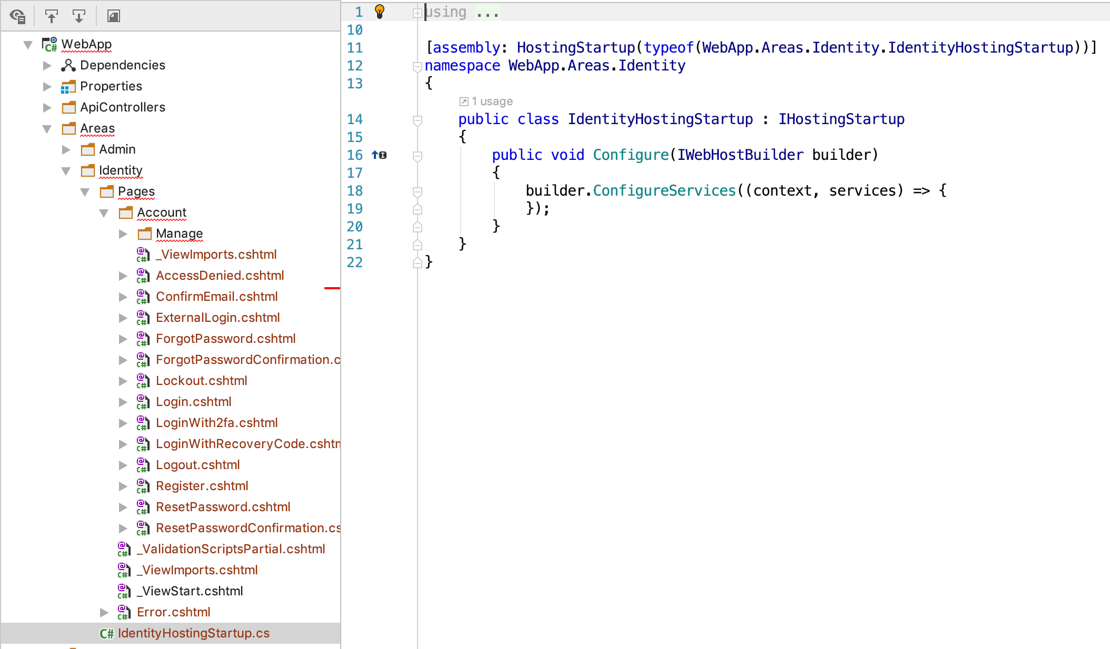
Identity – Custom UI

Slide 16
Identity – Full identity UI source
To obtain full control over identity, modify startup:
services
.AddIdentity<AppUser, AppRole>()
.AddEntityFrameworkStores<AppDbContext>()
.AddDefaultTokenProviders();
services.AddMvc()
.SetCompatibilityVersion(CompatibilityVersion.Version_2_2)
.AddRazorPagesOptions(options =>
{
options.AllowAreas = true;
options.Conventions.AuthorizeAreaFolder("Identity", "/Account/Manage");
options.Conventions.AuthorizeAreaPage("Identity", "/Account/Logout");
});

Slide 17
Identity – Full identity UI source
To obtain full control over identity, modify startup - cont:
services.ConfigureApplicationCookie(options =>
{
options.LoginPath = $"/Identity/Account/Login";
options.LogoutPath = $"/Identity/Account/Logout";
options.AccessDeniedPath = $"/Identity/Account/AccessDenied";
});
services.AddSingleton<IEmailSender, EmailSender>();

Slide 18
Identity – Full identity UI source
Add dummy IEmailSender implementation
namespace WebApp.Helpers
{
public class EmailSender : IEmailSender
{
public Task SendEmailAsync(string email, string subject, string message)
{
return Task.CompletedTask;
}
}
}

Slide 19
Identity – UI – Layout fixes
Fix layout issues in /Areas/Identity/Pages/Account/Manage
  In _Layout.cshtml
  Layout = "/Views/Shared/_Layout.cshtml";
  Create _ViewStart.chtml
  @{
  Layout = "_Layout";
  }
https://github.com/aspnet/Docs/issues/8440

Slide 20
Identity – Custom UI
Now you have full control over Identity in your Web project.
Modify AppUser, AppRole – and update Razor pages when/where needed
NB! There is no UI for role management – implement your own.
Use: RoleManager<AppRole> _roleManager;
Similar to UserManager – add, create and modify roles.
Roles are assigned to users via UserManager.

