Slide 1
Building Distributed Systems – ICD0009 Network Applications II: Distributed Systems – I371
TalTech IT College, Andres Käver, 2018-2019, Spring semester
Web: http://enos.Itcollege.ee/~akaver/DistributedSystems
Skype: akaver Email: akaver@itcollege.ee

Slide 2
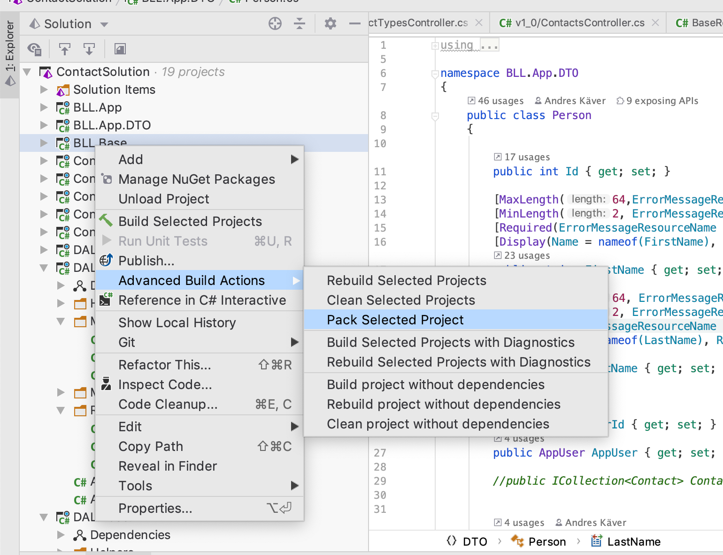
Nuget
Make a package build

Slide 3
Nuget
Find where the new nuget package was created

Slide 4
Nuget
Publish the package to local Nuget repo
nuget add /Users/akaver/Development/ITCollege/Distributed/DistributedDemo2019Spring/ContactSolution/BLL.Base/bin/Debug/BLL.Base.1.0.0.nupkg -source ~/nuget_repo

Slide 5
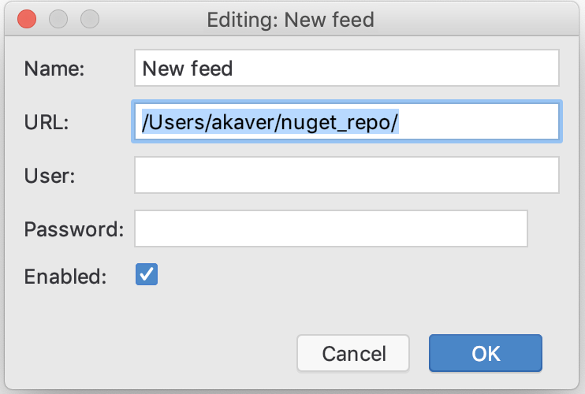
Nuget
Start a new project and add a reference to local repository

Slide 6
Nuget
Install the package in regular way.
Don’t forget your nuget package dependencies – everything has to be there!

Slide 7
Nuget
Typical packages in demo solution to add into nuget
Contracts.Base
Contracts.DAL.Base
Contracts.BLL.Base
DAL.Base.EF
BLL.Base
Identity

Slide 8
Nuget – nuget.org
Move your shared base packages into new solution (create it in your git repo folder)
Fix namespaces and project directory names
Add package build directives into csproj files
Rebuild solution in release mode – nuget packages will be created
<PropertyGroup>
<TargetFramework>netstandard2.0</TargetFramework>
<GeneratePackageOnBuild>true</GeneratePackageOnBuild>
<PackageVersion>1.0.2</PackageVersion>
<PackageLicenseExpression>MIT</PackageLicenseExpression>
</PropertyGroup>

Slide 9
Nuget – Nuget.org
Create account in nuget.org and get an api key
Publish your packages in nuget.org >nuget push -Source https://api.nuget.org/v3/index.json -ApiKey oy2i6er24xmbcsp2oasa6jfarhxohh5uzcpwvpiyseogki /Users/akaver/Development/ITCollege/Distributed/ee.itcollege.akaver/ee.itcollege.akaver.BLL.Base/bin/Release/ee.itcollege.akaver.BLL.Base.1.0.2.nupkg
Update your projects to use your nuget packages from nuget.org
Push solution into your git repository!

Slide 10
Nuget
The END!

