Slide 1
Mobile Software Development for Android - I397
TTU IT College, Andres Käver, 2018-2019
Email: akaver@itcollege.ee
Web: http://enos.itcollege.ee/~akaver/Android
Skype: akaver

Slide 2
Layout fundamentals
Basic layout
Linear
Relative
Frame
Table
Basic attributes
Size
Margin vs padding
Gravity

Slide 3
Layout
Defines declaritively visual structure for app
Takes into consideration screen properties
size
pixel density
System calculates sizes and position for all UI elements

Slide 4
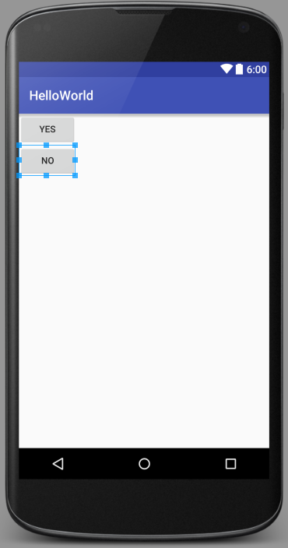
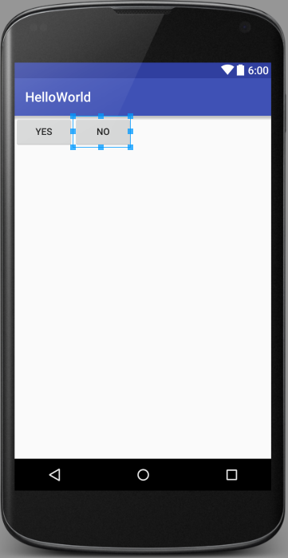
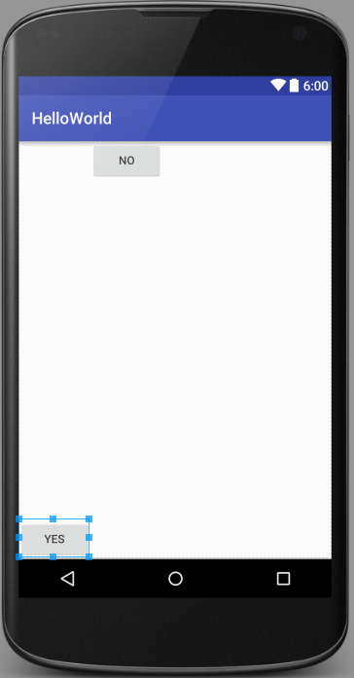
Layout

Slide 5
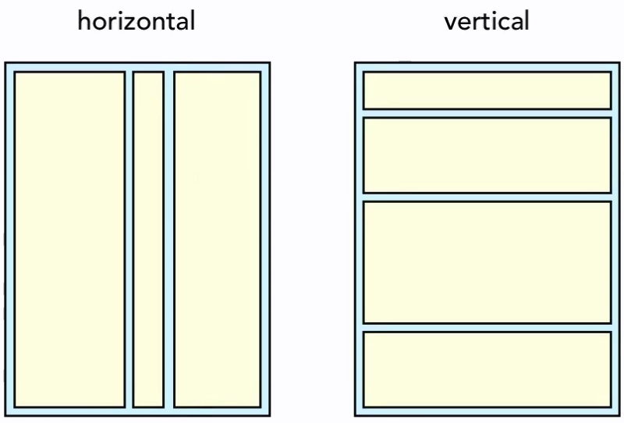
Layout - LinearLayout
Arranges its children in single direction
Orientation=“horizontal”
Orientation=“vertical”
<?xml version="1.0" encoding="utf-8"?> <LinearLayout
xmlns:android="http://schemas.android.com/apk/res/android" android:orientation="horizontal"
android:layout_width="match_parent" android:layout_height="match_parent"> …ui elements… </LinearLayout>

Slide 6
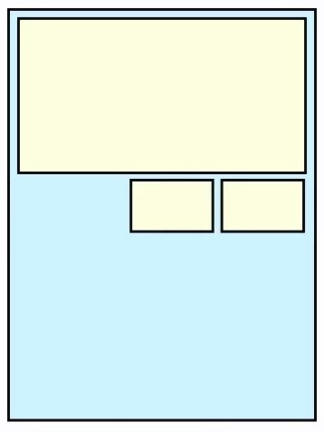
Layout - RelativeLayout
Elements are arranged relative to
Parent UI element
Sibling UI element
<?xml version="1.0" encoding="utf-8"?> <RelativeLayout xmlns:android="http://schemas.android.com/apk/res/android" android:layout_width="match_parent" android:layout_height="match_parent"> <EditText android:layout_width="wrap_content" android:layout_height="200px" android:inputType="textMultiLine" android:ems="10" android:id="@+id/editText2" android:layout_alignParentTop="true" android:layout_alignParentStart="true" android:layout_alignParentEnd="true" /> <Button android:layout_width="wrap_content" android:layout_height="wrap_content" android:text="New Button" android:id="@+id/button4" android:layout_below="@+id/editText2" android:layout_alignParentEnd="true" /> <Button android:layout_width="wrap_content" android:layout_height="wrap_content" android:text="New Button" android:id="@+id/button5" android:layout_alignBottom="@+id/button4" android:layout_toStartOf="@+id/button4" /> </RelativeLayout>

Slide 7
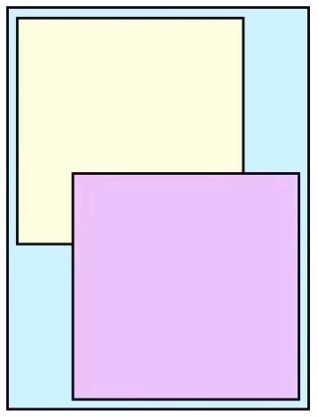
Layout - FrameLayout
Allows to put child views on top of each other
Specify order
Layout gravity for positioning

Slide 8
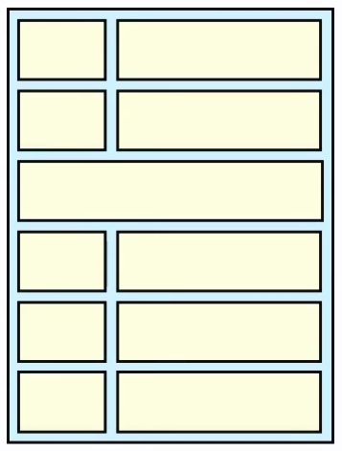
Layout - TableLayout
Rows and Columns
Like Linear vertical nesting Linear horizontal
Columns are aligned (by the widest in all the rows)

Slide 9
Basic attributes
Used across all layouts
Size
Margin vs padding
Gravity

Slide 10
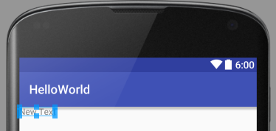
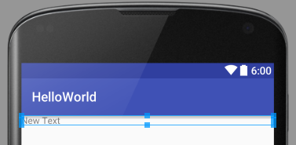
Size
Match_parent
Wrap_content
Use background tint for visual cues
Xxxdp
Density-independent pixel
px = dp * density
density = bucket(dpi/160)
<?xml version="1.0" encoding="utf-8"?> <LinearLayout xmlns:android="http://schemas.android.com/apk/res/android" android:orientation="vertical" android:layout_width="match_parent" android:layout_height="match_parent"> <TextView android:layout_width="match_parent" android:layout_height="wrap_content" android:text="New Text" android:id="@+id/textView2" /> </LinearLayout>
android:background="#ff0000"

Slide 11
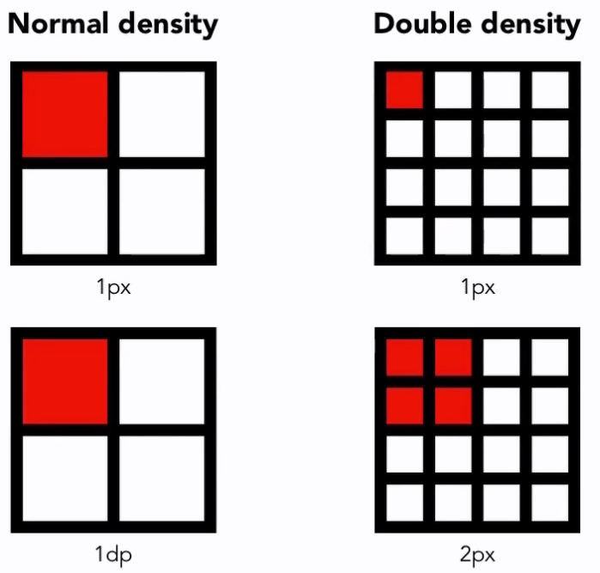
Size - dp

Slide 12
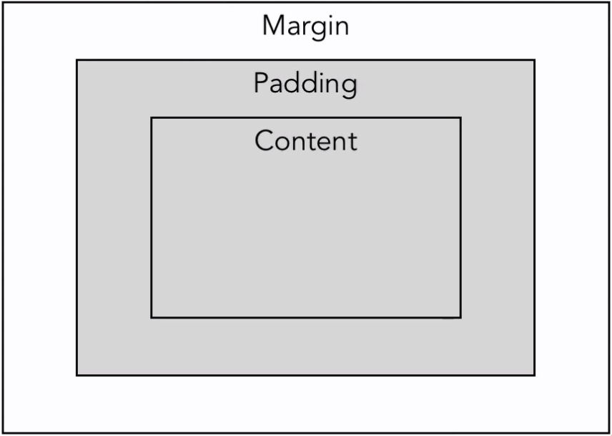
Margin vs padding

Slide 13
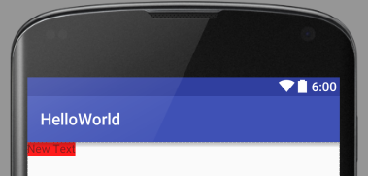
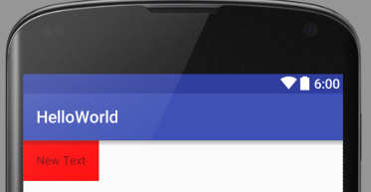
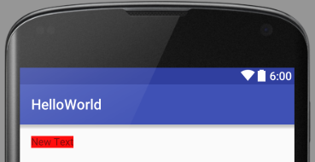
Margin vs padding
No margin
android:padding
android:layout_margin
layout_xxx prefix – deals with data from outside the view
padding – inside the view

Slide 14
Gravity
Android:layout_gravity
Position of the view, regarding its parent
Android:gravity
Position of the content inside the view

Slide 15
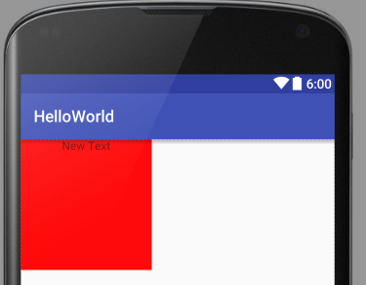
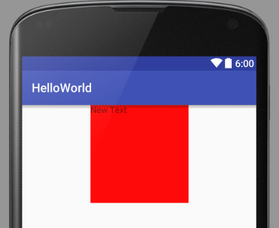
Gravity
<?xml version="1.0" encoding="utf-8"?> <LinearLayout xmlns:android="http://schemas.android.com/apk/res/android" android:orientation="vertical" android:layout_width="match_parent" android:layout_height="match_parent"> <TextView android:layout_width="160dp" android:layout_height="160dp" android:gravity="center_horizontal" android:background="#ff0000" android:text="New Text" android:id="@+id/textView2" /> </LinearLayout>
<?xml version="1.0" encoding="utf-8"?> <LinearLayout xmlns:android="http://schemas.android.com/apk/res/android" android:orientation="vertical" android:layout_width="match_parent" android:layout_height="match_parent"> <TextView android:layout_width="160dp" android:layout_height="160dp" android:layout_gravity="center_horizontal" android:background="#ff0000" android:text="New Text" android:id="@+id/textView2" /> </LinearLayout>

Slide 16
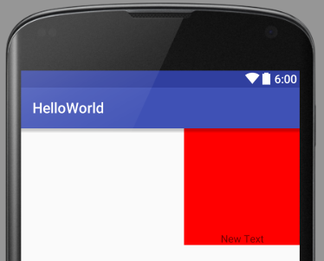
Gravity
Can be mixed and combined
<?xml version="1.0" encoding="utf-8"?> <LinearLayout xmlns:android="http://schemas.android.com/apk/res/android" android:orientation="vertical" android:layout_width="match_parent" android:layout_height="match_parent"> <TextView android:layout_width="160dp" android:layout_height="160dp" android:gravity="center_horizontal|bottom" android:layout_gravity="right" android:background="#ff0000" android:text="New Text" android:id="@+id/textView2" /> </LinearLayout>

Slide 17
LinearLayout
What is LinearLayout?
Gravity
Weight
Nested layout

Slide 18
LinearLayout

Slide 19
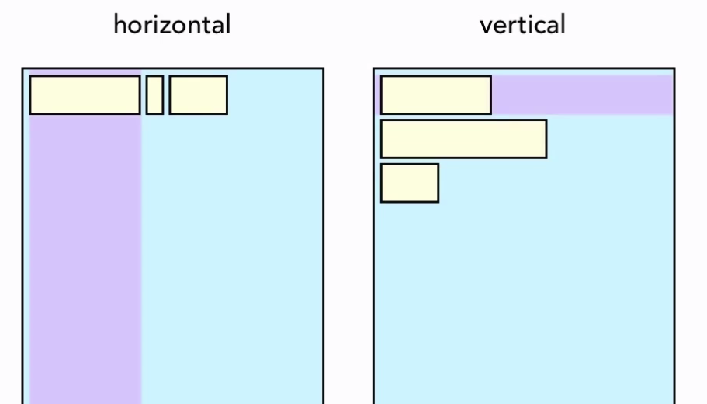
LinearLayout - Gravity

Slide 20
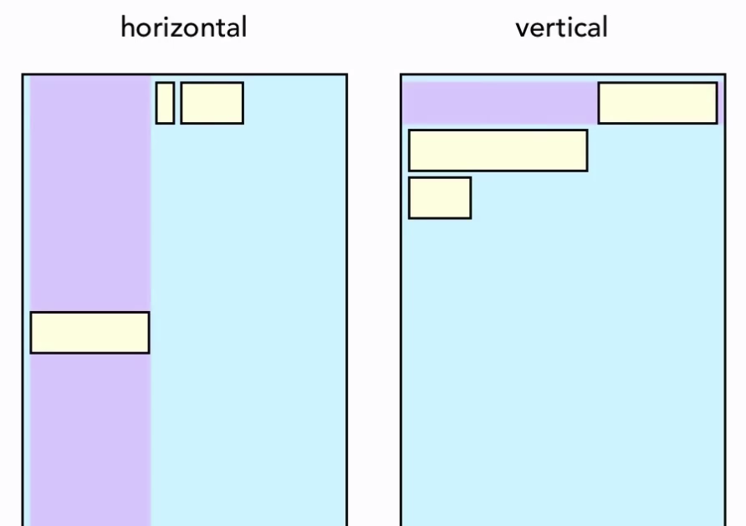
LinearLayout - Gravity

Slide 21
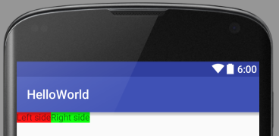
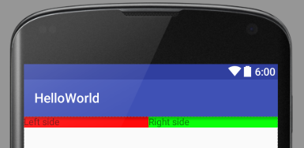
LinearLayout - Weight
Additional way to specify dimensions (match_parent, wrap_content, xxxdp)
Adds weights together
Width is based on ratios (1+1=2 => ½ and ½)
Can be mixed every way

Slide 22
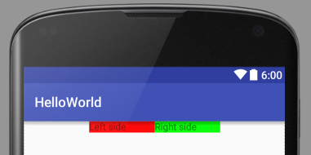
LinearLayout - weightSum
<?xml version="1.0" encoding="utf-8"?> <LinearLayout xmlns:android="http://schemas.android.com/apk/res/android" android:orientation="horizontal" android:layout_width="match_parent" android:layout_height="match_parent" android:gravity="center_horizontal" android:weightSum="4"> <TextView android:layout_width="0dp" android:layout_weight="1" android:layout_height="wrap_content" android:background="#ff0000" android:text="Left side" android:id="@+id/textView2" /> <TextView android:layout_width="0dp" android:layout_weight="1" android:layout_height="wrap_content" android:background="#00ff00" android:text="Right side" android:id="@+id/textView3" /> </LinearLayout

Slide 23
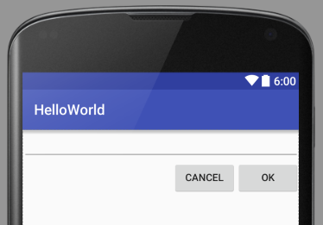
LinearLayout - nested
<?xml version="1.0" encoding="utf-8"?> <LinearLayout xmlns:android="http://schemas.android.com/apk/res/android" android:orientation="vertical" android:layout_width="match_parent" android:layout_height="match_parent"> <EditText android:layout_width="match_parent" android:layout_height="wrap_content" android:id="@+id/editText3" /> <LinearLayout android:orientation="horizontal" android:layout_width="match_parent" android:layout_height="wrap_content" android:gravity="right"> <Button android:layout_width="wrap_content" android:layout_height="wrap_content" android:text="Cancel" android:id="@+id/button6"/> <Button android:layout_width="wrap_content" android:layout_height="wrap_content" android:text="OK" android:id="@+id/button7" /> </LinearLayout> </LinearLayout>

Slide 24
RelativeLayout
What it is?
Relative Positioning
Relative Alignement
Missing Views

Slide 25
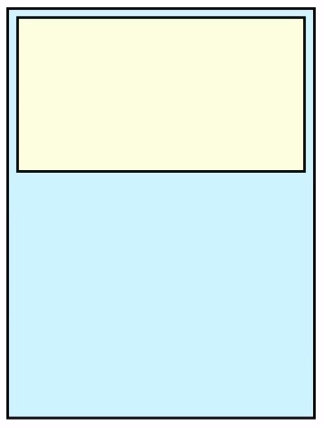
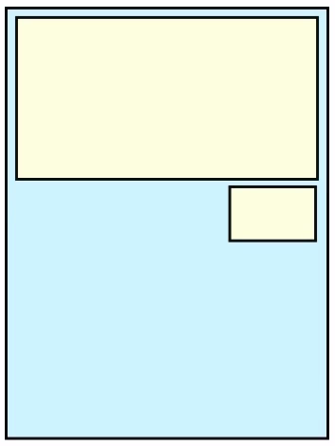
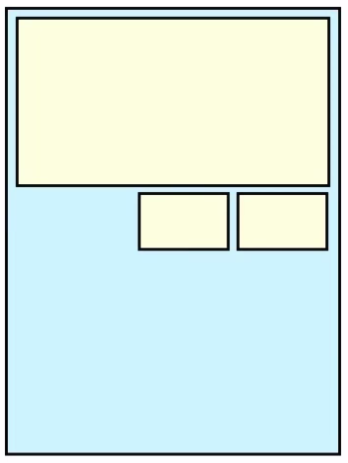
RelativeLayout

Slide 26
RelativeLayout
Relative
Position
Alignment
To
Parent
Sibling

Slide 27
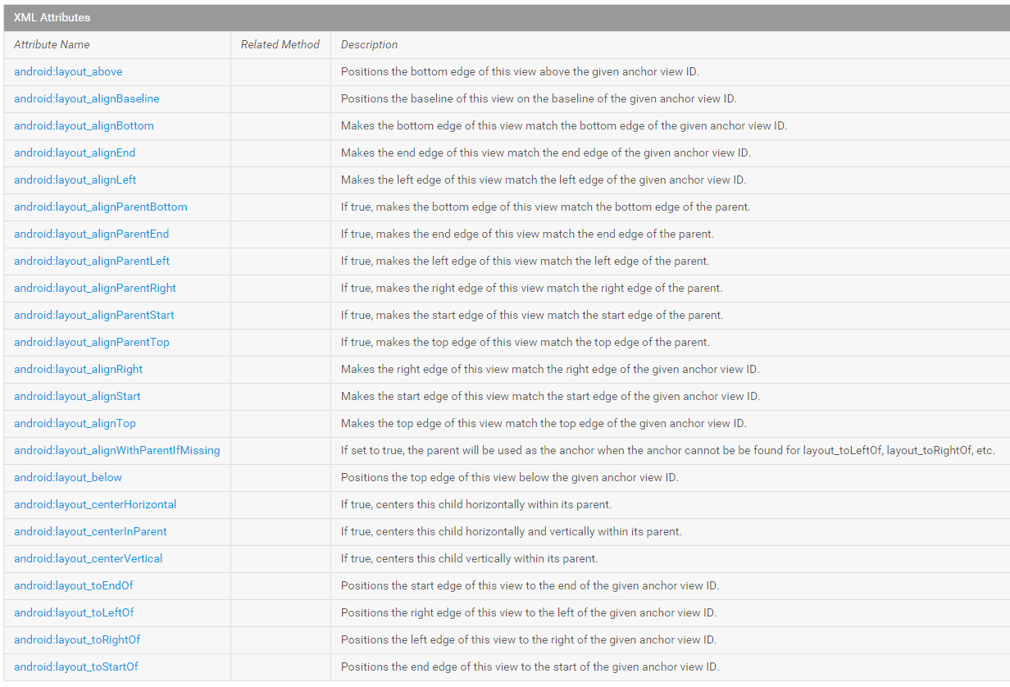
RelativeLayout - attributes

Slide 28
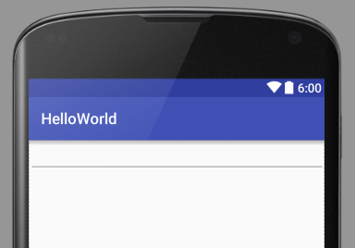
RelativeLayout
Uses default parameters
Top
Left
<?xml version="1.0" encoding="utf-8"?> <RelativeLayout xmlns:android="http://schemas.android.com/apk/res/android" android:layout_width="match_parent" android:layout_height="match_parent"> <EditText android:id="@+id/editText2" android:layout_width="match_parent" android:layout_height="wrap_content" android:inputType="textMultiLine" /> </RelativeLayout>

Slide 29
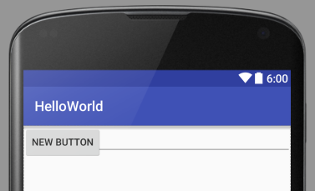
RelativeLayout
No positions given
Views are on top of each other
<?xml version="1.0" encoding="utf-8"?> <RelativeLayout xmlns:android="http://schemas.android.com/apk/res/android" android:layout_width="match_parent" android:layout_height="match_parent"> <EditText android:id="@+id/editText2" android:layout_width="match_parent" android:layout_height="wrap_content" android:inputType="textMultiLine" /> <Button android:id="@+id/button4" android:layout_width="wrap_content" android:layout_height="wrap_content" android:text="New Button" /> </RelativeLayout>

Slide 30
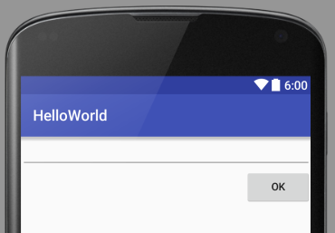
RelativeLayout
<?xml version="1.0" encoding="utf-8"?> <RelativeLayout xmlns:android="http://schemas.android.com/apk/res/android" android:layout_width="match_parent" android:layout_height="match_parent"> <EditText android:id="@+id/editTextGreeting" android:layout_width="match_parent" android:layout_height="wrap_content" android:inputType="textMultiLine" /> <Button android:id="@+id/buttonOk" android:layout_width="wrap_content" android:layout_height="wrap_content" android:layout_below="@id/editTextGreeting" android:layout_alignParentRight="true" android:text="OK" /> </RelativeLayout>

Slide 31
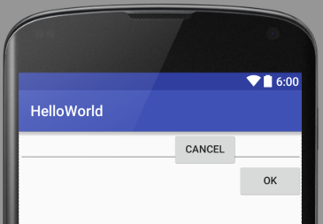
RelativeLayout
<?xml version="1.0" encoding="utf-8"?> <RelativeLayout xmlns:android="http://schemas.android.com/apk/res/android" android:layout_width="match_parent" android:layout_height="match_parent"> <EditText android:id="@+id/editTextGreeting" android:layout_width="match_parent" android:layout_height="wrap_content" android:inputType="textMultiLine" /> <Button android:id="@+id/buttonOk" android:layout_width="wrap_content" android:layout_height="wrap_content" android:layout_below="@id/editTextGreeting" android:layout_alignParentRight="true" android:text="OK" /> <Button android:layout_width="wrap_content" android:layout_height="wrap_content" android:layout_toLeftOf="@id/buttonOk" android:text="Cancel" android:id="@+id/buttonCancel" /> </RelativeLayout>

Slide 32
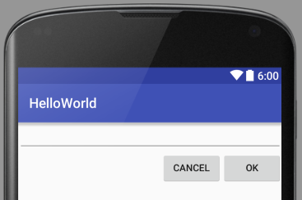
RelativeLayout
<?xml version="1.0" encoding="utf-8"?> <RelativeLayout xmlns:android="http://schemas.android.com/apk/res/android" android:layout_width="match_parent" android:layout_height="match_parent"> <EditText android:id="@+id/editTextGreeting" android:layout_width="match_parent" android:layout_height="wrap_content" android:inputType="textMultiLine" /> <Button android:id="@+id/buttonOk" android:layout_width="wrap_content" android:layout_height="wrap_content" android:layout_below="@id/editTextGreeting" android:layout_alignParentRight="true" android:text="OK" /> <Button android:layout_width="wrap_content" android:layout_height="wrap_content" android:layout_toLeftOf="@id/buttonOk" android:layout_below="@id/editTextGreeting" android:text="Cancel" android:id="@+id/buttonCancel" /> </RelativeLayout>

Slide 33
RelativeLayout
Relative to sibling
Layout_alignTop
Layout_alignBottom
Layout_alignLeft
Layout_alignRight
Layout_alignBaseline
Relative to sibling
Layout_above
Layout_below
Layout_toLeftOf
Layout_toRightOf

Slide 34
RelativeLayout
Relative to parent
Layout_alignParentTop
Layout_alignParentBottom
Layout_alignParentLeft
Layout_alignParentRight
Layout_centerHorizontal
Layout_centerVertical
Layout_centerInParent

Slide 35
RelativeLayout – Missing views
Visibility=“invisible”
View is still there, just invisible
Placement of element is not changed
Visibility=“gone”
UI layout changes, view is really not there
Defaults apply (top left)
When changing visibility programmatically
Layout_alignWithParentIfMissing=“true”

Slide 36
FrameLayout
Allows to put views on top of each other
Position child wiews with
layout_gravity
Layout_margin
Usually used for placing images on top of other images
Think of PictureFrame
You can save one view by using on FrameLayout definition
Android:foreground=“@drawable/somepicture”
Control scaling of foreground (default is fill)
Android:foregroundGravity=“top|left”

Slide 37
TableLayout
What is TableLayout
Spanning and skipping
Shrinking, stretching and collapsing

Slide 38
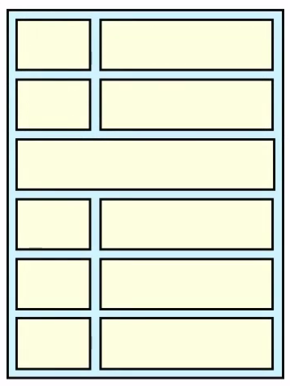
TableLayout
Specialized linear layout
Rows
Columns
TableRow is always
Layout_width=“match_parent”
Layout_height=“wrap_content”

Slide 39
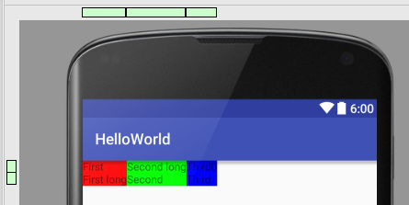
TableLayout
<?xml version="1.0" encoding="utf-8"?> <TableLayout xmlns:android="http://schemas.android.com/apk/res/android" android:layout_width="match_parent" android:layout_height="match_parent"> <TableRow> <TextView android:background="#ff0000" android:text="First" /> <TextView android:background="#00ff00" android:text="Second long" /> <TextView android:background="#0000ff" android:text="Third0" /> </TableRow> <TableRow> <TextView android:background="#ff0000" android:text="First long" /> <TextView android:background="#00ff00" android:text="Second" /> <TextView android:background="#0000ff" android:text="Third" /> </TableRow> </TableLayout>

Slide 40
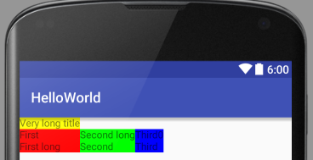
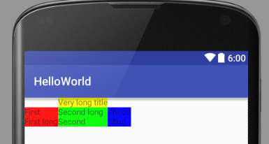
TableLayout – skipping
<?xml version="1.0" encoding="utf-8"?> <TableLayout xmlns:android="http://schemas.android.com/apk/res/android" android:layout_width="match_parent" android:layout_height="match_parent"> <TableRow> <TextView android:background="#ffff00" android:text="Very long title" android:layout_column="1"/> </TableRow> <TableRow> <TextView android:background="#ff0000" android:text="First" /> <TextView android:background="#00ff00" android:text="Second long" /> <TextView android:background="#0000ff" android:text="Third0" /> </TableRow> <TableRow> <TextView android:background="#ff0000" android:text="First long" /> <TextView android:background="#00ff00" android:text="Second" /> <TextView android:background="#0000ff" android:text="Third" /> </TableRow> </TableLayout>

Slide 41
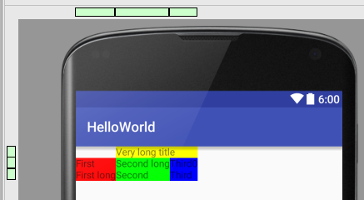
TableLayout – spanning
<?xml version="1.0" encoding="utf-8"?> <TableLayout xmlns:android="http://schemas.android.com/apk/res/android" android:layout_width="match_parent" android:layout_height="match_parent"> <TableRow> <TextView android:background="#ffff00" android:text="Very long title" android:layout_column="1" android:layout_span="2"/> </TableRow> <TableRow> <TextView android:background="#ff0000" android:text="First" /> <TextView android:background="#00ff00" android:text="Second long" /> <TextView android:background="#0000ff" android:text="Third0" /> </TableRow> <TableRow> <TextView android:background="#ff0000" android:text="First long" /> <TextView android:background="#00ff00" android:text="Second" /> <TextView android:background="#0000ff" android:text="Third" /> </TableRow> </TableLayout>

Slide 42
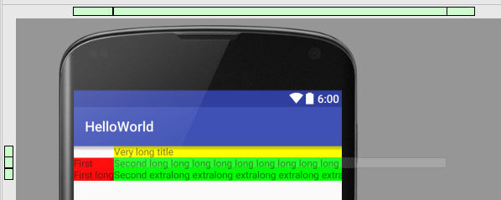
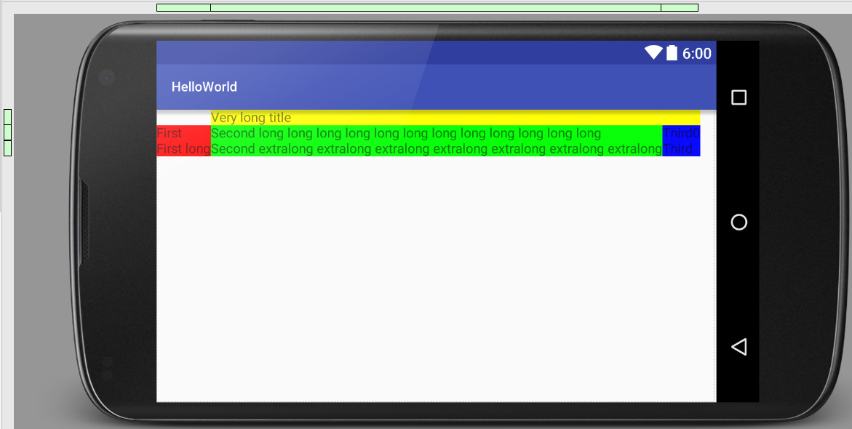
TableLayout – shrinking, stretching, collapsing

Slide 43
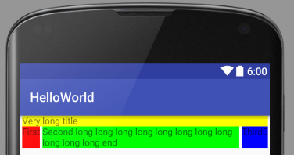
TableLayout – shrinking
<?xml version="1.0" encoding="utf-8"?> <TableLayout xmlns:android="http://schemas.android.com/apk/res/android" android:layout_width="fill_parent" android:layout_height="wrap_content" android:shrinkColumns="1"> <TableRow> <TextView android:layout_column="0" android:layout_marginLeft="4dp" android:layout_marginRight="4dp" android:layout_span="3" android:background="#ffff00" android:text="Very long title" /> </TableRow> <TableRow> <TextView android:layout_height="match_parent" android:layout_marginLeft="4dp" android:layout_marginRight="4dp" android:background="#ff0000" android:text="First" /> <TextView android:layout_height="match_parent" android:layout_marginRight="4dp" android:background="#00ff00" android:singleLine="false" android:text="Second long long long long long long long long long long long end" /> <TextView android:layout_height="match_parent" android:layout_marginRight="4dp" android:background="#0000ff" android:text="Third0" /> </TableRow> </TableLayout>

Slide 44
TableLayout – stretching
<?xml version="1.0" encoding="utf-8"?> <TableLayout xmlns:android="http://schemas.android.com/apk/res/android" android:layout_width="fill_parent" android:layout_height="wrap_content" android:shrinkColumns="1" android:stretchColumns="*"> <TableRow> <TextView android:layout_column="0" android:layout_marginLeft="4dp" android:layout_marginRight="4dp" android:layout_span="3" android:background="#ffff00" android:text="Very long title" /> </TableRow> <TableRow> <TextView android:layout_height="match_parent" android:layout_marginLeft="4dp" android:layout_marginRight="4dp" android:background="#ff0000" android:text="First" /> <TextView android:layout_height="match_parent" android:layout_marginRight="4dp" android:background="#00ff00" android:singleLine="false" android:text="Second long long long long long long long long long long long end" /> <TextView android:layout_height="match_parent" android:layout_marginRight="4dp" android:background="#0000ff" android:text="Third0" /> </TableRow> </TableLayout>

Slide 45
TableLayout – collapsing
Android:collapseColumns=“*”
*
0
1,2,4
Same as visibility=“gone”

Slide 46
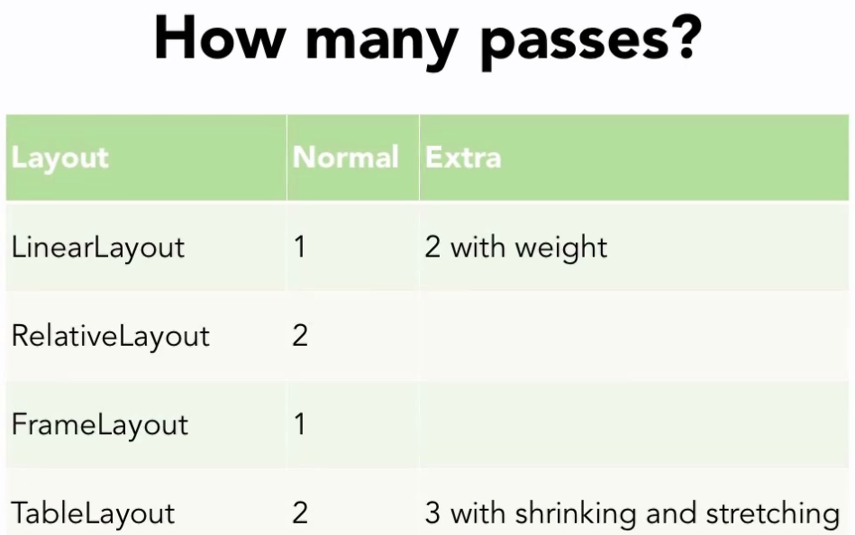
Varia - performance

Slide 47
Varia – Hierarchy Viewer
ViewServer
Download ViewServer.java from https://github.com/romainguy/ViewServer
Add INTERNET permission
Enable ViewServer in your activity

Slide 48
Varia – Hierarchy Viewer
Launch Android Device Monitor
Window -> Open Perspective… -> Hierarchy View
Select your running app from tree
Click the icon “Load the view hierarchy into the tree view”

