Slide 1
Introduction to Apple mobile technologies- I393
TalTech IT College, Andres Käver, 2018-2019 Fall
Web: http://enos.itcollege.ee/~akaver/apple
Skype: akaver Email: akaver@itcollege.ee

Slide 2
iOS
Requirements
Programming experience – java, databases, algorithms
OOP
Class, Instance, Superclass/Subclass
Message, Method
Protocol (interface)
Reference vs Value types, Instance variable
Closures...
Lots of code writing!

Slide 3
iOS
Requirements
Latest Xcode (10)
IT College class 320 – limited access
Or macOS based computer (ca be rented from Apple resellers)
Or virtualized macOS (slow, but works)
Or rented virtual access
http://www.macincloud.com/ ($20+ month)
HostMyApple, MacStadium, vmOSX, Xcloud, Xcodeclub, …

Slide 4
iOS
What’s in iOS – 100% OOP
Core OS – close to hardware, everything in C
OSX Kernel, Mach 3, BSD, Sockets, Security, Power Management, Keychain Access, Certificates, File System, Bonjour
Core Services – OOP in top of hardware
Collections, Address Book, Networking, File Access, SQLite, Core Location, Net Services, Threading, Preferences, URL Utilities
Media – originally it was iPod
Core Audio, OpenAL, Audio Mixing, Audio Recording, Video Playback, Images, PDF, Quartz, Core Animation, OpenGL ES
Cocoa Touch – UI layer
Multi-Touch, Core Motion, View Hierarchy, Localization, Controls, Alerts, WebView, Map Kit, Image Picker, Camera

Slide 5
iOS - Swift
Latest language in development scene (released in autumn 2014)
Current version is 4.2
You can mix it with older Apple language of choice – Objective C
Language is open source
https://swift.org

Slide 6
iOS - Swift
Mandatory reading – a Swift tour
https://docs.swift.org/swift-book/GuidedTour/GuidedTour.html

Slide 7
iOS - MVC
All iOS development is MVC based!
Model – data and business logic
View – UI
Controller – the glue between View and Model
Controller can directly control Model and View (Outlet)
Model and View never communicate with each other
View communicates with controller via
Action
Outlet
Delegate (should, will, did) – property in view using protocol
Data source – protocol
Model communicates via broadcasts – notifications & KVO – Key Value Observing

Slide 8
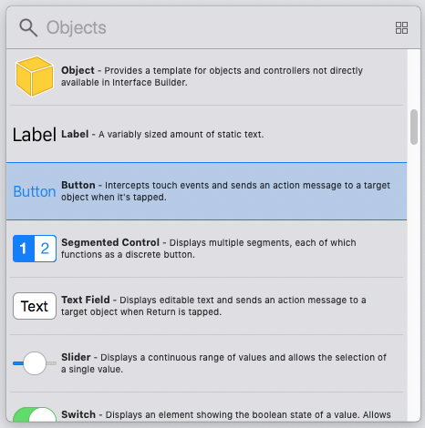
iOS- UI Components library
Click icon in upper right corner – circle with square in it

Slide 9
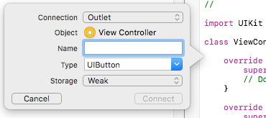
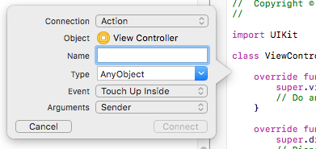
iOS – connecting UI and code
Open up Assistant editor (click double rings in upper right corner)
Hold ctrl key and drag with your mouse from UI element to code
Choose type for connection: Outlet or Action
Action – UI calls into code (buttons)
Outlet – code updates UI (labels)
Outlet collection – array of UI elements

Slide 10
iOS
Demo and some hands-on!

Slide 11
iOS
Home reading
https://docs.swift.org/swift-book/LanguageGuide/TheBasics.html
https://swift.org/documentation/api-design-guidelines/

Slide 12
iOS - Home reading
Basics
Type Safety and Type Inference, Numeric Type Conversion, Optionals
Operators
Nil-Coalescing Operator, Range Operators
Strings and Characters
Counting Characters, Accessing and Modifying a String, Substrings
Collection Types
Mutability of Collections, Arrays, Dictionaries

Slide 13
iOS - Home reading
Control flow
Switch, No Implicit Fallthrough, Break
Functions
Function Argument Labels and Parameter Names, Specifying Argument Labels

Slide 14
iOS - Home reading
Classes and Structures
Structures and Enumerations Are Value Types
Properties
Type Properties
Methods
Type Methods
Inheritance
Overriding Methods
Initialization
Customizing Initialization

