Slide 1
Native Mobile Applications - ICD0017
TalTech IT College, Andres Käver, 2018-2019, Spring semester
Web: http://enos.Itcollege.ee/~akaver/MobileApps
Skype: akaver Email: akaver@itcollege.ee

Slide 2
iOS - Autolayout
What have we used so far
Dashed blue lines – edges and vertical/horizontal centers
Ctrl-drag to edges and other elements (or itself) to set constraints
Size inspector
Click on constraint
Embed in stack view
Document outline – fundamental to autolayout

Slide 3
iOS - Autolayout
Buttons in lower right corner
Update frames
Embed in
Align
Add new constraints
Resolve auto layout issues

Slide 4
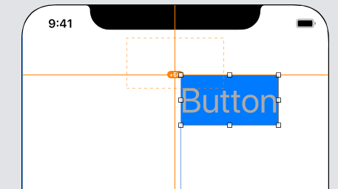
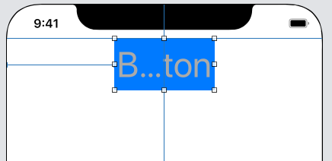
iOS - Autolayout
Update frames
Recalculates all the positions/sizes and redraws layout

Slide 5
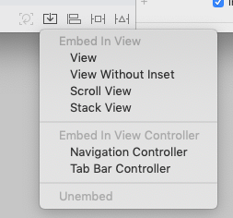
iOS - Autolayout
Embed in
Initially we are interest only in Stack View
Groups selected view elements into new container
Either horizontal or vertical
Can control spacing, distribution, etc
Somewhat similar to Linear Layout in Android

Slide 6
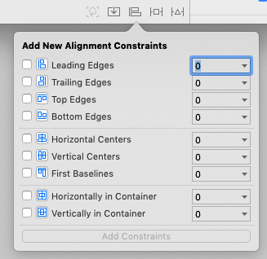
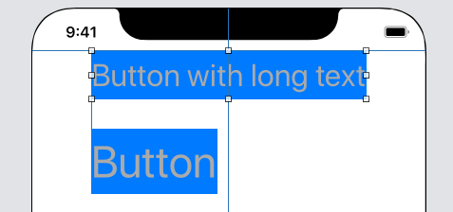
iOS - Autolayout
Align views to each-other
Or to container

Slide 7
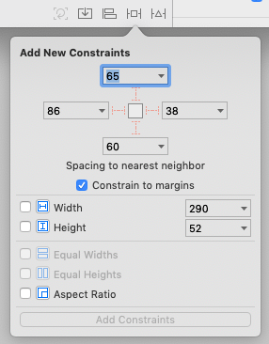
iOS - Autolayout
Add new constraints
To nearest neighbor (click the dashed red line to add)
Constrain to margins (not edges). Margin is 8dp on both sides of element edge
Fix width or height
Equal width or height between elements
Aspect ratio (1:1 is square)

Slide 8
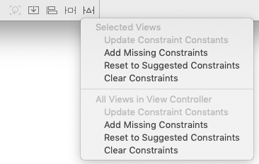
iOS - Autolayout
Resolve autolayout issues
Either for all the views or just selected
Add missing constraints
Xcode trys to do magic - not vey good!
Reset to Suggested Constraints
Set everything according to blue dashed lines
Clear constraints

Slide 9
iOS - Autolayout
But not everything is doable with constraints
If screen is wildly different - no constraint system can help you
In these cases we would like to have totally new positions, new constraints, show-or-hide some elements, change colors etc.

Slide 10
iOS – Size Classes
Apple has SIZE CLASSES
Width: Compact or Regular (and Any)
Heighth: Compact or Regular (and Any)

Slide 11
iOS – Size Classes

Slide 12
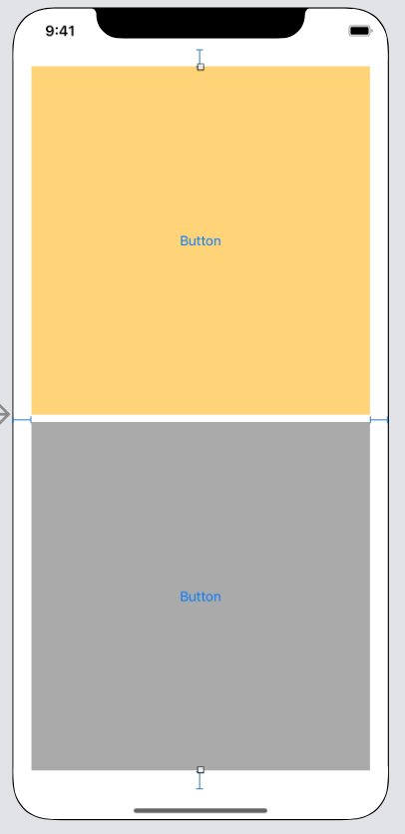
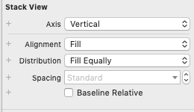
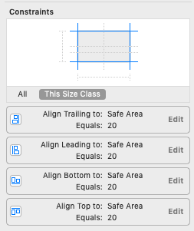
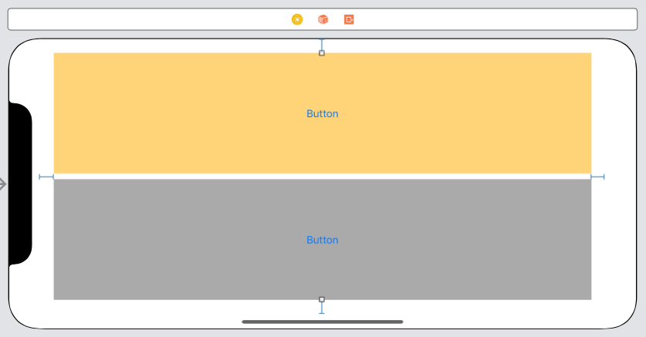
iOS – Size classes
This is not what we want!

Slide 13
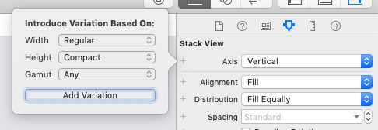
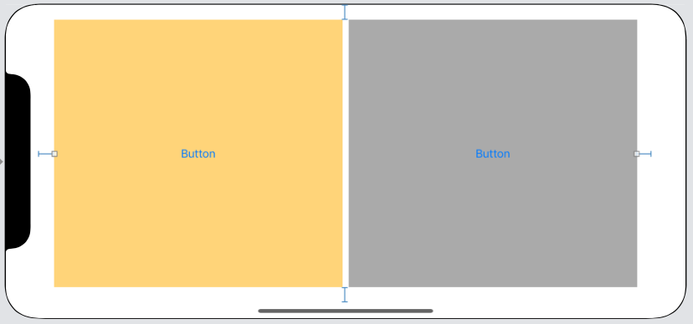
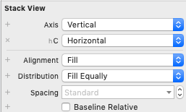
iOS – Size Classes
You can edit many properties separately in different size classes.
Click on + sign in front of property!
X to remove

Slide 14
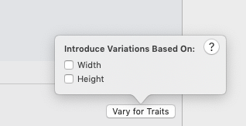
iOS – Size classes
You can do the same with constraints!
Select from the device selection the device size configuration you want to vary for
From Vary fro Traits choose either Width or Height (or both)
Device selection shows affected devices
Modify Storyboard to your liking!

Slide 15
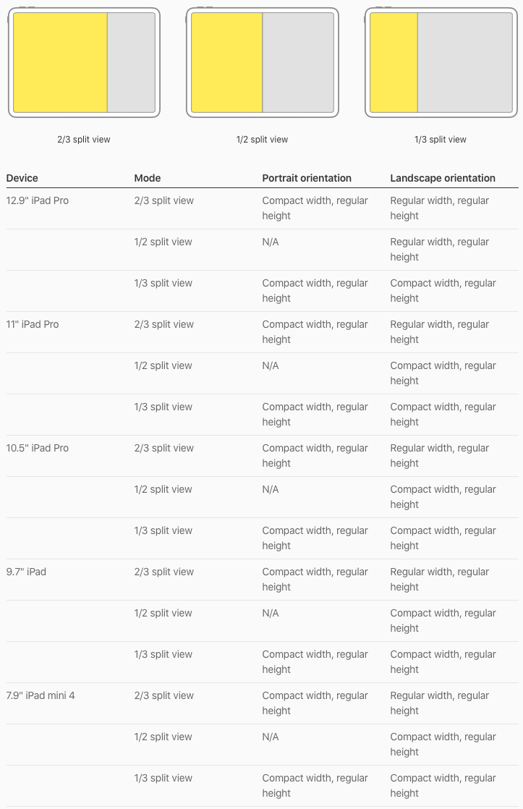
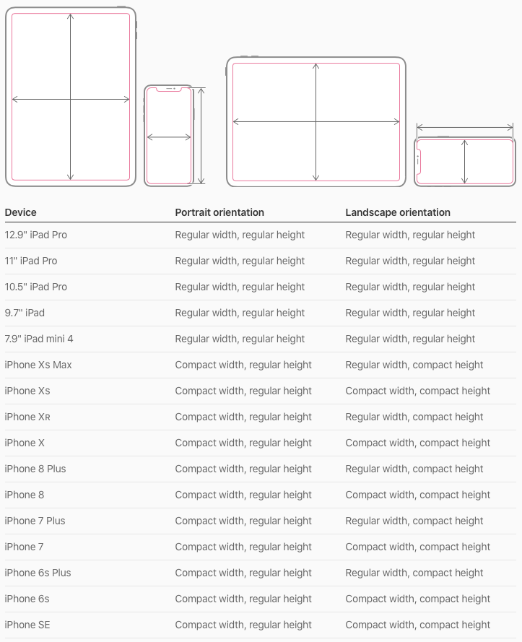
iOS – Size Classes

Slide 16
iOS - Autolayout
Everything can also be done in code
Look for these in UIView documentation
„anchor“
„auto layout“

Slide 17
iOS – Autolayout In code
func updateLabel(){
let attributes: [NSAttributedString.Key: Any] = [
.strokeWidth : 5.0,
.strokeColor: colorLiteral(red: 0, green: 0, blue: 0, alpha: 0.8470588235)
]
let attributedString = NSAttributedString(
string: traitCollection.verticalSizeClass == .compact ? "compact" : "regular",
attributes: attributes)
label.attributedText = attributedString
}
override func traitCollectionDidChange(_ previousTraitCollection: UITraitCollection?) {
super.traitCollectionDidChange(previousTraitCollection)
updateLabel()
}

