Slide 1
Native Mobile Applications - ICD0017
TalTech IT College, Andres Käver, 2018-2019, Spring semester
Web: http://enos.Itcollege.ee/~akaver/MobileApps
Skype: akaver Email: akaver@itcollege.ee

Slide 2
iOS – Memory management
No Garbage Collection in SWIFT/iOS – nothing gets thrown away automatically
Instead, there is Automatic Reference Counting (ARC)
Reference types (objects) are stored in the heap
System automatically counts references to them
When reference count goes to zero – heap object is destroyed
ARC can be modified
weak
strong
unowned

Slide 3
iOS – memory management
Strong default reference counting. As long as there is a pointer to this object, it’s kept in head
Weak keep this pointer alive, as long as somebody else has strong pointer to this object. If nobody is strongly interested anymore, set this pointer to nil. Outlets are typically weak – view hierarchy has strong pointers to them
Unowned don’t do anything, crash if this points to nonexistent object when accessed. Used to break memory cycles

Slide 4
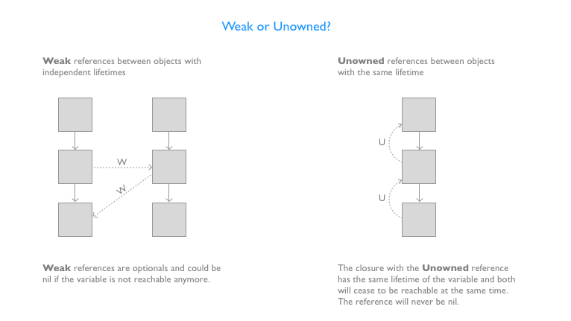
iOS – closures and capturing
Closures can reference surrounding variables (capture them)
Closures themselves are reference types (kept in heap)
This can cause unbreakable memory cycles
SendClosureSomewhere() { [ weak weakSelf = self ] in weakSelf?.someTextOutlet.textColor = UIColor.green
}

Slide 5
iOS – Error handling
Methods can throw errors (Exceptions)
Such methods have throws at the end func saveToDb() throws
You must use do catch structure for calling such function do { try saveToDb() } catch let error { // handle the error … // rethrow (if code is in throws ) throw error }

Slide 6
iOS – Error handling
Do it with force try! saveToDb() – program crashes in case of error
Or conditional let result = try? saveToDbGetChangeCountInt() // int?

Slide 7
iOS - Protocols
Similar to Interfaces in other languages
Protocol is collection of method and property declarations
Types can be declared as protocols (protocol is a type)
Any class, struct or enum can implement unlimited number of protocols
Normally any implementation of protocol must implement all methods/properties in protocol
It is possible to declare some methods as optional in protocol
Protocol has to be marked as @objc
Implementer must inherit from NSObject

Slide 8
iOS - Protocols
protocol SomeProtocol : InheritedProtocol1, InheritedProtocol2 {
var someProperty: Int { get set }
func aMethod(arg1: Double, anotherArgument: String) -> SomeType
^{mutating func changeIt()}
^{init(arg: Type)}
}
Declaring
Implementing
class SomeClass : SuperclassOfSomeClass, SomeProtocol, AnotherProtocol {
// implementation of SomeClass here
// which must include everything in SomeProtocol & AnotherProtocol
}

Slide 9
iOS – Protocols, advanced
Protocols can restrict generics
Protocol itself can use generics
struct Range<Bound: Comparable> {
^{let lowerBound: Bound}
^{let upperBound: Bound}
}
^{protocol SomeProtocol {}
var someProperty: T { get set } ^{associatedtype T}
}

Slide 10
iOS - Delegation
Implements blind communication between view and controller
will
should did
CONTROLLER
data at count
data source
delegate
MODEL
VIEW

Slide 11
iOS - Delegation
View defines a protocol
View has a weak delegate property of this protocol
View uses delegate property to get/do things it needs
Controller declares and implements the protocol
Controller sets the delegate property in view to itself (view.delegate = self)

Slide 12
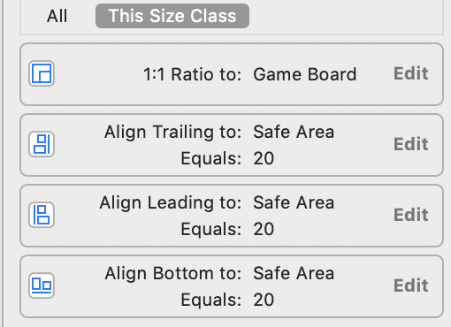
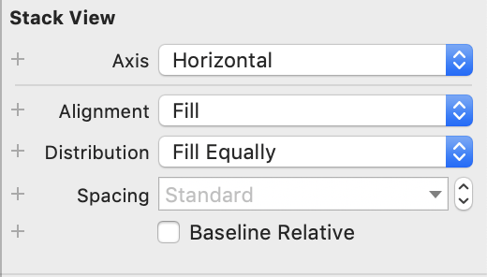
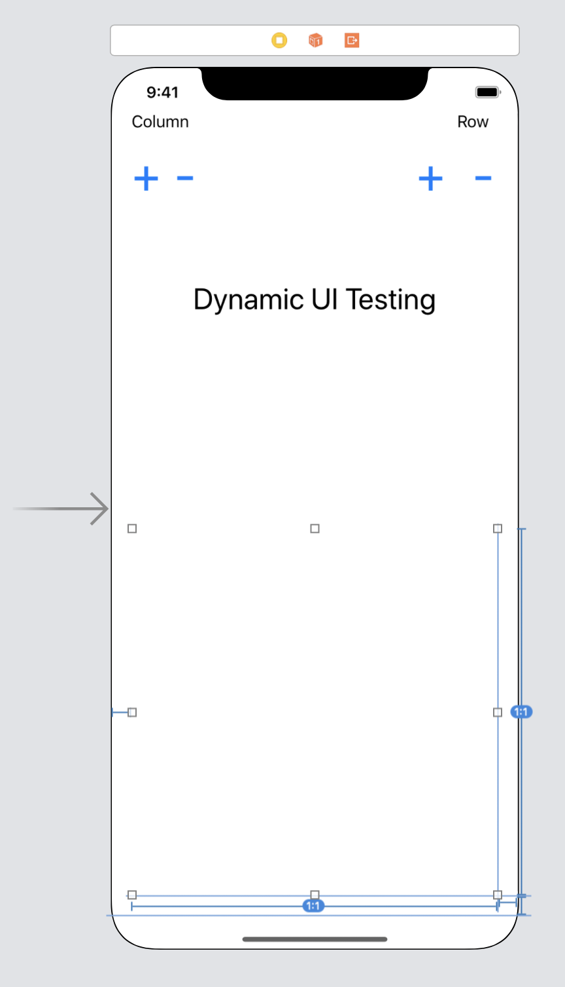
iOS - UI in code
Few pointers to get started
Design first layout in storyboard
Look at all the properties and constraints
Drag a new controller, and copy over minimum amount of base UI
Rest in code
To remove UI element from view hierarchy (don’t forget about Automatic Reference Counting – are there any pointers to it somewhere around?)
// remove view from stackview – but it is still in view hierarchy columnStackView.removeArrangedSubview(viewToRemove) // remove view totally, will be destroyed by ARC viewToRemove.removeFromSuperview()

Slide 13
iOS - UI in code
@IBOutlet weak var gameBoard: UIStackView!
var buttonCounter = 0
@IBAction func RowPlus(_ sender: UIButton) {
// is everything empty
if gameBoard.arrangedSubviews.count == 0 {
print("Empty game board, adding initial empty stack into board")
let columnStack = UIStackView()
columnStack.axis = .vertical
columnStack.alignment = .fill
columnStack.distribution = .fillEqually
columnStack.spacing = 8.0
gameBoard.addArrangedSubview(columnStack)
}
for subView in gameBoard.arrangedSubviews {
if let columnStack = subView as? UIStackView {
let button = UIButton()
button.backgroundColor =
// this will show as colored square in xcode source code
colorLiteral(red: 1, green: 0.8323456645, blue: 0.4732058644, alpha: 1)
button.setTitle("\(buttonCounter)", for: UIControl.State.normal)
buttonCounter += 1
columnStack.addArrangedSubview(button)
} else {
print("Found something else than UIStackView! WTF - What a Terrible Failure!")
}
}
}

Slide 14
iOS - UI in code
@IBAction func RowMinus(_ sender: UIButton) {
for subView in gameBoard.arrangedSubviews {
if let columnStack = subView as? UIStackView {
// this only removes view from stack, but it is still in view hierarchy
if let viewToRemove = columnStack.arrangedSubviews.last {
columnStack.removeArrangedSubview(viewToRemove)
// remove view totally, will be destroyed
viewToRemove.removeFromSuperview()
}
} else {
print("Found something else than UIStackView! WTF?")
}
}
if let firstView = gameBoard.arrangedSubviews.first {
if let firstStackView = firstView as? UIStackView {
let rowCount = firstStackView.arrangedSubviews.count
if rowCount == 0 {
for subView in gameBoard.arrangedSubviews {
print("Removing empty stack from gameBoard")
gameBoard.removeArrangedSubview(subView)
subView.removeFromSuperview()
}
}
}
}
}

Slide 15
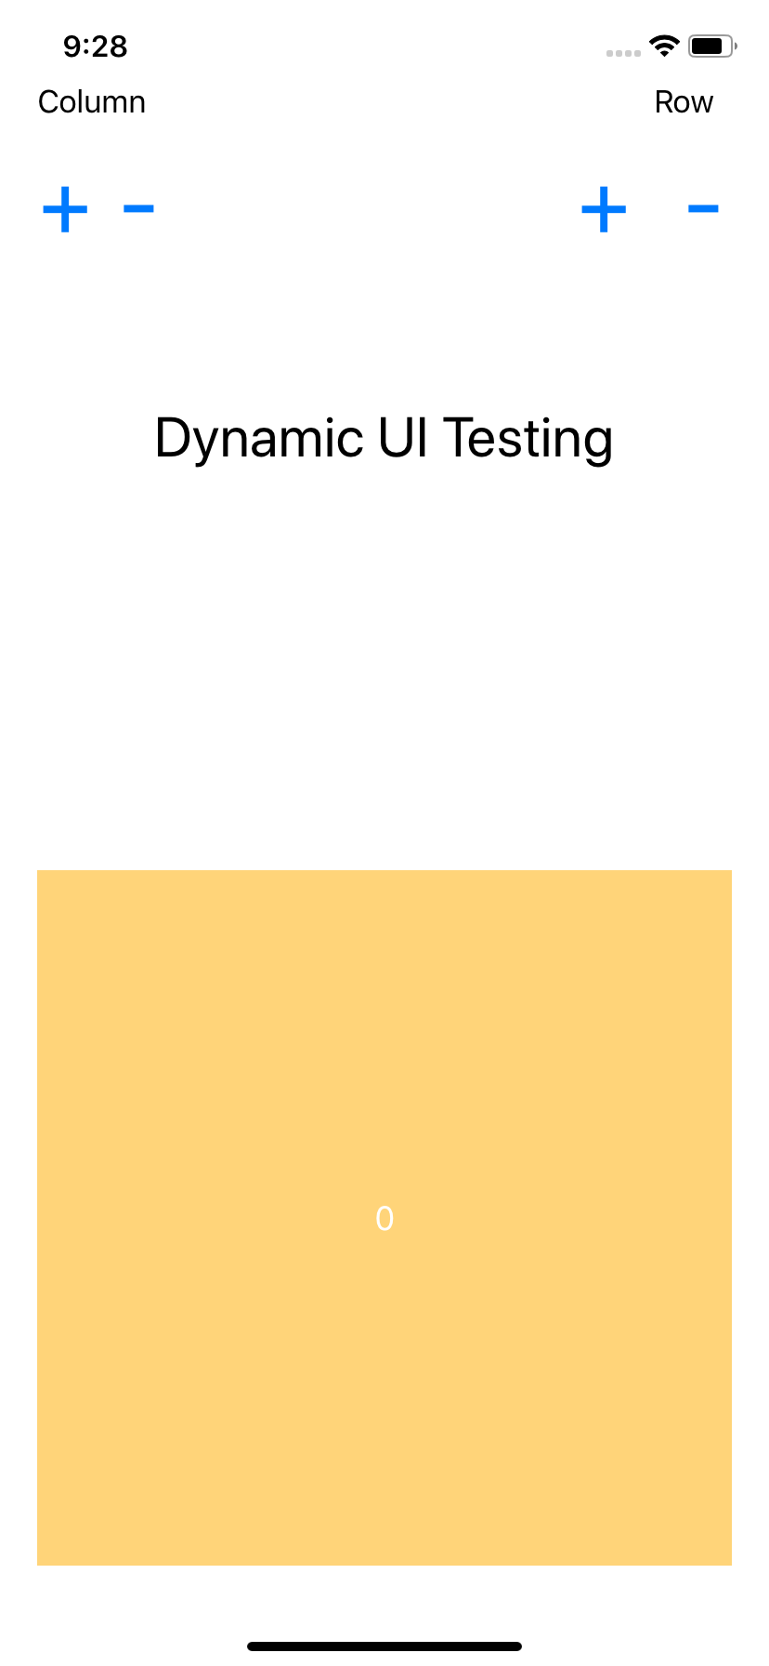
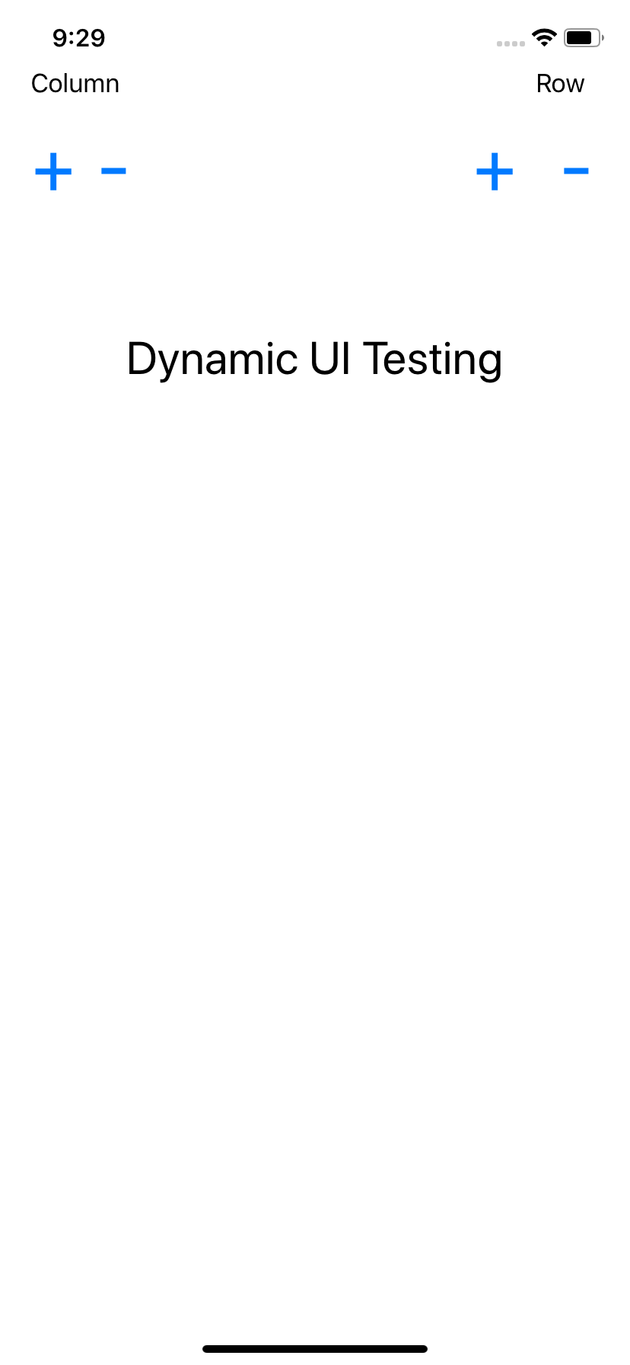
iOS
The End!

