Slide 1
Native Mobile Applications - ICD0017
TalTech IT College, Andres Käver, 2018-2019, Spring semester
Web: http://enos.Itcollege.ee/~akaver/MobileApps
Skype: akaver Email: akaver@itcollege.ee

Slide 2
iOS - TableView
UITableViewController
UITableView
UITableViewCell
One of the main UI design components in iOS
RecyclerView is Android analog

Slide 3
iOS - TableView

Slide 4
iOS - TableView

Slide 5
iOS - TableView
A view that presents data using rows arranged in a single column.
UITableView can display several predefined row layouts
Or you can have totally custom design in every row
Supports grouping, drag/drop
Header and Footer

Slide 6
iOS - TableView
Table views are data driven, normally getting their data from a data source object that you provide.
The data source object manages your app’s data and is responsible for creating and configuring the table’s cells.
If the content of your table never changes, you can configure that content in your storyboard file instead.

Slide 7
iOS – TableViewCell
A UITableViewCell object is a specialized type of view that manages the content of a single table row

Slide 8
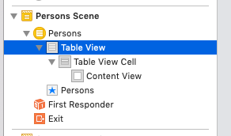
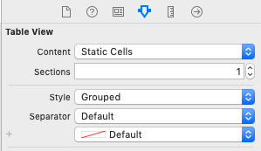
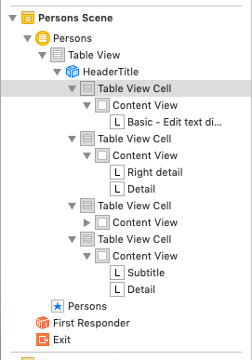
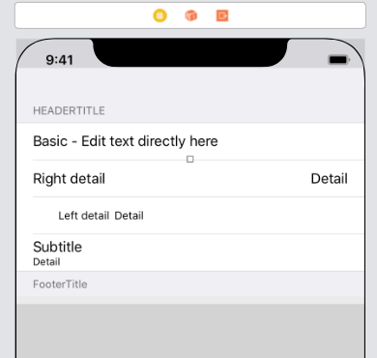
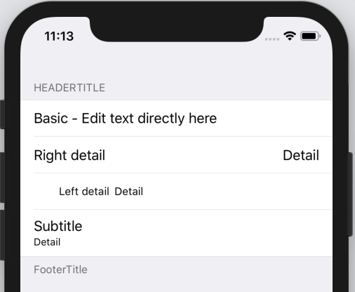
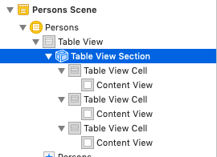
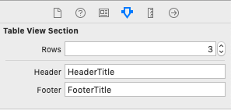
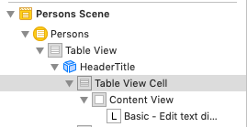
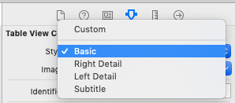
iOS – TableView - static
Static tableview – everything in Storyboard

Slide 9
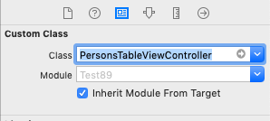
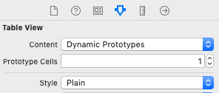
iOS – TableView – data in code
Section and row content from code
Add new Cocoa Touch Class – subclass of UITableViewController
Set this class as custom class in storyboard for TableViewController
Set TableView properties – Content Dynamic, 1 prototype, Style Plain

Slide 10
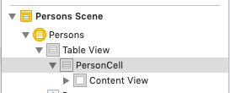
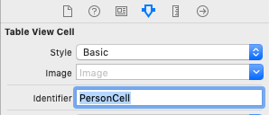
iOS - TableView
Configure Cell
Give some identifier to cell
customize the numberOfSectionsInTableView and tableView:numberOfRowsInSection methods from the UITableViewDataSource protocol to return a fixed number of sections and rows and remove the #warning comments
override func numberOfSections(in tableView: UITableView) -> Int {
return 3
}
override func tableView(_ tableView: UITableView, numberOfRowsInSection section: Int) -> Int {
return 5
}

Slide 11
iOS - TableView
Configure table row in code
Add method for section headers
override func tableView(_ tableView: UITableView, cellForRowAt indexPath: IndexPath) -> UITableViewCell {
let cell = tableView.dequeueReusableCell(withIdentifier: "PersonCell", for: indexPath)
// Configure the cell...
cell.textLabel?.text = "Section \(indexPath.section) Row \(indexPath.row)"
return cell
}
override func tableView(_ tableView: UITableView, titleForHeaderInSection section: Int) -> String? {
return "Section \(section)"
}

Slide 12
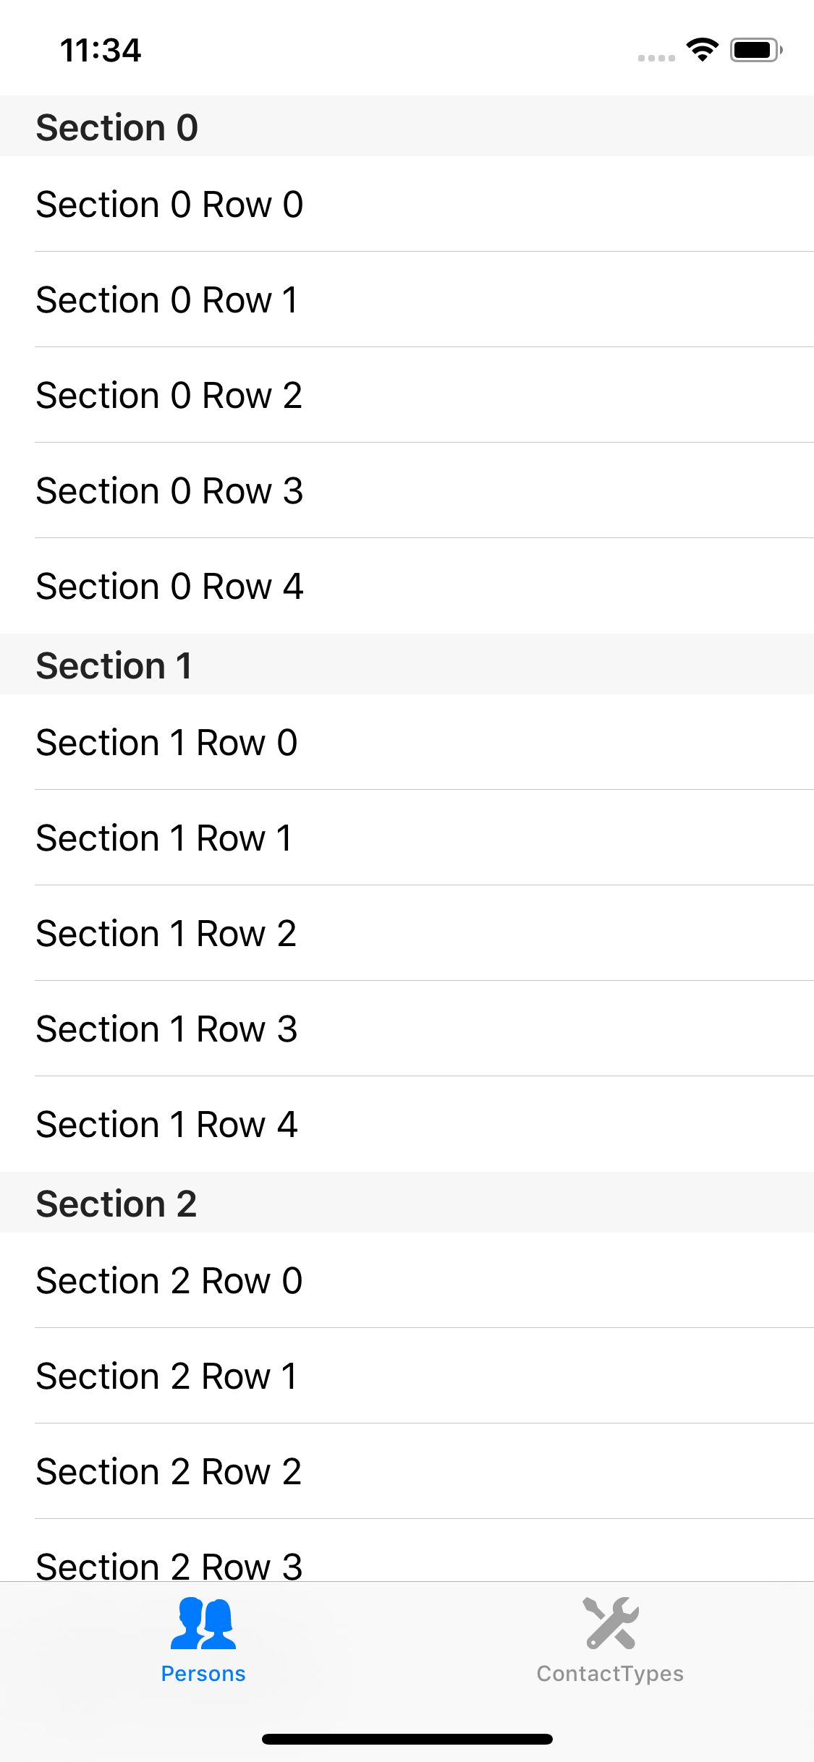
iOS - TableView
Result
3 sections, with headers
5 rows in every section

Slide 13
iOS – TableView – array as source
import Foundation
struct Person {
var id: Int
var firstName: String
var lastName: String
var image: String
}
Use array as data source
Create simple Person struct
And Array of data
class PersonsTableViewController: UITableViewController {
var persons = [
Person(id: 1, firstName: "Andres", lastName: "Käver", image: "maintenance")
Person(id: 2, firstName: "Mait", lastName: "Poska", image: "user_group_man_woman")
]

Slide 14
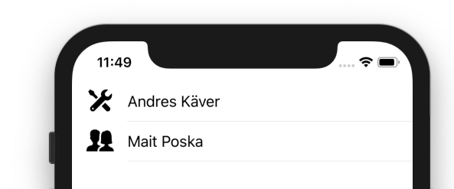
iOS - TableView
class PersonsTableViewController: UITableViewController {
var persons = [
Person(id: 1, firstName: "Andres", lastName: "Käver", image: "maintenance"),
Person(id: 2, firstName: "Mait", lastName: "Poska", image: "user_group_man_woman")
]
override func viewDidLoad() {
super.viewDidLoad()
}
override func numberOfSections(in tableView: UITableView) -> Int {
return 1
}
override func tableView(_ tableView: UITableView, numberOfRowsInSection section: Int) -> Int {
return persons.count
}
override func tableView(_ tableView: UITableView, cellForRowAt indexPath: IndexPath) -> UITableViewCell {
let cell = tableView.dequeueReusableCell(withIdentifier: "PersonCell", for: indexPath)
// Configure the cell...
let person = persons[indexPath.row]
cell.textLabel?.text = person.firstName + " " + person.lastName
cell.imageView?.image = UIImage(named: person.image)
return cell
}

Slide 15
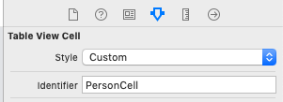
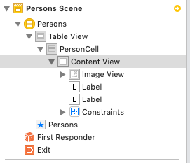
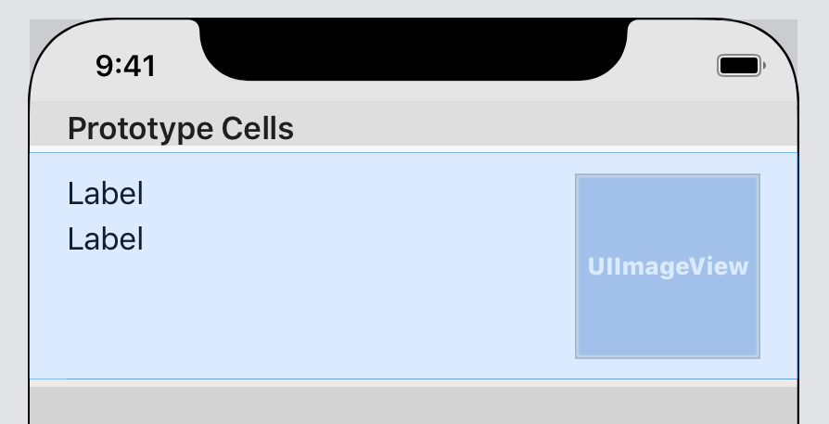
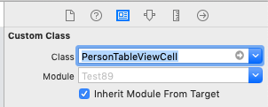
iOS – TableView – custom row design
Custom row/cell in tableview
Design the cell in usual way. Constraints!
Add a class for the cell derived from UITableViewCell
Set the custom class for cell

Slide 16
iOS - TableView
import UIKit
class PersonTableViewCell: UITableViewCell {
@IBOutlet weak var firstName: UILabel!
@IBOutlet weak var lastName: UILabel!
@IBOutlet weak var picture: UIImageView!
}
Connect outlets
Use new class in TableViewController
override func tableView(_ tableView: UITableView, cellForRowAt indexPath: IndexPath) -> UITableViewCell {
let cell = tableView.dequeueReusableCell(withIdentifier: "PersonCell", for: indexPath) as! PersonTableViewCell
// Configure the cell...
let person = persons[indexPath.row]
cell.firstName.text = person.firstName
cell.lastName.text = person.lastName
cell.picture.image = UIImage(named: person.image)
return cell
}

Slide 17
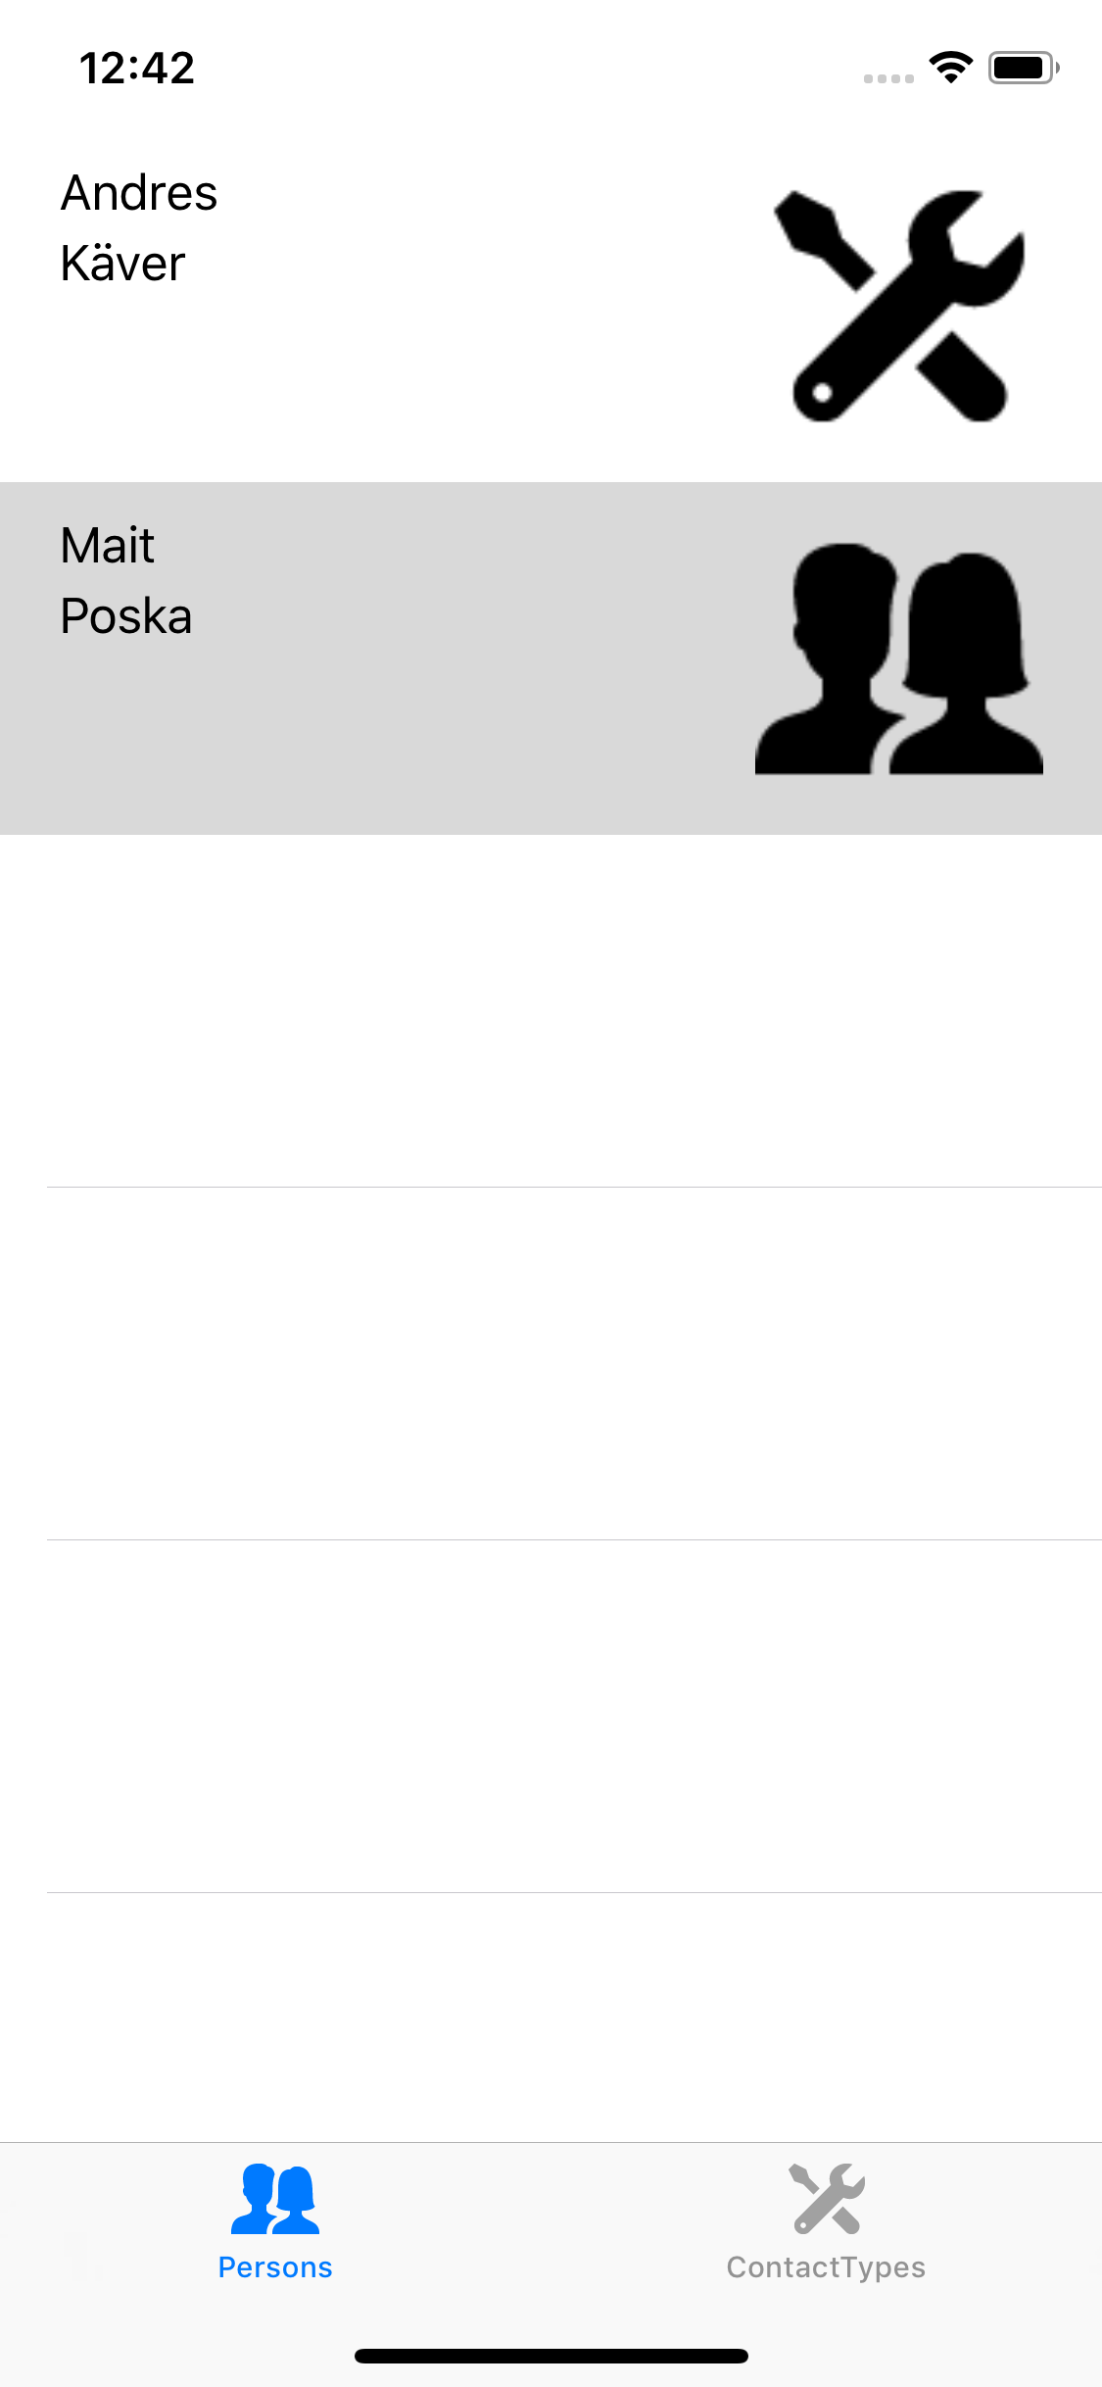
iOS - TableView
Result!

Slide 18
iOS - TableView
The END!

