Slide 1
Adme(kandja)d Andmesalvestustehnoloogiad ICA0006
Siim Vene, Edmund Laugasson
siim.vene@ttu.ee
Notes:
1/28/19
1
1

Slide 2
Loenguteemad
Andmed/Informatsioon
Andmete elutsükkel
Liidesed
Salvestusvahendid (HDD/SSD)
Notes:
1/27/19
2
2

Slide 3
Andmed ja informatsioon
Alus andmesalvestustehnoloogia arengule
Andmed vs informatsioon
Ekspotentsiaalne kasv
FunFact: Täna toodetakse maailmas 2 päevaga sama palju informatsiooni, kui ajaloo algusest kuni aastani 2003 kokku.
Mõned põhjused
Andmed > Informatsioon > Teadmised > Tarkus
Notes:
1/27/19
3
3

Slide 4
Andmed ja informatsioon
http://9gag.com/gag/6602736/20-years-later-and-all-of-these-things-fit-in-your-pocket
Notes:
1/27/19
4
4

Slide 5
Andmete elutsükkel
Miks on oluline teada, milline on ettevõtte andmete elutsükkel?
Notes:
1/27/19
5
5

Slide 6
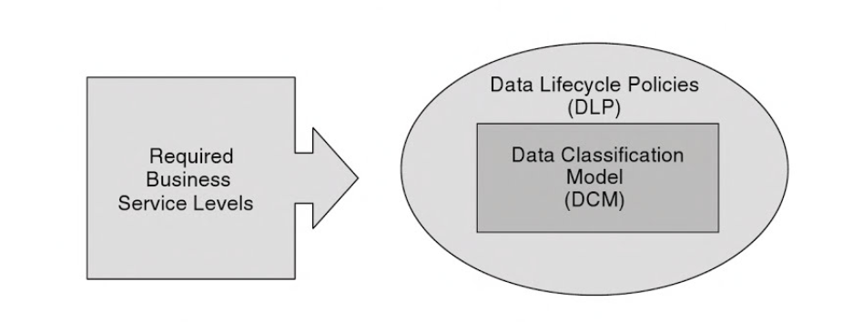
Notes:
DCM: An organization may classify data as Restricted, Private or Public. In this instance, public data represents the least-sensitive data with the lowest security requirements, while restricted data is in the highest security classification and represents the most sensitive data
DLP: Four recommended stages for DLM include: 1) Data acquisition and capture; 2) Data backup and recovery; 3) Data management and maintenance; 4) Data retention and secure destruction
ISKE: teabe käideldavus (K), teabe terviklus (T), teabe konfidentsiaalsus (S)

Slide 7
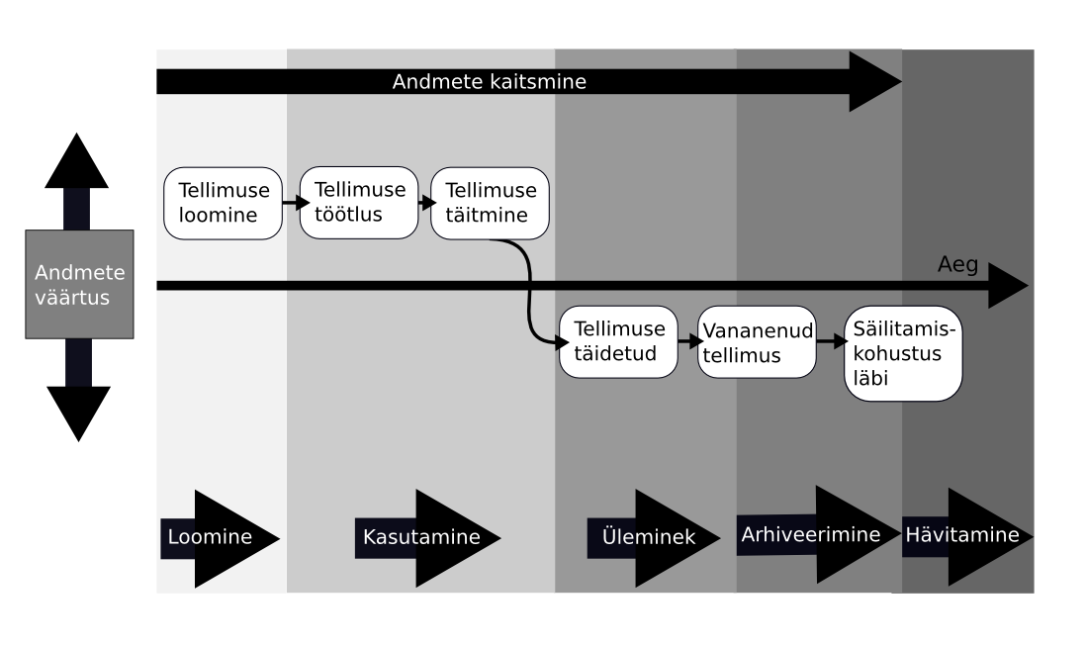
Andmete elutsükkel
Notes:
1/27/19
7
7
The creation and/or acquisition of the data.
The publication of the data.
The retention and/or removal of the data.

Slide 8
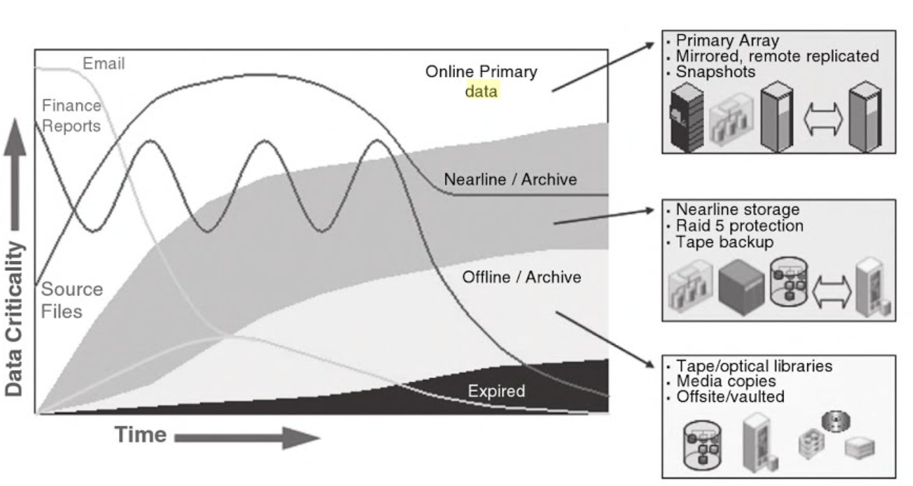
Data Lifecycles: Managing Data for Strategic Advantage

Slide 9
Andmekeskuse taristu
Lihtsustatud kujul:
Notes:
1/27/19
9
9

Slide 10
Andmekeskuse taristu I
Klientarvuti rakendus kasutajaliidesega
Võtab vastu / saadab välja andmeid
Võrguühendus – LAN, WLAN (Wireless LAN) jne
Transpordib klientarvutist saadud andmed andmebaasi või andmebaasist klientarvutisse
Server operatsioonisüsteemi (OS) ja andmebaasiga (AB), mis teenindab klientrakendust
OS: Platvorm andmebaasi tööks
AB: Salvestab andmed loogilistes tabelites
Notes:
1/27/19
10
10

Slide 11
Andmekeskuse taristu II
Andmesalvestusühendus – fiiber (FOC – fibre-optic cable), võrgukaabel (sõltuvalt valitud tehnoloogiast)
Andmete transportimine kettamassiivi või tagasi serverisse
Kettamassiiv – kõvaketaste kogum
Andmete kirjutamine füüsilisele kettale
Salvestatud andmete lugemine kettalt
Notes:
1/27/19
11
11

Slide 12
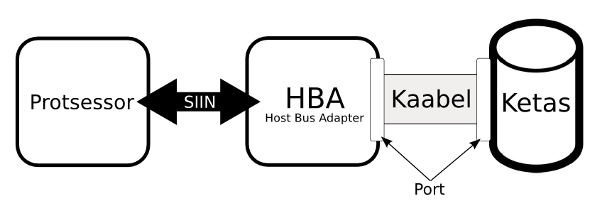
Salvestussüsteemid
Host ehk peremeesarvuti
Ühendatavus
Andmesalvestusvahendid
Notes:
1/27/19
12
12

Slide 13
Andmesalvestussüsteemi komponendid I
Host ehk peremeesarvuti
Lauaarvuti
Sülearvuti
Server(id)
Mobiilsed seadmed
Notes:
1/27/19
13
13

Slide 14
Andmesalvestussüsteemi komponendid I
Ühendatavus
PCI – Peripheral Component Interconnect
PCI – LAN kaardid, helikaardid, vanad videokaardid, raidkontrolleri kaardid jms
PCI express - videokaartidele
IDE/ATA – Integrated Drive Electronics / Advanced Technology Attachments (Parallel ATA)
Standardne liides kõvaketaste/flopi/optiliste seadmete ühendamiseks masinaga
SATA – Serial Advanced Technology Attachments
Notes:
1/27/19
14
14

Slide 15
Andmesalvestussüsteemi komponendid I
SCSI – Small Computer System Interface
Uuemal ajal kasutusel personaalarvutites ja sülearvutites
SAS - Serial-Attached SCSI
Kasutusel serverites suurtes kettamasiivides
Kallid kuid kiired (3x kiirem kui SATA)
Mahud on ajas muutuvad (Seagate teatab 2016 augustis 60 TB SAS-liidesega SSD-kettast, mis valmib 2017 aastal)
High Speed Data Link (HSDL) – PCIe/SAS peal töötav hübriid (nt RevoDrive)
Adminnina pead süsteemide ehitamisel arvestama ka ketaste kasutamise üle
SAS või SATA, tasapisi tulevad ka uuemad liidesed (PCIe, HSDL jne)
Kiirus/hind vs aeglus/odavus
Notes:
1/27/19
15
15

Slide 16
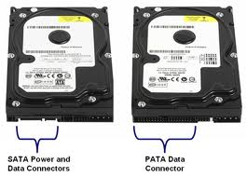
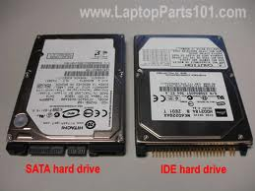
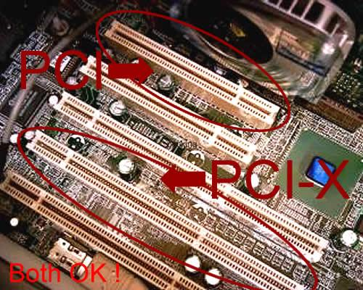
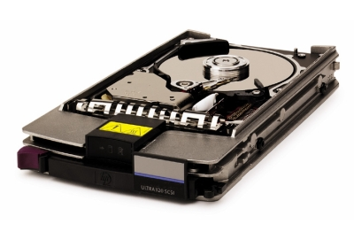
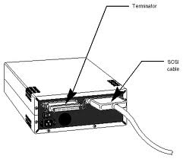
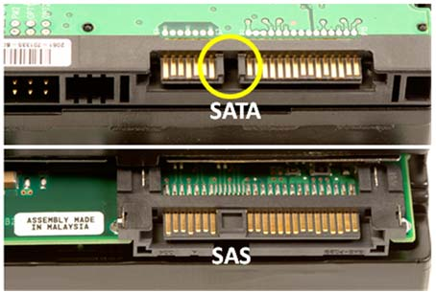
Andmesalvestussüsteemi komponendid I
Notes:
1/27/19
16
16

Slide 17
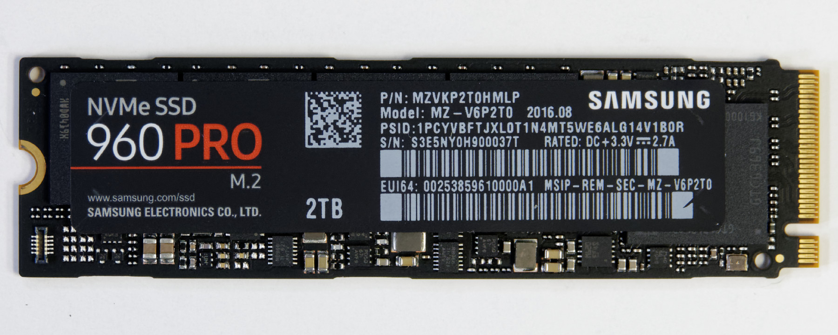
Andmesalvestussüsteemi komponendid I
NVMe (Non-Volatile Memory Express disks)
https://en.wikipedia.org/wiki/NVM_Express
https://www.pcper.com/reviews/Storage/Samsung-960-PRO-2TB-M2-NVMe-SSD-Full-Review-Even-Faster
Notes:
1/27/19
17
17

Slide 18
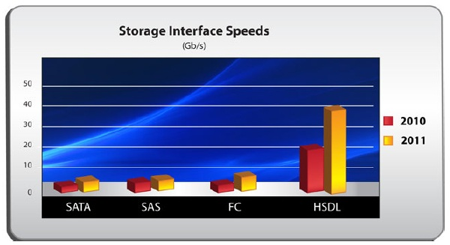
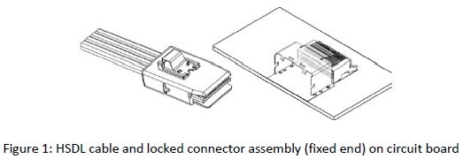
Andmesalvestussüsteemi komponendid I
HSDL puhul kasutatakse LVDS-
tehnoloogiat kaablites andmeedastuseks:
Short for Low Voltage Differential
Signaling, a low noise, low power,
low amplitude method for high-speed
(gigabits per second) data transmission
over copper wire.
http://www.webopedia.com/TERM/L/LVDS.html
https://www.pcper.com/reviews/Storage/OCZ-Ibis-High-Speed-Data-Link-HSDL-240GB-SSD-Review
Notes:
1/27/19
18
18

Slide 19
Andmesalvestussüsteemi komponendid II
Magneetilised meediad
Hard Disk Drive ehk HDD, lindid ehk TAPE
Flopiseade (FDD – Floppy Disk Drive) (iganenud)
Välkmälu meediad (ka pooljuhtkettad)
Universal Serial Bus ehk USB pulk
Solid State Disk ehk SSD
Optilised meediad
Compact Disk ehk CD
Digital Versatile Disk ehk DVD
Blu-Ray ehk BD
Notes:
1/27/19
19
19

Slide 20
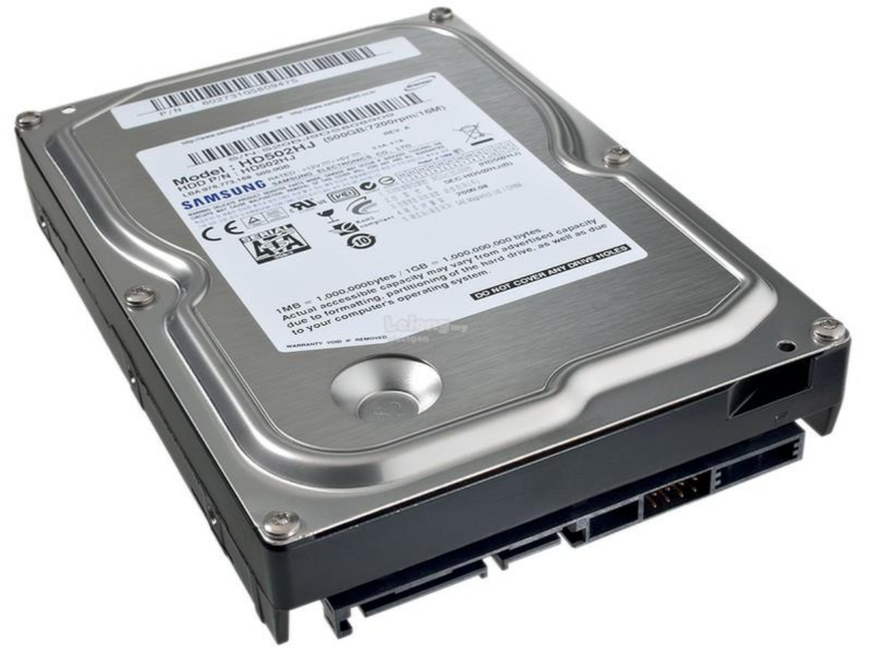

Slide 21
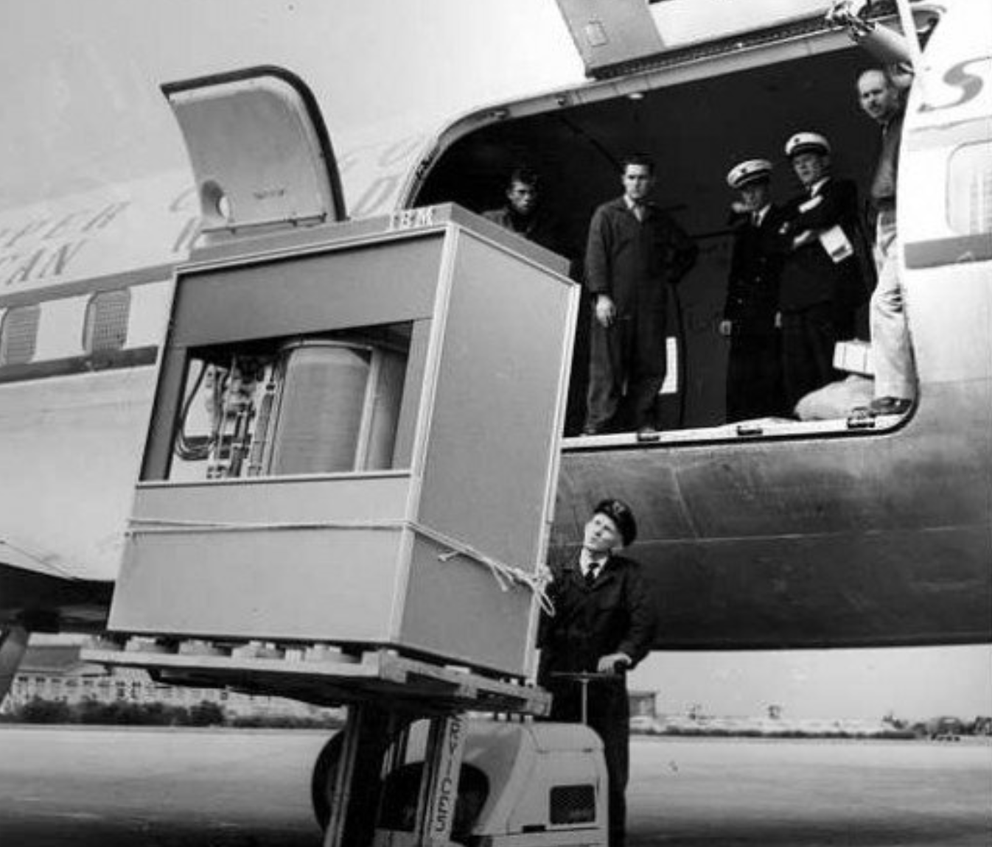
Notes:
The IBM 350 Disk File was developed under the code-name RAMAC by an IBM. It was announced in 1956 with the then new IBM 305 RAMAC computer
The IBM 350 drive had fifty 24-inch (0.6 m) platters, with a total capacity of five million 6-bit characters (3.75 megabytes) with an average access time of just under 1 second.
The HDD weighed over a ton and stored 5 MB of data.’

Slide 22
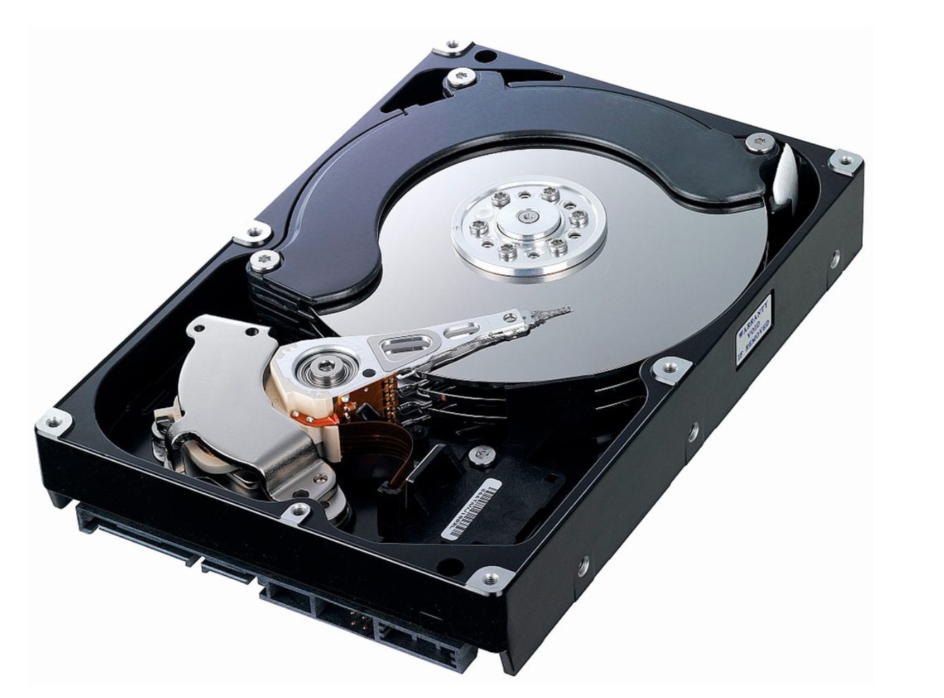
Notes:
1. Actuator that moves the read-write arm. In older hard drives, the actuators were stepper motors. In most modern hard drives, voice coils are used instead. As their name suggests, these are simple electromagnets, working rather like the moving coils that make sounds in loudspeakers. They position the read-write arm more quickly, precisely, and reliably than stepper motors and are less sensitive to problems such as temperature variations.
2. Read-write arm swings read-write head back and forth across platter.
3. Central spindle allows platter to rotate at high speed.
4. Magnetic platter stores information in binary form.
5. Plug connections link hard drive to circuit board in personal computer.
6. Read-write head is a tiny magnet on the end of the read-write arm.
7. Circuit board on underside controls the flow of data to and from the platter.
8. Flexible connector carries data from circuit board to read-write head and platter.
9. Small spindle allows read-write arm to swing across platter.

Slide 23
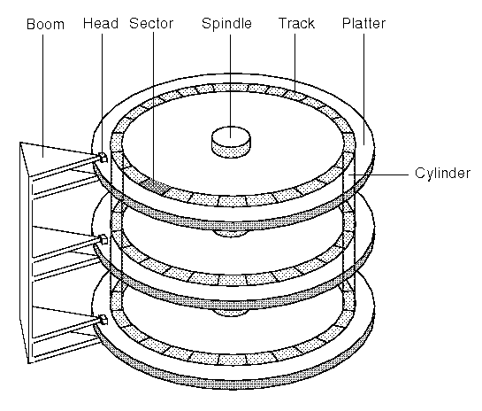
Magnetilise kõvaketta struktuur (HDD)
Rada
Silinder
Sektor
Pea
LBA logical block address
Notes:
1/27/19
23
23
A hard drive stores data on a series of spinning magnetic disks called platters. There’s an actuator arm with read/write heads attached to it. This arm positions the read-write heads over the correct area of the drive to read or write information.

Slide 25
Notes:
All information stored on a traditional hard drive, like the above example, is done magnetically. If the computer needs to read information from the hard drive, it would read the magnetic polarities on the platter. One side of the magnetic polarity is 0, and the other is 1. Reading this as binary data, the computer can understand what the data is on the platter. For the computer to write information to the platter, the read/write head aligns the magnetic polarities, writing 0's and 1's that can be read later.
A write head magnetises a region by generating a strong local magnetic field, and a read head detects the magnetisation of the regions

Slide 26
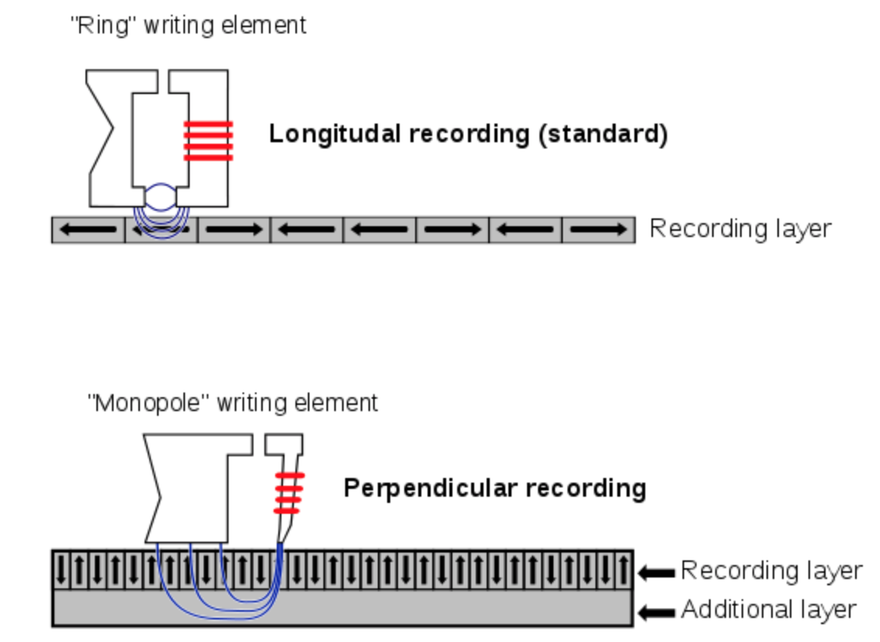

Slide 27
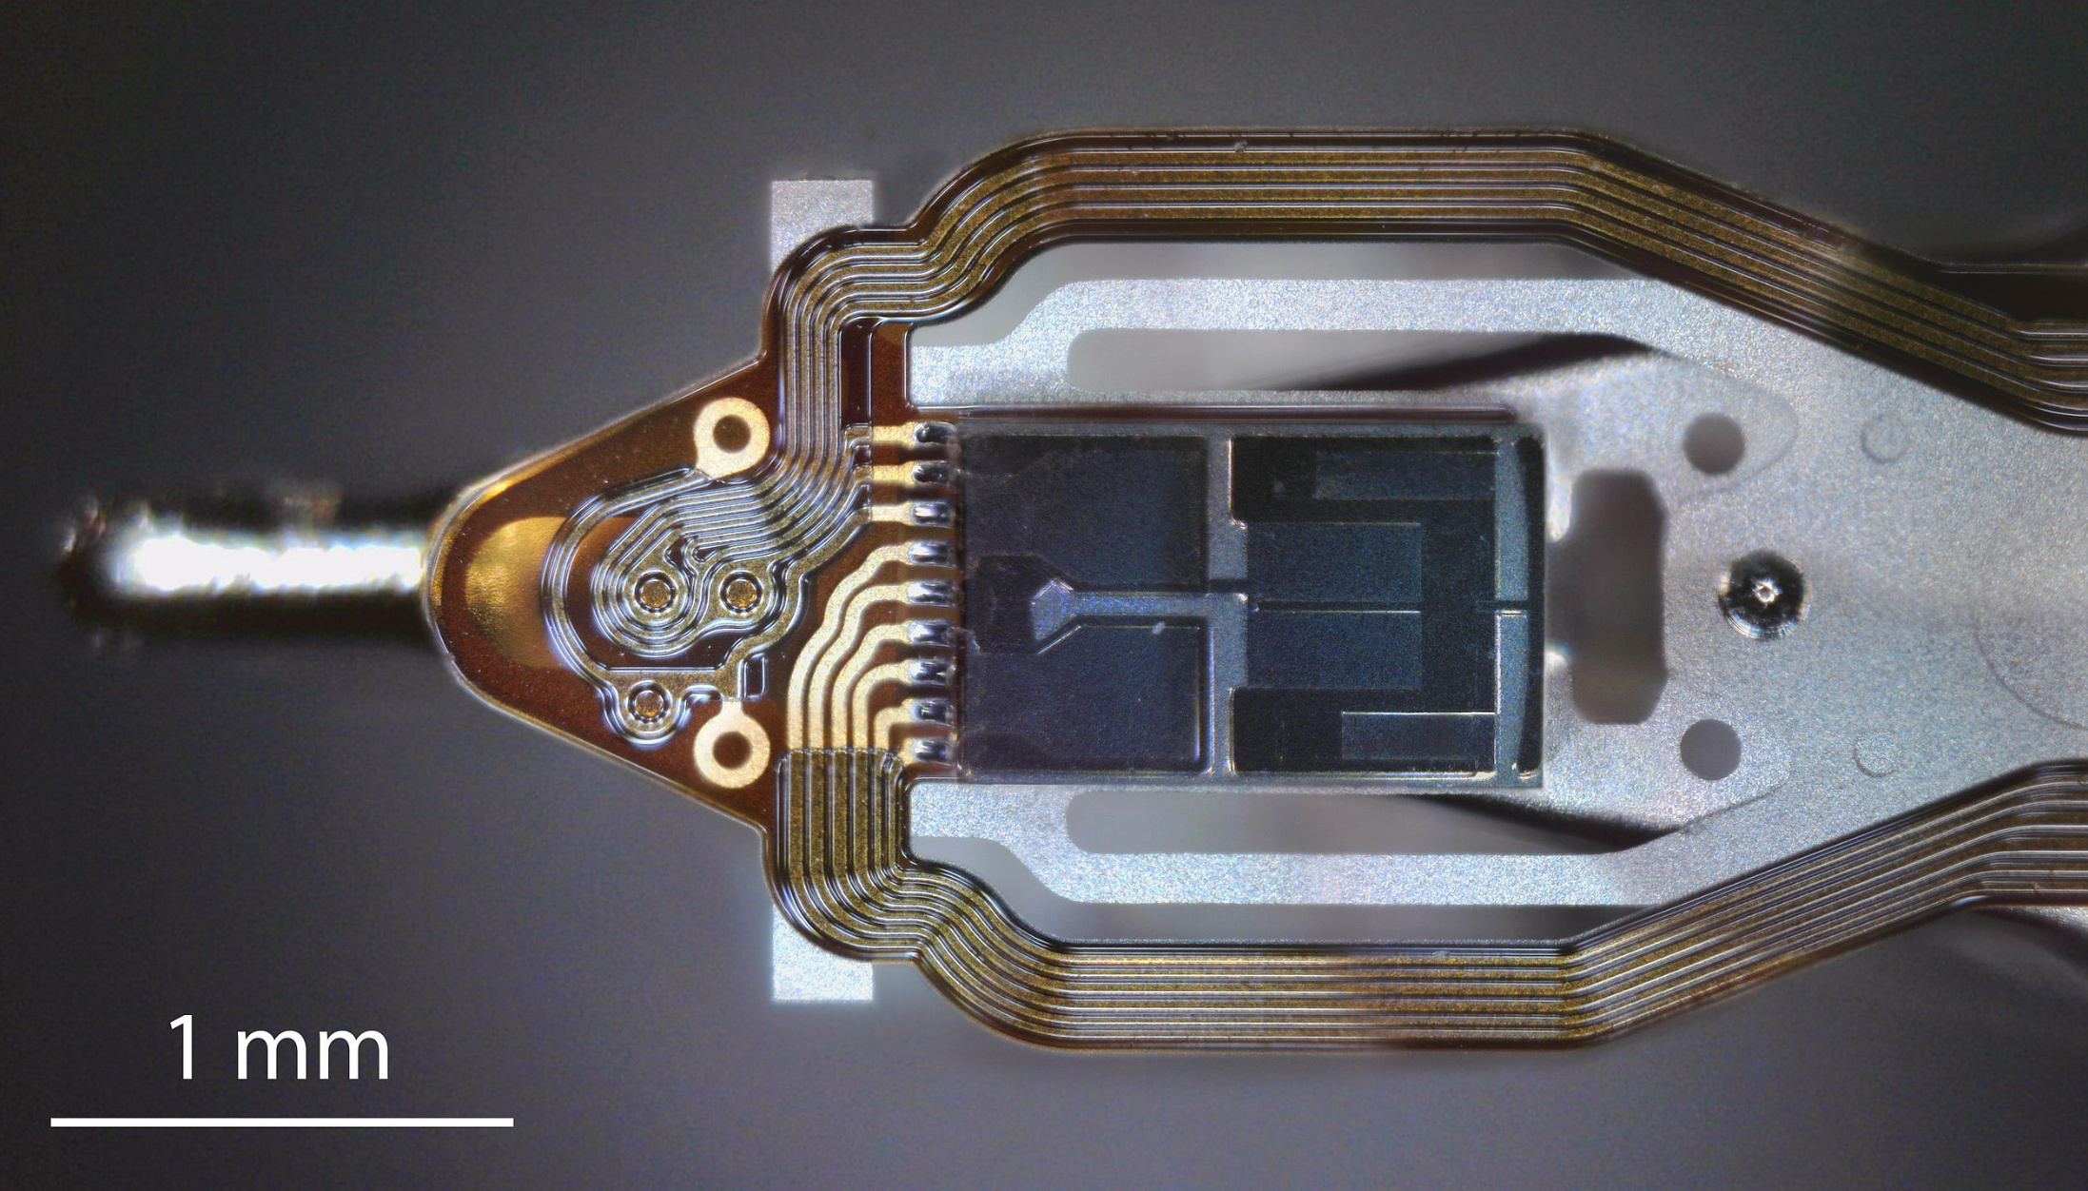
Notes:
The dark rectangular component is the slider and is 1.25mm long. The read/write head coils are to the left of the slider. Platter surface moves past the head from right to left.
The flying height of the head is controlled by the design of an air-bearing etched onto the disk-facing surface of the slider. The role of the air bearing is to maintain the flying height constant as the head moves over the surface of the disk. An air bearing (or air caster) utilizes a thin film of pressurized air to provide an exceedingly low friction load-bearing interface between surfaces.

Slide 28
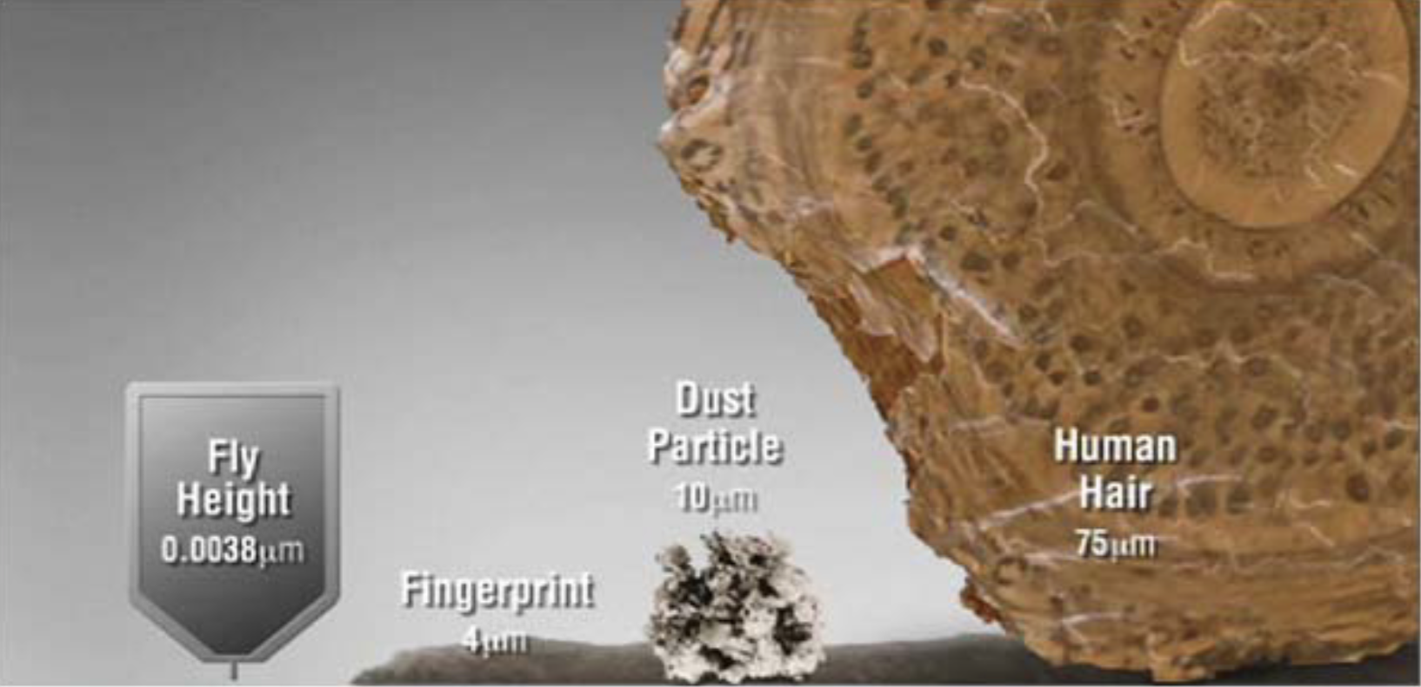
https://www.seagate.com/gb/en/tech-insights/advanced-format-4k-sector-hard-drives-master-ti/

Slide 29
Notes:
If you were to scale this up, imagine a fighter jet traveling in excess of Mach 5 (nearly 4,000MPH) at less than 1-inch off the ground, and being able to stop on any given blade of grass. That is how precise hard drives are.

Slide 30
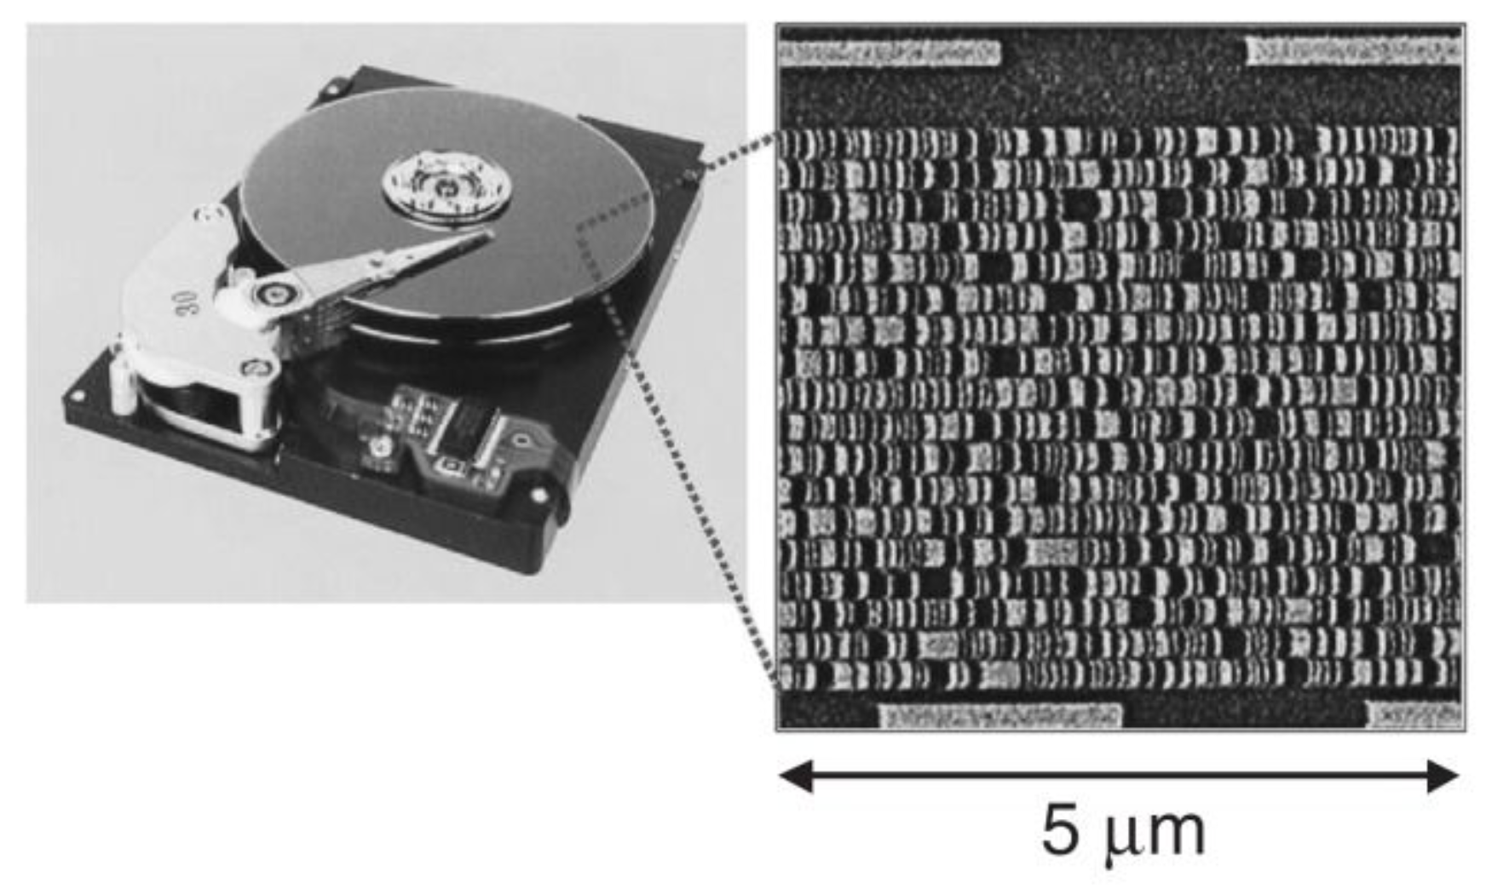
Notes:
The magnetic surface is conceptually divided into many small sub-micrometer-sized magnetic regions, referred to as magnetic domains, (although these are not magnetic domains in a rigorous physical sense), each of which has a mostly uniform magnetisation. Due to the polycrystalline nature of the magnetic material each of these magnetic regions is composed of a few hundred magnetic grains. Magnetic grains are typically 10 nm in size and each form a single true magnetic domain.

Slide 31
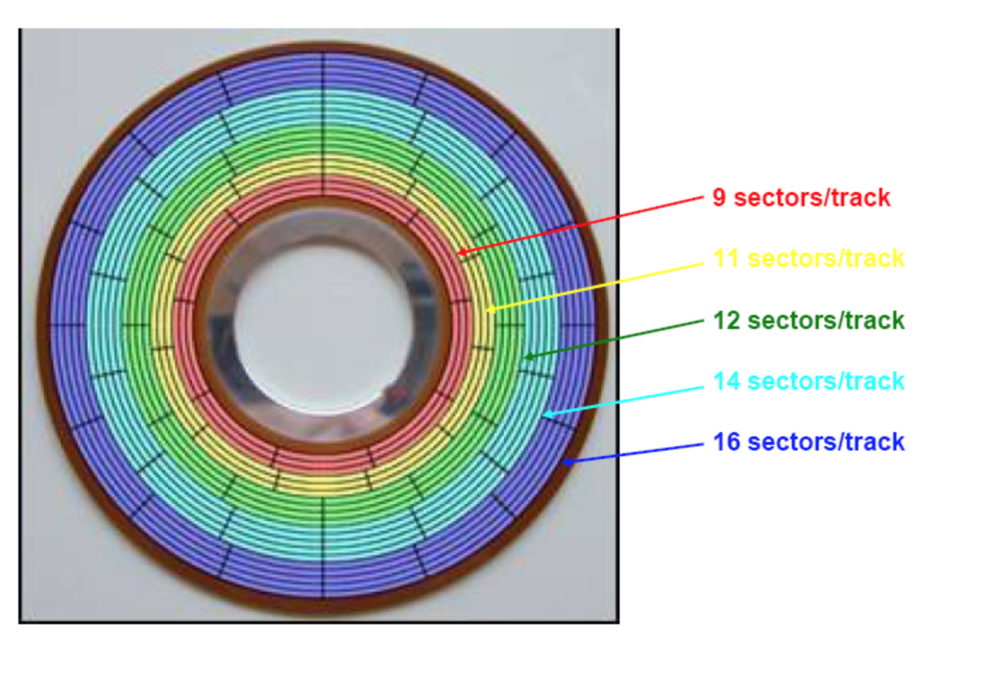

Slide 32
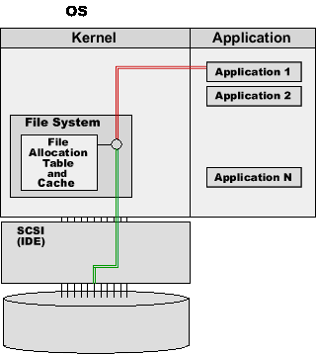
Notes:
Data sent to and read from the hard drive is interpreted by the disk controller, which tells the hard drive what to do and how to move the components in the drive. When the operating system needs to read or write information, it examines the hard drive's File Allocation Table (FAT) to determine file location and available write areas. Once they have been determined, the disk controller instructs the actuator to move the read/write arm and align the read/write head. Because files are often scattered throughout the platter, the head needs to move to different locations to access all information.

Slide 33
Notes:
Data sent to and read from the hard drive is interpreted by the disk controller, which tells the hard drive what to do and how to move the components in the drive. When the operating system needs to read or write information, it examines the hard drive's File Allocation Table (FAT) to determine file location and available write areas. Once they have been determined, the disk controller instructs the actuator to move the read/write arm and align the read/write head. Because files are often scattered throughout the platter, the head needs to move to different locations to access all information.

Slide 34
Kõvaketta näitajad I
Maht
1 GB/GigaByte (10^9) ja 1 GiB/GibiByte(2^30)
Kõvaketta tootjad kasutavad GB = 1000 MB
Silindrite, peade arv ning sektorite suurus
Kiirus
Pöörlemiskiirus
Revolutions per minute (rpm)
5400, 7200, 10000, 15000 jne
Notes:
1/27/19
34
34
Because the drive heads must align over an area of the disk in order to read or write data (and the disk is constantly spinning), there’s a non-zero wait time before data can be accessed. The drive may need to read from multiple locations in order to launch a program or load a file, which means it may have to wait for the platters to spin into the proper position multiple times before it can complete the command. If a drive is asleep or in a low-power state, it can take several seconds more for the disk to spin up to full power and begin operating.

Slide 35
Kõvaketta näitajad II
Jõudlus
Lugemise/kirjutamise kiirus
Juhusliku bloki lugemine (oluline otsimisaeg)
Järjestikune lugemine (oluline rpm kiirus)
Otsimisaeg – kindla bloki leidmiseks kulunud aeg
Ligipääsuaeg – kindla bloki juurde jõudmiseks kulunud aeg
Kosteaeg – „raisatud aeg“ :)
Töökindlus
MTBF on mean time between failures
HDD 1,5 miljonit tundi
Notes:
1/27/19
35
35

Slide 36
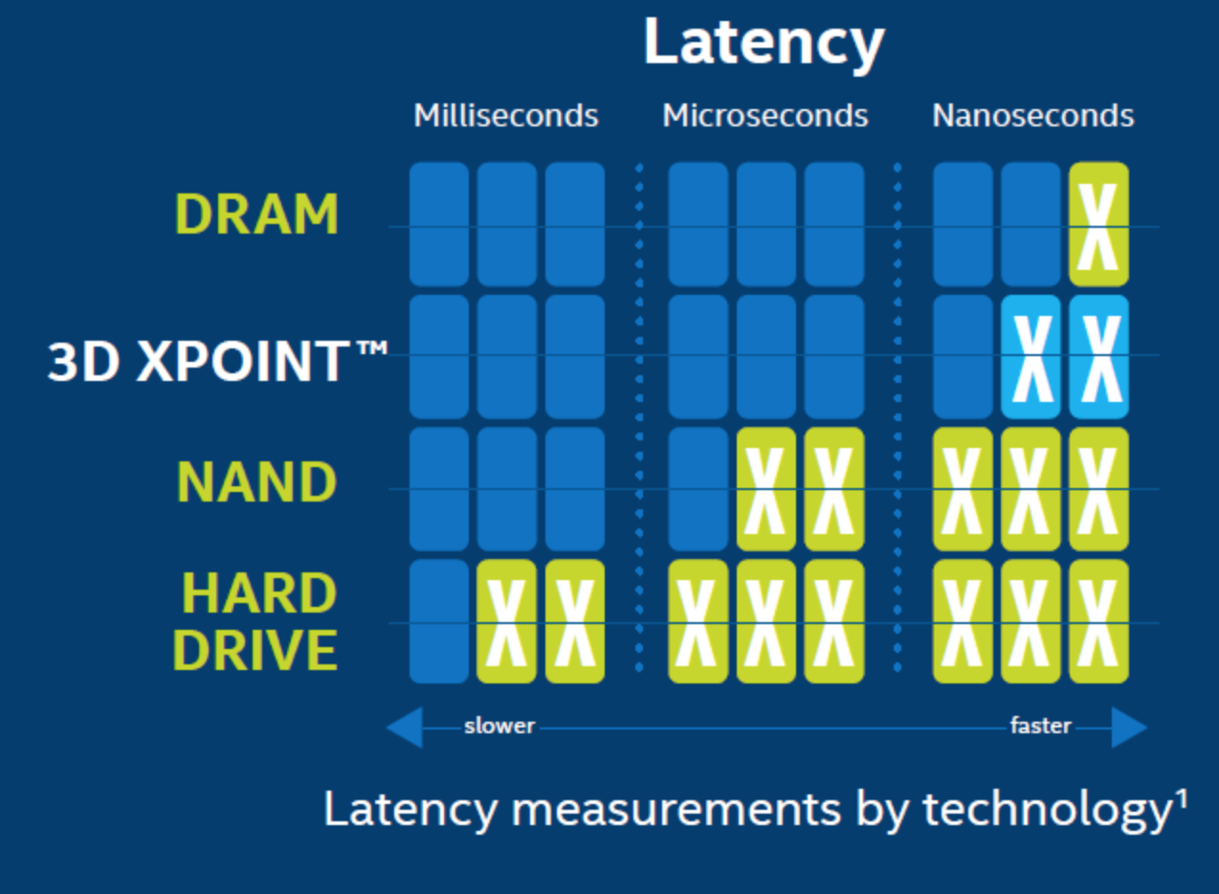
Notes:
Latency in HDDs is measured in milliseconds, compared with nanoseconds for your typical CPU. One millisecond is 1,000,000 nanoseconds, and it typically takes a hard drive 10-15 milliseconds to find data on the drive and begin reading it.

Slide 37
Välkmäluketas (SSD – Solid State Drive)
Plussid
Puuduvad liikuvad osad
Andmevahetuskiirus ~200...550MB (vs HDD max 200MB)
Väiksem voolutarve (2...3 W, ~30+ minutit akusäästu), olematu müratase ja vibratsioon
Põrutuskindel
Üldjuhul kõrgem eluiga
Miinused
Kõrgem hind 1GB=0,2$ vs HDD 1GB=$0,075
Tavakäibes keskmine suurus 1TB vs HDD 4...8TB
Vajab regulaarset kettapuhastust (TRIM) jõudluse säilitamiseks (Linuxis fstrim CRON kaudu – tõsta /etc/cron.weekly/ alt /etc/cron.hourly/ alla)
Ketas lõpetab töö hoiatamata (enamasti)
Notes:
1/27/19
37
37
Solid-state drives are called that specifically because they don’t rely on moving parts or spinning disks. Instead, data is saved to a pool of NAND flash. NAND itself is made up of what are called floating gate transistors. Unlike the transistor designs used in DRAM, which must be refreshed multiple times per second, NAND flash is designed to retain its charge state even when not powered up. This makes NAND a type of non-volatile memory.

Slide 38
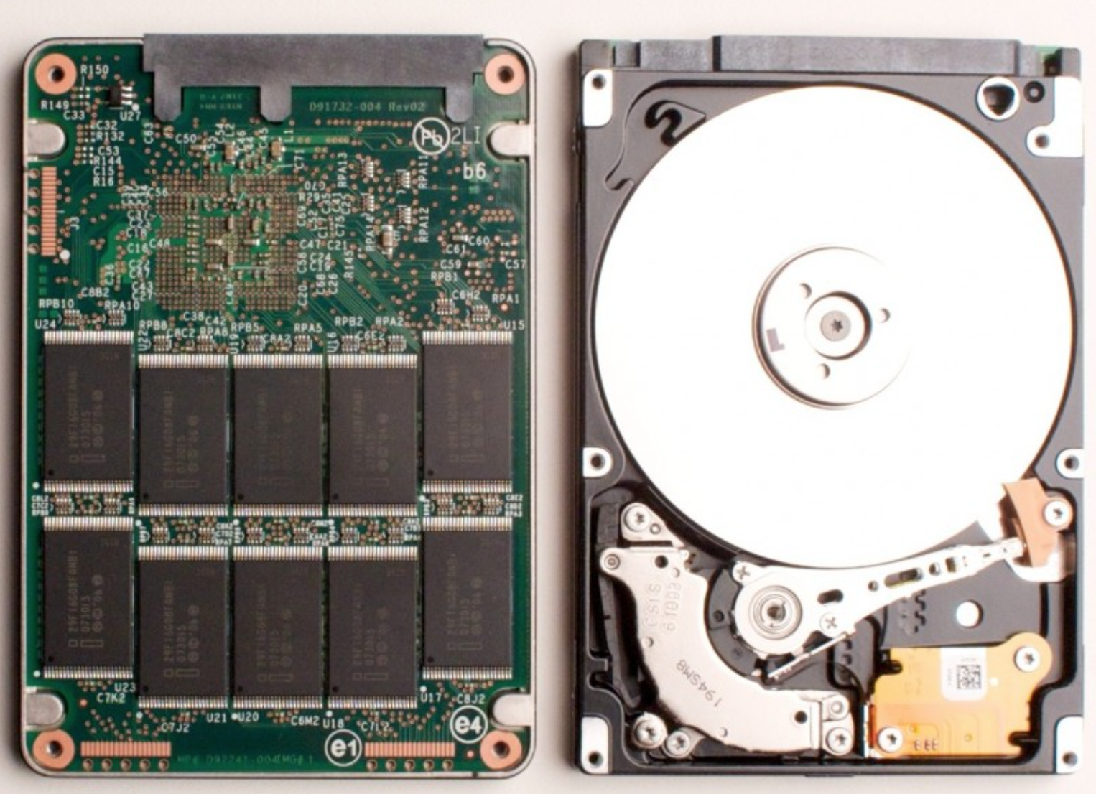

Slide 39
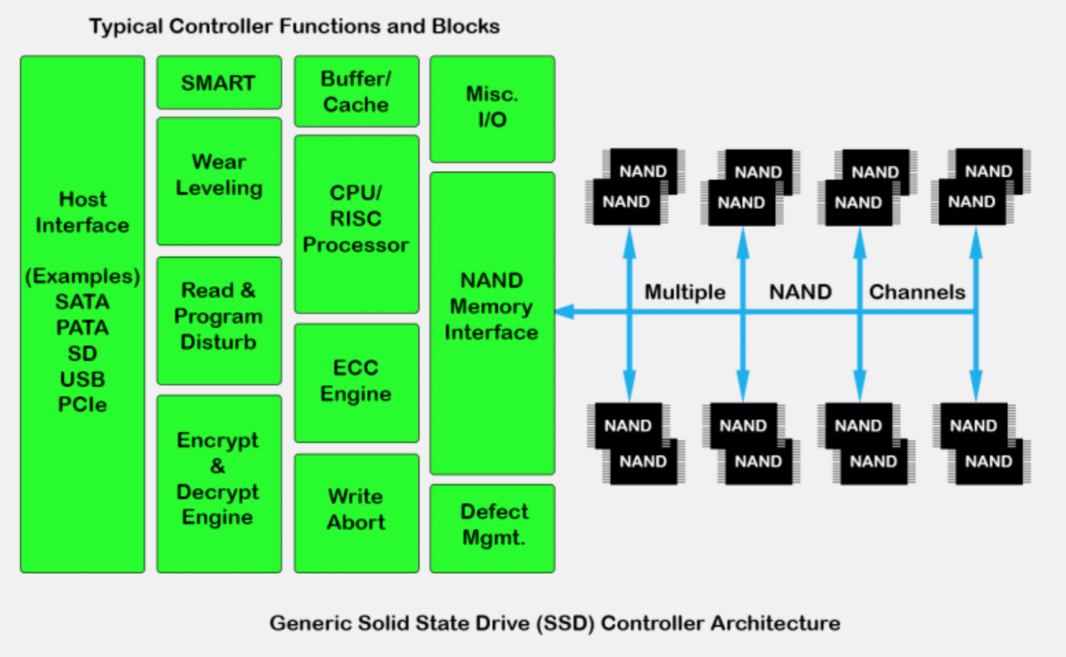

Slide 40
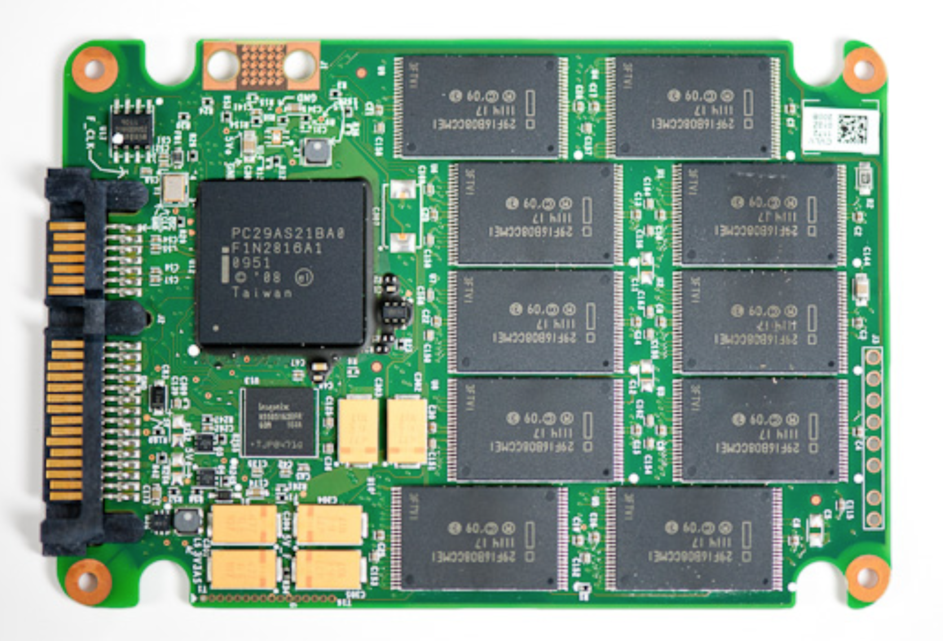
KONTROLLER
PUHVER
Notes:
NAND Flash chips are the black, rectangular blocks attached to the Printed Circuit Board (PCB) of your SSD (or any Flash-based product). Not to be confused with the DRAM Cache or Controller, NAND Flash chips are usually consolidated to one area of the PCB as shown below

Slide 41
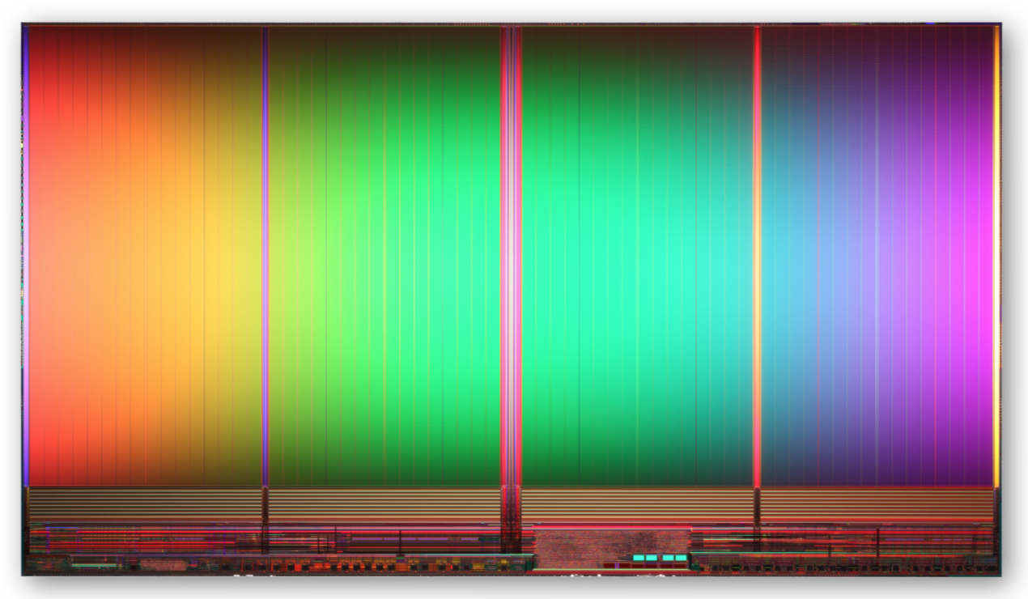
Notes:
The package is the memory chip, i.e. the black rectangle with little electrical connectors sticking out of it. If you look at an SSD, a flash card or the internals of a flash array you will see many flash packages

Slide 42
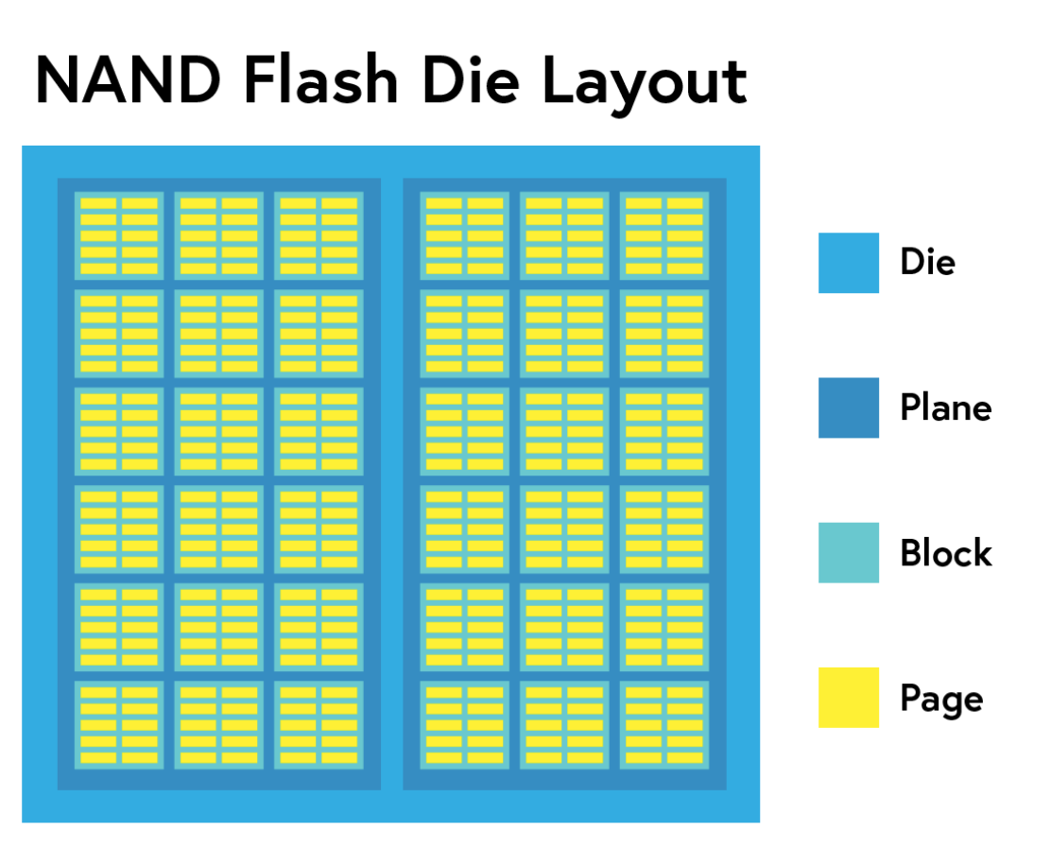
Notes:
Die: Semiconductor wafers are cut from a block of electronic-grade silicon. The piece of wafer cut from the block is referred to as a die.
Each package contains one or more dies (for example one, two, or four). The die is the smallest unit that can independently execute commands or report status.
Plane: One die contains one to two planes. Planes can (generally) execute identical operations together.
Block: Planes contain varying numbers of blocks. NAND Flash cells can only be erased at the block level.
Page: Blocks usually contain around 128 pages. Pages are the smallest units that can be programmed (or written to).

Slide 43
Notes:
Each die contains one or more planes (usually one or two). Identical, concurrent operations can take place on each plane, although with some restrictions.

Slide 44
Notes:
Block: Planes contain varying numbers of blocks. NAND Flash cells can only be erased at the block level.
NAND flash is organized in a grid. The entire grid layout is referred to as a block, while the individual rows that make up the grid are called a page. Common page sizes are 2K, 4K, 8K, or 16K, with 128 to 256 pages per block. Block size therefore typically varies between 256KB and 4MB

Slide 45
Notes:
Page: Blocks usually contain around 128 pages. Pages are the smallest units that can be programmed (or written to).

Slide 46
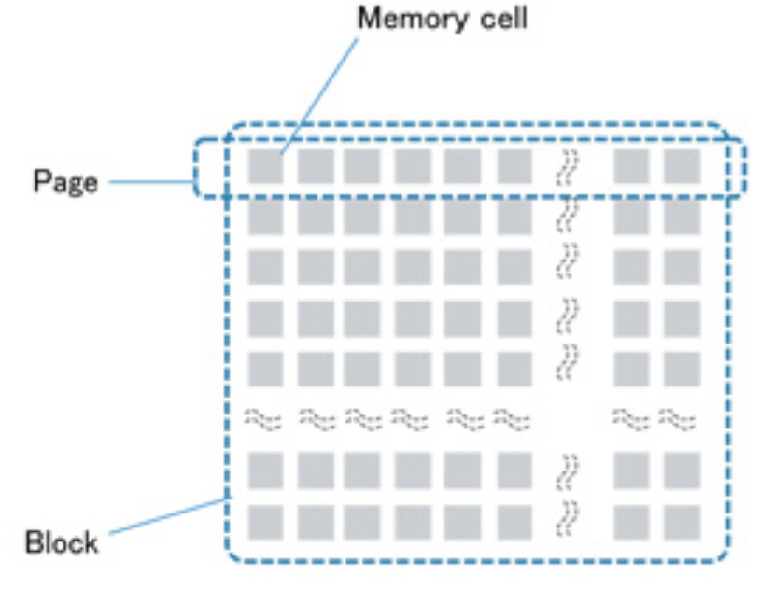
Notes:
Each page contains anywhere from 512 – 4,096 bytes (1 byte = 8 bits). Some cells hold just one bit, while others contain up to three depending on the SSD.

Slide 47
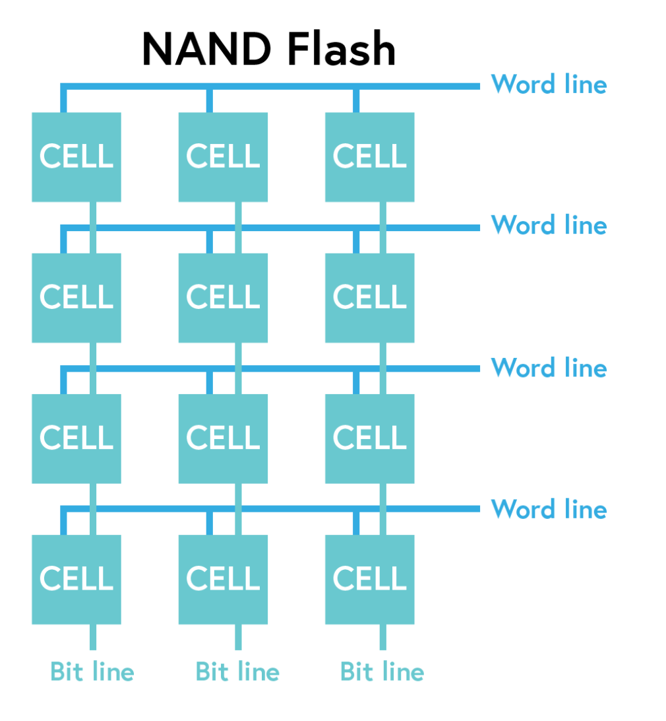
Notes:
Flash memory relies on electric circuits to store and retrieve data. Well, the intersecting word lines and bit lines are a part of that network of circuits. Word lines assess the cell’s electrical charge, and bit lines regulate the flow of electrical current from cell to cell.

Slide 48
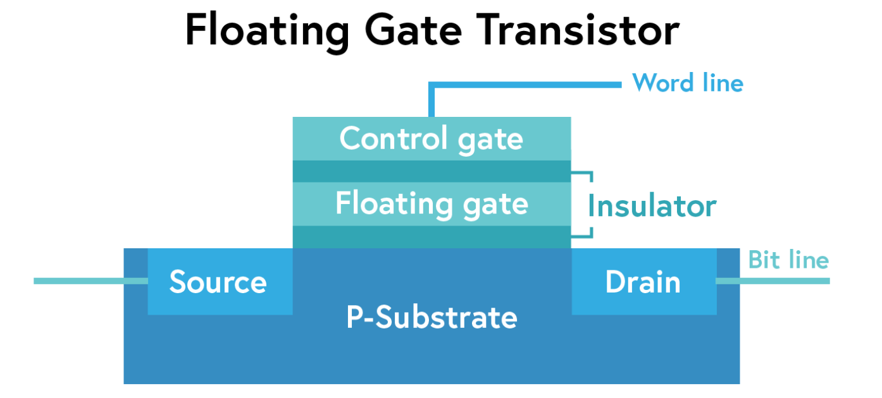
Notes:
Each NAND Flash memory cell contains a Floating Gate Transistor, which is where the Program/Erase cycle of a NAND Flash cell takes place.
The floating gate transistor consists of five main elements:
Control Gate
Floating Gate (hoiab informatsiooni)
Insulator, or “Oxide Layer“
P-Substrate (Poly-Silicon) (teatud tingimustel laseb elektronidel liikuda)
Source and Drain
The diagram above shows a simple flash cell design. Electrons are stored in the floating gate, which then reads as charged “0” or not-charged “1.” Yes, in NAND flash, a 0 means data is stored in a cell — it’s the opposite of how we typically think of a zero or one
NAND is programmed and read by seeing how each cell responds to various voltages.

Slide 49
Notes:
In a standard NAND configuration, word lines plug into the transistor’s control gate ( horizontally across rows) and bit lines link each cell’s source and drain (vertically along columns). The source is where electrical current enters the cell, and the drain is where it exits.

Slide 50
Notes:
The control gate opens and closes from voltage applied by the word lines. More specifically, the word line checks to see if the cell holds a charge (a “0”) or not (a “1”), also known as the cell’s bit state.
A cell registering as a “1” (no charge) indicates there are no electrons present in the Floating Gate (FG); if the cell’s bit state reads as a “0” (holding a charge), there are electrons in the FG.
ally think of a zero or one
NAND is programmed and read by seeing how each cell responds to various voltages.

Slide 51
Notes:
By applying a positive charge to the bit line and word line, electrons stored in the source get excited and plow through the P-Substrate field to the drain.
When this happens, some electrons squeeze through the “insulated” layer into the floating gate, a process called tunnel injection. Forcing electrons into a floating gate is how your drive writes data to a cell.
Writing — or programming — happens at the byte level, and sets individual bits from “1” to “0”.
Erasing data happens at the block level. A similar process called tunnel release forces electrons out of the floating gate, in turn changing the bit state to “1”.

Slide 52
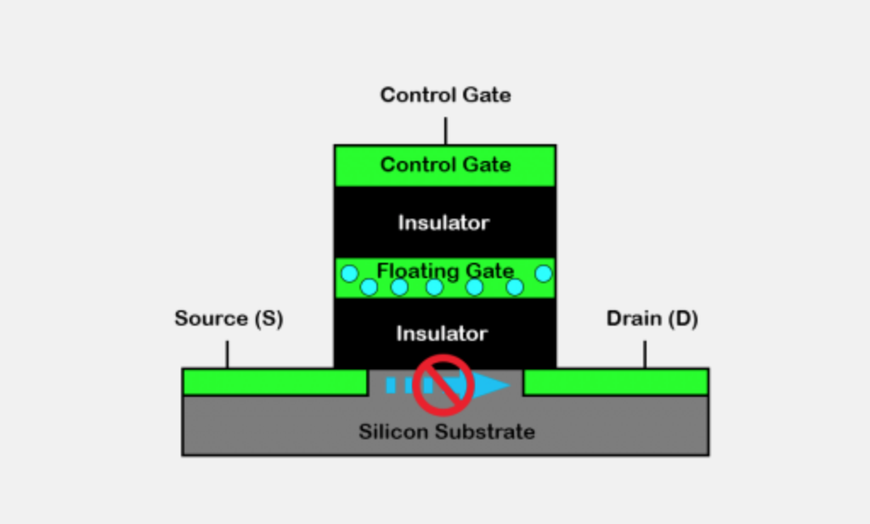
Notes:
To read a cell, voltage is applied to the control gate and current flow from the source to drain is attempted.
If there is no current flow, it signifies the floating gate is charged (binary 0) - as in the diagram above. If there is current flow, the floating gate is not charged (binary 1) - as in the diagram below.

Slide 53
Notes:
You write to NAND through a quantum tunneling process. Apply a high enough voltage across a floating-gate transistor and some electrons will actually tunnel through an insulating oxide layer and remain on the floating gate, even when the voltage is removed. Repeated tunneling can weaken the bonds of the oxide, eventually allowing electrons to freely leave the floating gate. It's this weakening that's responsible for a lot of NAND endurance issues, although there are other elements at play.

Slide 54
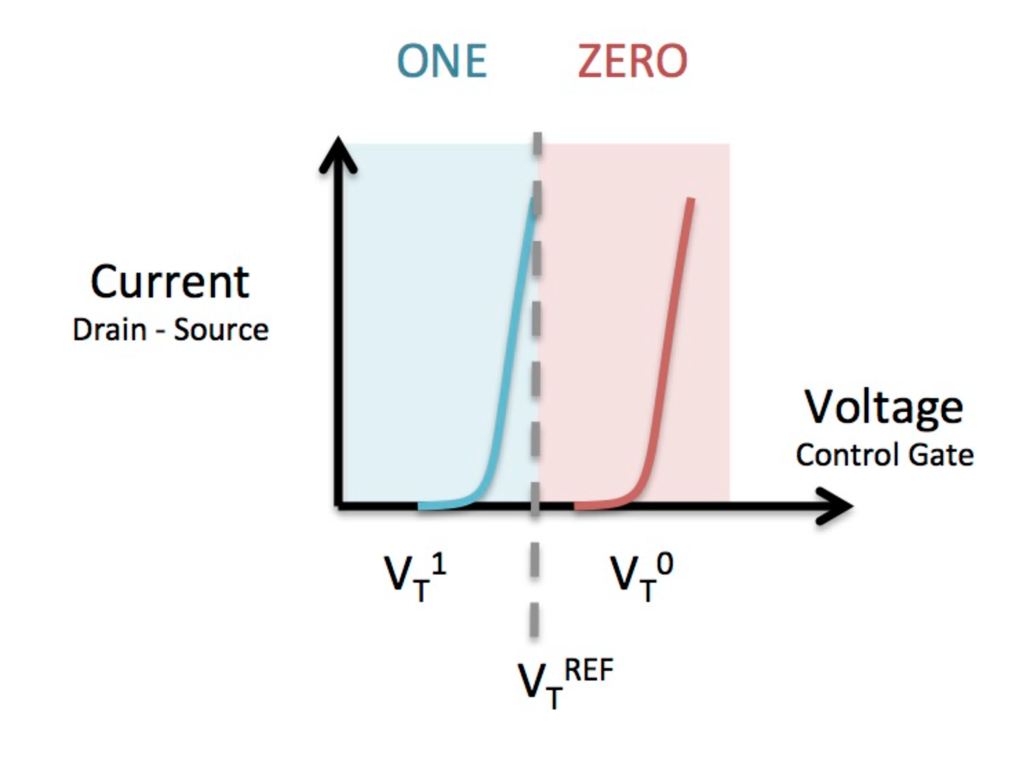
Notes:
FGMOS Read Thresholds: The voltage threshold at which current begins to flow from drain to source is different depending on the charge stored on the floating gate. By testing at an intermediate reference voltage (VtREF) called the “read point” we can determine whether the floating gate contains charge (which we call ZERO) or not (which we call ONE)

Slide 55
Notes:
Both types of NAND are identical architecturally, it's just a question of how many voltages you map to bits on the cell. MLC (2-bit-per-cell ) has four different voltage levels that correspond to values while SLC only has two. Note that each value can correspond to a distribution of voltages. As long as the threshold voltage falls within that range, the corresponding value is programmed or read.

Slide 56
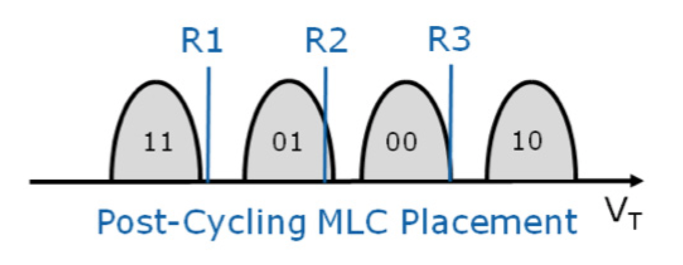
Notes:
As MLC NAND gets close to the end of its life, these margins start narrowing considerably. Continuously programming and erasing NAND cells weakens the oxide, eventually allowing electrons to become stuck in the oxide itself. This phenomenon alters the threshold voltage of the transistor, which in turn shifts bit placements:
There's now ambiguity between bits which, if this cell were allowed to remain active in an SSD, would mean that when you go to read a file on your drive there's a chance that you won't actually get the data you're requesting. A good SSD should mark these bits bad at this point.

Slide 57
Notes:
There's a JEDEC spec that defines what should happen to the NAND once its cells get to this point. For consumer applications, the NAND should remain in a read-only state that can guarantee data availability for 12 months at 30C with the drive powered off. Manufacturers must take this into account when they test and qualify their NAND. If you're curious, JEDEC also offers guidelines on how to cycle test the NAND to verify that it's compliant.

Slide 58
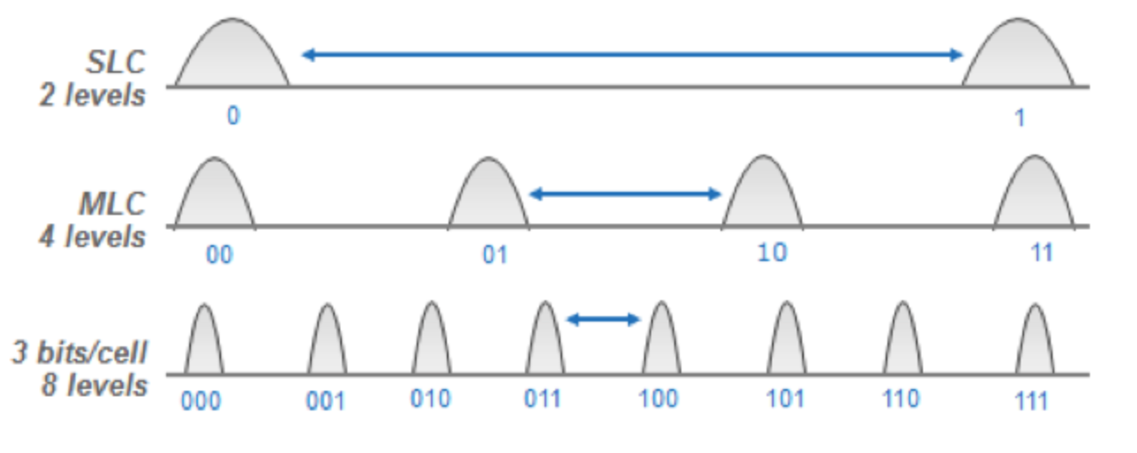
Notes:
The reason TLC NAND is slower than MLC or SLC has to do with how data moves in and out of the NAND cell. With SLC NAND, the controller only needs to know if the bit is a 0 or a 1. With MLC NAND, the cell may have four values — 00, 01, 10, or 11. With TLC NAND, the cell can have eight values. Reading the proper value out of the cell requires the memory controller to use a precise voltage to ascertain whether any particular cell is charged.

Slide 59
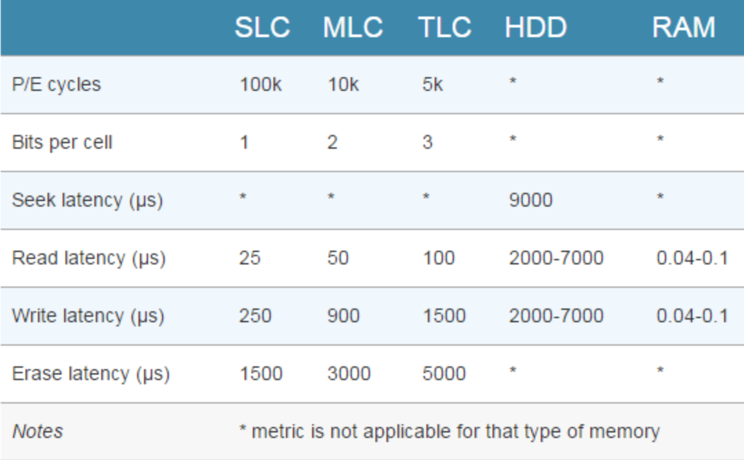
Notes:
One advantage of this system should be immediately obvious. Because SSDs have no moving parts, they can operate at speeds far above those of a typical HDD. The following chart shows the access latency for typical storage mediums given in microseconds.
There are two things to notice in the above chart. First, note how adding more bits per cell of NAND has a significant impact on the memory’s performance. It’s worse for writes as opposed to reads — typical triple-level-cell (TLC) latency is 4x worse compared with single-level cell (SLC) NAND for reads, but 6x worse for writes. Erase latencies are also significantly impacted. The impact isn’t proportional, either — TLC NAND is nearly twice as slow as MLC NAND, despite holding just 50% more data (three bits per cell, instead of two).

Slide 60
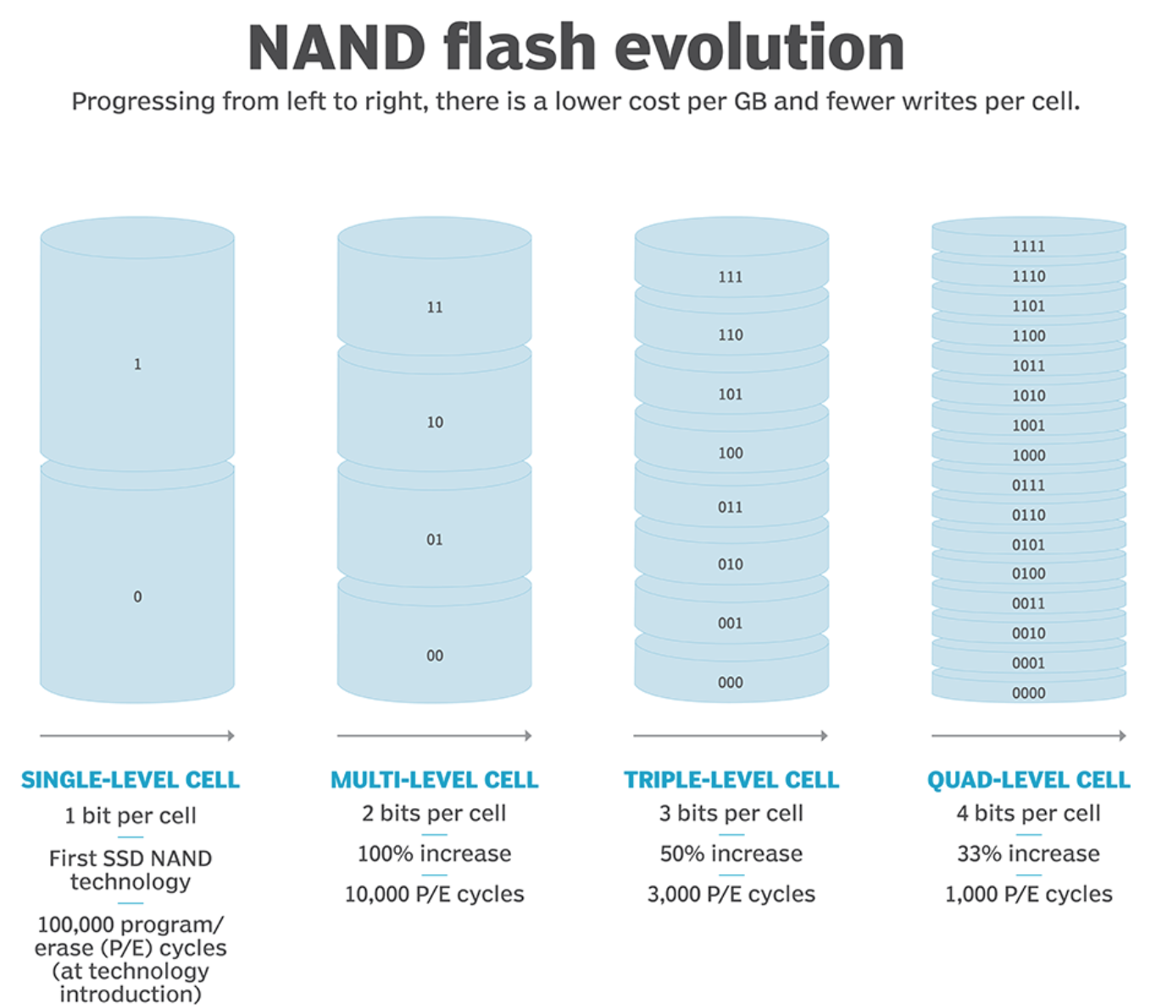
Notes:
A NAND flash SSD is able to endure only a limited number of write cycles. The program/erase process causes a deterioration of the oxide layer that traps electrons in a NAND flash memory cell, and the SSD will eventually become unreliable, wear out and lose its ability to store data.

Slide 61
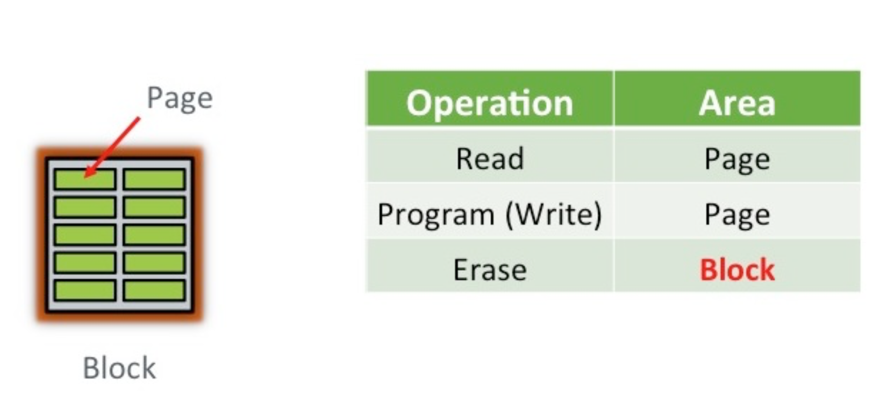
Notes:
Where it gets interesting is if you want to update the data you just wrote. There is no update operation for flash, no undo or rewind mechanism for changing what is currently in place, just the erase operation
An erase operation on a flash chip clears the data from all pages in the block, so if some of the other pages contain active data (stuff you want to keep) you either have to copy it elsewhere first or hold off from doing the erase.
The important bit here is that program operations (i.e. writes) take place to a page, which might typically be 8-16KB in size, while erase operations take place to a block, which might be 4-8MB in size. Since a block needs to be erased before it can be programmed again (*sort of, I’m generalising to make this easier), all of the pages in a block need to be candidates for erasure before this can happen.

Slide 62
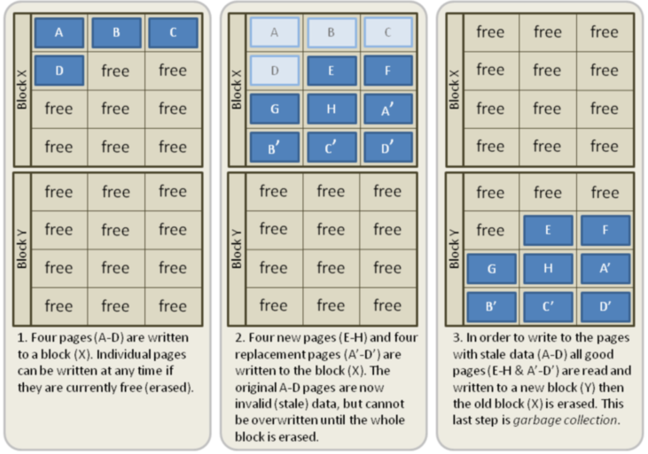
Notes:
Note in this example, the drive has taken advantage of the fact that it can write very quickly to empty pages by writing new values for the first four blocks (A’-D’). It’s also written two new blocks, E and H. Blocks A-D are now marked as stale, meaning they contain information the drive has marked as out-of-date. During an idle period, the SSD will move the fresh pages over to a new block, erase the old block, and mark it as free space. This means the next time the SSD needs to perform a write, it can write directly to the now-empty Block X, rather than performing the program/erase cycle.

Slide 63
Mida teha/kuidas kaitsta
Puhverdamine
Rohkem NAND-blokke kui reklaamitud
Jaotada kulumine ühtlaselt
TRIM
Notes:
There is a slight disconnect between operating systems and storage devices. An operating system "deletes" an HDD file by noting its clusters as free in a table. The OS doesn't need to tell the HDD anything about the deletion -- the HDD will overwrite the freed clusters on the disk as needed.
Flash memory and SSDs don't work the same way. Flash only realizes that a page is old when a new write is attempted. Only then will the old data be marked for discard and the new data will be written to that location. In other words, if you erase a file in flash memory, the OS may think that space is free, but the SSD will continue to hold and move the pages of that old file until a new file tries to use that space. Until then, SSDs incur more erase cycles and slower writes because they are still carrying that old data.
The TRIM function allows an operating system to tell the flash controller that certain data pages are outdated or invalid, and the garbage collection process can skip the old data instead of retaining it. TRIM allows the SSD to recognize freed space much sooner, recover that freed space earlier, collect garbage more effectively, and run more efficiently.

Slide 64
Viited
Valguskaabel (FOC -) https://en.wikipedia.org/wiki/Optical_fiber_cable
Võrgutaristu - https://en.wikipedia.org/wiki/Structured_cabling
Suurimad kõvakettad - http://www.digitaltrends.com/computing/highest-capacity-hard-drives/
Informaatikas kasutatavad binaareesliited - https://en.wikipedia.org/wiki/Binary_prefix
Atomic scale data storage (sh video) - http://www.ibtimes.com/seagate-announces-60tb-ssd-worlds-largest-capacity-solid-state-drive-2400084
Seagate Enterprise kettad - http://www.seagate.com/gb/en/enterprise-storage/hard-disk-drives/enterprise-capacity-3-5-hdd/
Revodrive - https://ocz.com/us/ssd/
Tulevikusalvestus teemantitel - http://tehnika.postimees.ee/v2/3888767/kuidas-salvestada-oma-andmed-igaveseks-andmesalvestuse-tulevik-peitub-teemantides
http://www.nytimes.com/2016/10/27/science/diamonds-data-storage.html
http://advances.sciencemag.org/content/2/10/e1600911
Notes:
1/27/19
64
64

Slide 65
Viited 2
SCSI, ATA, SAS, SATA erinevused http://www.webopedia.com/DidYouKnow/Computer_Science/sas_sata.asp
PCIe https://et.wikipedia.org/wiki/PCI_Express
Erinevad mälukaardid http://www.webopedia.com/DidYouKnow/Computer_Science/Memory_card_types.asp
Kõvaketas
https://et.wikipedia.org/wiki/Kõvaketas
https://et.wikipedia.org/wiki/Kirjutamis-_ja_lugemispea
Pooljuhtketas https://et.wikipedia.org/wiki/Pooljuhtketas
Ülevaated
http://www.storagereview.com
https://www.pcper.com/subject/storage
Notes:
1/27/19
65
65

Slide 66
Viited 3
Optilised andmekandjad
https://et.wikipedia.org/wiki/Kategooria:Optilised_andmekandjad
CD https://et.wikipedia.org/wiki/CD_(andmekandja)
DVD https://et.wikipedia.org/wiki/DVD
BD https://et.wikipedia.org/wiki/Blu-ray_Disc
Arvuti mälu https://et.wikipedia.org/wiki/Kategooria:Arvuti_mälu
SSD vs HDD võrdlus (aegub kiirelt) http://www.storagereview.com/ssd_vs_hdd
Ketta jagamine https://en.wikipedia.org/wiki/Disk_partitioning
/etc/fstab https://en.wikipedia.org/wiki/Fstab
Failisüsteem https://en.wikipedia.org/wiki/File_system
UUID https://en.wikipedia.org/wiki/Universally_unique_identifier
Notes:
1/27/19
66
66

Slide 67
Küsimused? Tänan tähelepanu eest!
TTÜ IT KOLLEDŽ
Raja 4C, 12616 Tallinn
tel +372 628 5800
info@itcollege.ee
http://www.itcollege.ee/
67 /
Notes:
1/27/19
67
67

